Slide 1
Adaptive Learn
241FA04639
241FA04316
241FA04657
241FA04F71

Slide 2
Introduction:
Traditional learning systems lack personalization
Difficult to identify weak and strong topics
No structured guidance based on performance
Proposed system generates adaptive learning roadmap
Prioritizes weak areas using quiz-based evaluation
Improves learning efficiency and focused preparation

Slide 3
Literature Survey:
Existing research focuses on e-learning platforms and online course delivery systems
• Most systems provide static content without adapting to individual performance
• Personalized learning systems improve learning efficiency and knowledge retention
• Quiz-based evaluation is used to measure performance but lacks structured roadmap generation
Limitations From Literature Survey:
No proper identification of weak and strong topics
Lack of adaptive learning roadmap generation
Absence of performance-based prioritization
Limited focus on structured learning paths

Slide 4
Improvements Over Existing System:
• Introduces adaptive learning based on quiz performance
• Generates personalized roadmap for each user
• Prioritizes topics into High, Medium, and Low levels
• Provides structured learning path instead of static content
• Integrates course learning, quiz evaluation, and roadmap generation in one platform
• Enables focused preparation by identifying weak areas
Research Papers:
Personalized Learning Path Generator-Link
Personalized Learning using Machine Learning-Link

Slide 5
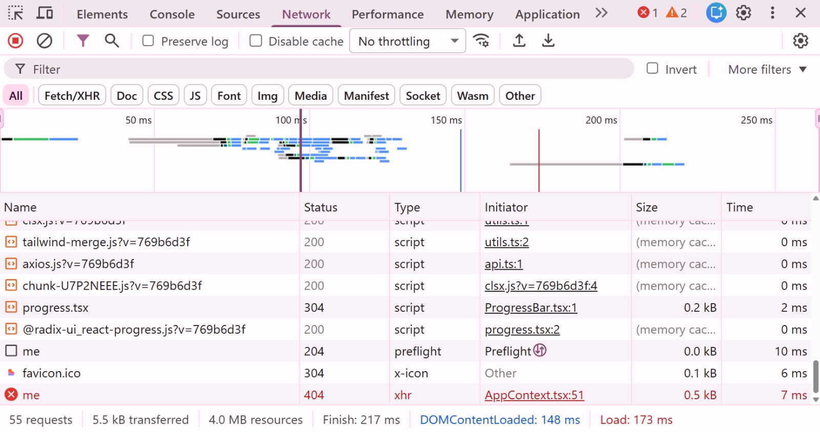
Performance Analysis
Load Time & Network Performance
• DOM Content Loaded Time: ~300–500 ms
• Total Page Load Time: ~350–650 ms
• Total API Requests: ~15–30
• Resource Size: Moderate (depends on UI components)

Slide 6
Backend Performance
• Average API Response Time: 100–250 ms
• Backend Framework: Node.js with Express
• Database: MongoDB (partially used)
Analysis:
• Fast response time for user requests
• Stable performance for small to medium usage
• No major delays in quiz evaluation or roadmap generation

Slide 7
Client Handling Capacity
Concurrent Users Supported:
• Approximately 20–50 users simultaneously
Throughput:
• Handles around 10–15 requests per second
System Stability:
• Smooth execution without crashes
• Stable performance for normal usage

Slide 8
Project Evaluation
Strengths:
• Personalized learning based on performance
• Structured and adaptive roadmap generation
• Simple and user-friendly interface
• Efficient quiz evaluation and response time
Weaknesses:
• Limited scalability for large users
• No advanced AI-based recommendations
• Partial database integration
• No real-time updates or notifications
Future Improvements:
• Implement AI-based learning recommendations
• Add real-time notifications and updates
• Improve database optimization and scalability
• Enhance UI with advanced analytics

Slide 9
Workflow of the System:
Step 1: User Registration & Login
User creates account and logs into the system
Step 2: Course Selection
User selects a course (DSA, DBMS, OS, etc.)
Step 3: Learning & Topic Completion
User studies topics and marks completion
Step 4: Quiz Evaluation
User attempts quiz based on selected course
Step 5: Performance Analysis
System evaluates answers and calculates score
Step 6: Roadmap Generation
System generates adaptive roadmap based on performance

Slide 10
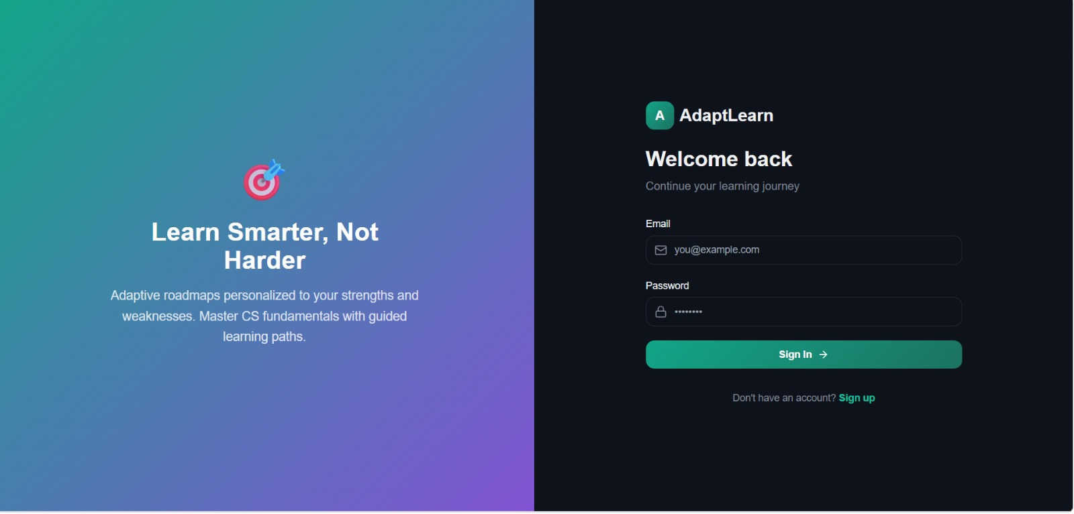
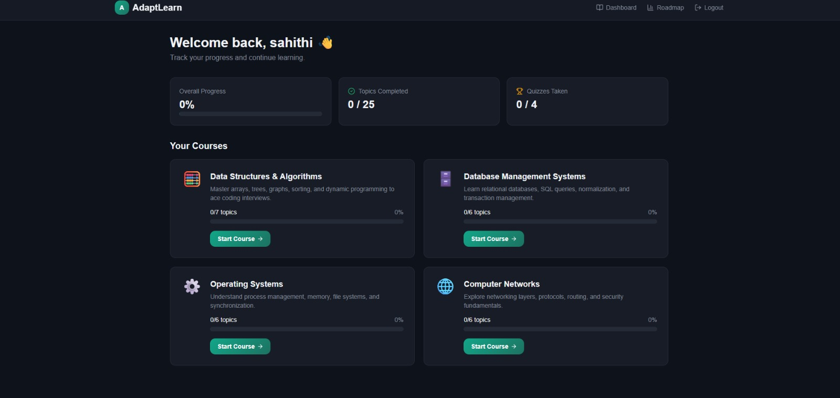
Results:

Slide 11
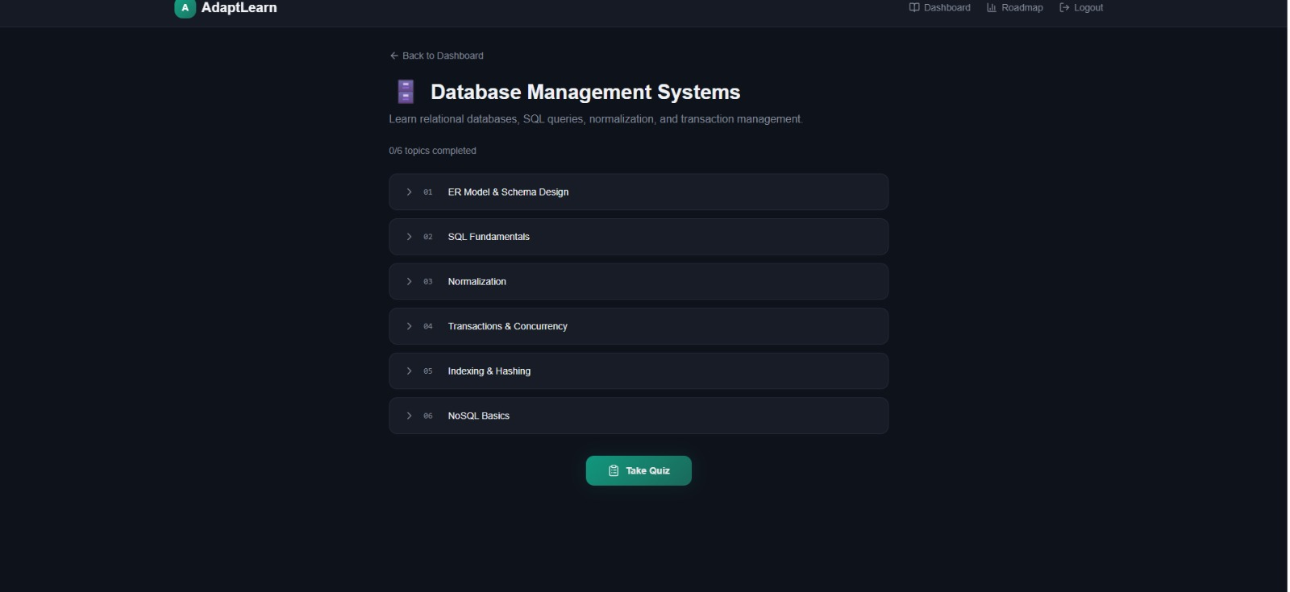
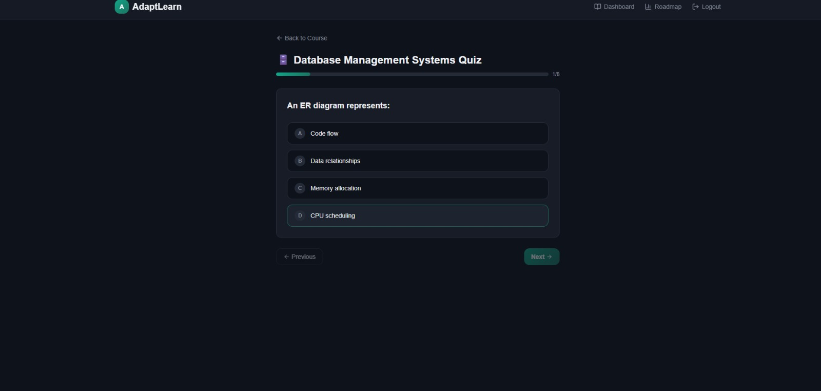

Slide 12
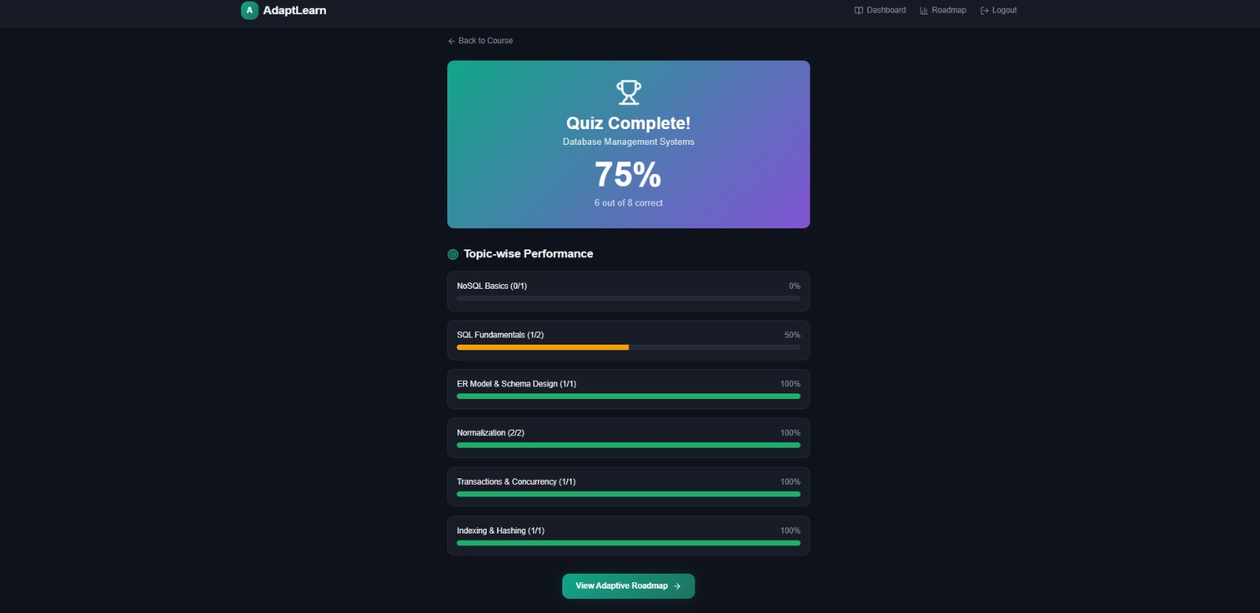
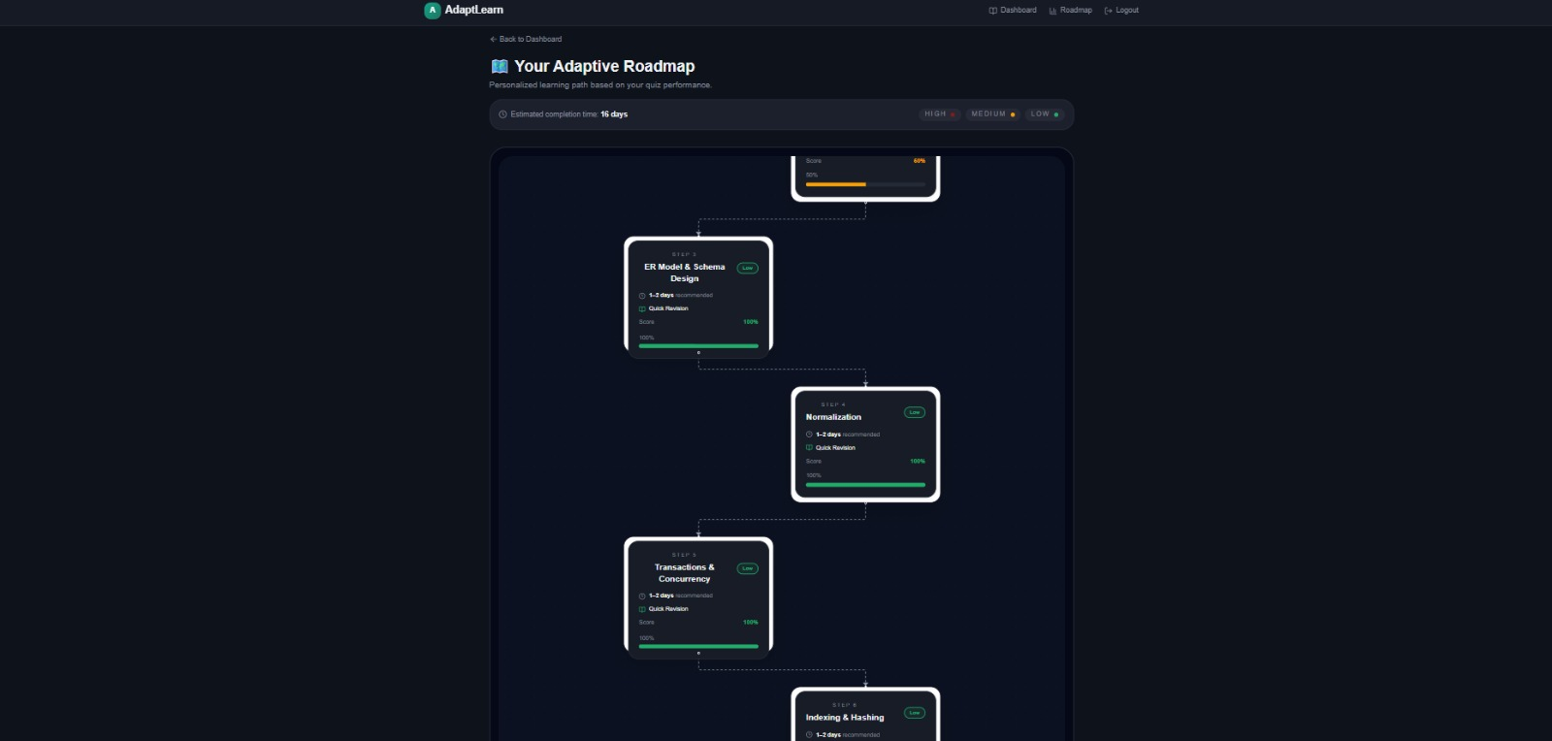

Slide 13
Thank You

