Slide 1

MACHINE LEARNING | FINAL REVIEW
SMART MOVIE RECOMMENDATION SYSTEM
Presented by
D. Swetha (24B11AI087)
K. Rishi Sahithi (24B11AI154)
K. Keerthi Reddy (24B11AI159)
Guided by
Mr. G. Siva Sankar(asst. professor, AIML)
Department of Artificial Intelligence and Machine Learning, Aditya University
Notes:
Good morning. We are presenting our machine learning project, the Smart Movie Recommendation System, developed under the guidance of Mr. G. Siva Sankar, Department of AI and ML, Aditya University.

Slide 2
Abstract
Smart Movie Recommendation System is a machine learning-based Streamlit web application that helps users discover movies by interest, mood and preference. It turns genres, keywords, overview, cast and director into TF-IDF vectors, finds similar movies with cosine similarity, adds candidates from the TMDB API, and ranks them by content, mood, language, runtime and rating, with a short “Why this movie?” explanation.
4,803
5,000
5
movies in the dataset
TF-IDF features
top picks shown
Python · Pandas · scikit-learn · Streamlit · Requests · Pickle · TMDB API
Notes:
The system recommends movies using content similarity and then ranks them with the user's mood, language, runtime and rating. It is built on 4,803 movies from the TMDB 5000 dataset with 5,000 TF-IDF features, shows up to five recommendations with explanations, and passed all ten test cases.

Slide 3




Introduction
Content-based filtering
What the system does
Recommends items similar to a selected item using its own descriptive information
Genres, keywords, overview, cast and director are merged into one “tags” field
TF-IDF vectors + cosine similarity find related movies; no other users’ ratings needed
TMDB API adds extra candidates; user preferences re-rank them
Search
Search for the movie title using TMDB.
Match
TF-IDF and cosine similarity to find similar movies in the local dataset
Personalize
Consider mood, language, minimum rating, and runtime
Explain
“Why this movie?” for each pick
Notes:
Movies are popular, but catalogues are huge. Content-based filtering recommends movies similar to one the user already likes, using descriptive information. We combine genres, keywords, overview, cast and director into a tags field, convert it with TF-IDF and compare movies with cosine similarity. On top of that, the system searches, personalizes and explains.

Slide 4
Problem Statement
Too many choices
Shallow matching
Thousands of titles across many genres and languages make manual browsing slow.
Title or genre search misses similar plots, keywords, cast and directors.
Context ignored
Unexplained results
General lists ignore mood, language, runtime and minimum rating.
Users rarely see why a movie was suggested, which lowers trust.
Notes:
We identified four problems: too many choices in large catalogues, shallow matching by title or genre only, recommendations that ignore the user's mood, language, runtime and rating, and results that are not explained.

Slide 5
Objectives and Scope of the Project
Objectives
Scope
Prepare a clean movie dataset with TF-IDF features
Find similar movies using cosine similarity
Add TMDB search and similar-movie candidates
Rank by mood, language, rating and runtime
Show up to five picks in a Streamlit interface
Explain each recommendation
Content-based recommendations from TMDB 5000 Movies and Credits (4,803 movies)
Inputs: title, mood, language, minimum rating, runtime category
Prototype: rule-based mood scoring, no collaborative filtering or viewing history
Results depend on dataset coverage, network access and TMDB responses
Notes:
Our objectives are a clean dataset with TF-IDF features, cosine similarity, TMDB candidates, preference-based ranking, a Streamlit interface and explanations. The scope is a content-based prototype on the TMDB 5000 data; it does not use collaborative filtering or personal viewing history.

Slide 6
Dataset Description
Feature | Description
Title | Name of the movie
Genres | Categories of the movie
Keywords | Important terms related to the movie
Overview | Short description of the plot
Cast | Actors in the movie
Director | Director of the movie
4,803
movies after preprocessing
12
columns in the working dataset
5,000
TF-IDF features per movie
Notes:
The dataset contains 4,803 movies and 12 columns after preprocessing. Genres, keywords, overview, cast, and director are combined into a single tags column, which is used to generate TF-IDF vectors for calculating movie similarity.

Slide 7
Data Preprocessing
1
2
3
4
5
Load & join
Parse fields
Clean
Create tags
TF-IDF & save
Movies and credits CSVs joined on movie id (Pandas)
Genres, keywords, cast to names; director from crew
Handle missing text; review duplicate titles
genres + keywords + overview + cast + director
5,000 features; vectors saved with Pickle
Example
A space-exploration movie gets tags such as “space”, “science fiction”, “survival” and “astronaut”, plus its cast and director names. TF-IDF weights these words, so movies that share meaningful terms get similar vectors.
Notes:
Preprocessing has five steps: load and join the CSV files with Pandas; parse genres, keywords, cast and director into readable names; check missing values and duplicates; build the tags column; then fit TF-IDF and save the artifacts with Pickle.

Slide 8
Exploratory Data Analysis (EDA)
Check | What was examined | Outcome
Data shape | Rows and columns after joining movies and credits | 4,803 rows × 12 columns
Missing values | Empty overviews or metadata that reduce similarity information | Converted to safe strings before tags are built
Duplicates | Repeated records and titles | Reviewed to avoid repeated recommendations
Feature roles | Genres: category · keywords: themes · overview: plot · cast and director: creative context | Five text features merged into tags
Vocabulary | Word weights across all movie tags | 5,000 features; English stop words removed
Feature matrix | Sparse TF-IDF representation | Shape (4803, 5000)
Common words such as “the” and “and” do not separate one movie from another, which is why stop words are removed.
Notes:
Before building the model we checked the shape of the data, missing values, duplicates, and how each feature contributes to similarity. The final table has 4,803 rows and 12 columns, and the TF-IDF matrix has shape 4,803 by 5,000.

Slide 9
Proposed Methodology
1. Offline preparation
TMDB 5000 data
Clean & join
Tags column
TF-IDF
Pickle files
Movies and Credits CSVs
Parse fields, handle missing
Five text features merged
5,000 features
movies, vectorizer, vectors
2. Online request (Streamlit)
User input
Candidates
Merge
Preference scores
Weighted rank
Top 5 + reasons
Title, mood, language, rating, runtime
Cosine similarity + TMDB search/similar
Combine, remove duplicates
Mood, language, runtime, rating
Content + preference score
“Why this movie?”
Notes:
The methodology has two parts. Offline, the data is prepared and the TF-IDF artifacts are saved. Online, a request flows from the Streamlit interface through local similarity and TMDB candidates, duplicate removal and preference ranking to the top five recommendations with explanations. The TMDB token is kept in Streamlit secrets and no personal information is collected.

Slide 10


Machine Learning Algorithms Used
TF-IDF
Cosine similarity
Weighted ranking
Converts movie tags into weighted numerical vectors (5,000 features, English stop words removed).
Measures the angle between two movie vectors; higher means more similar content.
Combines content relevance with preference scores to order the candidates.
TFIDF(t, d) = TF(t, d) × IDF(t)
sim(A, B) = A · B / (‖A‖ ‖B‖)
S = 0.55C + 0.20M + 0.10L + 0.10R + 0.05V
C = content relevance · M = mood · L = language · R = runtime · V = rating score
Content-based filtering needs no other users’ ratings, and TMDB similar-movie results add candidates beyond the local dataset.
Notes:
Three methods work together. TF-IDF converts movie tags to numerical vectors. Cosine similarity measures the angle between two vectors to find similar movies. A weighted formula then combines content relevance with mood, language, runtime and rating scores to rank candidates.

Slide 11
Model Training and Testing
Training (feature fitting)
Testing
Fit
TfidfVectorizer on the tags column
Level | What is checked
Unit | Preprocessing, TF-IDF vectorization, cosine similarity
Integration | Streamlit app, recommendation engine, TMDB API
Recommendation | Relevance of suggestions for different titles
User interface | Search, preference selection, result display
Configure
5,000 features, English stop words removed
Transform
4,803 × 5,000 sparse matrix
Save
movies.pkl, vectorizer and vectors with Pickle
5
recommendations at most
Notes:
There is no labelled training data: TF-IDF is fitted once on the tags column and the vectors are saved. Testing was done at four levels, unit, integration, recommendation and user interface, and all ten functional test cases passed.

Slide 12
Model Evaluation
How results were evaluated
Content relevance
Similar genres, keywords, cast and director appear
Preferences
Mood, language, rating and runtime change the ranking
Explanations
Every result shows a “Why this movie?” reason
Next step
Add precision@k and user feedback metrics
Notes:
Content relevance carries the most weight at 55 percent, mood 20, language and runtime 10 each and rating 5. We evaluated the recommendations by checking their relevance for different movie titles and preference combinations. Formal metrics such as precision at k are planned as future work.

Slide 13
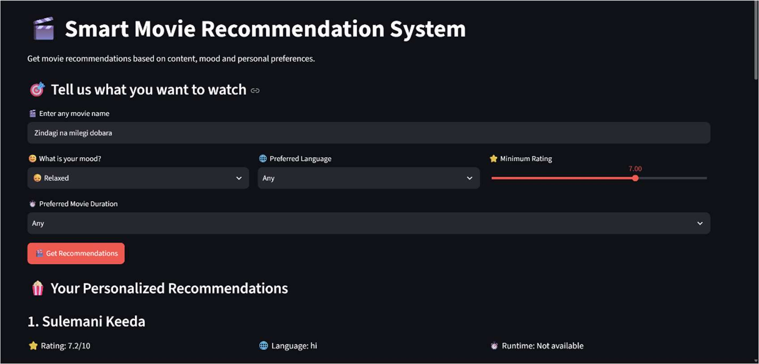
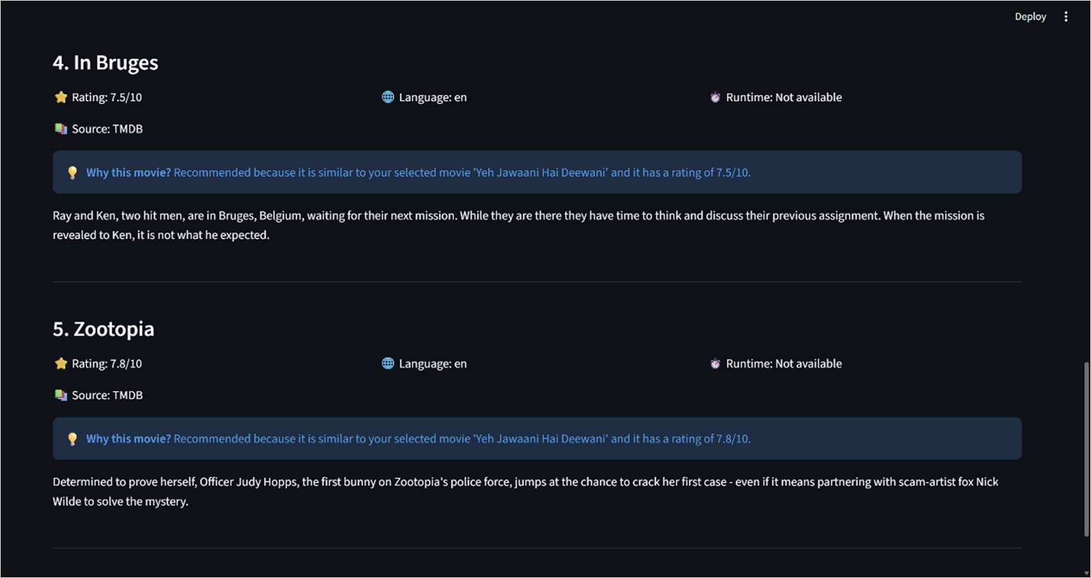
Results and Output Screenshots
Fig. 1: Input form with Relaxed mood and recommendations
Fig. 2: Final results with source and “Why this movie?”
1
Movie + mood
2
Ranked list
3
Reason shown
Title and mood set the context
Up to five movies by final score
Source and “Why this movie?” per title
Notes:
On the left the user searched Zindagi Na Milegi Dobara with the Relaxed mood and a minimum rating of 7. On the right the final results show each recommendation with rating, language, runtime, source and a short Why this movie reason.

Slide 14




Conclusion and Future Scope
Future Scope
Conclusion
Content similarity (TF-IDF + cosine) finds related movies
TMDB search adds candidates beyond the dataset
Mood, language, rating and runtime shape the ranking
Every pick has a “Why this movie?” explanation
Simple streamlit prototype evaluated through functional and recommendation testing.
Semantic embeddings
Similarity beyond matching words
Collaborative filtering
User ratings and viewing history
Feedback learning
Improve from likes and dislikes
Richer interface
Watchlists, posters, details
Notes:
To conclude, the system combines content-based filtering, TMDB integration and user preferences to give personalized recommendations with explanations in a simple Streamlit application. Future work includes semantic embeddings, collaborative filtering, learning from feedback, a richer interface and formal evaluation metrics.

Slide 15
References
[1] F. Pedregosa et al., “Scikit-learn: Machine Learning in Python,” JMLR, vol. 12, pp. 2825–2830, 2011.
[2] G. Salton and C. Buckley, “Term-weighting approaches in automatic text retrieval,” Inf. Process. Manag., vol. 24, no. 5, 1988.
[3] C. D. Manning, P. Raghavan and H. Schütze, Introduction to Information Retrieval, Cambridge University Press, 2008.
[4] P. Resnick and H. R. Varian, “Recommender Systems,” Communications of the ACM, vol. 40, no. 3, 1997.
[5] J. B. Schafer et al., “Collaborative Filtering Recommender Systems,” in The Adaptive Web, Springer, 2007.
[6] TMDB 5000 Movies and Credits datasets; TMDB API documentation, developer.themoviedb.org/docs
[7] Streamlit documentation, docs.streamlit.io
[8] Pandas and NumPy documentation, pandas.pydata.org/docs and numpy.org/doc
Notes:
These are the main papers, books, libraries, datasets and services the project is built on.

Slide 16
Questions and Discussion
Thank You
Smart Movie Recommendation System
Notes:
Thank you. We are happy to take questions.

