Slide 1

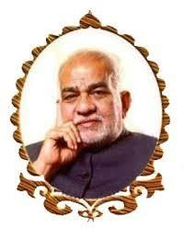
BVRIT HYDERABAD
College of Engineering for Women
SMART BLIND STICK

Slide 2

OUR TEAM
Sahithi
Supritha
Jahnavi
Susmitha

Slide 3
CONTENT
Problem statement
Existing solution
Limitations in existing solution
Proposed solution
Components
Uniqueness
Demo
Future proceedings

Slide 4
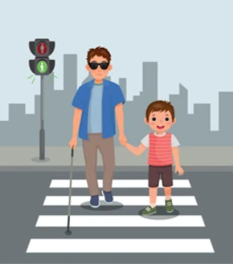
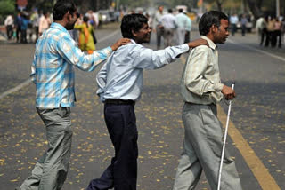
THE PROBLEM
Visually impaired people find difficulty in presence of objects in the surroundings and water on ground.
In dark surroundings, it is difficult to identify a blind person walking on the roads.

Slide 5
SOLUTION
Using ultrasonic sensors, we will detect the obstacles in the surroundings.
Using rain sensor, we will detect if water exists on the ground.

Slide 6
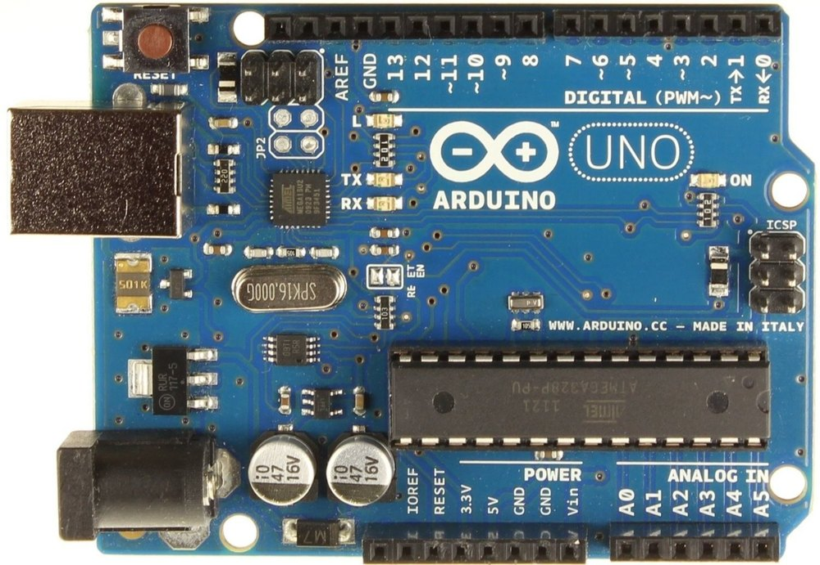
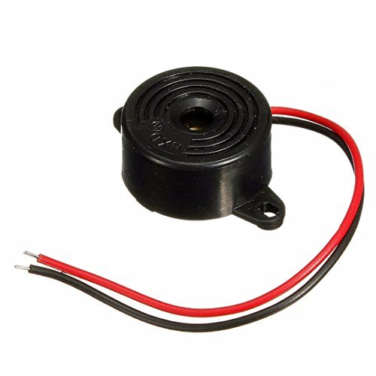
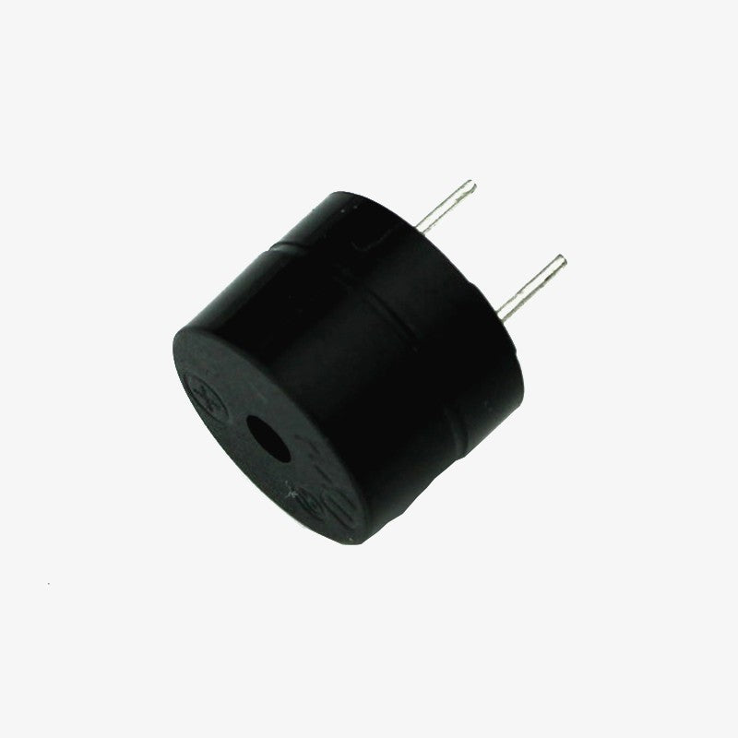
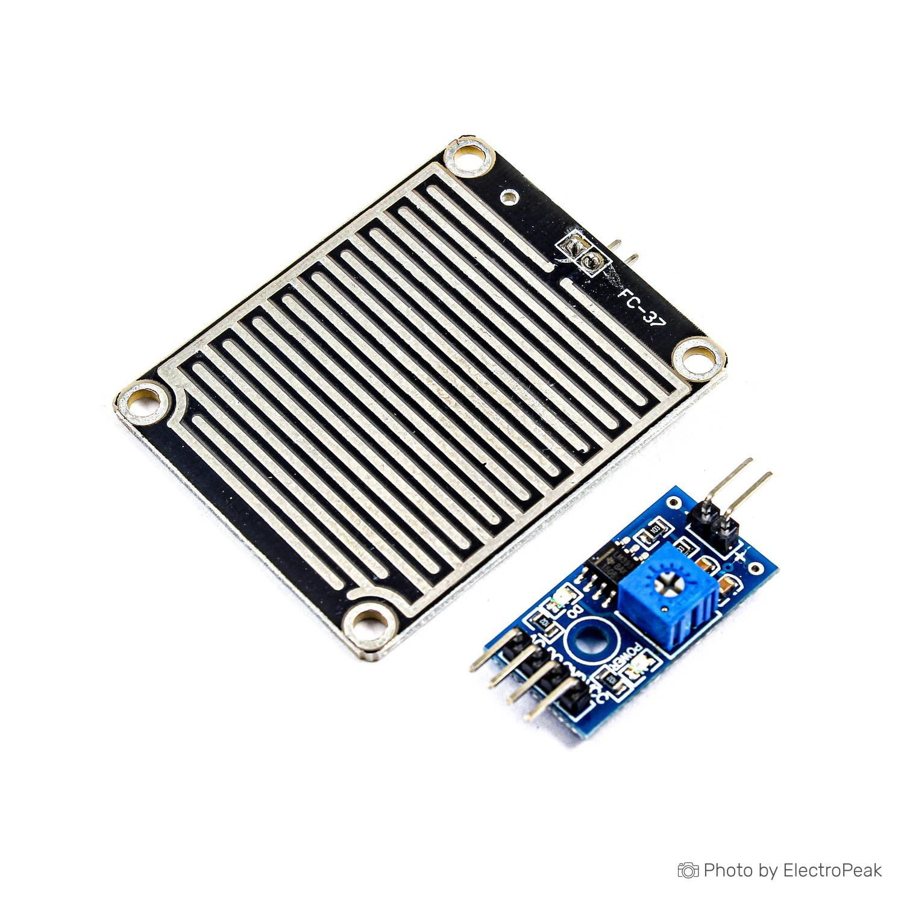
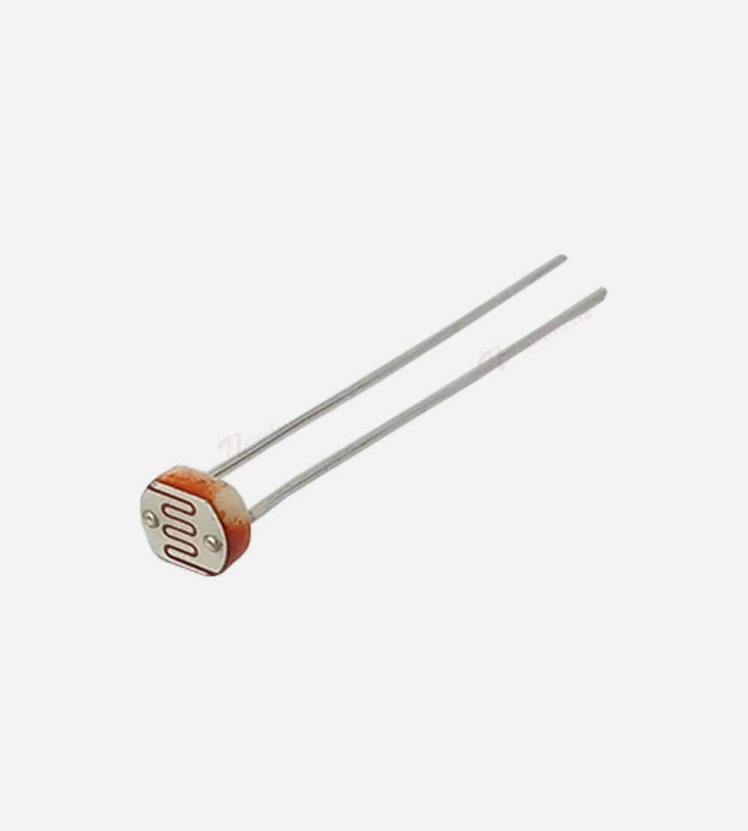
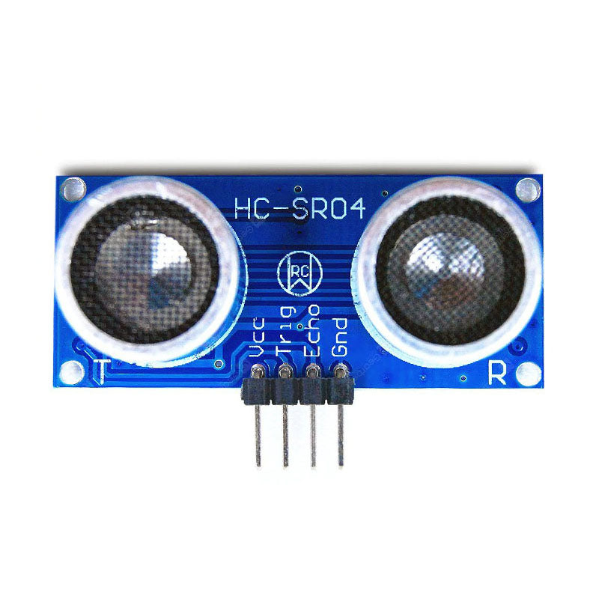
COMPONENTS
Arduino Uno
Piezoelectric buzzer
Buzzer
Rain sensor
LDR
Ultrasonic sensor

Slide 7
UNIQUENESS
Low cost.
Easy to use.
Light in weight and portable
Low power consumption.
Suitable for both indoor and outdoor environment.

Slide 8
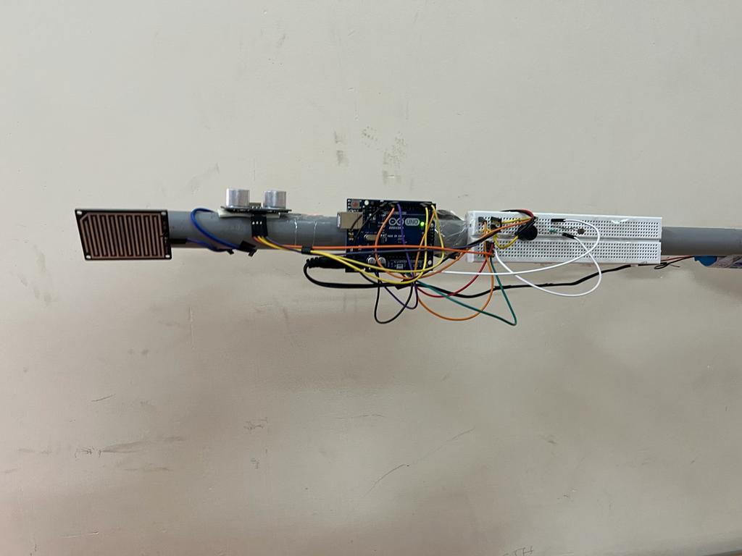
DEMO
The main theme of the project is to support the blind people in travelling from one place to another place.

Slide 9
FUTURE PROCEEDINGS
We can upgrade this blind stick by adding lDR to the blind stick so that we can identify the blind person on dark roads .
We can train this blind stick so that it can identify the object and give indications to the blind person
We can train the model so that it can help in zebra crossing.

Slide 10
THANK YOU

