Slide 1


StudBud
AI-Powered Smart Study planner

Slide 2


Team Name: MindX
Team members:
B. SRAVYA – (23B81A6652)
P. SINDHU – (23B81A6651)
M. SAHITHI – (23B81A6641)
A. SHREYA – (23B81A6650)

Slide 3
INTRODUCTION
StudBud is an intelligent AI-driven study planner designed to help students create personalized and efficient study schedules. GenAI, it tailors study plans according to a student's goals, strengths, weaknesses, and preferences . This innovative tool not only optimizes learning time but also ensures better time management, productivity, and performance. Whether preparing for exams or improving academic consistency, StudBud acts as a smart companion, making studying more structured and effective.
Key Features: ✔ AI-powered personalized study plans ✔ Adapts to individual learning needs ✔ Enhances productivity & focus

Slide 4
Problem Statement:
Students often struggle with time management, consistency, and personalized study planning. Traditional study schedules fail to adapt to individual strengths, weaknesses, and learning patterns, leading to inefficient study routines, stress, and poor academic performance.
Solution – StudBud: AI-Powered Smart Study Planner
StudBud leverages AI and BERT-based NLP to create personalized, dynamic study plans that adapt to each student's learning style and goals. It helps:
Optimize study schedules based on subject difficulty and available time
Identify strengths & weaknesses to focus on areas needing improvement
Enhance productivity & retention with smart AI-driven recommendations

Slide 5
Literature Review
Traditional Study Methods
Conventional study plans follow a fixed schedule that lacks adaptability.
Studies indicate that one-size-fits-all approaches fail to meet individual student needs.
AI & Machine Learning in Education
Research shows that AI-based adaptive learning models improve retention rates.
Natural Language Processing (NLP) techniques, such as BERT, enable better understanding of student queries and performance analysis.
Impact of Personalized Study Plans
Personalized learning platforms like Coursera and Duolingo have demonstrated higher engagement and effectiveness.
AI-driven tools help in time management, identifying weak areas, and optimizing learning paths.

Slide 6
System Architecture
The StudBud system follows a structured flow to generate personalized study plans:
User Input – Students provide their goals, strengths, weaknesses, and preferences through the web interface.
Frontend (HTML, CSS, JavaScript) – Collects user input and sends it to the backend.
Backend (Flask, Python, BERT Model) – Processes the input and uses the BERT model to generate study plans.
BERT Model Processing – Converts input into meaningful representations and generates a customized study plan.
Response Generation – The system formats the study plan and sends it back to the frontend.
Display Study Plan – The generated study plan is displayed on the web interface for the user.

Slide 7
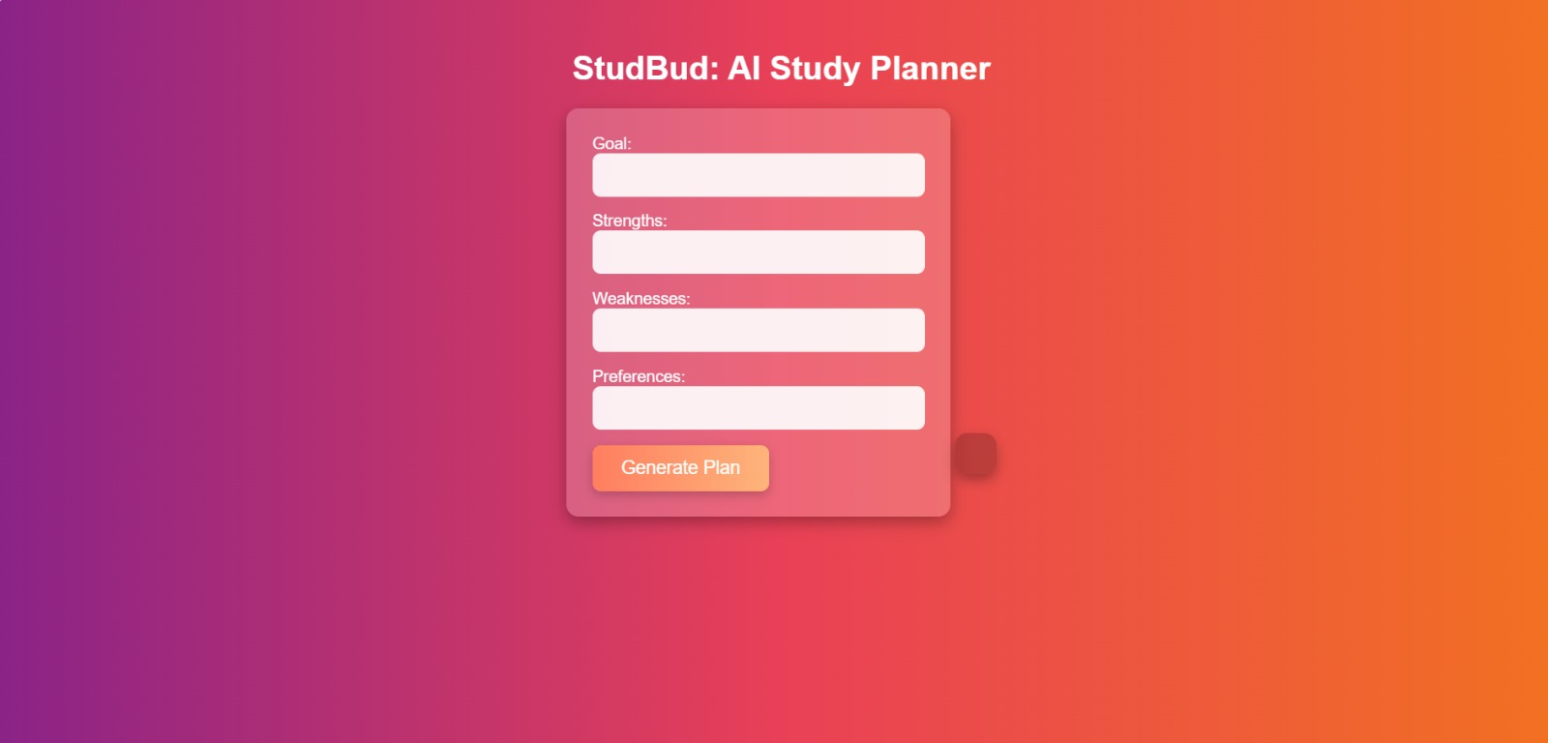

Slide 8
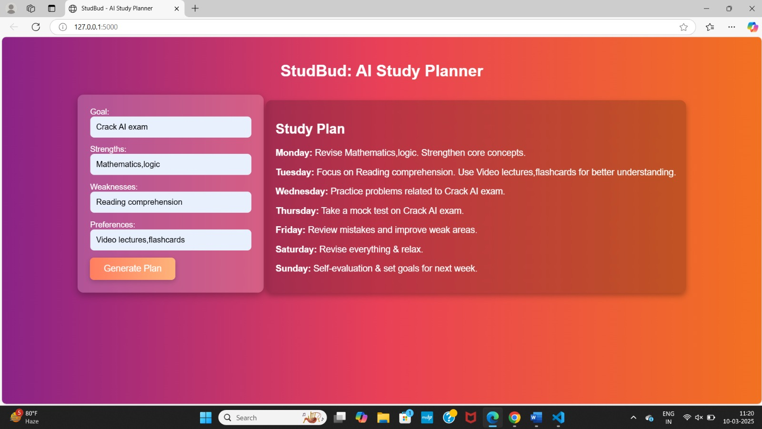

Slide 9
Technology Stack
Frontend: HTML, CSS,
Backend: Flask (Python)
Machine Learning: BERT (Transformers)
Database: No database (JSON-based communication)
Deployment: VS code
Libraries: Torch, Transformers, Flask-CORS

Slide 10
Features and Functionalities
AI-Powered Study Planner: Uses BERT to generate personalized study plans.
Customizable Inputs: Users can provide their goals, strengths, weaknesses, and preferences.
Automated Study Schedule: Plans tasks for each day of the week.
Web-Based Interface: Simple and interactive form for easy input.
Dynamic Recommendations: Adapts study plans based on user input.
User-Friendly UI: Clean, responsive, and visually appealing design.
Interactive Plan Display: Study plans are shown in an easy-to-read format.

Slide 11
Future Enhancements
Advanced AI Optimization: Improve study plan recommendations with more AI models.
User Progress Tracking: Monitor study progress and provide feedback.
Multiple Study Modes: Include focus mode, revision mode, and test mode.
Mobile Compatibility: Develop a mobile-friendly version or an app.
Personalized Notifications: Reminders and study tips based on progress.
Integration with Study Resources: Suggest books, videos, and articles.

Slide 12
Conclusion
StudBud is an AI-powered study planner that personalizes schedules based on student goals, strengths, and weaknesses. It simplifies learning by providing structured study plans, making studying more efficient and effective. With future enhancements, StudBud will become even smarter, offering more interactive and adaptive learning experiences.

Slide 13
THANK YOU

