Slide 1
KL UNIVERSITY • BACHUPALLY CAMPUS, HYDERABAD
Department of Computer Science & Engineering
Predicting Employee Attrition with Explainable Machine Learning (SHAP)
IBM HR Analytics case study | Logistic Regression & Random Forest with SHAP | Section 1, Team 22
PRESENTED BY
UNDER THE GUIDANCE OF
2520030242 Bhavana D
2520030262 Sahithi P
Raghavendra
Department of CSE
KLH Bachupally Campus
B.Tech | Machine Learning (25SC2107E) | Y25 Trimester 4 | Academic Year 2026-27 | Date: 13-10-2026
Notes:
Model template - Minor Project review presentation for B.Tech II year. Replace every placeholder in angle brackets. Title slide: speak for 30 seconds - greet the panel, state the title, introduce the team and the guide. Do not read the slide word for word.

Slide 2
AGENDA
Contents
1
Introduction & Domain Background
7
Methodology & Modules
2
Problem Statement & Motivation
8
Tools and Technologies
3
Literature Survey
9
Work Completed / Demo
4
Research Gap Identified
10
Timeline & Review Plan
5
Objectives of the Project
11
Expected Outcome & Conclusion
6
Proposed System Architecture
12
References
Dept. of CSE | KL University, Bachupally Campus
2
Notes:
Keep the agenda to one slide. In a 10-12 minute review, spend the most time on literature survey, objectives and work completed.

Slide 3
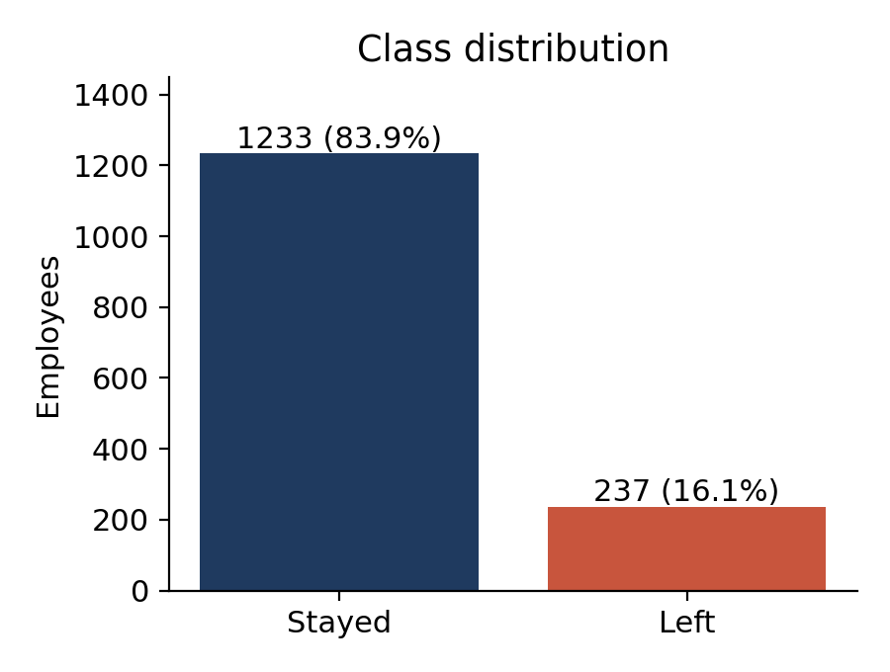
SECTION 1
Introduction & Domain Background
What is the domain?
HR analytics: using employee data to understand and predict workforce outcomes. Here the task is attrition, i.e. which employees are likely to leave.
Why is it relevant today?
In the IBM HR dataset 16.1% of 1,470 employees left [12]. Recent studies pair ML with SHAP so HR can see why [1], [2].
Where does your project sit?
Binary classification (LR vs RF) on IBM HR data, explained with SHAP at workforce and individual level.
Data note
Figures on this and later slides are computed by our own analysis of the full dataset [12] unless a reference is shown.
Dept. of CSE | KL University, Bachupally Campus
3
Notes:
60-90 seconds. Start broad (the domain), end narrow (your specific task). Avoid definitions copied from Wikipedia - the panel will ask for the source.

Slide 4
SECTION 2
Problem Statement & Motivation
PROBLEM STATEMENT
" Existing attrition models report accuracy on an 84:16 imbalanced dataset and act as black boxes, so at-risk employees are missed and retention actions are not targeted. "
1
2
3
Who is affected?
What is the cost of the problem?
Why solve it now?
HR teams, and the managers and employees in high-turnover roles (e.g. 39.8% attrition among Sales Representatives).
16.1% of employees left (237 of 1,470). A model that always says "stays" scores 84% accuracy yet finds no leavers.
SHAP is mature, and recent work [1], [2] calls for transparent, human-in-the-loop HR analytics rather than black-box scores.
Dept. of CSE | KL University, Bachupally Campus
4
Notes:
The problem statement must be ONE sentence. If you need two sentences, the scope is too wide for a minor project. The panel's first question is usually: who exactly benefits?

Slide 5
SECTION 3
Literature Survey
8 papers studied (2022 onwards, journals / conferences); the 5 most relevant are shown, all 8 are in References.
S.No | Author & Year | Title / Technique Used | Dataset / Tools | Key Findings | Limitation / Gap
1 | Alyousef et al. (2026) [1] | Soft-voting ensemble (LR, RF, XGBoost) with SMOTE/ADASYN; SHAP | IBM HR, 1,470 rows; scikit-learn | LR best F1 0.50 and recall 0.64; XGBoost AUC 0.80 | Single 80/20 split, no k-fold CV; only global SHAP shown
2 | Ansari et al. (2026) [2] | AI-based MIS: LR, RF, MLP, XGBoost + SHAP; SMOTE inside CV folds | IBM HR (as described by authors); 5-fold CV | Leakage-safe pipeline with feature-level SHAP transparency | Real-time deployment and HR user studies left as future work
3 | Mohiuddin et al. (2023) [3] | HR-DSS: 8 ML models + explainable AI and what-if analysis | Employee attrition data | Changing an individual's dominant features can flip attrition to retention | Per-employee what-if focus; no workforce-level driver ranking in abstract
4 | Raza et al. (2022) [4] | Optimised Extra Trees with EDA | IBM HR | 93% accuracy (as summarised in [1]); income, job level, age key | Accuracy emphasised despite 84:16 imbalance
5 | Chung et al. (2023) [5] | Stacking ensemble; six ML models compared | IBM HR | ~98% accuracy for gradient boosting (as summarised in [1]) | Accuracy-driven; little on explaining single predictions
Gap column is our reading of each paper's scope; figures are from abstracts or as summarised in [1]. The last column drives the research gap.
Dept. of CSE | KL University, Bachupally Campus
5
Notes:
Do not read the table aloud. Speak about the trend: what most papers did, what results they reached, and what all of them left unsolved. Row 1 is a worked example - delete it and put your own paper there.

Slide 6
SECTION 4
Research Gap Identified
GAP 1
OUR PROJECT ADDRESSES
Existing work does not consistently report recall alongside accuracy; headline accuracy (93-98% [4], [5]) is inflated by the 84:16 imbalance.
We close Gaps 1 and 2 and part of Gap 3: recall-centred LR vs RF with 5-fold CV, SHAP global + individual explanations mapped to HR actions.
GAP 2
Existing work does not pair an interpretable baseline with a SHAP-explained ensemble under cross-validation; single splits and global-only SHAP [1].
GAP 3
A risk dashboard for HR users is deliberately left as future scope.
Existing work does not turn per-employee drivers into concrete HR actions; deployment and practitioner use remain future work [2], [3].
Each gap traces to the last column of the literature survey (rows 1-5).
Dept. of CSE | KL University, Bachupally Campus
6
Notes:
This is the slide that separates a good review from an average one. State 2-3 gaps only, and make sure each one maps to a paper you listed.

Slide 7
SECTION 5
Objectives of the Project
Four objectives, each demonstrated by the final review.
To collect and prepare the IBM HR Analytics dataset (1,470 employees, 35 attributes) and study attrition patterns through EDA.
1
To design and implement Logistic Regression and Random Forest classifiers with balanced class weights and a stratified 80/20 split.
2
To evaluate both models using accuracy, precision, recall, F1-score and ROC-AUC, with priority on recall for leavers.
3
To explain and demonstrate the Random Forest with SHAP (global and individual) and map the drivers to HR retention actions.
4
Objectives map one-to-one to results: O1 to EDA, O2-O3 to the metrics table, O4 to the SHAP plots.
Dept. of CSE | KL University, Bachupally Campus
7
Notes:
Avoid vague verbs - study, understand, analyse. Use build, classify, detect, compare, deploy. Four objectives is the right number for a minor project.

Slide 8
SECTION 6
Proposed System Architecture
INPUT
PRE-PROCESSING
CORE MODULE
OUTPUT
IBM HR Analytics CSV
1,470 employees x 35 columns
Drop 4 columns, one-hot
encode (44 features),
stratified 80/20 split
Logistic Regression
+ Random Forest
(balanced weights)
Risk score, metrics
(recall, F1, AUC) and
SHAP drivers for HR
EVALUATION AND EXPLANATION LAYER
5-fold CV AUC on training data; test-set accuracy, precision, recall, F1, ROC-AUC, ROC curves, confusion matrices.
SHAP TreeExplainer on Random Forest: global importance, beeswarm direction plot, individual explanation.
Arrow labels
Arrow 1: raw CSV. Arrow 2: 44-feature matrix + train/test sets. Arrow 3: class-1 probabilities and SHAP values.
Dept. of CSE | KL University, Bachupally Campus
8
Notes:
Walk the panel through the diagram left to right in under a minute, naming the input and the output first. Be ready to say where your contribution sits.

Slide 9
SECTION 7
Methodology & Modules
1
Module 1 - Data
2
Module 2 - Processing
IBM HR Analytics (Kaggle [12]): 1,470 rows, 35 columns, no missing values; 237 leavers (16.1%).
Drop 4 constant/ID columns, one-hot encode, standardise (LR only), stratified split: 1,176 train / 294 test.
3
Module 3 - Core Logic
4
Module 4 - Explanation and Output
LR as interpretable baseline; RF for non-linear effects and exact Tree SHAP [10], [11]. Both use balanced class weights.
SHAP summary and individual plots, risk scores and driver-to-action table, delivered as a Python notebook.
Dept. of CSE | KL University, Bachupally Campus
9
Notes:
One module per team member works well - it also answers the panel question 'who did what'.

Slide 10
SECTION 8
Tools and Technologies
SOFTWARE
HARDWARE / PLATFORM
Language: Python 3
Libraries: pandas, NumPy, scikit-learn, SHAP
Plotting: Matplotlib, Seaborn
Front end: Jupyter / Colab notebook
Back end: none (offline analysis)
Data store: CSV file
Processor: i5 or above
RAM: 8 GB minimum
GPU: not required (CPU only)
Sensors or devices: none
Deployment: local notebook / Colab
Version control: GitHub (team repository)
Dept. of CSE | KL University, Bachupally Campus
10
Notes:
Name versions where you know them. If you have a GitHub repository, show the link here - it is strong evidence of real work.

Slide 11
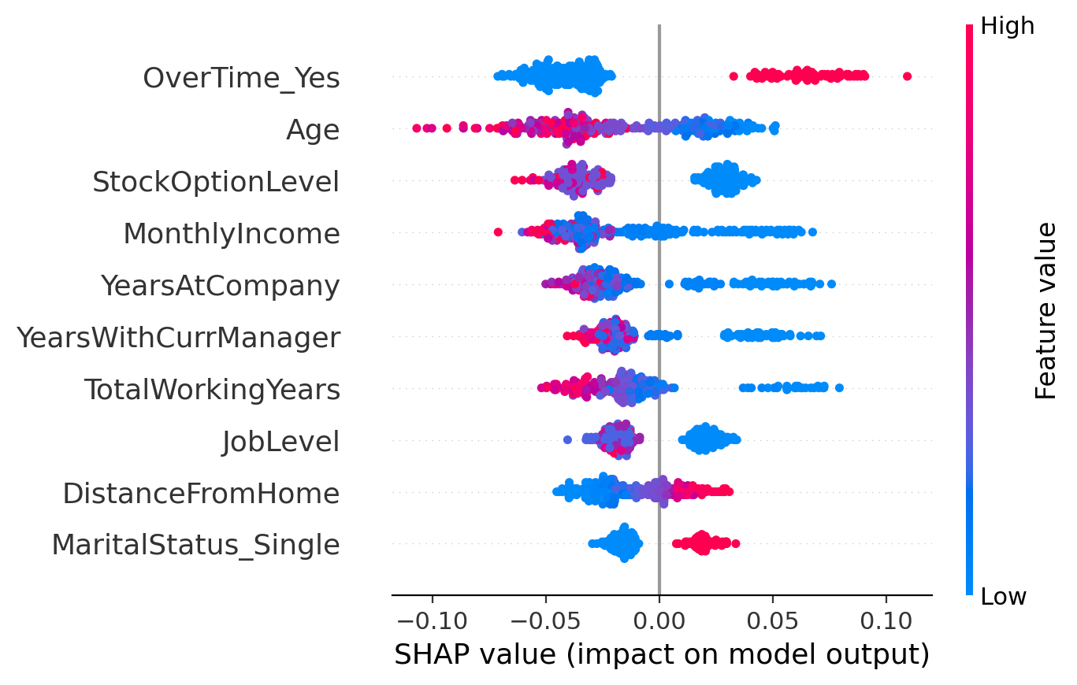
SECTION 9
Work Completed / Demo
Literature survey
Completed
Dataset collection and EDA
Completed
Pre-processing pipeline
Completed
Model training and evaluation
Completed
SHAP explainability
Completed
HR risk dashboard (optional)
Pending
Result so far: LR recall 0.62, AUC 0.80; RF AUC 0.77. SHAP ranks overtime as the top driver of risk.
Dept. of CSE | KL University, Bachupally Campus
11
Notes:
Be honest about status. Panels reward accurate self-assessment and penalise claims that fall apart under one question.

Slide 12
SECTION 10
Timeline & Review Plan
Review 0
Review 1
Review 2
Final
Week 2
Week 5
Week 9
Week 14
Title, abstract, team roles finalised
Literature survey, gap, objectives
EDA, models and SHAP implemented
Full demo, results, report
Filled circles = completed reviews. Update this slide before every review.
What the panel checks every time: progress since the last review, honesty of the status you claim, and whether each objective still has enough weeks left to finish.
Dept. of CSE | KL University, Bachupally Campus
12
Notes:
Adjust week numbers to your academic calendar. Showing a plan for the remaining weeks is what the panel wants to hear at Review 1.

Slide 13
SECTION 11
Expected Outcome & Conclusion
DELIVERABLE
MEASURABLE TARGET
BEYOND THE LAB
A reproducible attrition-risk pipeline: LR and RF models with SHAP explanations
Test set: LR recall 0.62 / AUC 0.80; RF recall 0.72 at threshold 0.30
HR teams can prioritise retention talks; needs re-validation on real company data
CONCLUSION
We took up attrition prediction that HR can trust: prior work stresses accuracy and gives few per-employee reasons. On the IBM HR data, LR was better at finding leavers (recall 0.62), while RF explained by SHAP showed overtime, age, stock options, income and tenure as key drivers. Future scope: cross-validated threshold tuning, boosting models, fairness audit and an HR dashboard.
Dept. of CSE | KL University, Bachupally Campus
13
Notes:
Do not introduce anything new here. The conclusion restates the problem, the gap and the promise - nothing else.

Slide 14
SECTION 12
References
IEEE style, numbered in order of first citation. [1]-[8] are the studied literature; [9]-[13] support methods and data.
[1] M. I. Alyousef, H. W. Khan and M. U. Sattar, "A hybrid predictive model for employee turnover," Information, vol. 17, no. 2, Art. 208, 2026.
[2] M. E. Ansari et al., "An AI-driven management information system for employee attrition prediction," Computers, vol. 15, no. 7, Art. 400, 2026.
[3] K. Mohiuddin et al., "Retention is all you need," in Proc. ACM CIKM, 2023, pp. 4752-4758.
[4] A. Raza et al., "Predicting employee attrition using machine learning approaches," Appl. Sci., vol. 12, no. 13, Art. 6424, 2022.
[5] D. Chung, J. Yun, J. Lee and Y. Jeon, "Predictive model of employee attrition based on stacking ensemble learning," Expert Syst. Appl., vol. 215, Art. 119364, 2023.
[6] S. M. Varkiani et al., "Predicting employee attrition and explaining its determinants," Expert Syst. Appl., vol. 272, Art. 126575, 2025.
[7] H. Talebi, A. K. Bardsiri and V. K. Bardsiri, "Developing a hybrid ML model for employee turnover prediction," J. Open Innov., vol. 11, Art. 100557, 2025.
[8] M. Elhosseini, "Integrating ML and explainable AI for employee attrition prediction in HR analytics," Zayed Univ. Scholars, 2026.
[9] S. M. Lundberg and S.-I. Lee, "A unified approach to interpreting model predictions," in Proc. NeurIPS, 2017, pp. 4765-4774.
[10] S. M. Lundberg et al., "From local explanations to global understanding with explainable AI for trees," Nature Mach. Intell., vol. 2, pp. 56-67, 2020.
[11] L. Breiman, "Random forests," Mach. Learn., vol. 45, no. 1, pp. 5-32, 2001.
[12] P. Subhash, "IBM HR Analytics Employee Attrition & Performance," Kaggle. [Online]. Available: kaggle.com/datasets/pavansubhasht/ibm-hr-analytics-attrition-dataset
[13] F. Pedregosa et al., "Scikit-learn: Machine learning in Python," J. Mach. Learn. Res., vol. 12, pp. 2825-2830, 2011.
Slide 5 shows [1]-[5]; [6]-[8] were also surveyed.
Dept. of CSE | KL University, Bachupally Campus
14
Notes:
Use Google Scholar's 'Cite' option and pick MLA/IEEE, then fix the formatting by hand. Never cite a blog, a YouTube video or a paper you have not opened.

Slide 15
Thank You
Questions & Suggestions
Team: Bhavana D, Sahithi P (Team 22) | Guide: Raghavendra | Dept. of CSE, KLH Bachupally
Notes:
Keep the deck open on the architecture slide during questions - most panel questions point back to it.

