Slide 1
AI-Driven Personalized Learning and Remedial Recommendation Through Knowledge Concept-Centric Evaluation
FINAL REVIEW · FINAL-YEAR PROJECT
A working system that finds weak concepts, writes verified help, and re-tests, on free AI models
Team: [Student Name 1] ([Roll No.]) | [Student Name 2] ([Roll No.]) | [Student Name 3] ([Roll No.])
Guide: [Guide Name], [Designation]
[Department of Computer Science and Engineering] · [College Name] · [2025–2026]
Notes:
Introduce the team and guide. One sentence: the full system from the base paper is implemented, runs on free AI models, and adds a personal study PDF for every student. Replace the bracketed placeholders before the review.

Slide 2
What we will cover
AGENDA
1
2
3
4
Problem & base paper
Objectives status
System architecture
Modules implemented
5
6
7
8
Our additions to the paper
Live demo
Results & evaluation
Conclusion & future scope
Notes:
Eight parts. Part 5 (orange) is what we added beyond the base paper; give it the most time.

Slide 3
From one total mark to mastery of every concept
PROBLEM & BASE PAPER
The problem
Everyone gets the same material and test, and one total mark
The mark does not show which concepts were missed
Teachers cannot write personal material for every student
The base paper
Pradeesh et al., IEEE Access, vol. 13, 2025
Six modules: RAG, concepts, EKT, remedial plans, MCQs, adaptive test
Paid models: OpenAI writes, Gemini and DeepSeek verify
We implemented it end to end and extended it
Notes:
Quick recap for the panel. Left: the problem. Right: the base paper we implement. Keep this under a minute; the panel has seen it in the first review.

Slide 4
Seven of eight objectives are complete
OBJECTIVES STATUS
Extract concepts and course outcomes from the syllabus
Cross-verified five-part remedial plans
✓
✓
RAG knowledge base with MiniLM + FAISS
De-duplicated MCQs by difficulty and Bloom level
✓
✓
EKT mastery per concept, compared with DKT
Adaptive re-test, study PDF, web app and API
✓
✓
Gap detection with OBE threshold 50% / target 70%
Evaluation with a real class of students
✓
–
Notes:
Go down the list. Be honest about number 8: the classroom study with real students is not done; we used simulated students, and that is future work.

Slide 5
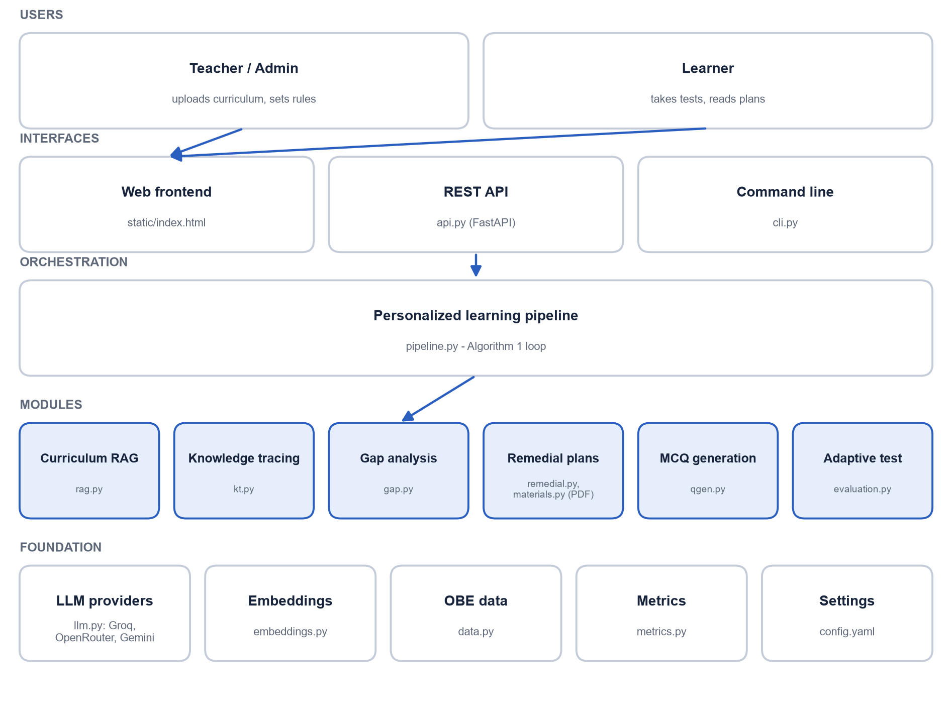
Five layers, six modules, three AI models
SYSTEM ARCHITECTURE
Built with
Python, PyTorch, sentence-transformers, FAISS
FastAPI + single-page HTML/JS frontend
reportlab for the study PDF; pytest (36 tests)
Groq
writes
OpenRouter
verifies
Gemini
verifies
Notes:
Users reach the system through the web page, the REST API or the command line. The pipeline runs the six modules. In the foundation, llm.py talks to Groq, OpenRouter and Gemini, all free, with an offline fallback.

Slide 6
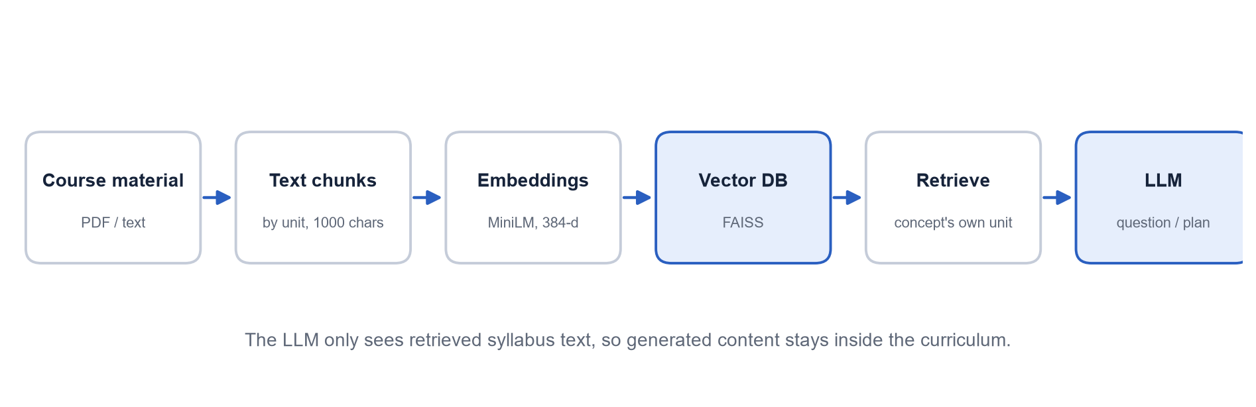
The AI writes only from our syllabus
MODULES 1 & 2 · COURSE PROCESSING AND RAG
1000 / 100
384
5
Top 4
chunk size / overlap (characters)
dimensions per MiniLM embedding
concepts, one per unit (CO1–CO5)
chunks retrieved per request
Notes:
The syllabus is read with pypdf, split by unit, cut into 1000-character chunks with 100 overlap, embedded with MiniLM and stored in FAISS. Each unit becomes one concept with its course outcome. When the AI writes about a concept, it only receives that unit's chunks.

Slide 7
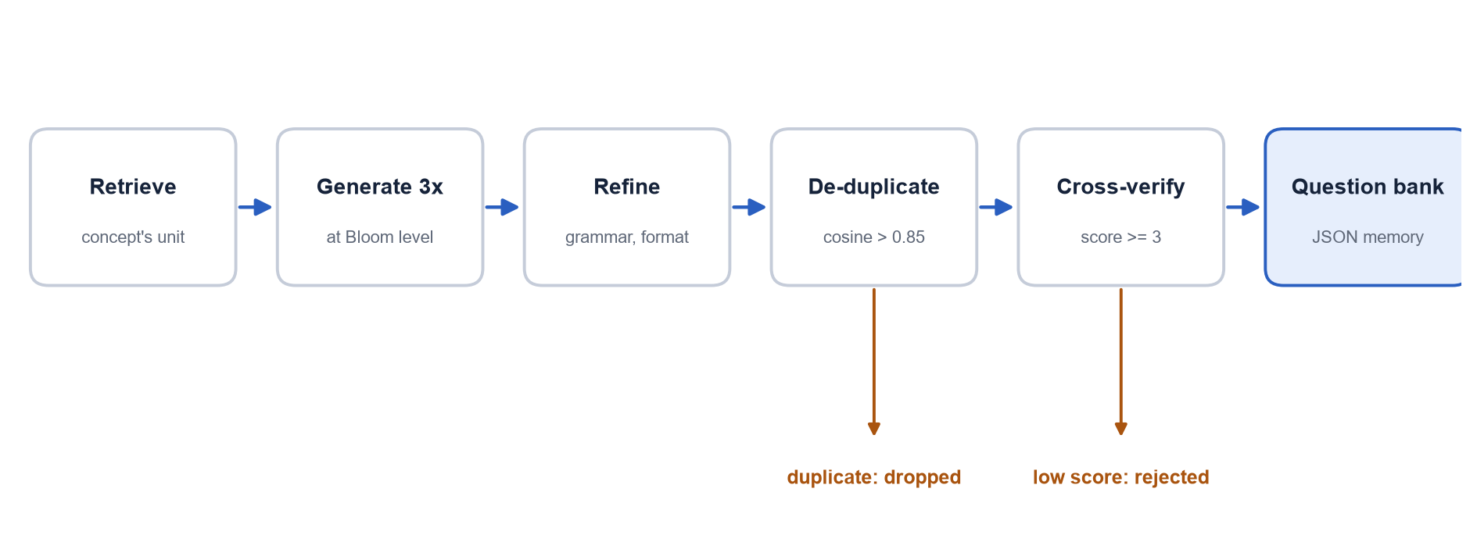
Generate three times, keep only unique, verified questions
MODULE 3 · MCQ GENERATION
90
25
65
3 / 5
questions generated
near-duplicates removed (> 0.85)
unique questions stored
minimum verifier score to accept
Notes:
The generator asks for three times the number of questions needed. Near-duplicates (cosine similarity above 0.85) are removed, and each question is scored by two other models; below 3 out of 5 it is rejected. In our run 90 were generated, 25 duplicates removed, 65 kept. Every stored question has 4 options, a valid key, a difficulty and a Bloom level.

Slide 8
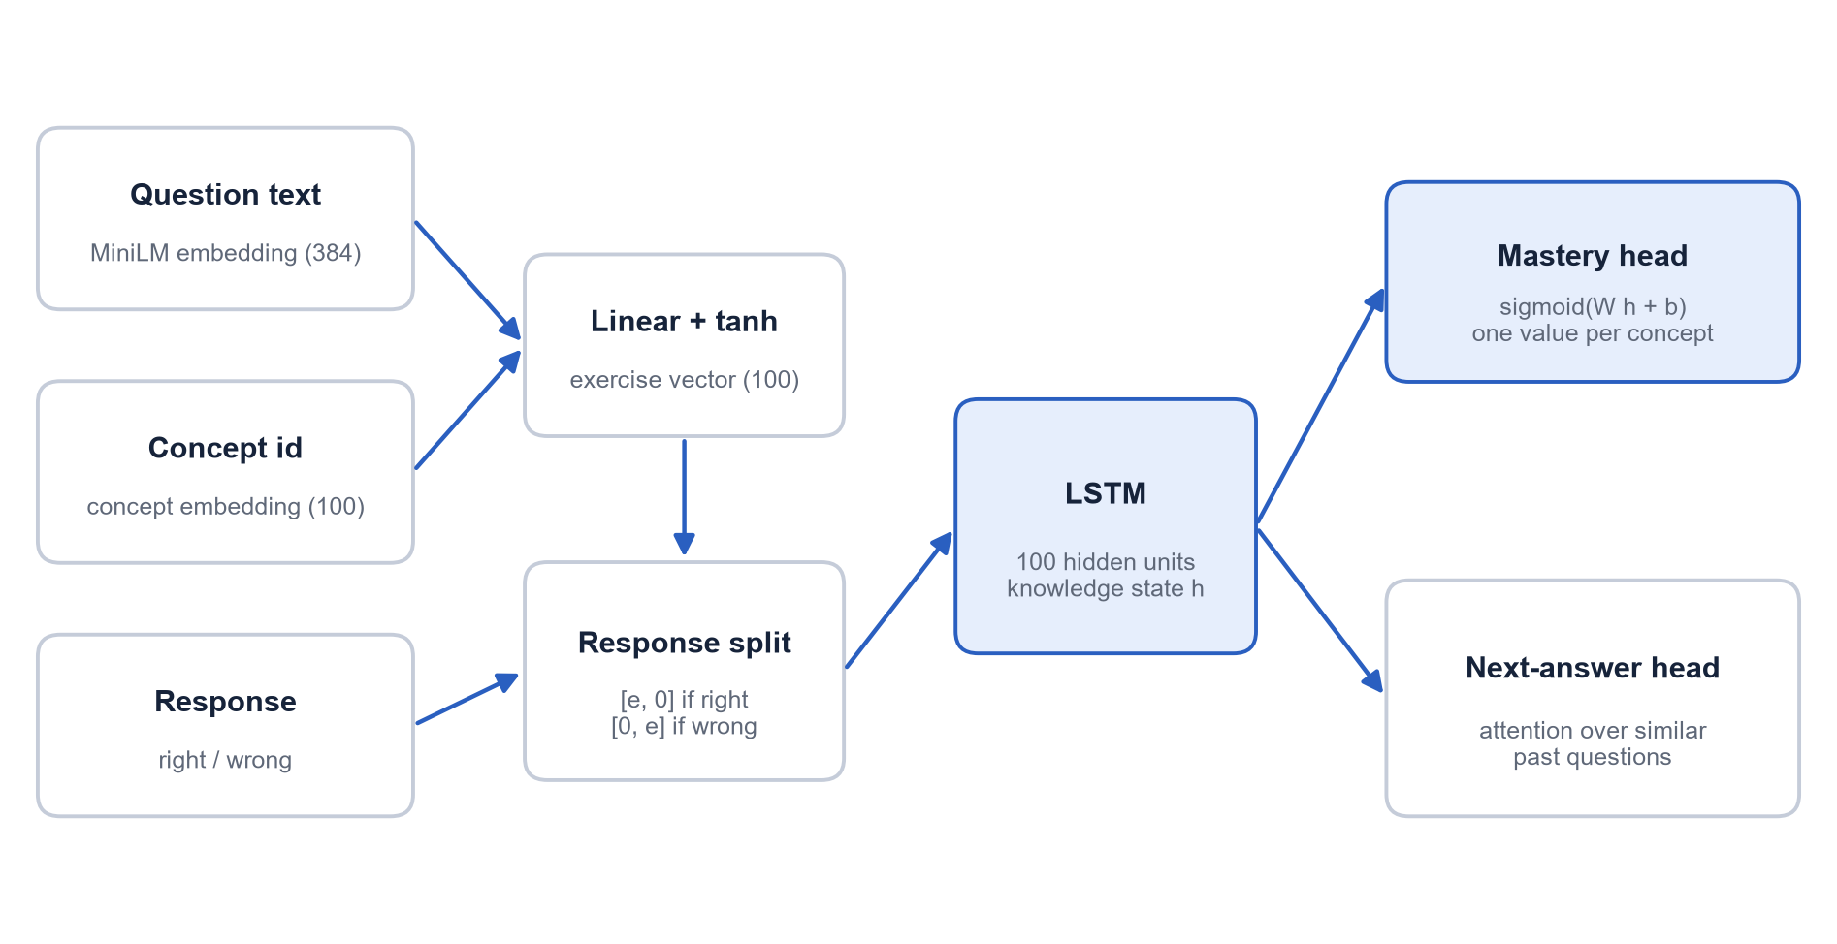
EKT reads the question, not only right or wrong
MODULE 4 · KNOWLEDGE TRACING (EKT)
Test AUC (higher is better)
0.827
EKT (ours): uses question text
0.665
DKT baseline: right/wrong only
600 learners · 24,000 answers · 12 epochs
Notes:
EKT embeds the text of each question, feeds it with the right/wrong answer into an LSTM, and outputs mastery for every concept. DKT, the baseline, only sees the concept and right/wrong. On our test set EKT reaches AUC 0.827 against 0.665 for DKT.

Slide 9
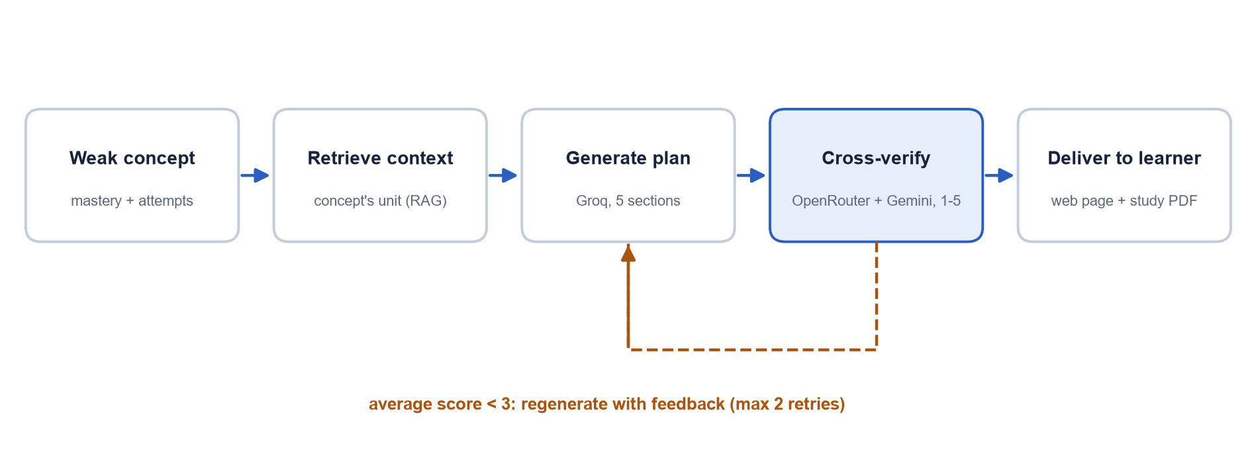
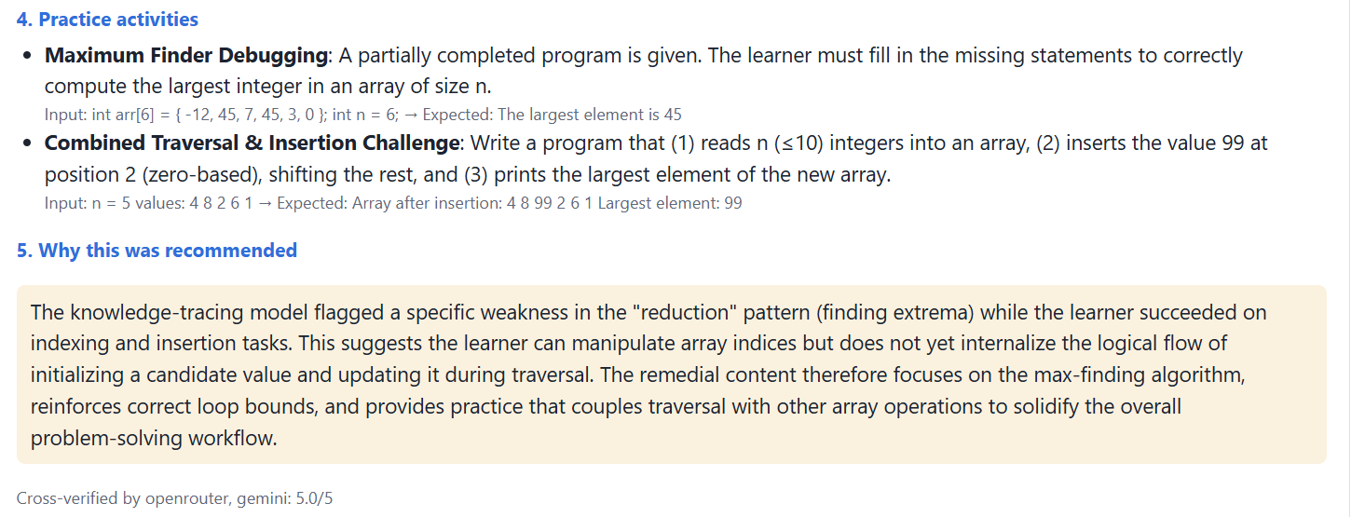
One writes, two verify
MODULE 5 · REMEDIAL RECOMMENDATION
Five sections of every plan
Learning objectives
Topics to revise
Explanation
Two practice activities
Why this was recommended
Real output
Plan written by Groq for a weak Arrays concept, then scored 5.0 / 5 by OpenRouter and Gemini.
Notes:
For each weak concept Groq writes a five-part plan from the syllabus and the questions the student got wrong. OpenRouter and Gemini each score it from 1 to 5; if the average is below 3 it is rewritten with their feedback, up to two times. Show the screenshot: this is what the student sees.

Slide 10
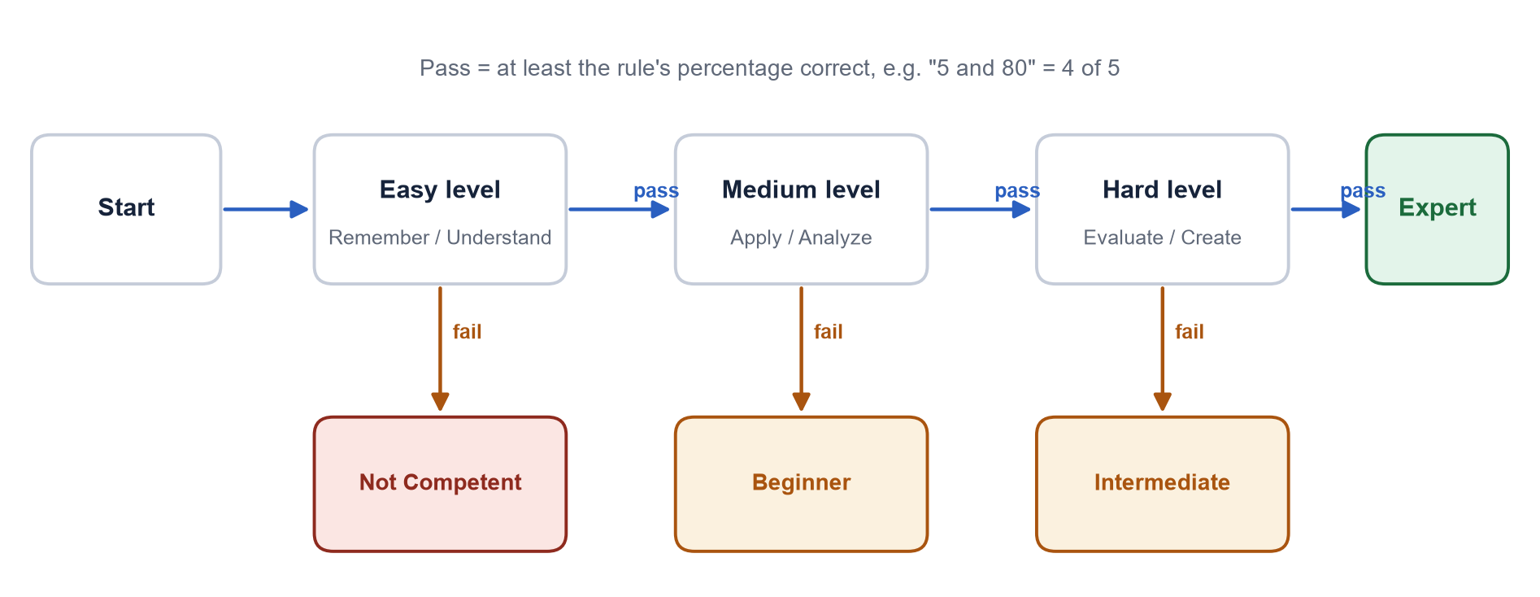
Easy, then Medium, then Hard, on weak concepts only
MODULE 6 · ADAPTIVE RE-TEST
Highest level passed | None | Easy | Medium | Hard
Category | Not Competent | Beginner | Intermediate | Expert
Rule “N and P”: e.g. “5 and 80” for a core course, “1 and 100” for an optional course
Notes:
The instructor sets the rule as N and P: N questions per level, P percent to pass. With 5 and 80, the student needs 4 of 5 to unlock the next level. The highest level passed gives the category. Questions already seen are never repeated.

Slide 11
What we added on top of the paper
BASE PAPER VS OUR PROJECT
Feature | Base paper | Our project
AI models | Paid: OpenAI, Gemini, DeepSeek | Free: Groq writes, OpenRouter + Gemini verify
When the AI fails or is busy | Not described | Pacing, retry, switch-off, offline mock
Retrieval | Fixed chunks | Unit-aware: always the concept's own unit
EKT mastery | Next-answer loss only | Extra mastery loss: values rise when correct
Student take-away | On-screen plan | Personal study PDF of own gaps
Interfaces | In-house LMS | Web app, REST API, command line
Testing | Not described | 36 automated tests, no API cost
Notes:
The orange column is ours. Walk through each row. The study PDF, free models with automatic fallback, unit-aware retrieval and calibrated mastery are not in the base paper.

Slide 12
Free tiers have limits, so we built a safety layer
ADDITION 1 · FREE AI THAT KEEPS WORKING
1
2
3
4
Pacing
Retry
Circuit breaker
Offline mock
max requests per minute: Gemini 8, Groq 25, OpenRouter 15
on 429 / 502 / 503 / 504, wait as the server suggests
on 401 / 402 / 404, or 3 rate limits in a row: stop calling
same JSON answer format, so the app never stops
python -m plrs models
Lists the models each key can use and warns when the configured one has been retired, which is how we fixed the Groq and OpenRouter 404 errors.
Notes:
Free APIs limit requests per minute, are sometimes overloaded (503), and retire model names (404). Every call goes through four steps: pacing, retry with the server's suggested wait, a circuit breaker that switches a failing provider off, and an offline mock so the app never crashes. The models command lists valid model names for each key.

Slide 13
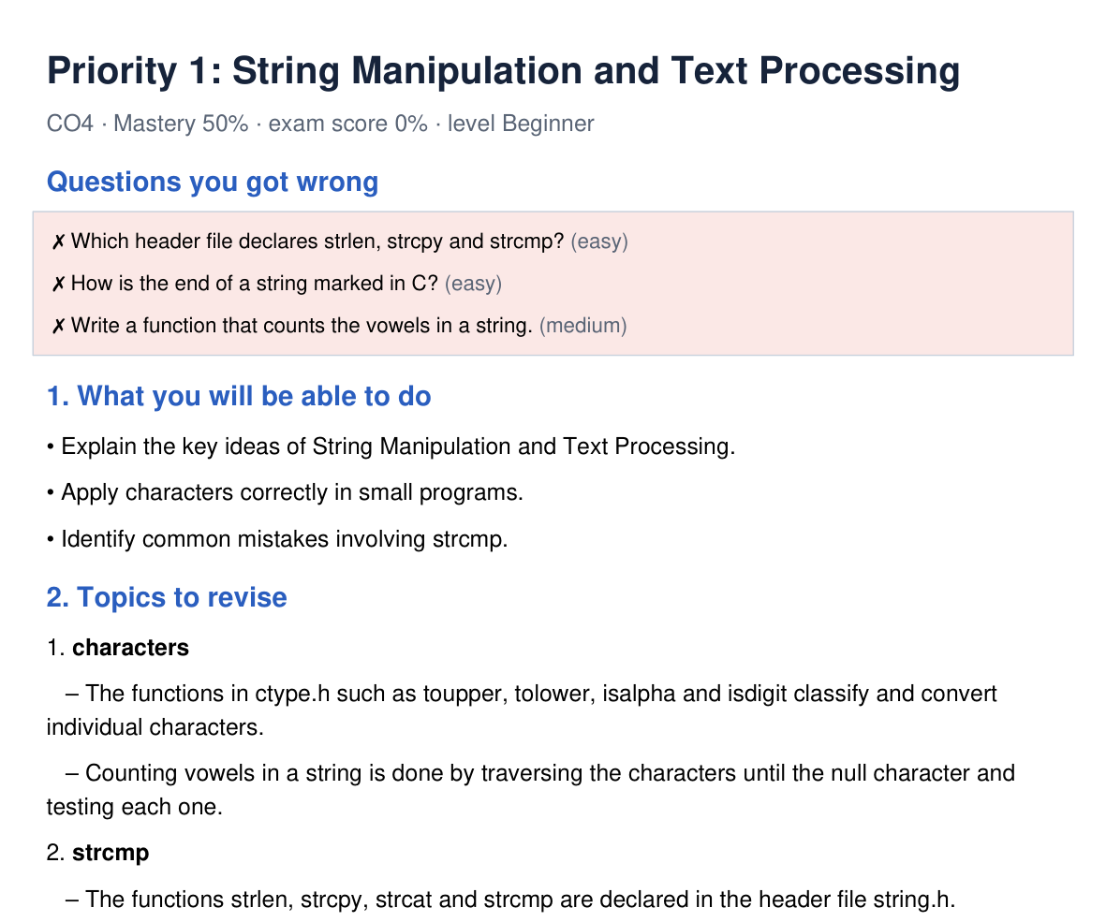
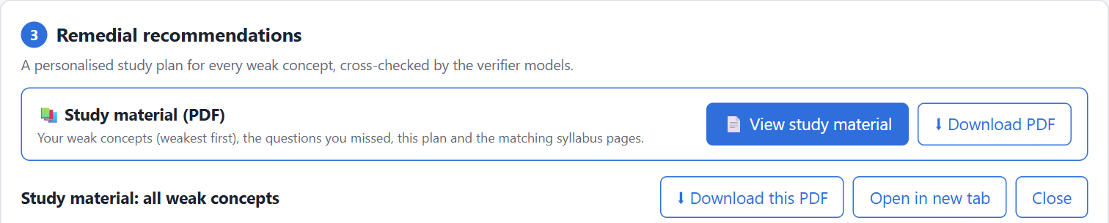
Every student gets material they can keep
ADDITION 2 · PERSONAL STUDY PDF
What is inside
Knowledge state of every concept
Questions the student got wrong
The five-part plan, weakest concept first
The concept's own syllabus pages (RAG)
A tick-box self-check before the re-test
No extra AI calls: built from the plan already shown
Notes:
Students asked for something to study from after the screen is closed. The PDF has only their weak concepts, weakest first: the questions they got wrong, the five-part plan, the matching syllabus pages from RAG and a self-check list. It reuses the plan already generated, so it costs no extra AI calls. Show it live if possible: View study material.

Slide 14
Content stays on topic; mastery means something
ADDITION 3 · BETTER RETRIEVAL AND MASTERY
Calibrated EKT mastery
Problem: mastery stayed near 50% for every concept
Fix: an extra loss trains the mastery output on the next answer of the same concept
Result: mastery rises after correct answers, so the 70% gap rule works
Chunk size 1000 characters; measured on the C programming syllabus
Notes:
Left: with the paper's fixed 1000-character chunks only 38% of retrieved text belonged to the right unit; our unit-aware retrieval gets 100%. Right: with only the next-answer loss, EKT mastery stayed near 0.5 for every concept; our extra mastery loss makes it rise when the student answers correctly, so gaps can be found reliably.

Slide 15
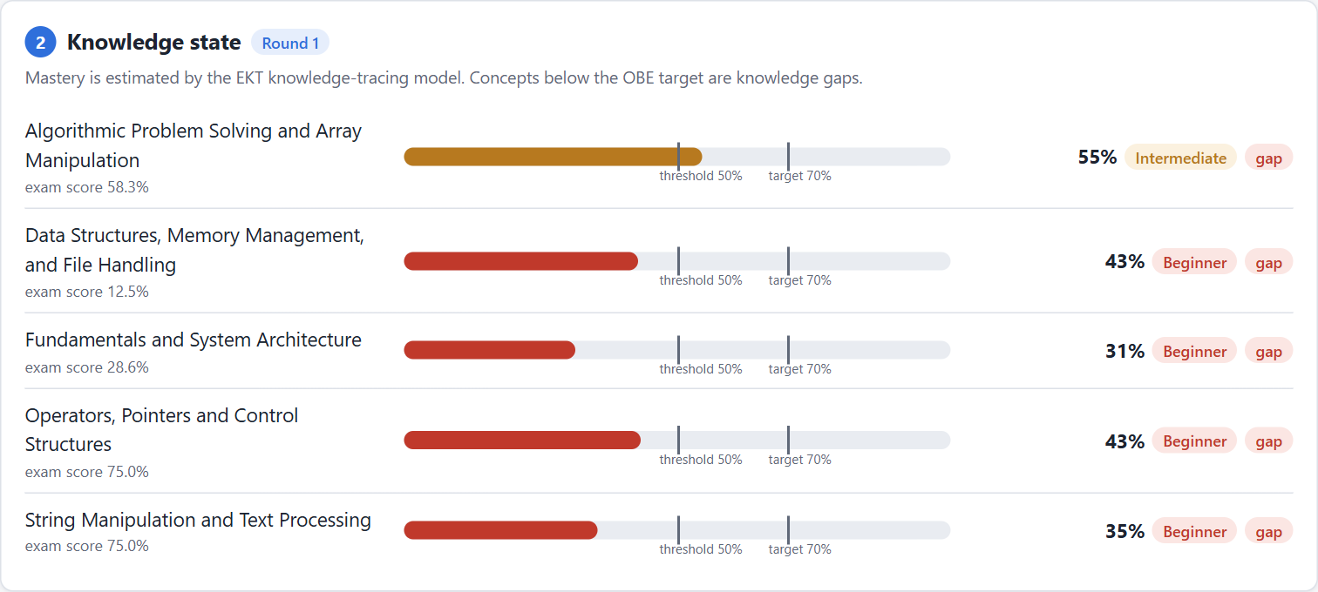
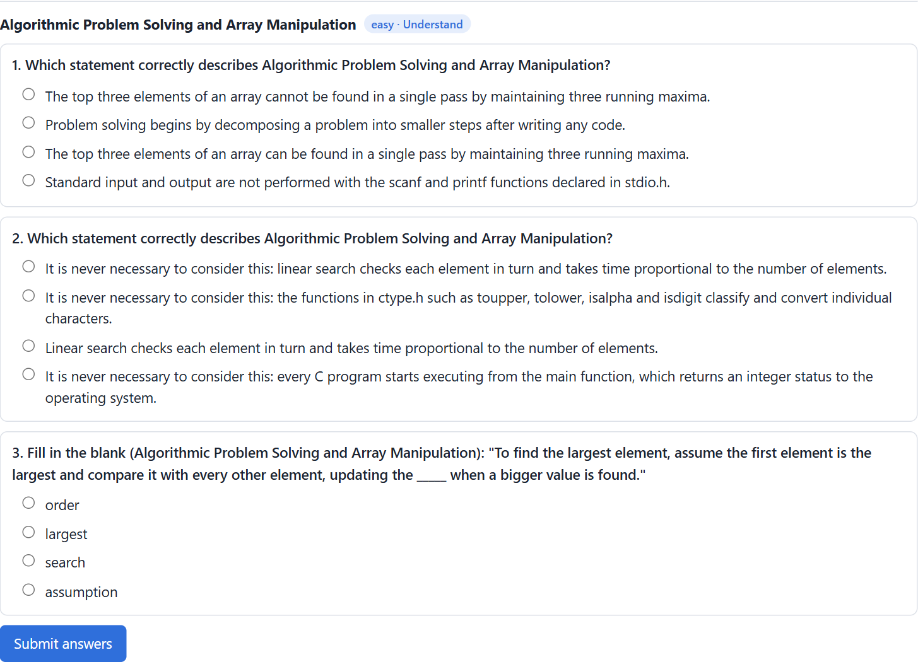
Run with python -m plrs serve
LIVE DEMO
1
Upload a CSV
2
Analyse
3
Read the plan
4
View study PDF
5
Take the re-test
Notes:
Demo order: 1) upload sample_uploads/1_single_student_weak_in_strings.csv; 2) Analyse - show the mastery bars; 3) open the recommendation; 4) View study material; 5) Start self-assessment. If the network fails, the offline mock still works.

Slide 16
EKT beats the DKT baseline on every metric
RESULTS · KNOWLEDGE TRACING
Set-up
600 simulated learners, 24,000 answers
75 / 25 split of learners
12 epochs, Adam, learning rate 0.001
Paper (real data): EKT AUC 0.9334
Notes:
Same data and settings for both models; the only difference is that EKT reads the question text. Higher is better for AUC, accuracy and F1. The paper reports 0.9334 on real data; ours is lower because of different, synthetic data, but the ranking EKT > DKT is the same.

Slide 17
Scores rose on all five concepts
RESULTS · BEFORE AND AFTER REMEDIATION
+38.7%
largest gain: Strings (66.7 → 92.5)
3 of 5
concepts significant at p < 0.05
Students and the study effect are simulated; a real class is future work.
Notes:
30 simulated students took a pre-test, received recommendations, and took a post-test. Mean scores rose on all five concepts; the paired t-test is significant (p < 0.05) for Fundamentals, Strings and Data structures. Say clearly that the students and the study effect are simulated.

Slide 18
Remediation closes gaps faster
RESULTS · THE FULL LOOP
38 / 40
27 / 40
Closed-loop simulation: 40 students who all start with gaps. One round = plan + study + adaptive re-test.
students with no gaps after one round, with remediation
without remediation
Case study: learner CSE230001, EKT mastery
Concept | Round 1 | Round 2 | Target 70% reached
Fundamentals | 31% | 79% | Yes
Operators | 43% | 75% | Yes
Arrays | 55% | 85% | Yes
Strings | 35% | 74% | Yes
Data structures | 43% | 90% | Yes
Notes:
Closed-loop simulation with 40 students who all start with gaps. With remediation, 38 of 40 had no gaps after one round; without remediation only 27 of 40. The case study: learner CSE230001 had all five concepts below target and reached the target on all five after one round.

Slide 19
What remains to be done
LIMITATIONS AND FUTURE SCOPE
Limitations
Students are simulated, not a real class
Question quality with the free models not yet measured
Free tiers limit requests per minute
Generated content still needs a teacher's check
Only multiple-choice questions
Future scope
Pilot with a real class and real pre/post tests
Feedback based on the wrong option a student chose
Teacher dashboard and LMS (Moodle) plug-in
Descriptive and coding questions
Study material in regional languages
Notes:
Be open about limitations; panels respect it. The most important future step is a pilot with a real class.

Slide 20
From marks to mastery, automatically, at no cost
CONCLUSION
1
2
3
Complete implementation
Better than the baseline
Our additions
All six modules of the base paper, working end to end, with web app, API and 36 tests
EKT AUC 0.827 vs DKT 0.665; scores rose on all five concepts after remediation
Free AI with automatic fallback, unit-aware retrieval, calibrated mastery and a personal study PDF
Notes:
Summarise in three points, then thank the panel.

Slide 21
Thank you
Questions are welcome
Notes:
Likely questions: why three AI models; what if the API fails; is the study PDF in the paper (no, it is ours); why simulated students; EKT vs DKT.

