Slide 1
AI-Driven Personalized Learning and Remedial Recommendation Through Knowledge Concept-Centric Evaluation
FIRST REVIEW · FINAL-YEAR PROJECT
Find each student's weak concepts, explain them, and re-test until the course outcome is reached
Team: [Student Name 1] ([Roll No.]) | [Student Name 2] ([Roll No.]) | [Student Name 3] ([Roll No.])
Guide: [Guide Name], [Designation]
[Department of Computer Science and Engineering] · [College Name] · [2025–2026]
Notes:
Introduce the team and guide. One line on the project: we find exactly which concepts each student is weak in, give them personal study material, and re-test them with fresh questions until they reach the course target. Replace the bracketed placeholders before the review.

Slide 2
What we will cover
AGENDA
1
2
3
4
Introduction
Base paper
Problem statement
Existing system
5
6
7
8
Literature survey & gap
Objectives
Proposed system & our additions
Requirements & plan
Notes:
Eight parts. The orange card (7) is where we show what our project adds on top of the base paper.

Slide 3
One total mark hides what a student does not understand
INTRODUCTION
Personalized learning
Adapts study material, practice and tests to what each student already knows
Outcome-Based Education (OBE): every course outcome has a threshold (50%) and a target (70%)
Our idea: measure every concept separately, then fix only the weak ones with AI-generated help
Same student, total mark 60%
Arrays
90%
Strings
60%
50%
70%
Pointers
30%
OBE threshold: below it, a concept is not attained
OBE target: below it, a concept is a gap
The weak concept (pointers) is invisible in the total mark.
Notes:
Personalized learning means each student studies what they personally need. In Outcome-Based Education each course outcome has a threshold (50%) and a target (70%). The example on the right: a student scoring 60% overall can have mastered arrays but know almost nothing about pointers. A single mark cannot show that; our system measures each concept separately.

Slide 4
Our project is built on an IEEE Access 2025 paper
BASE PAPER
What the paper proposes
“AI-Driven Personalized Learning and Remedial Recommendation Through Knowledge Concept-Centric Evaluation”
N. Pradeesh, M. G. Thushara, K. Arun Krishna, V. Pranav, S. Krishnamoorthy
IEEE Access, vol. 13, pp. 207817–207837, 2025
DOI: 10.1109/ACCESS.2025.3638427
1
Curriculum RAG
syllabus → chunks → vector database
2
Concept extraction
one concept per unit, mapped to a CO
3
Knowledge tracing (EKT)
mastery of every concept
4
Remedial recommendation
OpenAI writes; Gemini, DeepSeek verify
1,276
382
0.933
5
MCQ generation
3× generation, de-duplication at 0.85
learners (real LMS data)
concepts
EKT AUC reported
6
Adaptive evaluation
Easy → Medium → Hard
Notes:
Read out the title and venue. Explain that the paper proposes the framework: six modules in one loop, tested on real data from an in-house LMS. They used paid models: OpenAI to generate, Gemini and DeepSeek to verify. Their EKT model reached an AUC of 0.9334. We implement the full framework ourselves and add the improvements shown later.

Slide 5
Marks tell how much, not what was missed
PROBLEM STATEMENT
1
2
3
Problem
Impact
Need
Every student gets the same material and the same test, and one total mark that does not show which concepts were missed.
Weak concepts stay hidden and carry into later topics. Mistakes repeat. Teachers cannot write personal material for 60+ students.
A system that finds each student's weak concepts automatically, gives targeted help, and re-tests with new questions.
Notes:
Three cards: the problem, its impact on students and teachers, and what is needed. The need is exactly what our system does.

Slide 6
Today: same content, same test, one number
EXISTING SYSTEM
Same material
Same test
Total mark
Generic feedback
Limitations
Marks do not show which concept is weak
Personal material is too slow to prepare by hand
Re-tests repeat the same questions
No continuous tracking of each student's knowledge
Typical feedback today
“Revise chapter 3.”
It does not say which concept inside chapter 3 was missed.
Notes:
Walk through the four boxes from left to right. Then the limitations: no concept-level view, no personal material, re-tests repeat questions, and nothing tracks progress over time.

Slide 7
What earlier work does, and what it leaves out
LITERATURE SURVEY
Work | Approach | Strength | Limitation
Corbett & Anderson, 1994 (BKT) | Hidden Markov model per skill | Simple, interpretable | One skill at a time
Piech et al., 2015 (DKT) | LSTM over (concept, right/wrong) | Learns from answer sequences | Ignores question text
Zhang et al., 2017 (DKVMN) | Key-value memory per concept | Readable concept state | No exercise content
Liu et al., 2021 (EKT) | Question text + LSTM + attention | Uses what was asked | Needs exercise text
Lewis et al., 2020 (RAG) | Retrieve, then generate | Grounded, fewer hallucinations | Not built for assessment
Hang et al., 2024 (MCQGen) | LLM-driven question generator | Personalized questions | No knowledge tracing loop
Pradeesh et al., 2025 (base) | All modules in one OBE loop | End to end, real classroom | Paid APIs; nothing to keep
Notes:
Knowledge tracing went from BKT to DKT, DKVMN and EKT; EKT is the only one that reads the question text, which is why the base paper and we use it. RAG grounds generated text in a document. MCQGen shows LLMs can write personalized questions. The base paper puts these together; its gaps are paid APIs and no study material the student can keep.

Slide 8
The pieces exist, but rarely in one working loop
RESEARCH GAP
Knowledge tracing
The gap we address
No single affordable system links tracing, question generation and remediation in one loop
Generated content is rarely checked by independent models
Students get feedback on screen but no material they can keep
Most systems need paid AI services
Question generation
Remedial content
Adaptive testing
Notes:
Each research area on the left is usually studied on its own. The gap: one working, affordable system that links them, ties them to OBE targets, and gives the student something to study from. That is what we build.

Slide 9
What the project will deliver
OBJECTIVES
1
Extract concepts and course outcomes from the syllabus
5
Write cross-verified remedial plans for each weak concept
2
Build a RAG knowledge base (embeddings + vector database)
6
Generate new, de-duplicated MCQs by difficulty and Bloom level
3
Estimate concept mastery with EKT; compare with DKT
7
Re-test adaptively (Easy → Medium → Hard) and track progress
4
Detect weak concepts with the OBE threshold and target
8
Add a personal study PDF and run on free AI models
Notes:
Eight objectives. 1 to 7 follow the base paper; 8 is our own: a personal study PDF and free AI models.

Slide 10
A closed loop from exam marks to mastery
PROPOSED SYSTEM
Exam answers
marks per question
How it works
Teacher uploads the syllabus once and the exam results
Each student gets mastery per concept, not one mark
AI content is written only from the syllabus and checked by two other models
New answers update the student's knowledge state
Adaptive re-test
Easy → Medium → Hard
Knowledge tracing
EKT mastery per concept
repeat until every concept reaches the target
New questions
from the syllabus (RAG)
Find gaps
mastery below 70%
Remedial plan + PDF
written by AI, verified
Notes:
Go around the loop: marks come in; EKT estimates mastery per concept; concepts below 70% are gaps; the AI writes a plan and a study PDF; new questions are generated; the adaptive re-test produces new answers, which go back into EKT. The loop repeats until every concept reaches the target.

Slide 11
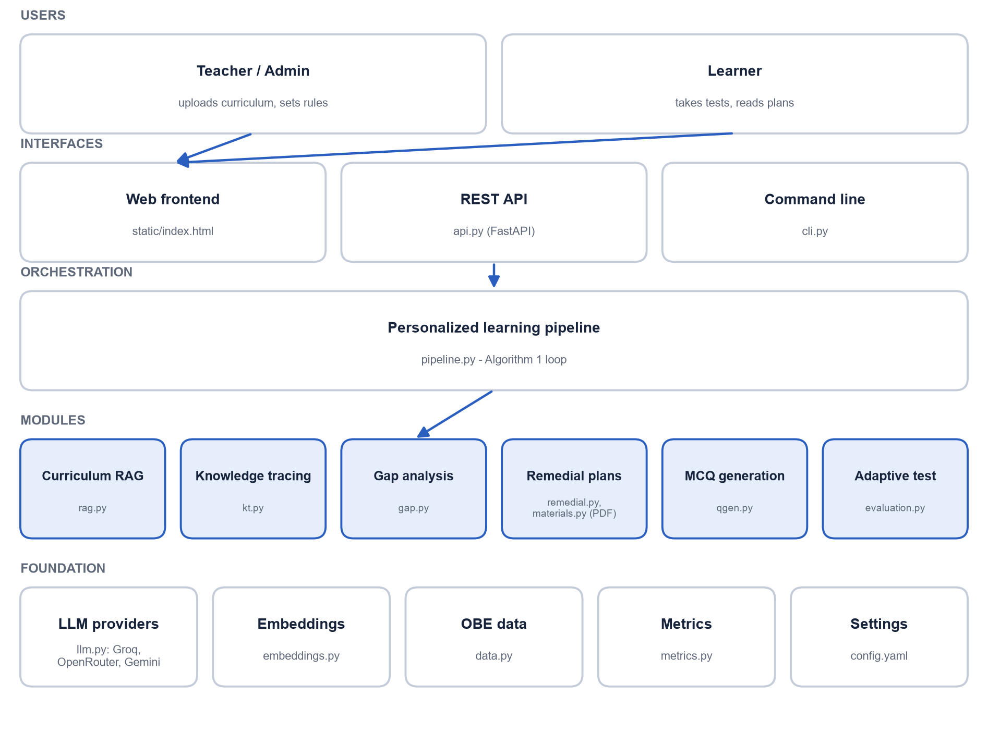
Five layers, six modules
SYSTEM ARCHITECTURE
Workflow
Syllabus is chunked, embedded and stored in a FAISS vector database
EKT estimates mastery for every concept
Gaps get a five-part plan and a study PDF
Groq writes; OpenRouter and Gemini verify (all free)
Adaptive re-test answers feed back into EKT
Notes:
Users reach the system through a web page, a REST API or the command line. The pipeline runs the six modules in order. The foundation layer holds the AI providers, embeddings, data and settings.

Slide 12
What our project adds
BEYOND THE BASE PAPER
1
Free AI models
2
Reliable on free tiers
3
Unit-aware retrieval
Groq writes; OpenRouter and Gemini verify. The paper used paid OpenAI and DeepSeek.
Request pacing, automatic retry, and an offline fallback so the app never stops.
Questions and plans use only the concept's own syllabus unit.
4
Meaningful mastery
5
Personal study PDF
6
Web app, API and tests
An extra training loss so EKT mastery rises when a student answers correctly.
Missed questions, the plan and the matching syllabus pages, weakest concept first.
Single-page web app, REST API, command line and automated tests.
Notes:
This is the most important slide for the panel. The base paper is the starting point; these six things are ours. 1: free models instead of paid OpenAI and DeepSeek. 2: the system keeps working when free limits are hit. 3: questions always come from the right unit of the syllabus. 4: EKT mastery values are meaningful. 5: every student can keep a personal study PDF. 6: a full web app with tests.

Slide 13
Runs on an ordinary laptop, free of cost
REQUIREMENTS
Hardware
Any 64-bit CPU (no GPU)
8 GB RAM
3 GB free disk
Internet only for the AI models
Software
Windows / Linux / macOS
Python 3.10+
Any modern browser
Free API keys: Groq, OpenRouter, Gemini
Technologies
PyTorch (EKT, DKT)
sentence-transformers + FAISS
FastAPI + HTML/JS
reportlab (study PDF)
pytest
Notes:
No GPU and no paid service are needed. The AI keys are free tiers; without keys an offline mode still runs everything.

Slide 14
Six phases over thirteen weeks
PROJECT PLAN
W1
W2
W3
W4
W5
W6
W7
W8
W9
W10
W11
W12
W13
Phase 1 Literature study and requirements
Phase 2 Data, RAG and concept extraction
Phase 3 Knowledge tracing (EKT, DKT)
Phase 4 MCQ generation and remedial plans
Phase 5 Adaptive test, web app, study PDF
Phase 6 Testing, evaluation and report
Milestones: First review after phase 2 · Second review after phase 4 · Final review after phase 6
Notes:
Point at where we are today: phases 1 and 2 are done for this first review. The second review comes after phase 4 and the final review after phase 6.

Slide 15
Thank you
Questions and suggestions are welcome
Notes:
Invite questions. Likely ones: why EKT and not DKT; why three AI models; what is new compared to the base paper (slide 12).

