Slide 1
FIRST REVIEW
AI-Driven Personalized Learning and Remedial Recommendation Through Knowledge Concept-Centric Evaluation
Concept-level knowledge tracing, RAG question generation and AI remedial learning in one loop
TEAM MEMBERS
PROJECT GUIDE
[Student Name 1] · [Roll No.]
[Student Name 2] · [Roll No.]
[Student Name 3] · [Roll No.]
[Guide Name], [Designation]
Base paper: Pradeesh et al., IEEE Access, vol. 13, 2025 (DOI 10.1109/ACCESS.2025.3638427)
Department of Computer Science and Engineering · [College Name] · [2025–2026]
Notes:
Introduce the team and guide. One sentence: we identify each student's weak concepts and give them a personalised study plan and new questions until they reach the target.

Slide 2
FIRST REVIEW
Agenda
1
Introduction
8
Proposed Methodology
2
Problem Statement
9
System Architecture
3
Motivation
10
Technologies Used
4
Literature Survey & Research Gap
11
Expected Results
5
Existing System
12
Project Timeline
6
Proposed System
13
Conclusion & References
7
Objectives
Notes:
Walk through the order of the presentation.

Slide 3
INTRODUCTION
A total mark hides what a student still doesn't understand
Project background
One score can hide very different gaps
Most courses give every student the same material, the same test and one total mark.
Outcome-Based Education (OBE) asks for measurable attainment of each course outcome, not just a total.
Generative AI and knowledge tracing now make concept-level support possible at class scale.
Arrays
90% concept mastery
Pointers
30% concept mastery
Strings
What is personalized learning?
75% concept mastery
Adapting content, practice and assessment to each learner's current knowledge, so that time is spent on the concepts the learner has not yet mastered.
Files
45% concept mastery
Average: 60%, yet two concepts are clearly weak
First Review · AI-Driven Personalized Learning and Remedial Recommendation
3
Notes:
Explain the idea of concept-level evaluation with the illustrative bars on the right: the average hides the weak concepts. (Illustrative values, not results.)

Slide 4
PROBLEM
Problem statement
1
Existing learning challenges
2
Impact on students
3
Need for personalization
Same content and test for every learner
Total marks hide weak concepts
Re-tests repeat the same questions
Gaps carry into later topics
Mistakes repeat without targeted help
Teachers cannot write material for every student
Find gaps at the concept level
Give a plan for each weak concept
Re-assess with new questions until the target is met
Problem: build an intelligent system that identifies knowledge gaps at the concept level, recommends personalized remedial learning, re-assesses the learner with new questions and repeats until the required level of competency is reached.
First Review · AI-Driven Personalized Learning and Remedial Recommendation
4
Notes:
Read the problem statement at the bottom; the three cards explain why it matters.

Slide 5
MOTIVATION
Motivation
?
Why personalized learning?
AI
Why AI-based remedial learning?
Students learn at different speeds and have different gaps.
A 60% score can hide a complete lack of understanding of one concept.
OBE requires every course outcome to be attained, not just a pass mark.
Supports SDG 4: inclusive, quality education for all.
Knowledge tracing estimates mastery after every answer, continuously.
Generative AI can write explanations and practice for each weak concept.
RAG keeps all generated content inside the course syllabus.
Automation removes the manual effort that makes personalization impractical.
First Review · AI-Driven Personalized Learning and Remedial Recommendation
5
Notes:
Left: the educational reason. Right: why AI makes it feasible now.

Slide 6
LITERATURE SURVEY
Literature survey
Work | Contribution | Limitation
BKT – Corbett & Anderson (1994) | Hidden mastery state per concept (HMM) | One concept at a time, no exercise text
DKT – Piech et al. (NeurIPS 2015) | RNN over (concept, correct) sequences | Ignores exercise text; mastery hard to read
DKVMN – Zhang et al. (WWW 2017) | Key–value memory per concept | Does not use exercise text
EKT – Liu et al. (IEEE TKDE 2021) | Exercise text + LSTM + attention | Needs exercise text
RAG – Lewis et al. (NeurIPS 2020) | Generation grounded in retrieved documents | General purpose, not education-specific
MCQGen – Hang et al. (IEEE Access 2024) | LLM + RAG multiple-choice questions | No knowledge tracing or remediation
Pradeesh et al. (IEEE Access 2025) | EKT + RAG + GenAI in an OBE loop | Base paper for this project
First Review · AI-Driven Personalized Learning and Remedial Recommendation
6
Notes:
Knowledge tracing has moved from BKT to deep models; EKT adds exercise text. RAG and MCQGen cover question generation. The base paper joins them.

Slide 7
LITERATURE SURVEY
Research gap
Adaptive assessment
tests that adjust difficulty
Question generation
LLM / RAG MCQs
Knowledge tracing
mastery per concept
Recommendation
learning resources
Studied mostly in isolation, rarely tied to OBE targets
THE GAP THIS PROJECT ADDRESSES
No single working system links knowledge tracing, RAG question generation and remedial content in one loop.
Generated remedial content is rarely cross-verified by a second AI model before reaching students.
Few implementations can be run and tested end to end, with or without paid AI services.
First Review · AI-Driven Personalized Learning and Remedial Recommendation
7
Notes:
The gap: integration plus verification plus a reproducible implementation.

Slide 8
EXISTING SYSTEM
Existing system
Current approach
Limitations
Same material
Same test
Total marks
Generic feedback
Same content regardless of each learner's understanding
Marks do not reveal weak concepts
Manual personalization is too time-consuming for teachers
No continuous tracking of progress
No targeted remediation; re-tests reuse the same questions
Example feedback: “revise chapter 3”, with no indication of which concept inside the chapter was missed.
RESULT
The learner gets a number, not a diagnosis, and the teacher has no concept-level view of the class.
First Review · AI-Driven Personalized Learning and Remedial Recommendation
8
Notes:
Contrast this one-shot process with the loop on the next slide.

Slide 9
PROPOSED SYSTEM
Proposed system: a closed learning loop
Proposed solution
Knowledge tracing
mastery per concept
Replace the single mark with a concept-level knowledge state, and repeat assessment → remediation → re-assessment until every concept reaches the OBE target.
Adaptive re-test
Easy → Medium → Hard
Gap analysis
below 70% target
Key features
Until
target met
Concepts extracted automatically from the syllabus
Syllabus-grounded MCQs at chosen difficulty and Bloom level
Exercise-aware Knowledge Tracing (EKT) for mastery
Five-part remedial plan, cross-verified by a second model
Adaptive Easy → Medium → Hard re-test
New MCQs
RAG, de-duplicated
Remedial plan
five parts, verified
First Review · AI-Driven Personalized Learning and Remedial Recommendation
9
Notes:
Left: what the system does. Right: the loop that repeats until every concept meets the target.

Slide 10
OBJECTIVES
Objectives
Project goals
EXPECTED OUTCOMES
1
Extract concepts and course outcomes from the curriculum
A working web application, REST API and CLI
A concept-wise knowledge report for each learner
Higher mastery after remediation (pre vs post)
Less manual effort for teachers
2
Build a RAG knowledge base with embeddings and a vector database
3
Generate concept-aligned MCQs by difficulty and Bloom level
4
Estimate concept mastery with EKT; compare with a DKT baseline
5
Detect weak concepts using the OBE threshold and target
6
Generate cross-verified personalized remedial plans
7
Re-assess adaptively and track improvement statistically
First Review · AI-Driven Personalized Learning and Remedial Recommendation
10
Notes:
Seven goals map one-to-one to modules in the methodology.

Slide 11
METHODOLOGY
Proposed methodology
Concept extraction
syllabus → concepts + COs
RAG
chunks · embeddings · vector DB
MCQ generation
difficulty + Bloom level
Knowledge tracing
EKT mastery per concept
Remedial recommendation
five-part plan + re-test
repeat until every concept reaches the target
Inputs
Processing
Outputs
Course curriculum (PDF / text)
Learners' OBE exam results (CSV)
Gap = mastery below the 70% target
Content generated only from retrieved syllabus text
Mastery report per concept
Study plan + new questions per gap
First Review · AI-Driven Personalized Learning and Remedial Recommendation
11
Notes:
Five modules; the loop closes when re-test answers are fed back into knowledge tracing.

Slide 12
METHODOLOGY
Methodology: concept extraction, RAG and MCQ generation
1
Concept extraction
2
Retrieval-Augmented Generation
3
MCQ generation
Read the syllabus PDF (pypdf)
Split by unit: one concept and course outcome per unit
Teacher reviews the extracted concepts
~1000-character chunks, 100 overlap
MiniLM sentence embeddings (384-d)
FAISS vector database
Top-4 chunks retrieved per concept
LLM writes 4-option MCQs from retrieved text only
Easy = Remember/Understand
Medium = Apply/Analyze; Hard = Evaluate/Create
Duplicates removed (cosine > 0.85)
Second model verifies each question
Every question is written only from retrieved syllabus text, so content stays inside the course and duplicates or off-level questions are filtered before students see them.
First Review · AI-Driven Personalized Learning and Remedial Recommendation
12
Notes:
RAG grounds every question in the syllabus, which limits hallucination.

Slide 13
METHODOLOGY
Methodology: knowledge tracing and remedial recommendation
1
Knowledge tracing (EKT)
2
Gap identification
3
Remedial loop
Input: question text + right/wrong
LSTM (100 units) tracks knowledge over time
Outputs mastery (0–1) for every concept
Baseline: DKT without question text
OBE threshold 50%, target 70%
Below 50%: Beginner (gap)
50–70%: Intermediate (gap)
70% and above: Expert (no gap)
Plan: objectives, topics, explanation, 2 practice tasks, rationale
Adaptive re-test Easy → Medium → Hard (“5 and 80” rule)
Answers go back to EKT; repeat until target
Gaps are decided from EKT mastery, not the raw score, so one lucky or unlucky answer does not decide what a learner studies next.
First Review · AI-Driven Personalized Learning and Remedial Recommendation
13
Notes:
The “5 and 80” rule: 5 questions per level, 80% to pass.

Slide 14
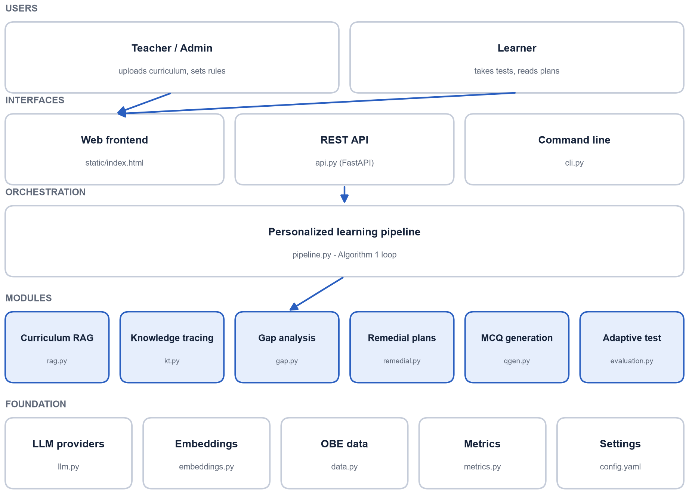
ARCHITECTURE
System architecture
Overall workflow
1. Teacher uploads the curriculum and exam results
2. Curriculum is chunked, embedded and indexed
3. EKT estimates mastery for each learner
4. Weak concepts receive a remedial plan
5. New questions are generated and verified
6. Learner takes the adaptive re-test
7. Results update the knowledge state
First Review · AI-Driven Personalized Learning and Remedial Recommendation
14
Notes:
Layers from top: users, interfaces, pipeline, six modules, shared foundation.

Slide 15
TECHNOLOGIES
Technologies used
1
AI / ML
2
Retrieval
PyTorch: EKT and DKT models
sentence-transformers: MiniLM embeddings
LLMs: OpenAI, Gemini, DeepSeek (or offline mock)
FAISS vector index
pypdf for PDF text extraction
NumPy for vectors
3
Backend
4
Frontend & storage
Python 3.13
FastAPI + Uvicorn REST API
Command-line interface
HTML, CSS, JavaScript single page
JSON / CSV / NumPy files (no SQL database)
pytest for automated tests
First Review · AI-Driven Personalized Learning and Remedial Recommendation
15
Notes:
Everything is open source and runs on a laptop CPU.

Slide 16
EXPECTED RESULTS
Expected results
Personalized recommendations
Improved concept mastery
A study plan only for the concepts the learner is weak in
Explanations and practice written from the course's own material
A clear rationale: which answers revealed the gap
New, non-repeated questions for each re-test
Mastery rises above the 70% target after remediation
Pre-test vs post-test gains measured per concept (paired t-test)
EKT expected to predict answers better than the DKT baseline
Teachers see which concepts the whole class finds hard
First Review · AI-Driven Personalized Learning and Remedial Recommendation
16
Notes:
These are expected outcomes at proposal stage; actual results come in the final review.

Slide 17
PLAN
Project timeline
W1
W2
W3
W4
W5
W6
W7
W8
W9
W10
W11
W12
W13
Phase 1
Literature study and requirements
Phase 2
Data, RAG pipeline and concept extraction
Phase 3
Knowledge tracing (EKT, DKT)
Phase 4
MCQ generation and remedial module
Phase 5
Adaptive evaluation, web UI and API
Phase 6
Testing, evaluation and report
Milestones: First review after Phase 2 · Second review after Phase 4 · Final review after Phase 6
First Review · AI-Driven Personalized Learning and Remedial Recommendation
17
Notes:
Weeks are planned durations; adjust them to your semester calendar.

Slide 18
CONCLUSION
Conclusion
The project proposes a closed loop that finds each learner's weak concepts, explains them, and re-tests with new questions until the OBE target is met.
1
Proposed contribution
2
Concept-level insight
3
Trustworthy AI content
4
Practical for teachers
A complete, tested implementation of the base paper's loop
Mastery per concept instead of one total mark
RAG grounding plus cross-verification by a second model
Runs offline without paid APIs; web UI, REST API and CLI
Next: implement and evaluate the modules for the second and final reviews.
First Review · AI-Driven Personalized Learning and Remedial Recommendation
18

Slide 19
REFERENCES
References
[1] N. Pradeesh et al., “AI-Driven Personalized Learning and Remedial Recommendation Through Knowledge Concept-Centric Evaluation,” IEEE Access, vol. 13, pp. 207817–207837, 2025.
[2] Q. Liu et al., “EKT: Exercise-aware knowledge tracing for student performance prediction,” IEEE TKDE, vol. 33, no. 1, pp. 100–115, 2021.
[3] C. Piech et al., “Deep knowledge tracing,” in Proc. NeurIPS, 2015.
[4] J. Zhang et al., “Dynamic key-value memory networks for knowledge tracing,” in Proc. WWW, 2017.
[5] P. Lewis et al., “Retrieval-augmented generation for knowledge-intensive NLP tasks,” in Proc. NeurIPS, 2020.
[6] C. N. Hang, C. W. Tan and P.-D. Yu, “MCQGen: A large language model-driven MCQ generator for personalized learning,” IEEE Access, vol. 12, 2024.
[7] A. T. Corbett and J. R. Anderson, “Knowledge tracing: Modeling the acquisition of procedural knowledge,” UMUAI, vol. 4, 1994.
[8] L. W. Anderson and D. R. Krathwohl, A Taxonomy for Learning, Teaching, and Assessing. Longman, 2001.
First Review · AI-Driven Personalized Learning and Remedial Recommendation
19

Slide 20
Thank you
Questions and suggestions are welcome
First Review · AI-Driven Personalized Learning and Remedial Recommendation

