Slide 1


Department of Information Technology
V R Siddhartha Engineering College
HYBRID LLM-BASED GRAPH NEURAL NETWORK (GNN) AND GRAPH ATTENTION NETWORK (GAT) FRAMEWORK FOR FOOD DRUG INTERACTION PREDICTION Bachelor of Technology in Information Technology
Major Project Review Presentation
Presented by
Mr. M Mohan Bala Sahith (228W1A12A8)
Mr. P Nireekshana Pal (238W5A1215)
Under the guidance of
Dr. A Srisaila
Assistant Professor (Selection Grade)

Slide 2
AGENDA
Introduction and Problem statement
Objectives and Outcomes of the Project
Literature Review and Summary
Datasets and Requirements
Methodology and Algorithems involved
Architecture diagram
Implementation Steps and Execution
Result Obtained
Conclusion and Future work
References

Slide 3
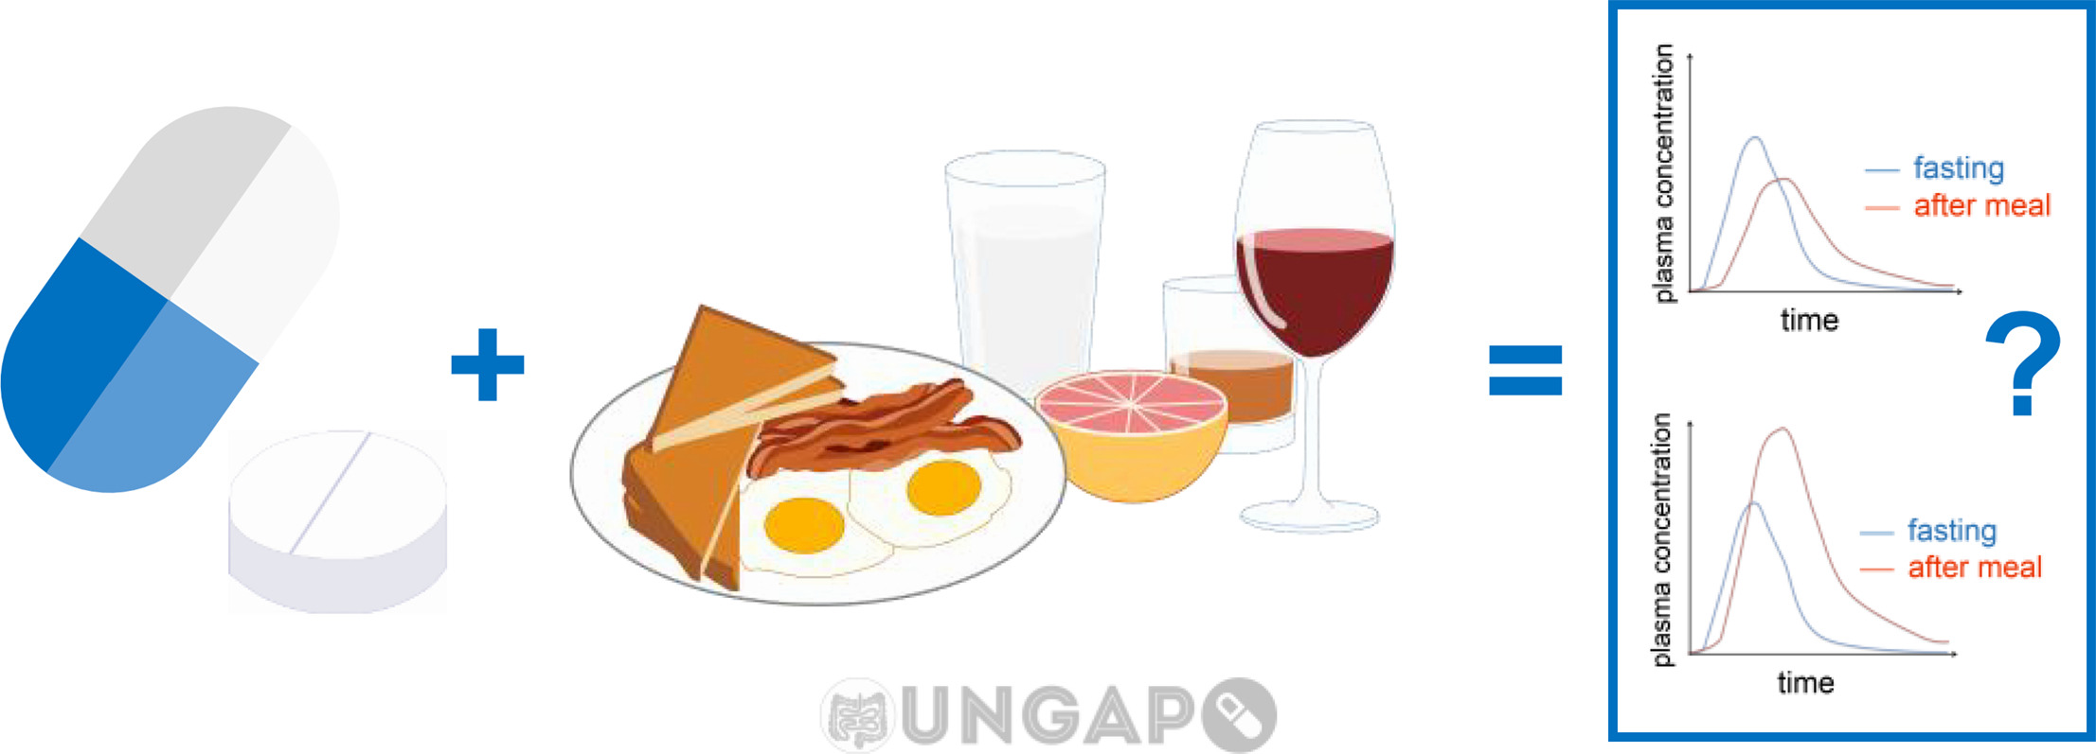
INTRODUCTION
Food–Drug Interactions (FDIs) can significantly alter drug absorption, metabolism, and overall effectiveness.
Many FDIs remain undetected due to limited clinical studies and small sample populations.
Experimental (wet-lab) detection methods are costly, time-consuming, and not scalable.
The growing number of drugs and dietary compounds makes exhaustive interaction testing practically infeasible.
There is a need for an intelligent, scalable, and attention-based computational framework to accurately predict potential FDIs.

Slide 4
PROBLEM STATEMENT
Due to the small numbers of participants in clinical studies, many FDIs remain undetected. Similarity-based computational methods struggle worth complex interactions.
Traditional Graph Neural Networks (GNNs) do not priorities pharmacologically relevant neighbors.
The research gap consists of a lack of frameworks that combine molecular representation learning with graph structural context in a focused manner.
Wet-lab FDI detection is time-consuming, costly, and limited in scale. A vast number of possible food-drug combinations makes exhaustive testing impossible.
Use of SMILES-based molecular embeddings + Graph Attention Networks (GAT) enables advanced pattern recognition.

Slide 5
OBJECTIVES
Develop an intelligent model to predict food–drug interactions.
Generate embeddings using SBERT, ChemBERTa, and T5.
Construct a graph of food and drug relationships.
Apply GNN and GAT to learn interaction patterns.
Perform link prediction for interaction prediction.
Evaluate using Accuracy, AUROC, and AUPR.

Slide 6
OUTCOMES
Accurate model to predict food–drug interactions using GAT.
High-quality embeddings using SBERT, ChemBERTa, and T5.
Graph-based model representing food and drug relationships.
Improved performance in metrics like AUROC, AUPR, and accuracy.
Ability to detect new or unknown interactions.
Better understanding of attention mechanism in graph models.

Slide 7
LITERATURE SUMMARY
Paper Title | Method/Model Used | Description of System | Performance | Limitations
KELLM: Knowledge Enhanced Label Wise Large Language Model for Safe and Interpretable Drug Recommendation | LLM + Knowledge Graph + Attention | Uses knowledge-enhanced LLM to recommend drugs with interpretability and safety using label-wise attention | Improved interpretability and recommendation quality | High computational cost, depends on quality of knowledge graph
Learning Universal Knowledge Graph Embedding for Predicting Biomedical Pairwise Interactions | Knowledge Graph Embedding | Represents biomedical entities as vectors and predicts interactions using embedding similarity | Good performance in predicting unseen interactions | Cannot capture complex structural relations, depends on graph completeness

Slide 8
LITERATURE SUMMARY
Paper Title | Method/Model Used | Description of System | Performance | Limitations
Generative AI and Large Language Models in Reducing Medication Related Harm and Adverse Drug Events | Generative AI + LLM | Uses AI models to analyze clinical data and reduce adverse drug events | Improves clinical decision support and safety | Risk of incorrect outputs, requires validation
DDI-GPT: Explainable Prediction of Drug-Drug Interactions using LLM + Knowledge Graphs | LLM + Knowledge Graph | Predicts DDIs with human-readable explanations using integrated knowledge | Better explainability and prediction accuracy | Computational complexity, requires curated data

Slide 9
DATASET AND REQUIREMENTS
Datasets:​
Diet-Drug Interaction Database: ​
DDID is a manually curated open access knowledge base dedicated to diet-drug interactions research. It not only provides basic information about drugs, foods, herbs(which can be linked to corresponding databases), also provides the effect of interactions.​
https://bddg.hznu.edu.cn/ddid/download/​
DrugBank Database:
Over 12,000+ drug entries with detailed information on drug names, mechanisms, targets, and structured drug-drug interaction (DDI) annotations.
https://go.drugbank.com/releases/latest
Requirements:​
Python, PyTorch, Pandas, Scikit-Learn, Matplotlib / Seaborn.

Slide 10
ALGORITHMS USED IN PROJECT
Graph Neural Network (GNN)
GNN is used for learning from graph-structured data
Represents food and drugs as nodes and interactions as edges
Captures relationships between entities using message passing
Aggregates information from neighboring nodes
Helps in understanding structural patterns in the data

Slide 11
ALGORITHMS USED IN PROJECT
Graph Attention Network (GAT)
GAT extends GNN by introducing attention mechanism
Assigns different importance to neighboring nodes
Focuses on more relevant interactions in the graph
Uses multi-head attention for better feature learning
Enhances the representation of node relationships

Slide 12
ALGORITHMS USED IN PROJECT
Combined Use of GNN and GAT
GNN captures overall graph structure and relationships
GAT refines learning by focusing on important connections
Combination improves interaction prediction performance
Integrates structural and attention-based learning
Suitable for complex biomedical data like food–drug interactions

Slide 13
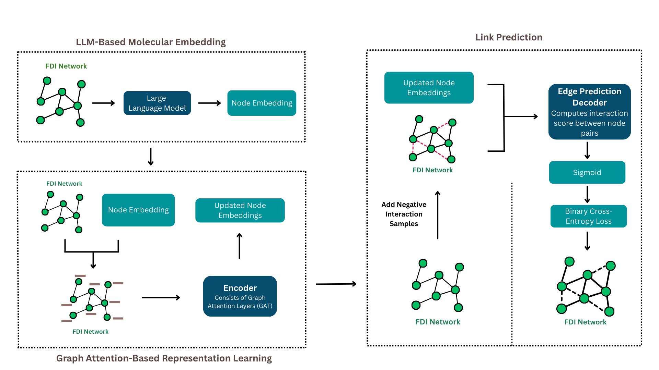
ARCHITECTURE DIAGRAM

Slide 14
IMPLEMENTATION AND EXECUTION STEPS
Step 1: Collect food–drug interaction data from DDID and DrugBank
Step 2: Preprocess data (cleaning, normalization, duplicate removal)
Step 3: Extract SMILES strings and textual information
Step 4: Generate embeddings using SBERT, ChemBERTa, and T5
Step 5: Convert embeddings into feature vectors
Step 6: Split dataset into training, validation, and testing

Slide 15
IMPLEMENTATION AND EXECUTION STEPS
Step 7: Construct interaction graph (nodes: food & drugs, edges: interactions)
Step 8: Initialize GNN and GAT models
Step 9: Train the model on training data
Step 10: Learn node representations through graph learning
Step 11: Perform link prediction to identify interactions
Step 12: Evaluate using AUROC, AUPR, accuracy, precision, and recall

Slide 16
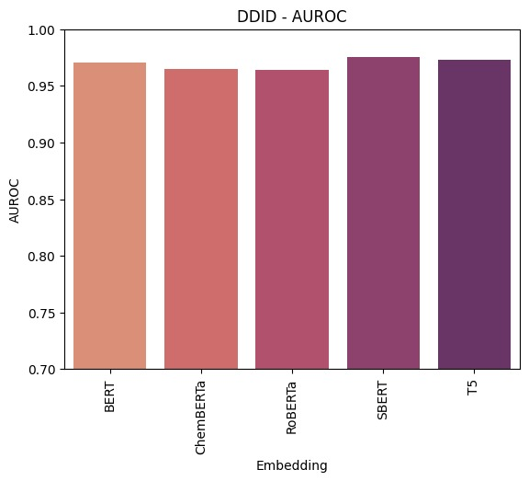
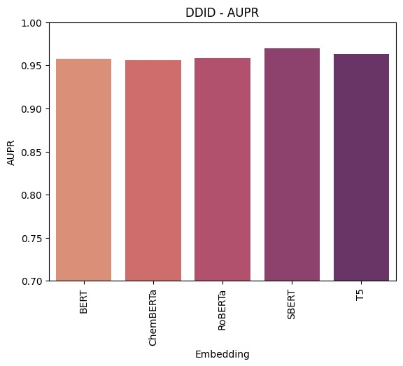
RESULTS OBTAINED
AUROC Comparison of Embedding Models for GNN
AUPR Comparison of Embedding Models for GNN

Slide 17
RESULTS OBTAINED
Performance evaluated using AUROC and AUPR metrics
Models compared: BERT, ChemBERTa, RoBERTa, SBERT, T5
All models achieved high performance
SBERT achieved the best overall results
T5 also showed competitive performance
Results consistent across different embedding models
Embedding Model | AUROC | AUPR
BERT | 0.970 | 0.956
ChemBERTa | 0.965 | 0.955
RoBERTa | 0.964 | 0.957
SBERT | 0.975 | 0.970
T5 | 0.972 | 0.963
Comparison between the Models for GNN

Slide 18
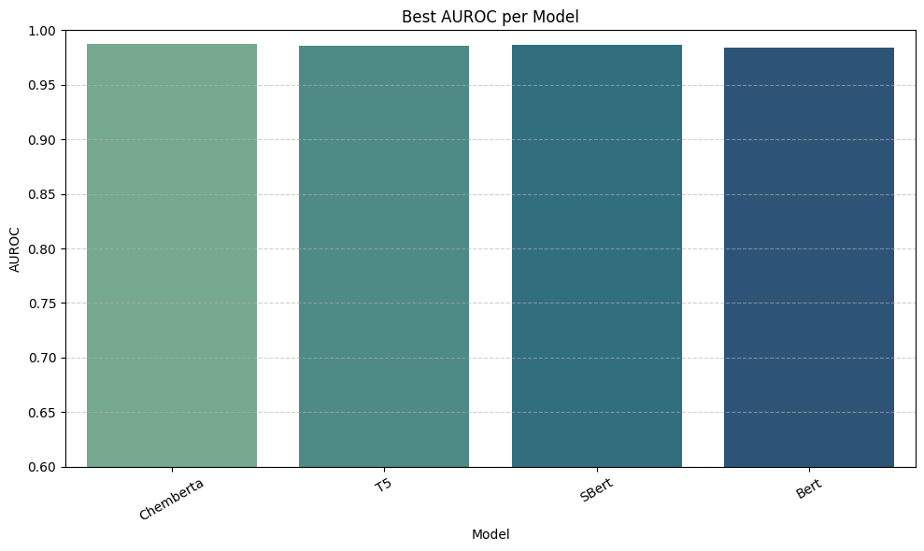
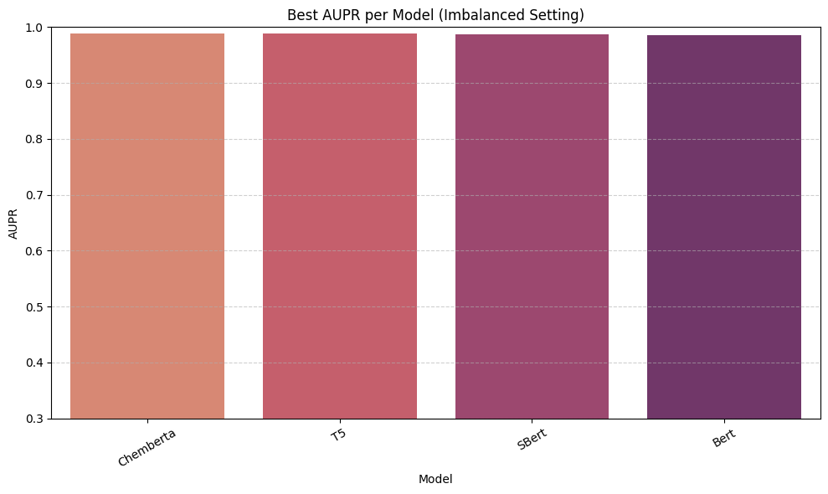
RESULTS OBTAINED
AUROC Comparison of Embedding Models for GAT
AUPR Comparison of Embedding Models for GAT

Slide 19
RESULTS OBTAINED
Performance evaluated using AUROC and AUPR metrics
Models compared: BERT, ChemBERTa, SBERT, T5
All models achieved high performance
ChemBERTa achieved the best overall results
SBERT and T5 also showed competitive performance
Results consistent across different learning rates
Embedding Model | AUROC | AUPR
BERT | 0.984 | 0.985
ChemBERTa | 0.989 | 0.988
SBERT | 0.988 | 0.987
T5 | 0.986 | 0.989
Comparison between the Models for GAT

Slide 20
CONCLUSION AND FUTURE WORK
Developed a hybrid GNN–GAT model for accurate food–drug interaction prediction
Achieved high performance in AUROC and AUPR, handling imbalanced data effectively
GAT improved prediction by focusing on important interactions
Model integrates both structural and semantic information
Future work includes integration with real-time healthcare systems
Extend to larger and more diverse biomedical datasets
Improve interpretability using explainable AI techniques

Slide 21
REFERENCES
[1] Xu, T., & Li, B. (2025). Kellm: Knowledge-enhanced label-wise large language model for safe and interpretable drug recommendation. Electronics, 14(1), 154.
[2] Tao, S., Yang, Y., Liu, X., Feng, Y., & Zheng, J. (2025). Learning universal knowledge graph embedding for predicting biomedical pairwise interactions. IEEE Transactions on Computational Biology and Bioinformatics.
[3] Ling Ong, J. C., Michael, C., Ng, N., Elangovan, K., Ting Tan, N. Y., Jin, L., ... & Liu, N. (2024). Generative AI and Large Language Models in Reducing Medication Related Harm and Adverse Drug Events–A Scoping Review. MedRxiv, 2024-09.
[4] Xu, C., Bulusu, K. C., Pan, H., & Elemento, O. (2024). Ddi-gpt: Explainable prediction of drug-drug interactions using large language models enhanced with knowledge graphs. BioRxiv, 2024-12.

Slide 22
THANK YOU
.

