Slide 1
MACHINE LEARNING
LABORATORY PROJECT
Team Members:
RANJITH KUMAR E – 20CSR167
SABARISH K – 20CSR174
SAHITHYA B A – 20CSR177

Slide 2
ABOUT DATASET
Lung Cancer Detection
No.Of Data : 1000
The Dataset consist of different symptoms and conditions that may leads to Lung Cancer.

Slide 3
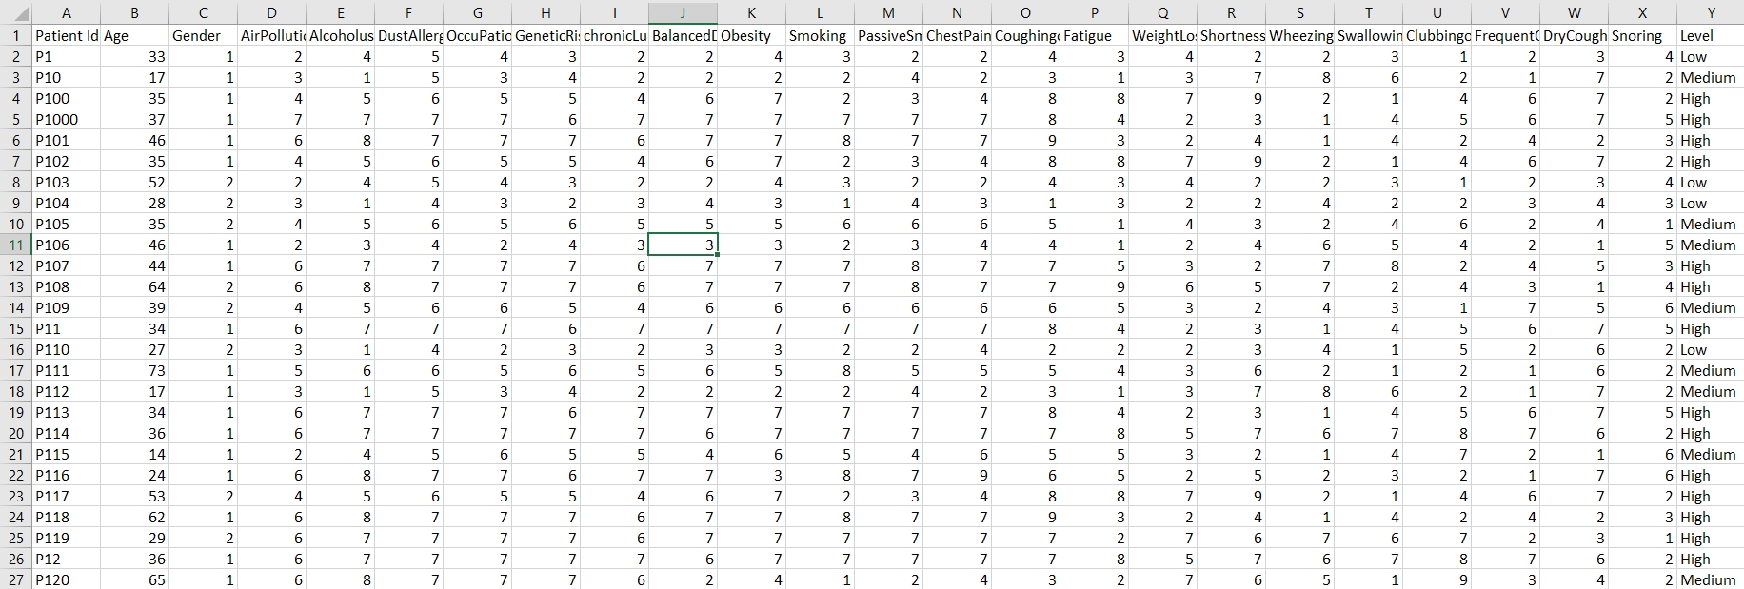
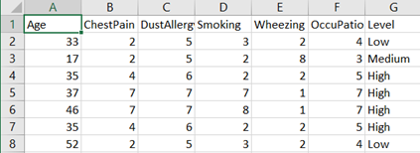
Data Set – LungCancer.csv

Slide 4
Decision Tree Learning
Decision tree learning is a method for approximating discrete-valued target functions. The learned function is represented by a decision tree.
A learned decision tree can also be re-represented as a set of if-then rules.
Decision tree learning is one of the most widely used and practical methods for inductive inference.
It is robust to noisy data and capable of learning disjunctive expressions.
Decision tree learning method searches a completely expressive hypothesis
Avoids the difficulties of restricted hypothesis spaces.
Its inductive bias is a preference for small trees over large trees.

Slide 5
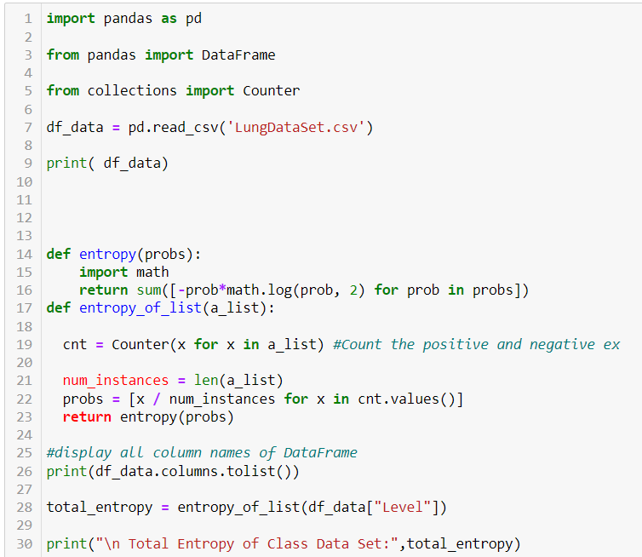
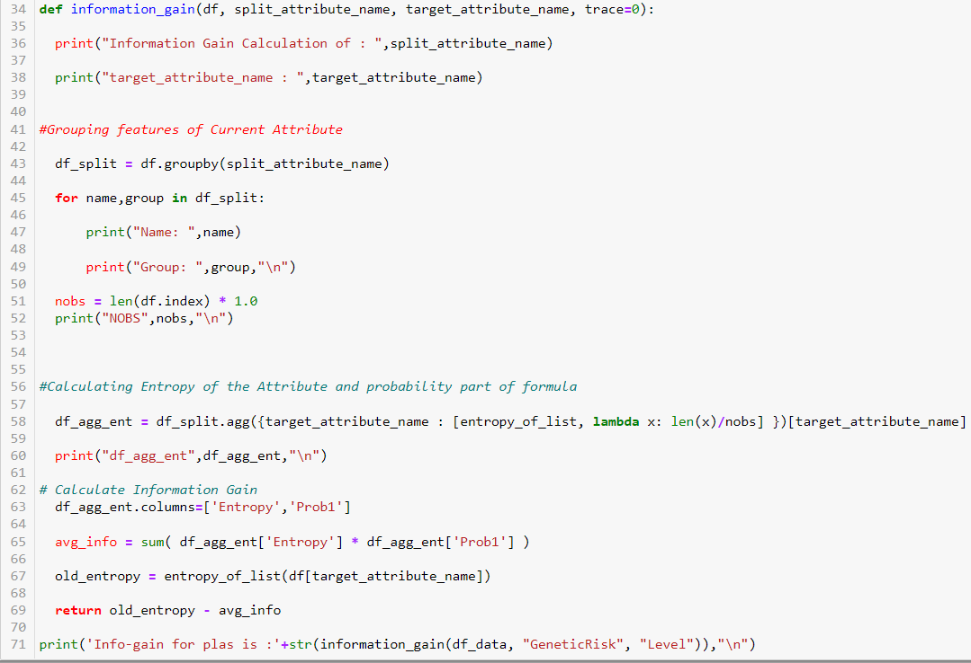
Decision Tree Learning

Slide 6
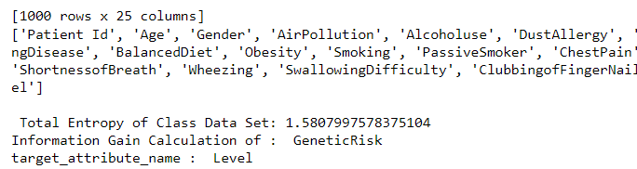
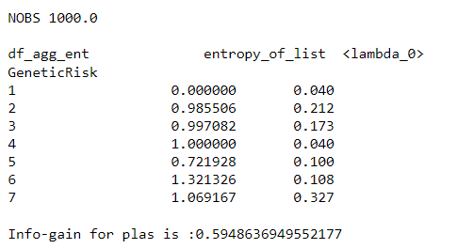
Output

Slide 7
K Nearest Neighbour
K-Nearest Neighbour is one of the simplest Machine Learning algorithms based on Supervised Learning technique.
K-NN algorithm assumes the similarity between the new case/data and available cases and put the new case into the category that is most similar to the available categories.
K-NN algorithm stores all the available data and classifies a new data point based on the similarity
K-NN algorithm can be used for Regression as well as for Classification but mostly it is used for the Classification problems.
It is also called a lazy learner algorithm because it does not learn from the training set immediately instead it stores the dataset and at the time of classification, it performs an action on the dataset.

Slide 8
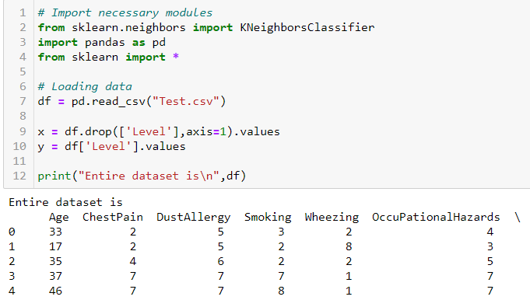
K Nearest Neighbour

Slide 9
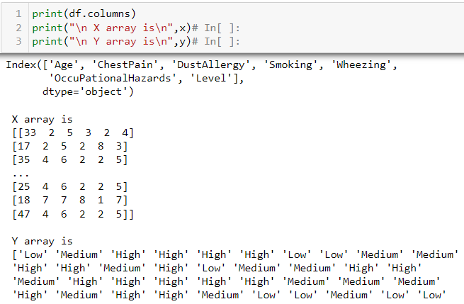
K Nearest Neighbour

Slide 10
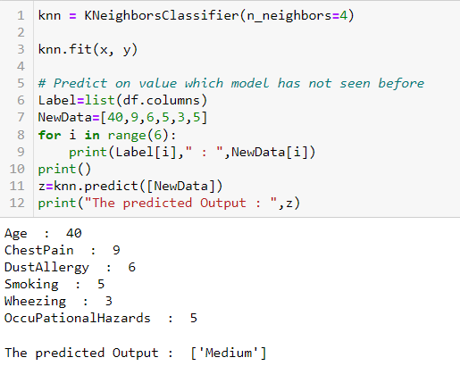
K Nearest Neighbour

Slide 11
K Means Algorithm
k-Means clustering algorithm proposed by J. Hartigan and M. A. Wong [1979].
Given a set of n distinct objects, the k-Means clustering algorithm partitions the objects into k number of clusters such that intracluster similarity is high but the intercluster similarity is low.
In this algorithm, user has to specify k, the number of clusters and consider the objects are defined with numeric attributes and thus using any one of the distance metric to demarcate the clusters.

Slide 12
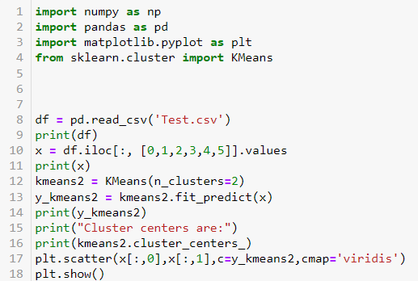
K Means Algorithm

Slide 13
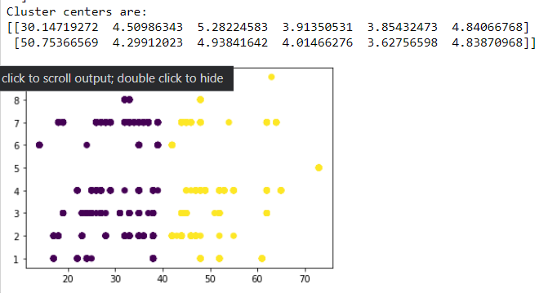
K Means Algorithm

Slide 14
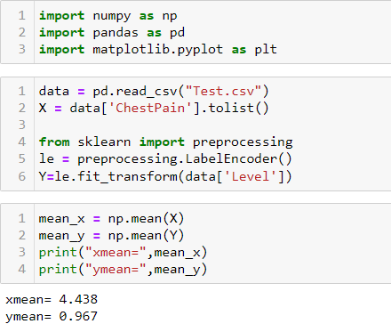
LINEAR REGRESSION

Slide 15
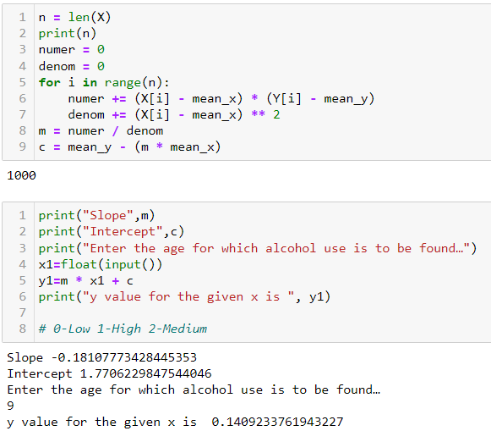
LINEAR REGRESSION

Slide 16
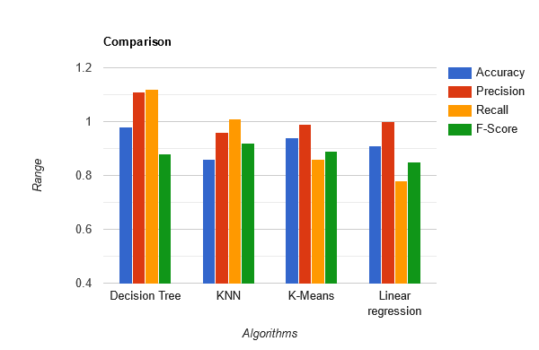
COMPARISION

Slide 17


