Slide 1
EV FLEET MONITORING AND PREDICTION

Slide 2
INTRODUCTION
EV Fleet Monitoring and Predictive Analysis is a Python-based solution designed to enhance the management and operation of electric vehicle (EV) fleets. By predicting the range of EVs, the system provides fleet operators and data-driven recommendations.
Predictive Analytics: Use historical data to forecast range and maintenance needs.
User-Friendly Interface: Provides both fleet operators and administrators with easy-to-access insights, empowering them to make data-driven decisions.

Slide 3
PROJECT OVERVIEW
DRIVER FEATURES
User Account Creation - Drivers can create a new user account to access the application.
Secure Login - Log in with a username and password. - Forgot password? Easily reset via a link sent to the registered email.
Driver's Dashboard - After login, access a dashboard. - Predict EV range by selecting the car name and entering battery percentage.

Slide 4
PROJECT OVERVIEW
ADMINISTRATOR FEATURES
Admin Dashboard Access - After login, access the admin dashboard with advanced tools.
Data Visualization - Bar graphs for dynamic distribution analysis. - Pie charts for understanding distribution. - Relationship visualization for better insights. - Status Counts: View the count of vehicles in Working or Charging conditions. - Average maintenance costs by manufacturer.
Driver Behavior Analysis - Identify overspeeding drivers. - Notify drivers via email regarding safety and behavior.
Range Prediction - Select models and input battery percentages for EV range prediction.

Slide 5
SOFTWARE SPECIFICATION
Operating System: Linux /Windows 10
Programming Language: Python 3.12.3
IDE : VS code , Jupyter notebook/google colab
DataBase: mysql Ver 8.0.39-0ubuntu0.24.04.2 for Linux on x86_64 ((Ubuntu))
Libraries Used : Flask(3.1.0), Numpy(2.1.3), Pandas(2.2.3), Flask-Mail(0.10.0), Faker(32.1.0)

Slide 6
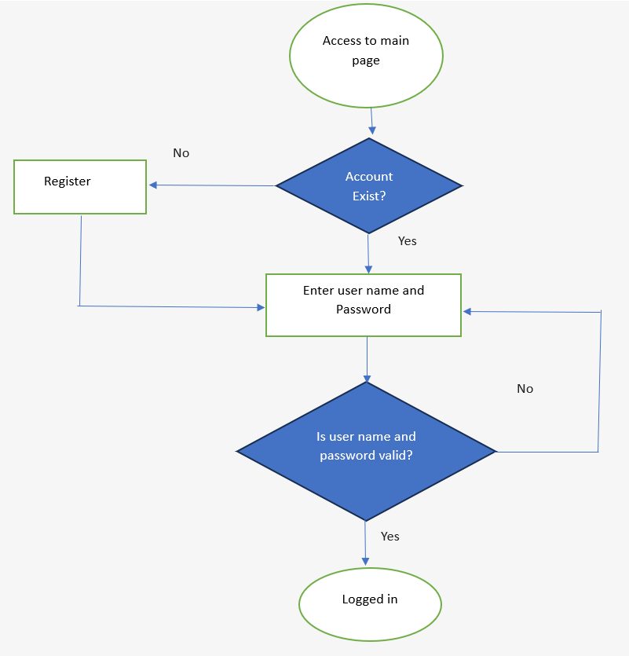
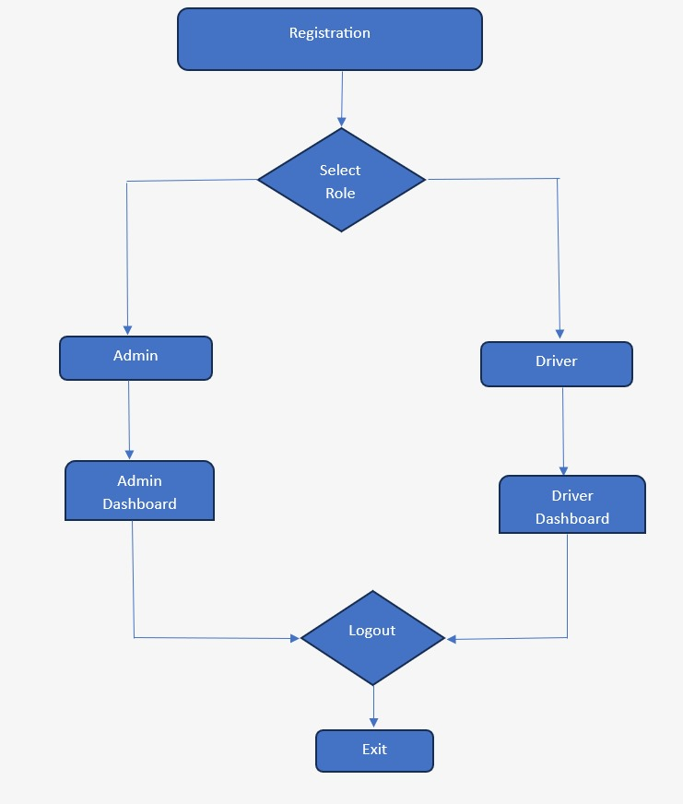
FLOW OF PROJECT

Slide 7
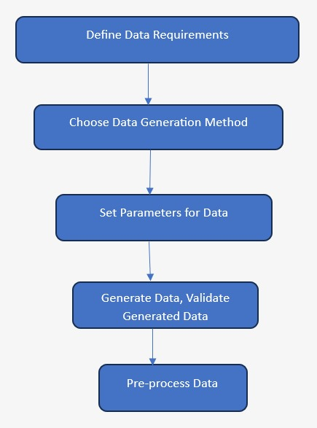
SYNTHETIC DATA STEPS

Slide 8
SYNTHETIC DATA RULES
Install the Faker Library: First, install the faker library in your environment, either using Google Colab or Jupyter Notebook.
Import Required Libraries: Import all necessary libraries for creating the DataFrame. In this code, we will use pandas, random, faker, and datetime.
Create DataFrame with 1000 Rows: We will generate a DataFrame containing 10000 rows of data with the following columns:
– Range: Generate a correlated range value.
– Battery Level (%): Use random.randint to generate random battery levels within the range of (15, 100).
– Latitude (N) and Longitude (E): Use random.uniform to generate latitude values in the range (10.00, 20.00) and longitude
values in the range (76.00, 80.00).
– Speed: Generate random speeds within the range (30, 200).
– Length and Width: Generate random values within the range,Length Range(2500,5500) in mm,Width Range(1500,4500) in mm.
– Height: Generate random values within the range (500, 2000) in mm.
– Top Speed: Generate values within the range (70, 200).
– Vehicle Status: Use random.choice to select randomly between 0 and 1, representing the vehicle's status.
– Charge Time: Use fake.time() to generate fake times.
– Maintenance Cost: Generate random values within the range (400, 2500).
– Charge Cost: Generate values within the range (10, 100).
– Dates: Use a custom function generate_random_dates to create dates formatted as %d for day, %m for month, and %y for year.
Set the start date as January 1, 2024, and the end date as October 31, 2024.
4. Extract Day, Month, and Year: Use Python's substring functions to extract the day, month, and year from the date column.
5. Create the DataFrame: Finally, create the DataFrame using the function pd.dataframe

Slide 9
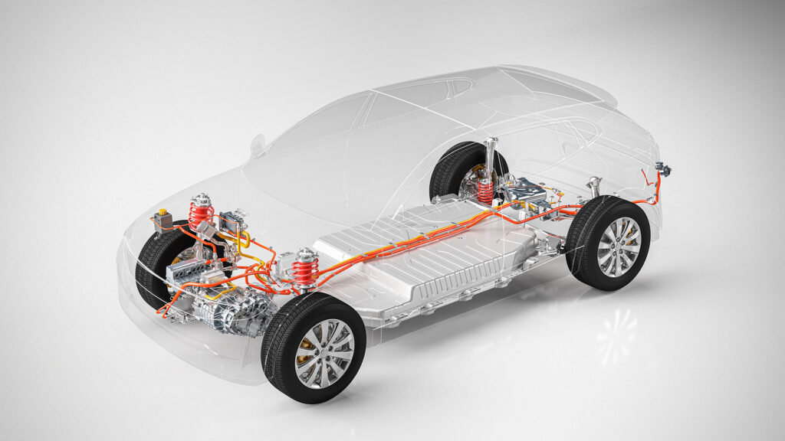
MODEL PREDICTION STEPS
Prepare Your Dataset : Ensure the dataset is in the correct directory and properly formatted.
Process the Data : Select Features and Target and Add Noise to Target Variable.
Split the Dataset : Use train_test_split() to divide the data into training and testing subsets , ensuring that 80% is used for training and 20% for testing.
Scale the Data : Standardize the feature set using StandardScaler(). Fit the scaler on the training data, and apply the same transformation to the testing data.
Train the Model : Initialize and train a LinearRegression() model on the scaled training data using model.fit().
Make Predictions : Use the model.predict() method on the test set(X_test_scaled) to generate predictions for the 'Range'.
Evaluate the Model : Calculate evaluation metrics using(MSE,RMSE,MAE,RSS)

Slide 10
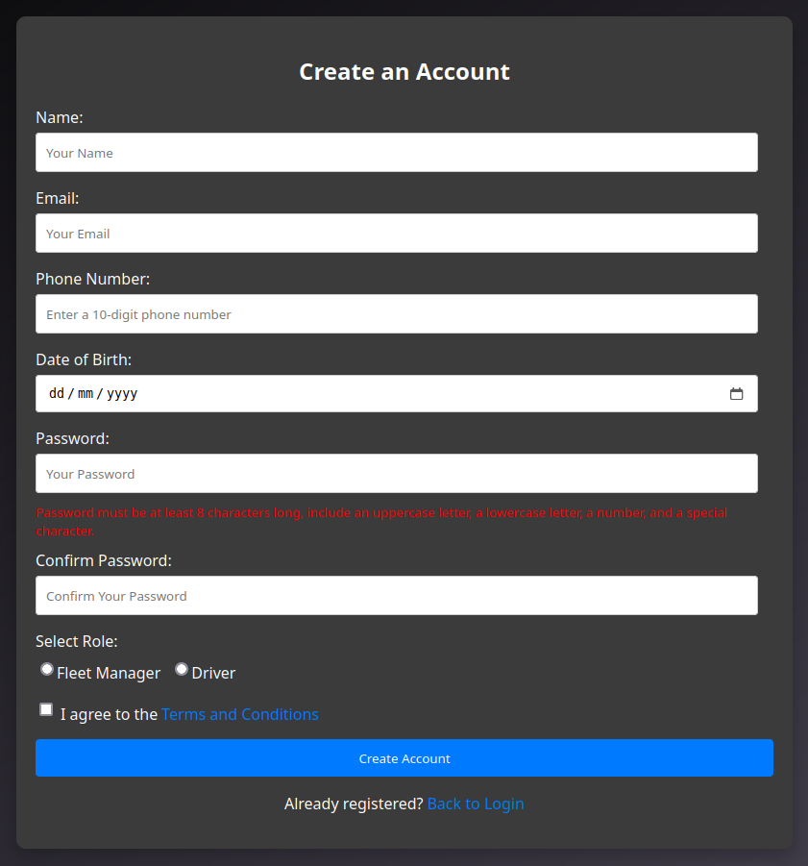
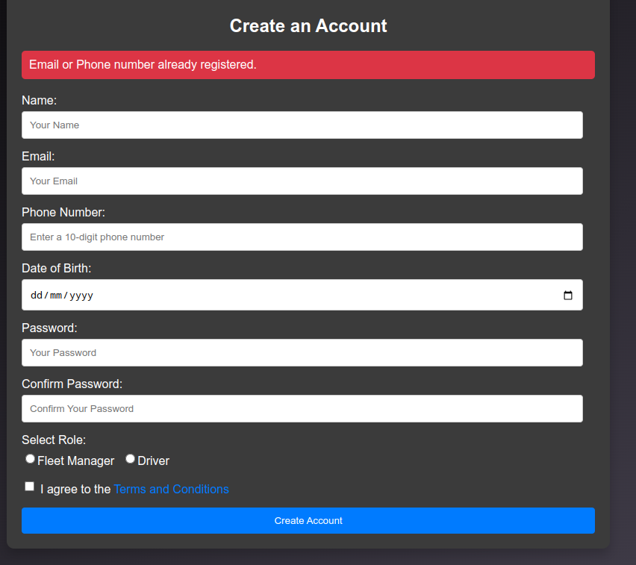
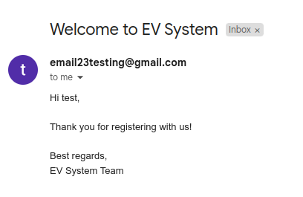
LOGIN/REGISTER

Slide 11
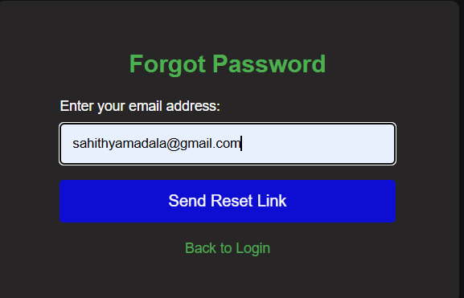
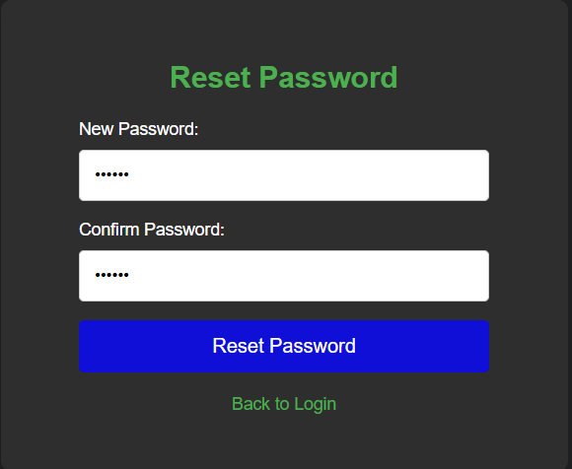
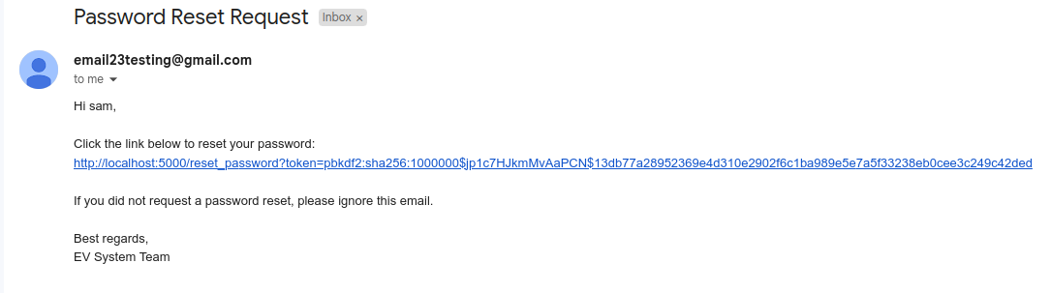

Slide 12
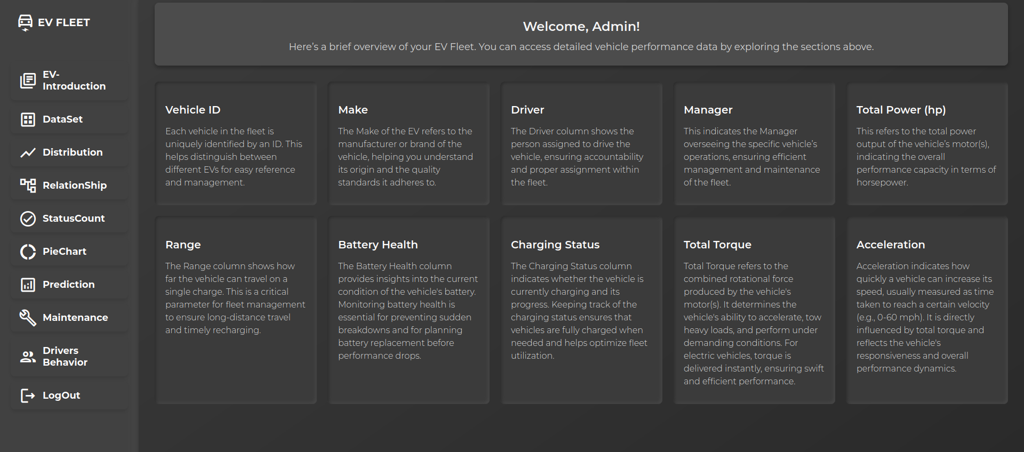
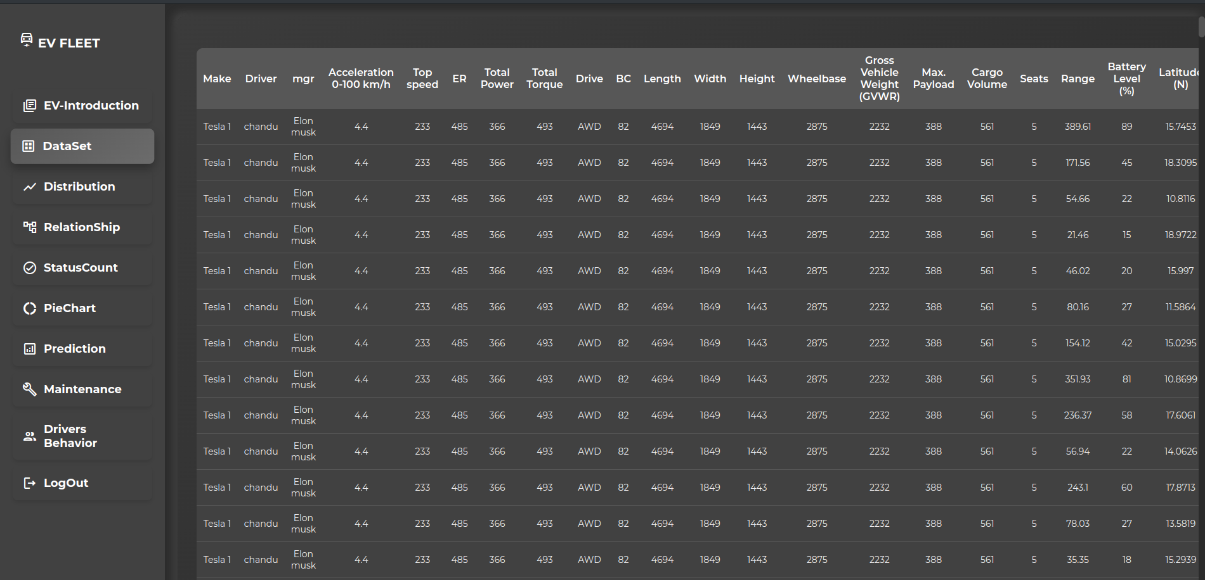
DASHBOARD FOR FLEET MANAGER

Slide 13
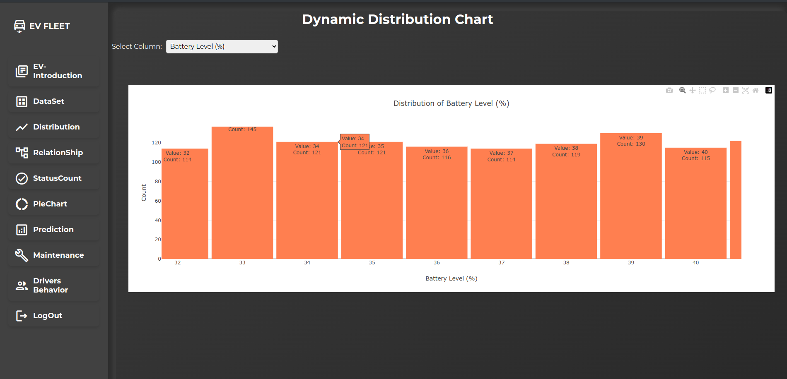
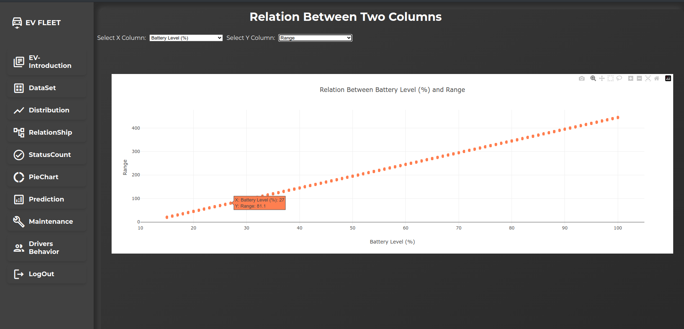
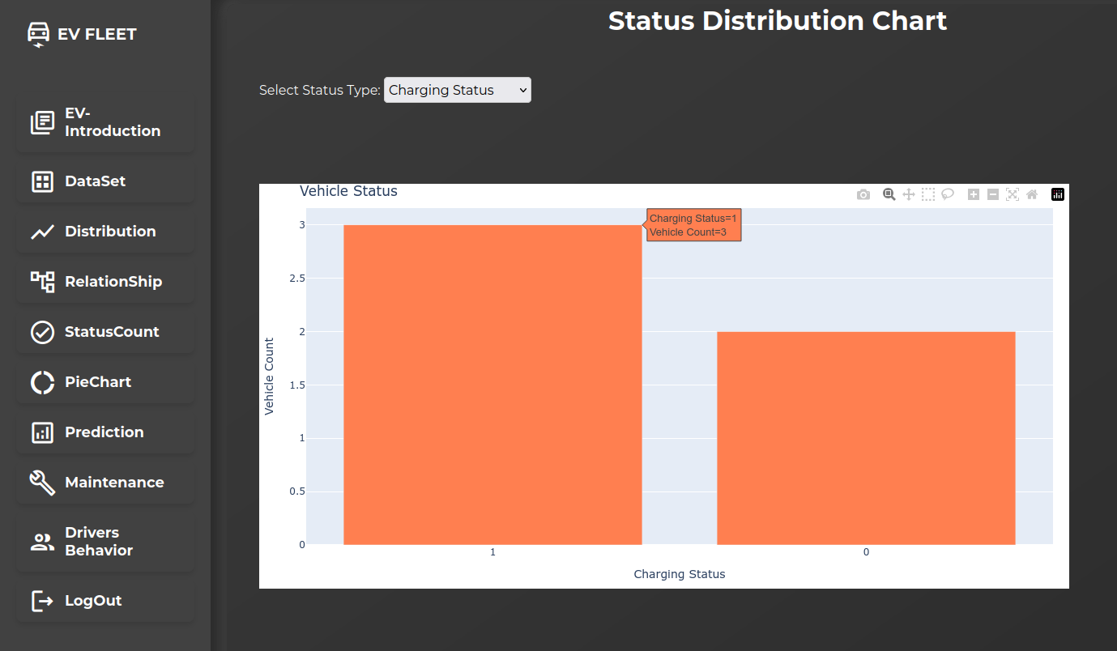

Slide 14
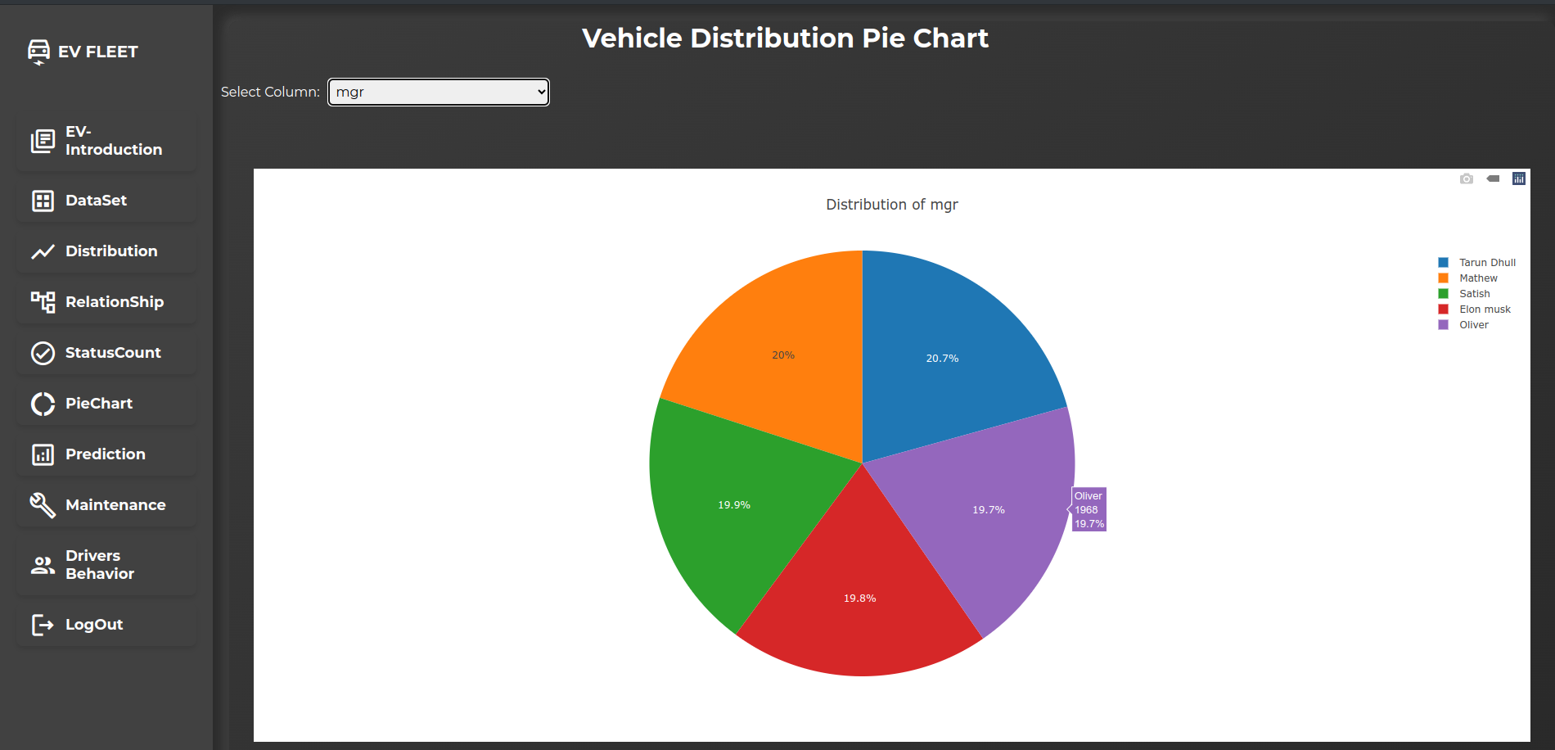
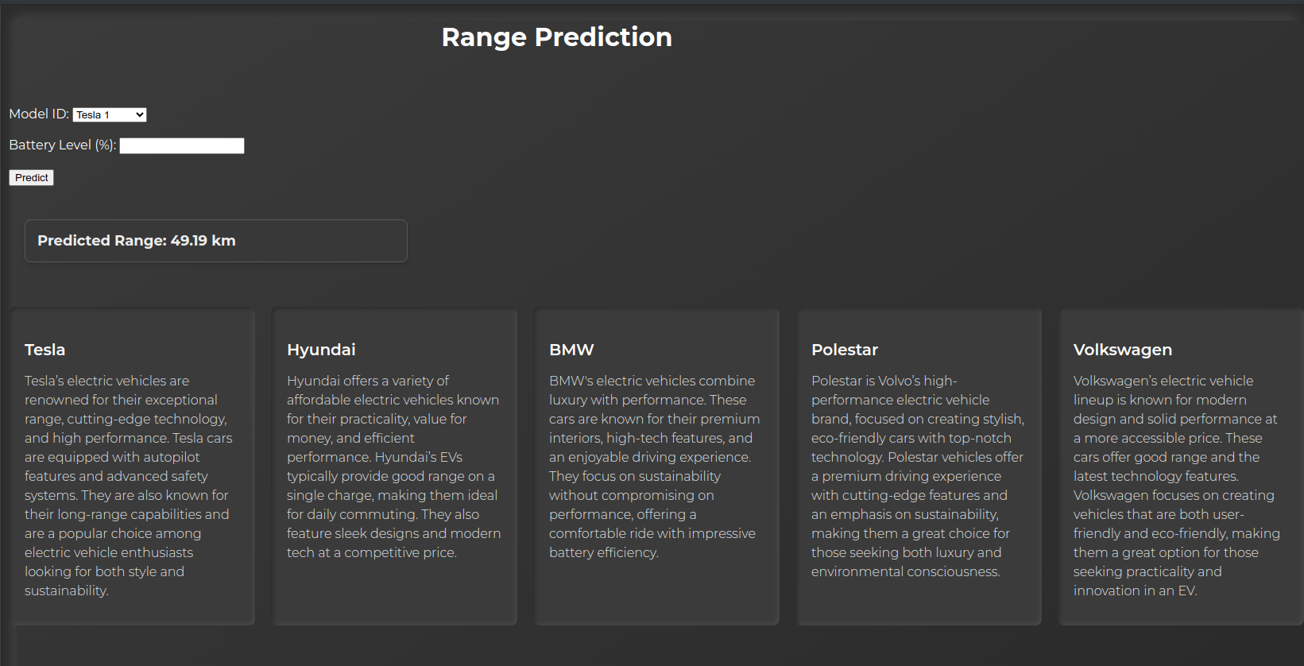
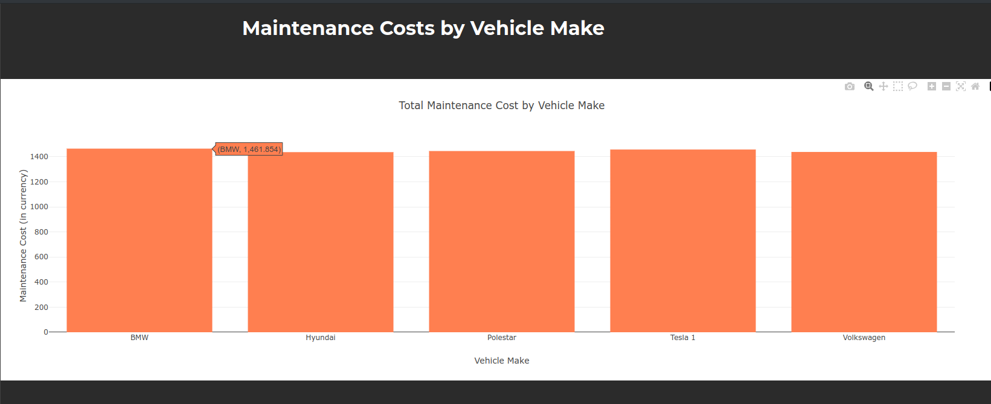

Slide 15
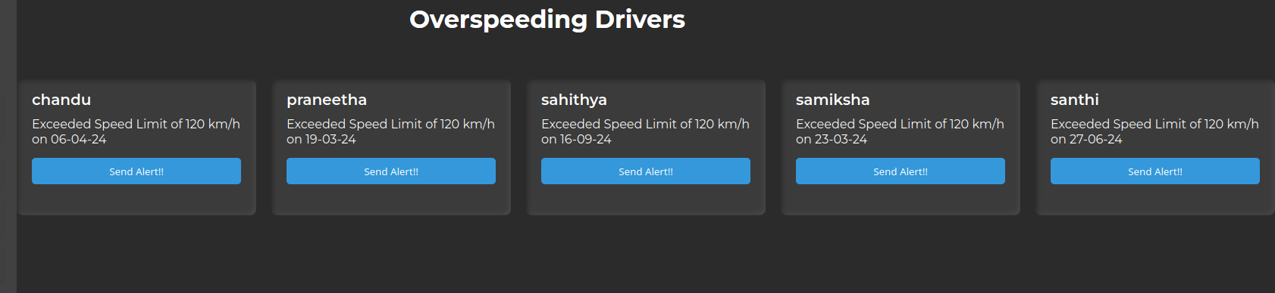
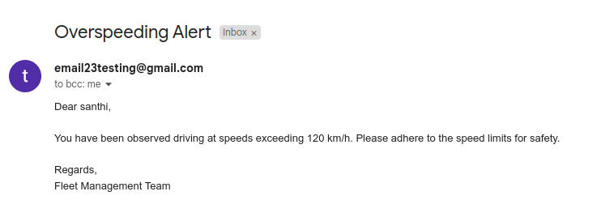

Slide 16
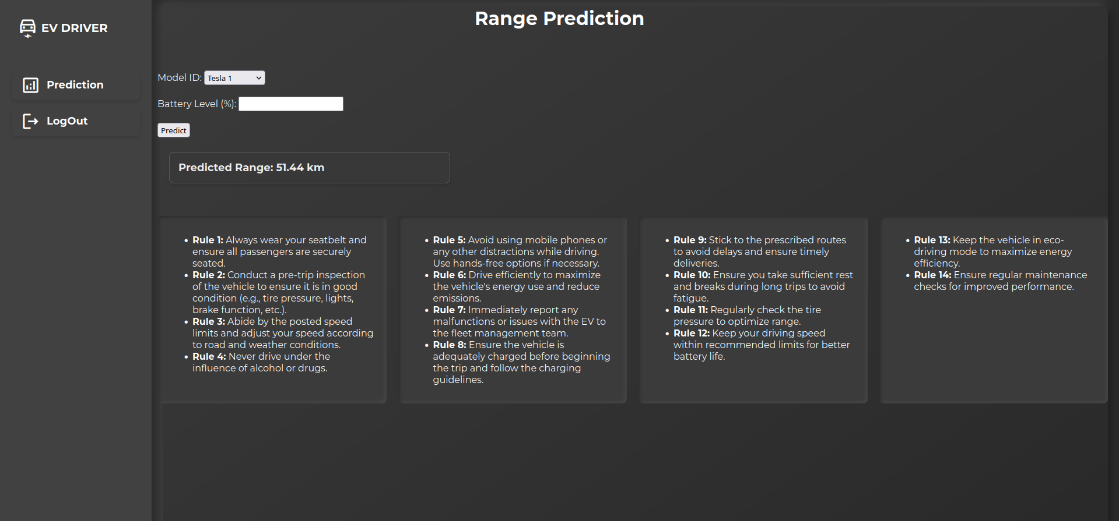
DASHBOARD FOR DRIVER

Slide 17
FUTURE SCOPE
Real-Time Data Integration - Integrates live data from IoT devices and sensors to provide up-to-date vehicle performance.
Driver Behavior Monitoring and Feedback - Tracks driving patterns and provides real-time feedback to encourage safe and efficient driving.
Mobile App Integration - Offers a mobile platform for drivers and fleet managers to access real-time updates
Live Location Tracking - Tracks the real-time location of vehicles using GPS.
Personalized Dashboards - Customizes dashboard views based on user roles

Slide 18
CONCLUSION
The EV Fleet Monitoring and Predictive Analysis System is a comprehensive solution designed to optimize fleet management. This project integrates various metrics including vehicle status, cost per meter, fuel and maintenance expenses, assignments, and open issues, offering a holistic view of fleet operations.
The system provides essential tools for tracking and analyzing fleet performance, enabling managers to make data-driven decisions, reduce operational costs, and improve overall efficiency. By predicting vehicle range and providing detailed dashboards, this solution enhances the ability to manage and monitor electric vehicles effectively, paving the way for a sustainable and efficient fleet management approach.

Slide 19

TEAM MEMBERS
Wagh Samiksha Satish
Masetty Lakshmi Chandana
Chutla Praneetha
Madala Sahithya

Slide 20
THANK YOU

