Slide 1
SHAPELY
Interpretable ML

Slide 2
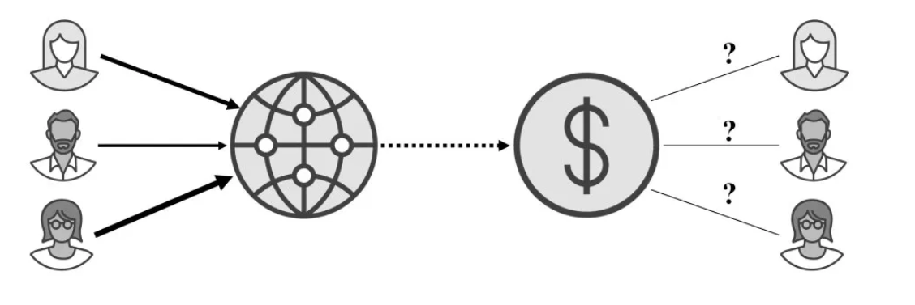
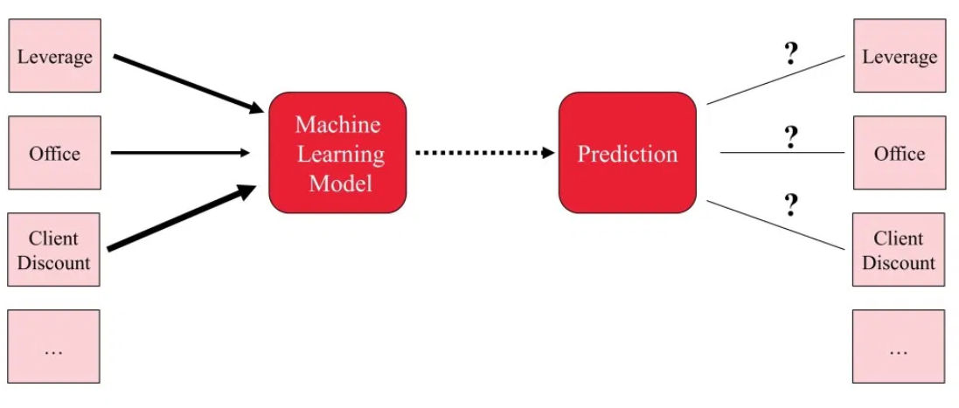
Shapely values
Used in game theory: How to fairly distribute payout among multiple players with different skills?
Interpretable ML: How to fairly distribute a prediction among different features?

Slide 3
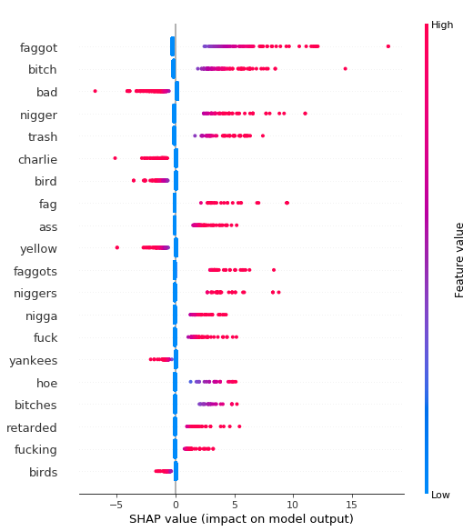
Experiment with shapely values
How to interpret a model globally with SHAP?

Slide 4
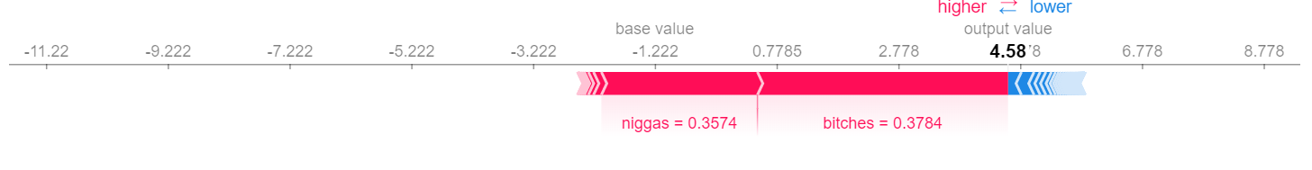
Experiment with shapely values
How to interpret a model locally with SHAP?
niggas wear wigs more than bitches these days
prediction: HATE
True label : HATE

Slide 5
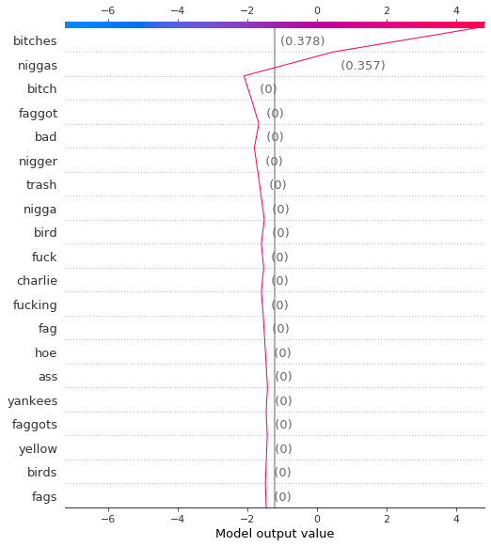
Experiment with shapely values
How to interpret a model locally with SHAP?
niggas wear wigs more than bitches these days
prediction: HATE
True label : HATE

Slide 6
Proposals
1. Shapely accelerated smart labelling
Demo paper
December 2019
2. Case study report on explainable AI
Case study report – Rabo/ Achmea
March 2020
https://www.journals.elsevier.com/artificial-intelligence/call-for-papers/special-issue-on-explainable-artificial-intelligence

Slide 7
Shapely accelerated smart data labelling
Short term proposal (Oct-Dec 2019)

Slide 8
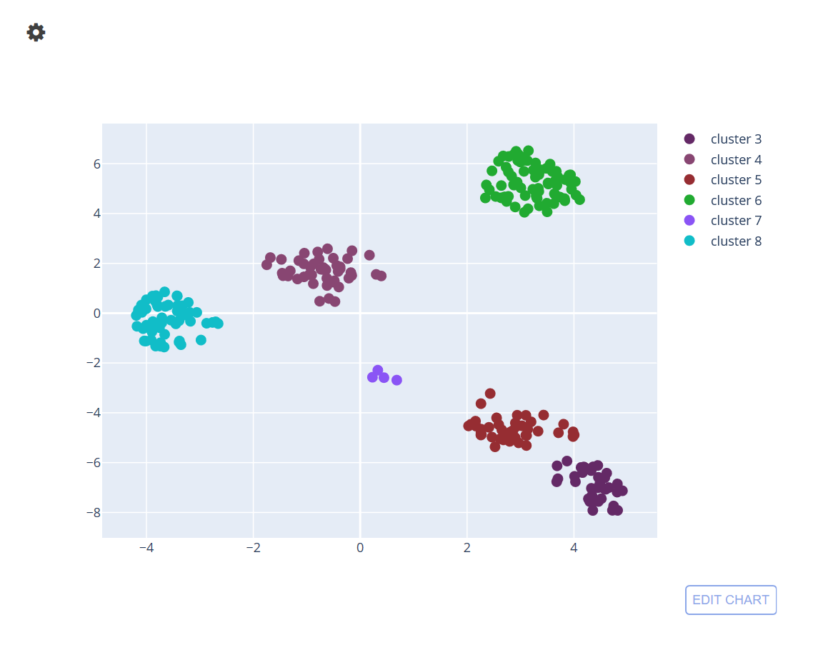
Clustering using shapely values
What happens if we cluster in Shapely space?
Number of clusters = no. of most important features

Slide 9
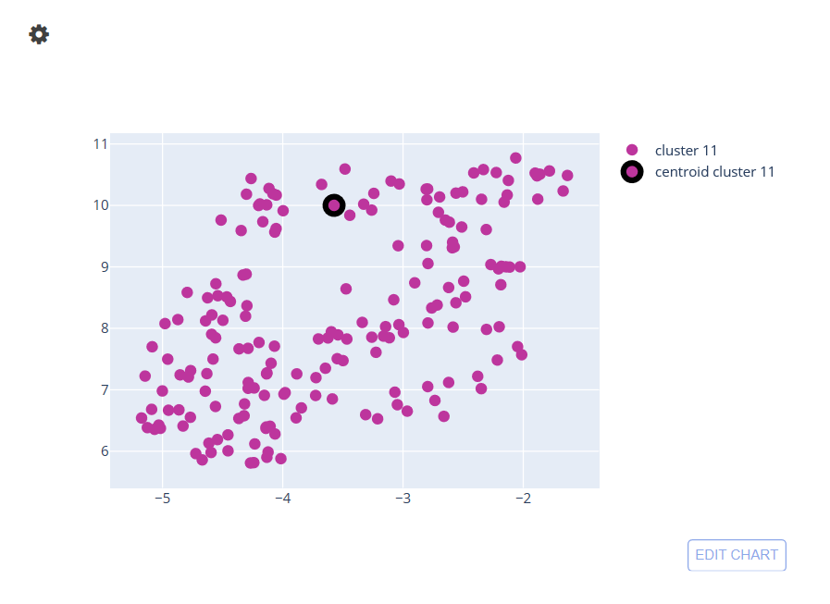
Shapely accelerated smart labelling
Label whole cluster at one go as the whole cluster is most likely to have same class
Data in cluster 1 | Label
logan and you know best about the bird moves | 0
the bird has a hat so it is hats on hats who can beat that
got to on flappy bird
the iskyrim theme song then i realized that he was a bird
moscato they would make a great baby bird picture
bird nest in my garage and so now when the birds fly out they poop on my car
he will not bite we promise he is a friendly bird

Slide 10
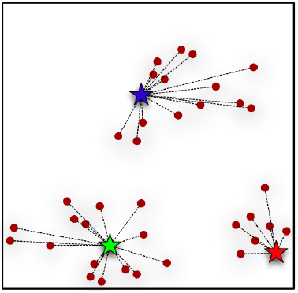
Experiment (smart labelling)
Hypothesis: Data points in same cluster contain same words, hence label is the same
Propagate label of center of cluster to all other cluster points
Test what happens to accuracy

Slide 11
Results
Accuracy and F1-score is not affected due to the propagation (which means data points of same class clustered together)
Accelerated labelling with similar level of accuracy!
 | Actual labelling(80% labelled) | Smart labelling (20% + 20 Cluster center )
Accuracy | 0.952 | 0.946
F1 score | 0.91 | 0.903

Slide 12
Next
How to measure the speed up in labelling?
Develop tool with options for smart labelling (labelling entire cluster in one go) and conventional labelling
Design an experiment to measure the time saved by SHAP accelerated labelling vs conventional labelling
Can we improve the accuracy even further?
Feedback : Some experts can provide feedback on which data points wrongly grouped into the cluster
Model: Neural nets instead of SVC or logistic regression ( we need to train only once at the beginning and at the end – doesn’t affect user experience)

Slide 13
Case study report: Measure the effect of model interpretability
Long term proposal
(Oct 2019 – March 2020)
https://www.journals.elsevier.com/artificial-intelligence/call-for-papers/special-issue-on-explainable-artificial-intelligence

Slide 14
Interpretability
Despite a growing literature on creating interpretable machine learning methods, there have been few experimental studies of their effects on end users (domain expert)
Pick an industrial use-case from Rabo bank or achmea in which domain experts can participate
Measure the effect of interpretability by comparing black box and white box models

Slide 15
Literature survey: Apartment price prediction : weights LR Industrial use case: Shapely
WHITE BOX
BLACK BOX

Slide 16
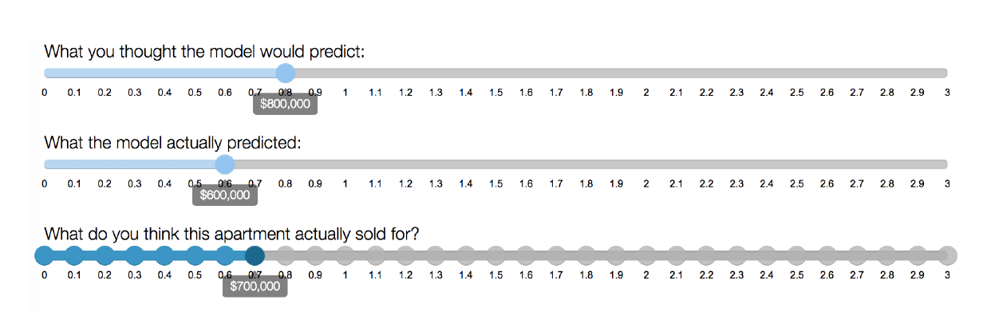
What can we measure?

Slide 17
What can we measure?
1. Does the expert trust the model more with white box?
Trust = Expert’s final decision – Model prediction
2. Does the white box model help the expert to detect failures better?
Prediction error = Actual apartment price – Experts final decision
3. Does the white box model help in detecting bias?

Slide 18
Timeline
Oct 10 - Nov 10
Nov 1 - Dec 1
Use case confirmation with Rabo/ Achmea
Development of black box vs white box tool
Jan 1 - Feb 1
Experiment with expert
Feb 1 - Mar 1
Result analysis and report
2019
Week 1
3
5
7
9
11
13
15
17
19
21
Today

