Slide 1
Scaling and Load Balancing

Slide 2
Scalability
A system is described as scalable, if it will remain effective when there is a significant increase in the number of resources and the number of users
Types: Horizontal Scaling and Vertical Scaling
Horizontal Scaling – Adding more servers
Vertical Scaling - Adding more capabilities to a server node.
Vertical Scaling –Related to high availability and Reliability

Slide 3
How is Scalability Achieved
DNS (Domain Name System) load balancing:
Specify multiple targets for a given name
DNS servers rotate among those targets
HTTP redirection (HotMail, now LiveMail):
Front-end machine accepts initial connections
Redirects them among an array of back-end machines.
Load-balancing switch:
All incoming packets pass through one switch, which dispatches them to one of many servers; once TCP connection established, load balancer will send all packets for that connection to the same server.
In some cases the switches are smart enough to inspect session cookies, so that the same session always goes to the same server.

Slide 4
Network Level vs Application Level Load Balancers
At network level: Instead of mapping Internet access for multiple private nodes via a single IP, they provide a single externally accessible IP mapped to a bunch of private servers.
Layer 7 load balancers can take advantage of explicit protocol knowledge. This comes with clear performance penalties due to a higher overhead of parsing traffic to the application layer. Eg: Caching, Session stickiness etc…

Slide 5
Session Stickiness
Session stickiness is a technique to map a certain user accessing a web application to the same backend web server during his browsing session.
Any request from user needs to be forwarded to same server.
Maintain session state in user cookies.

Slide 6
Issues Related to Session Stickiness
A web architecture should provide means to access session data from different servers and cannot just clog the request to same server.
Issue when a server fails. The session data is also lost.
Need to maintain session data in the synchronized memory accessed by all the servers.
Complicates Load balancing

Slide 7
Load balancing strategies
Round-Robin
Least Connections
Least Response Time
Randomized
Resource-Aware (Based on available resources for application execution).

Slide 8
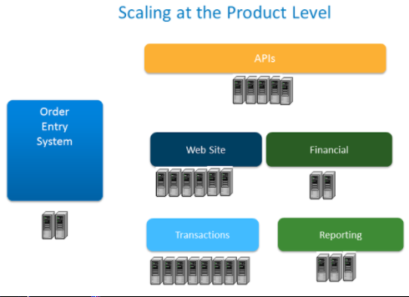
Techniques – Scaling at Product Level

Slide 9
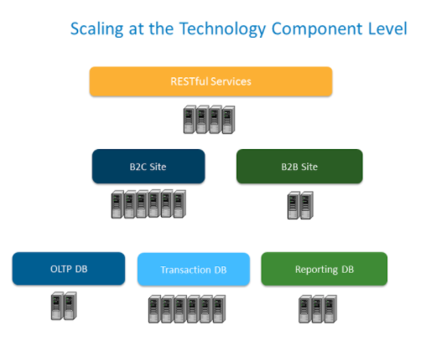
Techniques – Scaling at Component Level

Slide 10
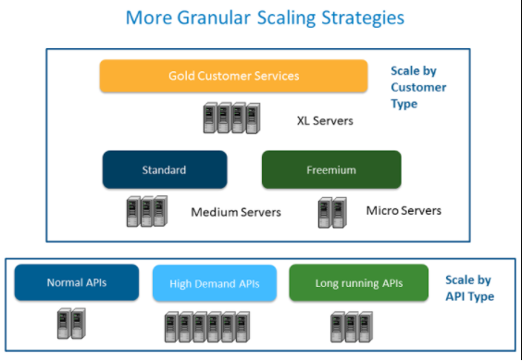
Techniques - Scaling by Customer Types

Slide 11
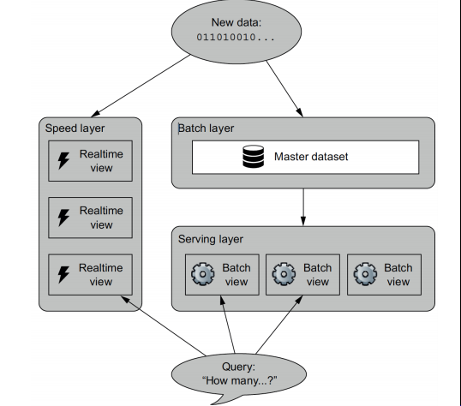
Using Lambda Architecture for Scaling
Creating Pre-Compiled Views
Why Lambda Architecture?
batch view = function(all data) − Step1
query = function(batch view) − Step2

Slide 12
Closures/Callbacks/Lambda Functions
function startAt(x)
function incrementBy(y)
return x + y
return incrementBy
variable closure1 = startAt(1)
variable closure2 = startAt(5)

Slide 13
Scaling techniques
Scaling at
Application level,
caching,
Database tier and
load balancing tier.

Slide 14
Load balancing techniques
Load Balancing
At Layer 4 or Layer 7.
Layer 4 load balancing works by balancing the sticky sessions if enabled by the providers. DNS for Layer 4.
Layer 7 load balancing use HTTP header contents to balance load on the server).
Use Elastic Load Balancers
Using Hardware (Layer 4 or Layer 7)
Use Application Delivery Controller
Placed between webservers and firewalls.
Main functionality includes SSL offloading, Caching, Load Balancing
Using Software (mod_backend -> Provides HTTP re-direction for a list of apache web servers).
Integrate with Reverse Proxy/CDN. Reverse proxies are proxies that are distributed across geographical network.

Slide 15
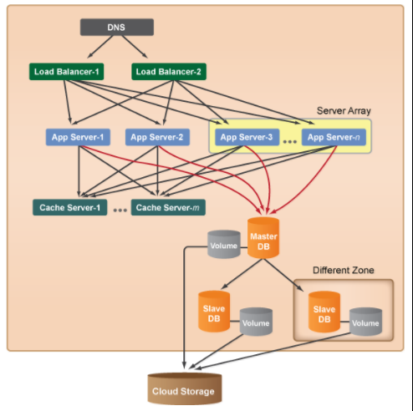
Scaling techniques

Slide 16
Elastic Load balancers
Available with AWS.
Provides Application load balancing (layer 7). Application Load Balancer simplifies and improves the security of your application, by ensuring that the latest SSL/TLS ciphers and protocols are used at all times. (Use HTTP based data to balance the network load)
Network load balancing (Balancing TCP traffic, DNS failed over, use IP based data to balance the network load). Useful for virtual private Cloud.
AWS provides classic load balancing for instances that are built on EC2.

Slide 17
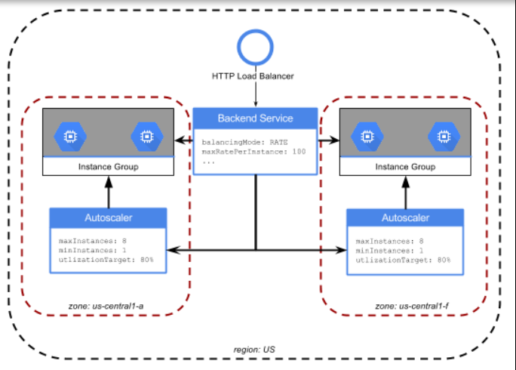
Case Study – google cloud load balancing

Slide 18
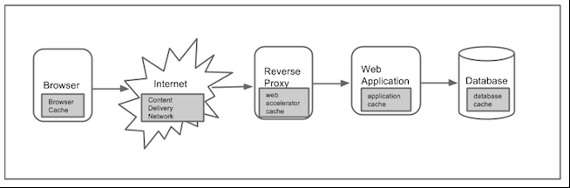
Caching layers in web architecture

Slide 19
Caching techniques
Using memcached -> Store data in RAM. Use hash tables to store entry for faster query.
memcache.add(key="[KEY]", value="[VALUE]", time=[EXPIRATION_TIME])
memcache.get(key="[KEY]“)

Slide 20
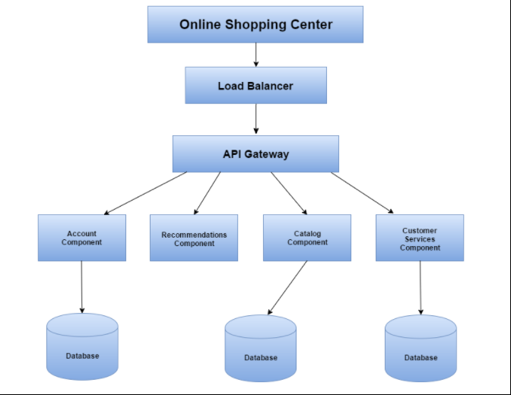
Developing Microservices for scalability

Slide 21
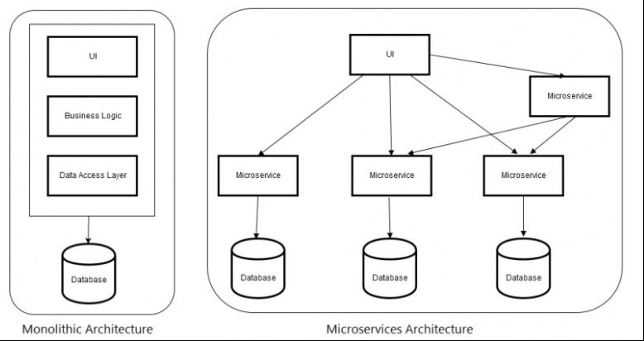
Monolithic vs microservices

Slide 22
Using containers or dockers
A container image is a lightweight, stand-alone, executable package of a piece of software that includes everything needed to run it: code, runtime, system tools, system libraries, settings. Available for both Linux and Windows based apps, containerized software will always run the same, regardless of the environment. Containers isolate software from its surroundings, for example differences between development and staging environments and help reduce conflicts between teams running different software on the same infrastructure.

