Slide 1
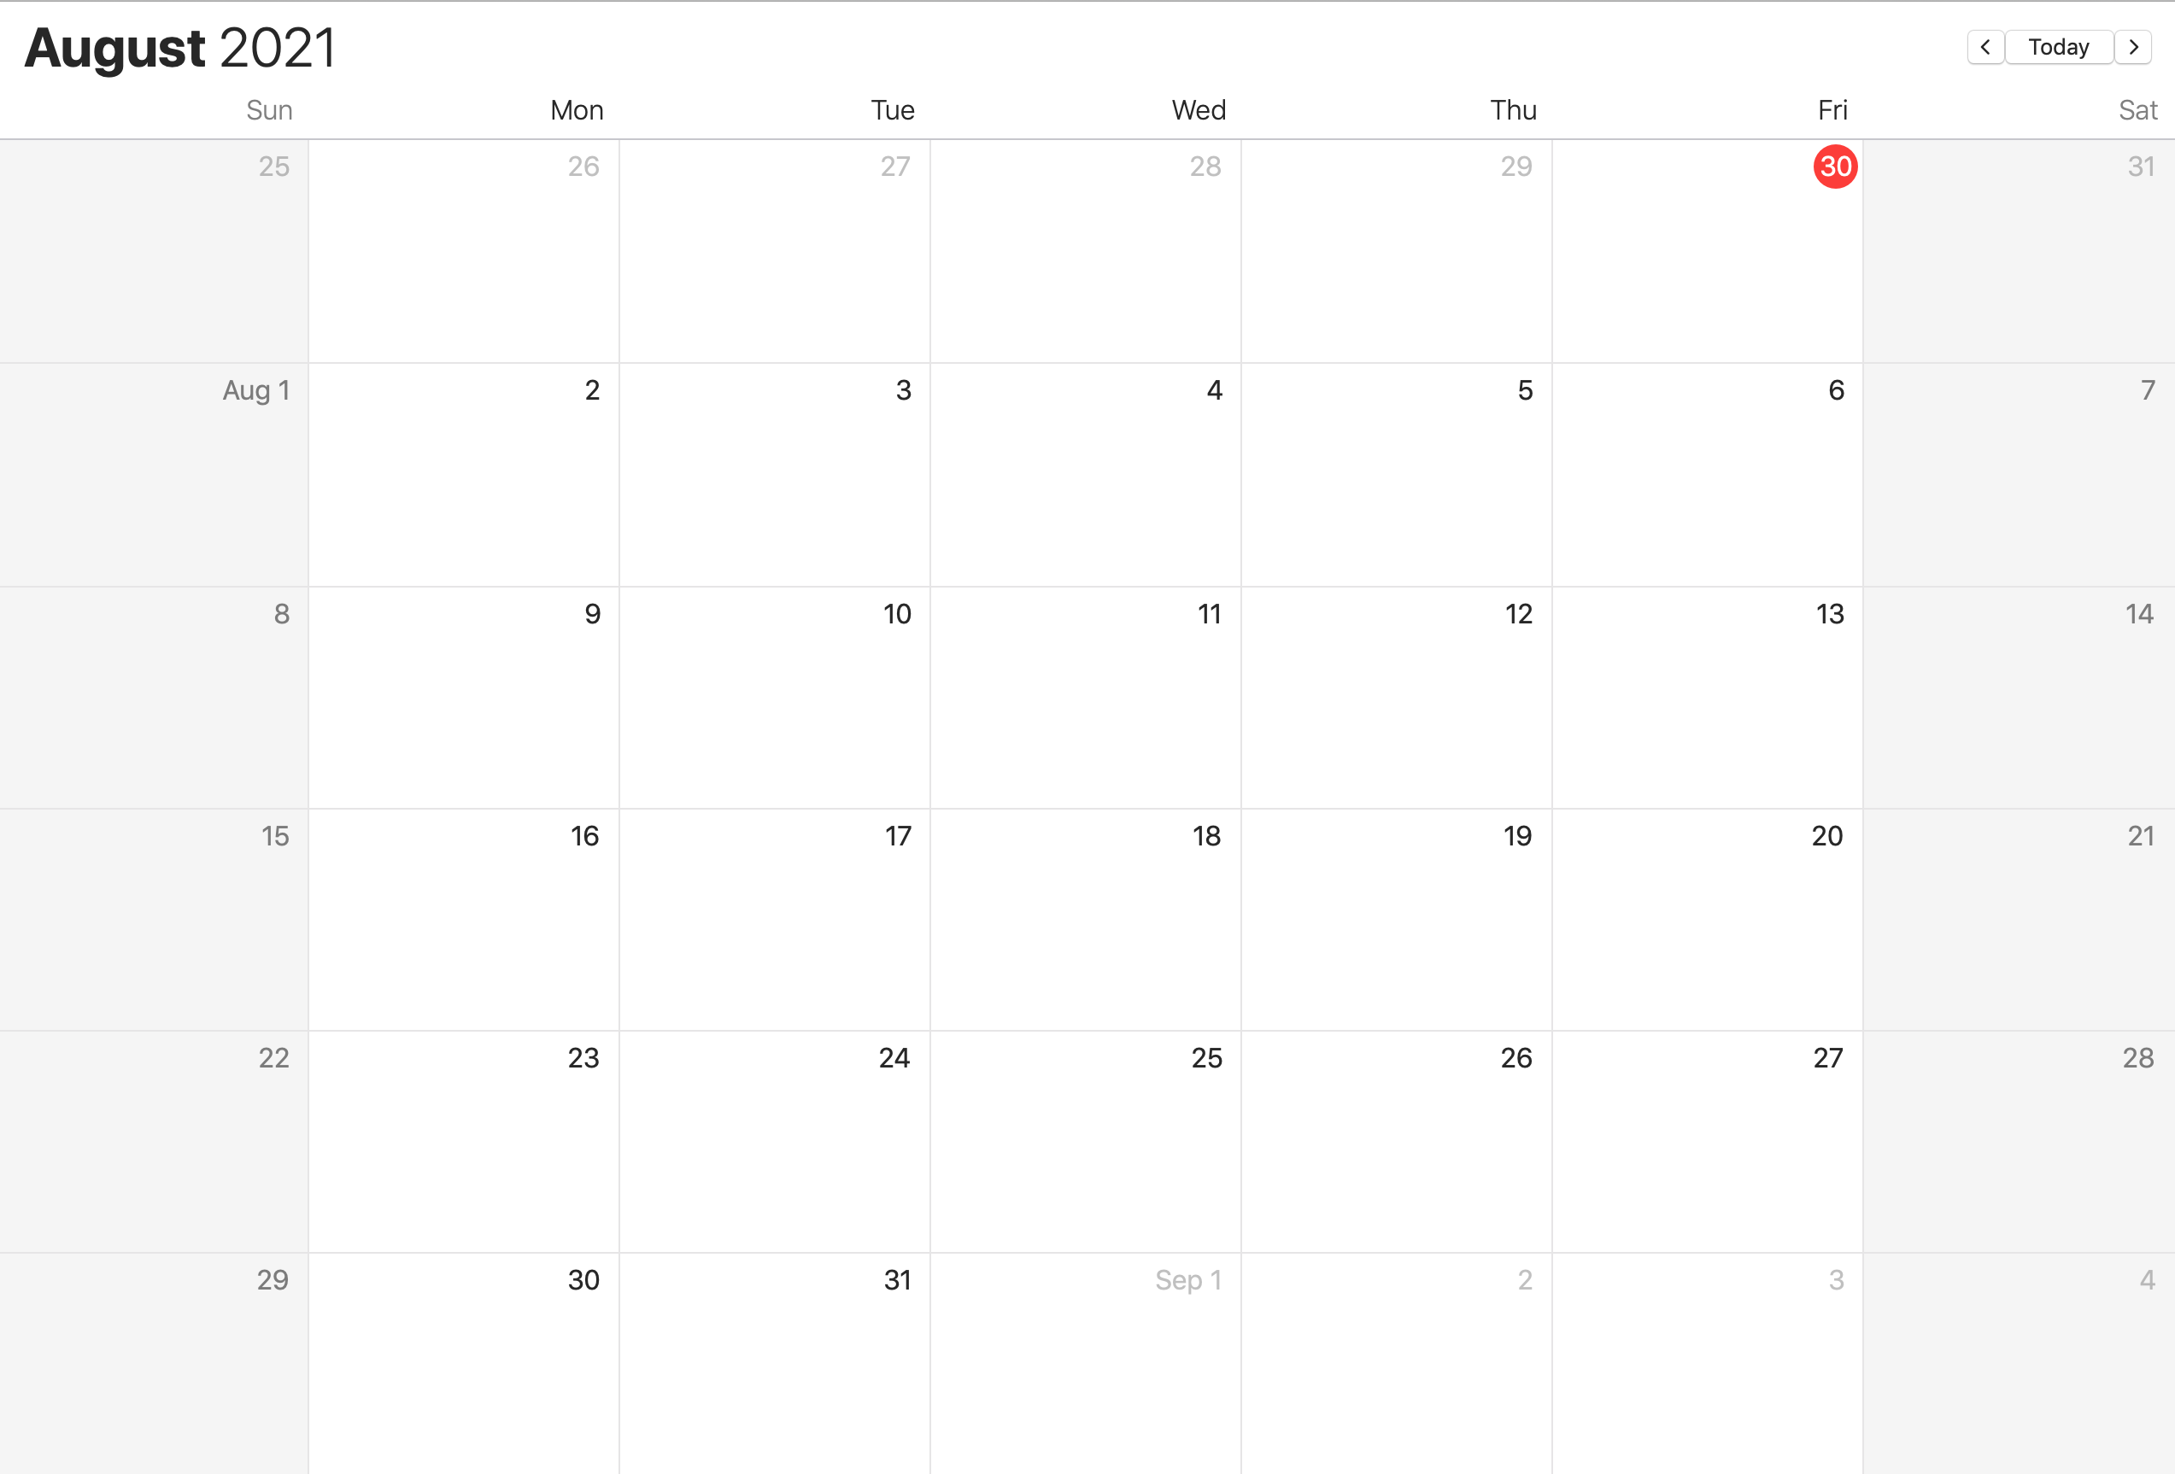
New unseen ranked list
Paper writing(Structure, Motivation Points)
Paper writing (Related Work, Methods)
Gene embedding based NN model
Draft deadline
Paper writing
Digenic Prediction problem
Complete Draft deadline
Experiments required by the paper, Analysis
Improving writing , revising
Deadline
Polishing, Editing
Analysis, Final Experiments

