Slide 1

CallWise
Whom should a bank call? Trees, forests and a famous leak
0.44
test PR-AUC without the leaky feature (call length)
EC-417 Introduction to Machine Intelligence · Term Project P05
3.8× the no-skill line of 0.117
Roll Nos. 623169 · 623195 · NIT Andhra Pradesh · November 2026
Notes:
CallWise predicts, before a telemarketing call is made, how likely a bank client is to subscribe to a term deposit, so the call centre can phone the most promising clients first. Headline: without the leaky duration feature the best models reach a test PR-AUC of about 0.44 (mean over 3 seeds), 3.8 times the no-skill value of 0.117.

Slide 2


Always saying “no” is 88% accurate and useless
The task: rank clients before the call
88.3%
Estimate each client’s chance of subscribing to a term deposit, then call the best-ranked clients first.
accuracy of always predicting “no”
Primary metric: PR-AUC
Rewards putting the rare “yes” clients at the top of the list. Its no-skill value is the positive rate, 0.117.
0
Also reported
subscribers that model finds
ROC-AUC (optimistic on imbalanced data), recall at a threshold chosen on validation, lift and profit.
So we rank by probability and score the ranking.
Notes:
Only 11.7% of calls end in a subscription, so accuracy is misleading: predicting 'no' for everyone is 88.3% accurate and finds nobody. The useful output is a ranked call list, so the primary metric is PR-AUC (average precision), whose no-skill value equals the positive rate (0.117) and is shown by the trivial baseline in the results table. ROC-AUC is reported but not used for decisions because it reads optimistic when positives are rare (Saito and Rehmsmeier, 2015).

Slide 3
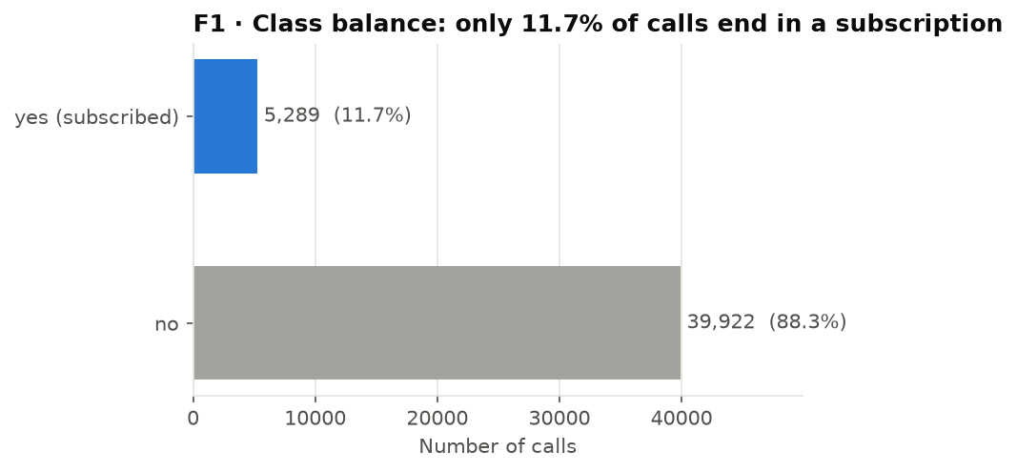
45,211 calls, and only 11.7% end in a yes
45,211
phone calls, May 2008 – Nov 2010
16
features about the client, the contact and past campaigns
5,289
Source: UCI Bank Marketing, bank-full.csv (Moro, Cortez and Rita, 2014), CC BY 4.0. “unknown” is kept as its own category; pdays = −1 means never contacted, so a previously_contacted flag is added.
calls ended in a subscription (11.7%)
Notes:
The data are 45,211 telemarketing calls made by a Portuguese bank between May 2008 and November 2010, with 16 features plus the target and no empty cells. 'unknown' values carry signal, so they are kept as a normal category. pdays = -1 means the client was never contacted before; it is kept and an explicit previously_contacted flag is added. The EDA is in notebooks/01_eda.ipynb.

Slide 4
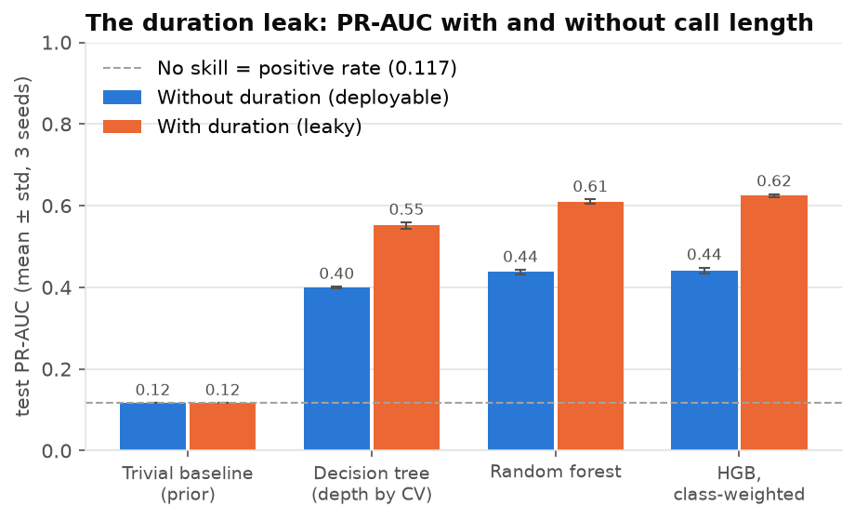
Call length leaks the answer: +0.18 PR-AUC
Boosting, test PR-AUC
0.625 → 0.441
with → without duration
duration is the length of the call: known only after it ends, and a 0-second call is always a “no”.
Every model is trained twice: FULL (reference) and DEPLOYABLE (no duration).
All headline numbers use DEPLOYABLE.
Notes:
duration is the strongest predictor in the file, but it is measured after the call has ended, so it cannot be used to decide whom to call. Every model was trained on both feature sets. Adding duration raises test PR-AUC by 0.15 (tree), 0.17 (forest) and 0.18 (boosting), roughly 28% of the leaky score, and ROC-AUC from about 0.80 to 0.93. A report built on the FULL set would look excellent and be useless for planning calls.

Slide 5

Split first: the test set is locked away
Train 70% · 31,647 rows
Validation 15%
6,782 rows
Test 15%
6,782 rows
Seeds 42, 43, 44 reshuffle train ↔ validation
Same rows for every model and seed
1
2
3
4
Split first
Fit on train only
Tune on validation
Score test once
Stratified 70/15/15 before anything is fitted.
One-hot encoding sits inside the Pipeline; boosting reads categories natively.
Tree depth by 5-fold CV; forest and boosting settings and the threshold on validation.
Everything frozen first; report the mean ± std over 3 seeds.
Notes:
The test set (15%, 6,782 clients) is split off first with a fixed seed of 42 and is identical for every model and seed. Seeds 42, 43 and 44 only change how the other 85% is divided into train and validation. All encoders live inside a scikit-learn Pipeline, so they are fitted on training rows only. Hyperparameters, the decision threshold (best F1 on validation) and the choice of model were all fixed on validation; the test set was scored once at the end.

Slide 6
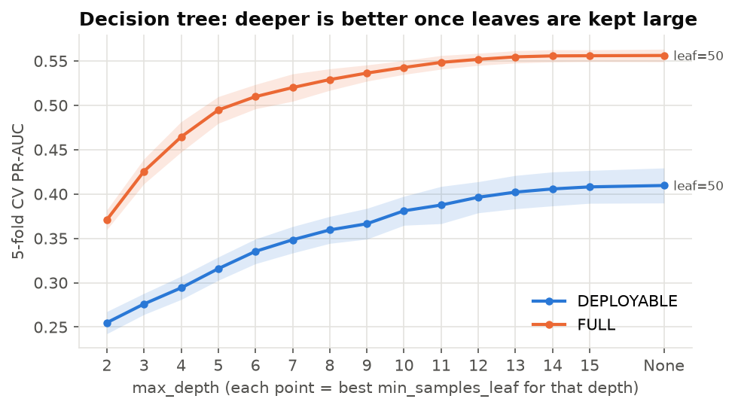
A single decision tree reaches 3.4× no skill
0.117
Trivial baseline: predicts the 11.7% rate for everyone
0.399 ± 0.003
Decision tree, test PR-AUC (ROC-AUC 0.755)
5-fold CV chose unlimited depth with large leaves (50–100 clients each): leaf size, not depth, limits overfitting.
Notes:
The trivial baseline (DummyClassifier, strategy='prior') predicts the training positive rate for everyone, so its PR-AUC equals the positive rate, 0.117. The decision-tree baseline has its max_depth and min_samples_leaf chosen by 5-fold stratified CV on the training part only. The grid was widened to leaf sizes 100-400 after CV kept picking the edge value of 50. With large leaves, deeper trees keep improving, so CV chose no depth limit. Test PR-AUC 0.399 ± 0.003 over 3 seeds.

Slide 7
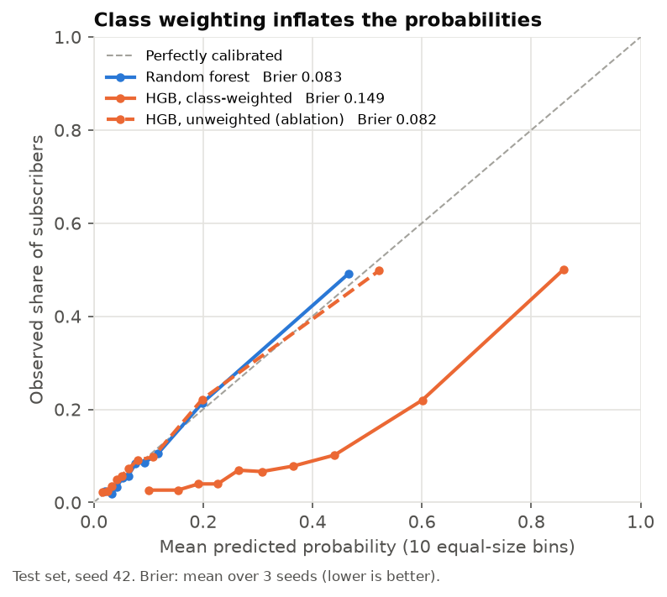


Boosting ties the forest; class weights don’t help
Random forest
Weighted boosting
main model
the improvement
300 deep trees on bootstrap samples, averaged. 18 settings compared on validation.
Shallow trees added one at a time, each fixing current errors. Each “yes” weighs 7.5× a “no”.
0.438 ± 0.005
0.441 ± 0.007
test PR-AUC
test PR-AUC
Ablation: the same boosting model with weighting switched off
0.446 ± 0.003
0.082 vs 0.149
Weighting pushes scores up without changing their order: a weighted score of 0.6 means about a 22% chance.
test PR-AUC (weighted: 0.441)
Brier, unweighted vs weighted (lower = better)
Notes:
Random forest averages 300 deep trees grown on bootstrap samples. The improvement is HistGradientBoosting with class_weight='balanced': trees are added one at a time to fix the current errors, and each 'yes' gets about 7.5 times the weight of a 'no'. It ties the forest (0.441 vs 0.438, within one standard deviation). The ablation keeps the chosen configuration and only switches the weighting off: PR-AUC is slightly higher (0.446) and the Brier score nearly halves, so the weighting inflates probabilities without improving the ranking. An improvement that does not help, honestly measured, is still the result.

Slide 8
Without the leak, the ensembles lead at 0.44
Model | Features | PR-AUC | ROC-AUC | Recall @ t* | Train time
Trivial baseline (prior) | DEPLOYABLE | 0.117 ± 0.000 | 0.500 ± 0.000 | – | –
Decision tree (depth by CV) | DEPLOYABLE | 0.399 ± 0.003 | 0.755 ± 0.001 | 0.475 ± 0.012 | 0.3 s
Random forest | DEPLOYABLE | 0.438 ± 0.005 | 0.796 ± 0.002 | 0.521 ± 0.011 | 3.8 s
+ Boosting, class-weighted | DEPLOYABLE | 0.441 ± 0.007 | 0.797 ± 0.001 | 0.520 ± 0.013 | 1.7 s
Boosting, unweighted (ablation) | DEPLOYABLE | 0.446 ± 0.003 | 0.801 ± 0.002 | 0.497 ± 0.020 | 1.2 s
Decision tree | FULL (leaky) | 0.551 ± 0.007 | 0.901 ± 0.005 | 0.683 ± 0.054 | 0.4 s
Random forest | FULL (leaky) | 0.609 ± 0.006 | 0.927 ± 0.000 | 0.715 ± 0.036 | 1.8 s
Boosting, class-weighted | FULL (leaky) | 0.625 ± 0.004 | 0.931 ± 0.001 | 0.683 ± 0.024 | 1.9 s
Test set: 6,782 clients (793 subscribers), scored once. Mean ± std over seeds 42, 43, 44. Threshold t* = best F1 on validation. Grey rows include the leaky duration feature and are for reference only.
Notes:
Every model beats the trivial baseline by a wide margin, and the ensembles beat the single tree (0.44 vs 0.40, far outside the seed spread of about 0.005). Boosting does not meaningfully beat the forest. The unweighted ablation is slightly better on PR-AUC. Validation scores were about 0.02 higher than test, as expected after picking the best of many configurations on validation; the model ranking did not change. Train time is fitting the chosen configuration once on a laptop CPU; the hyperparameter search took 15-60 s per model and seed on top of that.

Slide 9
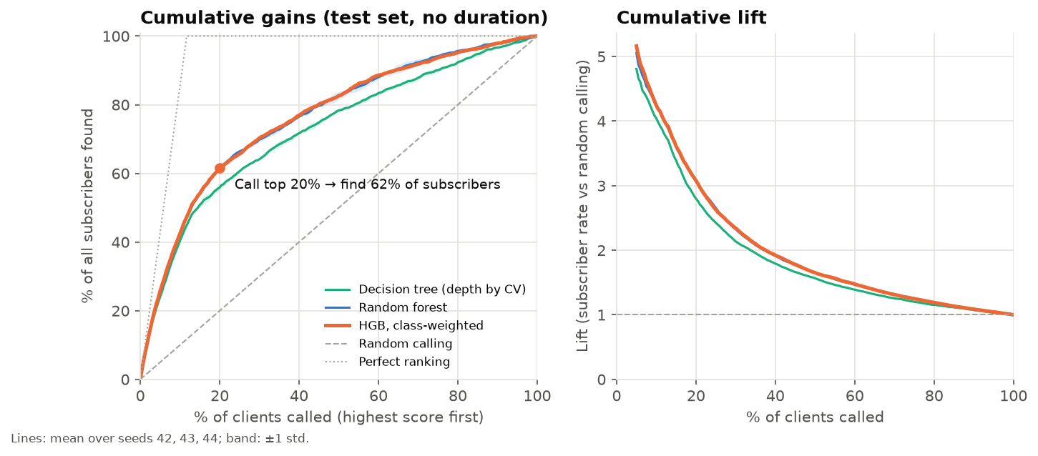
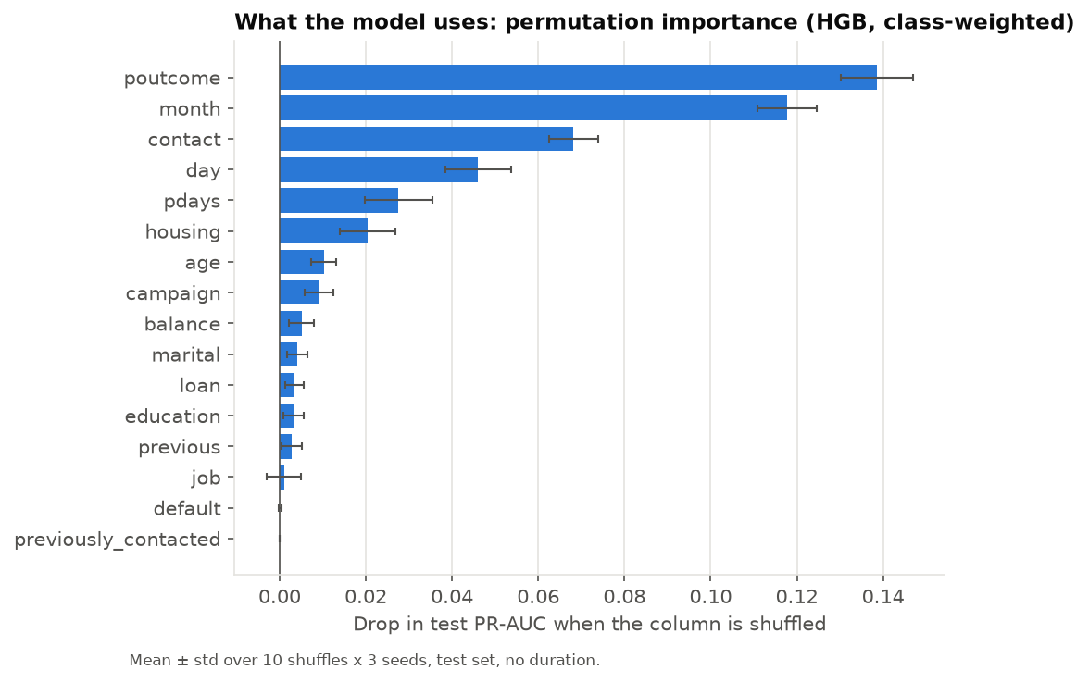
Call the top 20% and find 62% of subscribers
42%
62%
17.6k
poutcome
of subscribers found by calling only the top 10%
found in the top 20%: 3.1× better than random calling
profit vs 5.7k for calling everyone (cost 5, reward 50)
and month matter most; demographics add little
Notes:
Using the weighted boosting model (best validation PR-AUC): ranking clients and calling the top 10% reaches 42% of subscribers, and the top 20% reaches 62%, a lift of about 3.1. With a call cost of 5 and a reward of 50, the validation-chosen threshold earns about 17.6k on the test list, against 5.7k for calling everyone; at reward 25, calling everyone loses 14.1k while the model still earns 5.7k. Permutation importance on the test set: the previous campaign outcome (poutcome) and month dominate, then contact type, day and pdays.

Slide 10



What this model cannot tell us yet
Limitations
Ethics
Next steps
Random, not time-based, split: no evidence yet about a future campaign
One Portuguese bank, 2008–2010
Weighted scores rank well but are not probabilities
The model calls 68% of clients aged 60+ and 51% of students, but about 9% of those aged 40–59
Cap contacts per client and audit who is targeted
Train on earlier months, test on later ones
Calibrate (isotonic), then set the profit threshold at c/r
Better features for first-time contacts (82% of clients)
Code, results and report: github.com/sahitya1903/ec417-miniproject-P05-623169-623195 (tag v1.0)
Notes:
Limitations: calls from 2008-2010 are shuffled across train and test, so the scores say nothing yet about predicting a future campaign; month is the second most important feature and part of that may be campaign timing. The data come from one bank during the financial crisis. Ethics: because older clients and students subscribe more often, the model concentrates calls on them; older clients can be vulnerable to pressure selling, so a real deployment needs contact caps, a suitability check and an audit of who is targeted. Next steps: a temporal split, isotonic calibration with a profit threshold at c/r, and better features for first-time contacts, where the model is weakest (PR-AUC 0.31 vs 0.75 after a previous success).

