Slide 1
Blood Donor Web Portal
Presented by:
K.Krishna.Karthika - 17BQ1A05A1
K.V.S.Sahitya - 17BQ1A05A0
K.Geethika - 17BQ1A05B6
Guided By:
-Dr.T.Kameswara Rao

Slide 2
Abstract
Objective of this application is to develop an Online Blood Donation Information System.It consist of two modules,one for the donar and another for acceptor.This application serves both the people based on the information stored in the blood donation system.This information is maintained by the admin about donors and available blood groups.

Slide 3
Modules
Donate Blood
-Blood Donate Form
Require Blood
-Blood Require Form

Slide 4
Software Requirements:
- Windows 7 or higher
- HTML,CSV
- PHP
- XAMPP
Hardware Components:
- Processor-Core i7
- Hard Disk-100GB
- Memory-1GB RAM

Slide 5
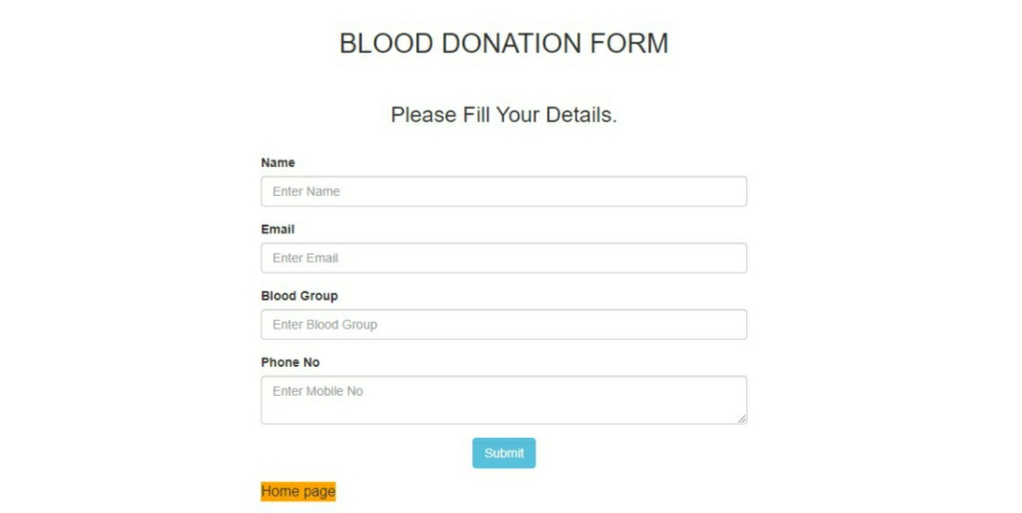
Donate Blood Interface

Slide 6
Donor Blood Details
Donation Blood interface should include the following details
- Name
- Email
- Blood Group
- Phone No

Slide 7
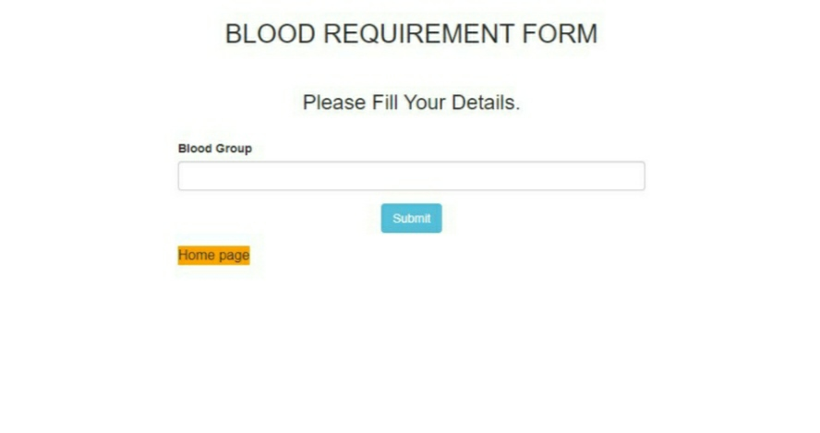
Require Blood Interface

Slide 8
Require Blood Details
Require Blood interface includes the following in
- Blood Group

Slide 9
Advantages
Recipients can get donor details easily.
In case of emergency he/she can find for the certain blood group donor.

Slide 10
Limitations
It requires active internet connection.
Application
Useful for finding donor details during emergency cases.

Slide 11
Thank You

