Slide 1

Detection of Nuke Attacks (Love-Hate Attack) in Recommender Systems
19CSE305 - Machine Learning
Case Study review 1
Group 6

Slide 2
Team Members
Roll No | Name | Contribution
CB.EN.U4CSE19006 | A Harsha Vardhan Chowdary | Preprocessing
CB.EN.U4CSE19014 | D Lalith Varma | Problem Statement and understanding
CB.EN.U4CSE19015 | E Sahitya | Visualization
CB.EN.U4CSE19024 | Inukonda Sudheepthi | Dataset identified and understanding

Slide 3
Problem Statement
Recommender systems are vulnerable to Profile-injection attacks. User-generated content data such as user ratings and reviews, are used by attackers to manipulate recommendation rankings.
There are different types of Profile-injection attacks .
Push Attack(To increase the ratings of an item)
Nuke attack(To decrease the ratings of an item)
Love-Hate attack is one of the Nuke attacks. Love-Hate attack is a specialized attack model that works effectively to decrease ratings .
The aim of our case study is to create an efficient machine learning model that helps in detecting the Nuke Attacks(Love-Hate attack) in recommender systems.

Slide 4
How to Detect Attacks?
Credibility of group users by rating prediction model
User-based collaborative filtering recommendation
Prediction shift and rating variances of shilling attacks
Shilling attack detecting approach based on a two-phase structure
Locate suspicious time intervals by rating time series

Slide 5
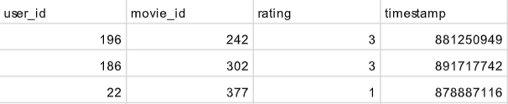
Dataset
We have chosen a 3 datasets, which when combined have 50,000 ratings from more than 900 users on more than 1600 movies.
Link : https://grouplens.org/datasets/movielens/100k/
The three datasets identified are :-
1) data.csv - A dataset which contains the following attributes :-
user id , movie id , rating , timestamp
Rating given here is an integer that lies in : {0-5}
A timestamp is when a certain event occurred.
In this case it is the unix seconds since 1/1/1970 UTC
Example : A user with user id : 196 has rated a movie with movie id : 242 as 3 (rating) and the timestamp for this particular action of the user is 881250949 .

Slide 6
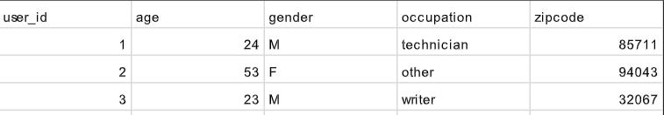
2) user.csv - A dataset which contains information about the users.
Attributes in this dataset are :- user id , age , gender , occupation , zip code
3) movie.csv - A dataset which contains information about the movies . Attributes in this dataset are :-
movie id , movie title , release date , video release date , IMDB URL , unknown , Action, Adventure , Animation , Children's , Comedy , Crime , Documentary , Drama , Fantasy , Film-Noir , Horror , Musical ,Mystery , Romance , Sci-Fi , Thriller , War , Western
Common attribute between data.csv and user.csv is user_id
Hence we can merge these two datasets upon the attribute user_id
Similarly this resultant dataset and movie.csv are merged upon the attribute movie_id

Slide 7
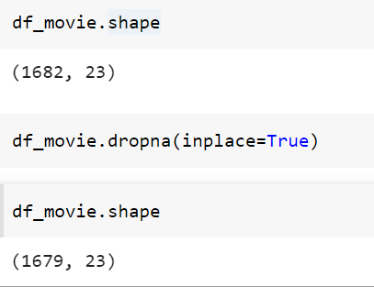
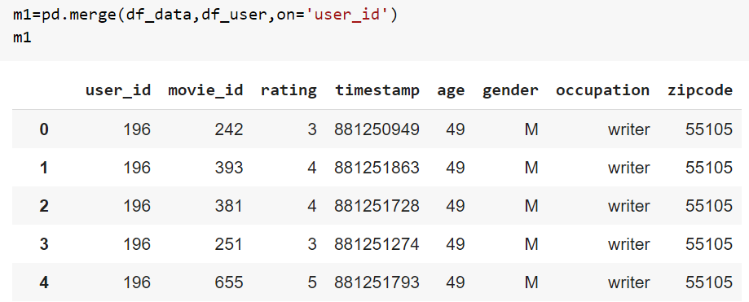
Data Preprocessing - The technique used to convert the raw data into a clean data set.
Why should we preprocess the data ?
A real-world data is raw in nature and generally contains noises, missing values, and maybe in an unusable format which cannot be directly used for machine learning models. Hence , data preprocessing is required for cleaning the data and making it suitable for a machine learning model which also increases the accuracy and efficiency of a machine learning model.

Slide 8
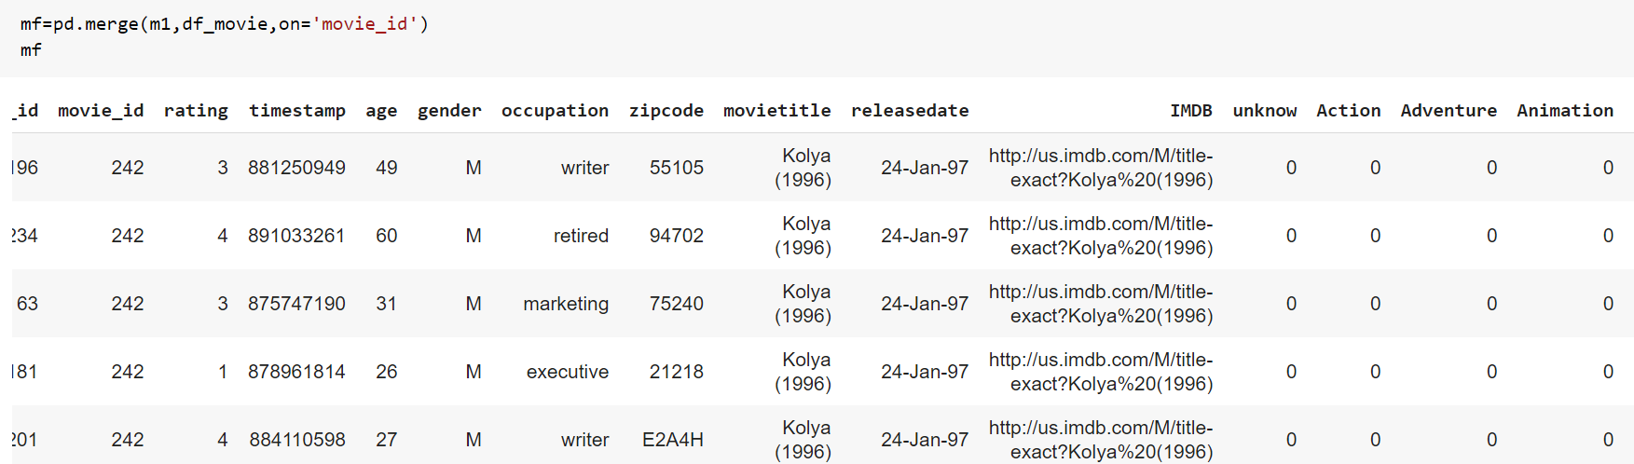
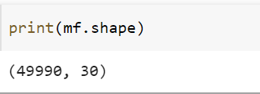
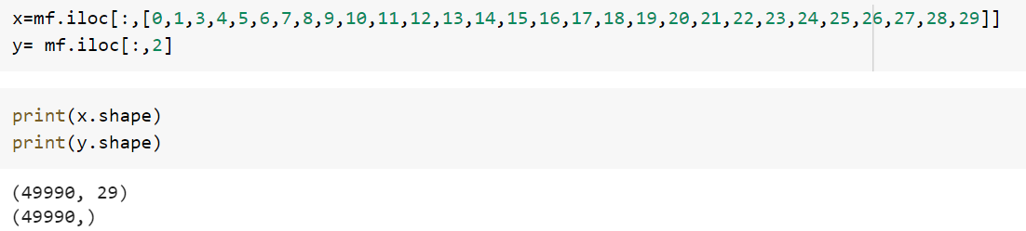

Slide 9
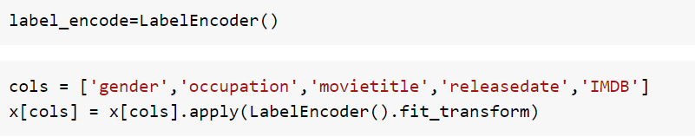
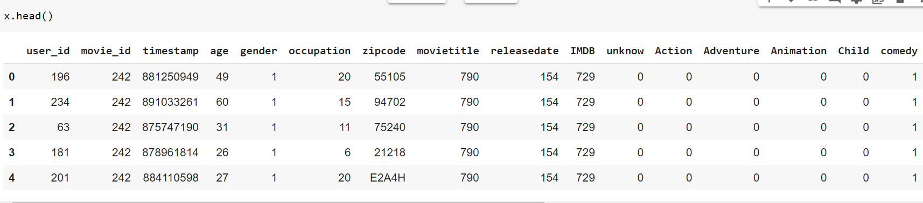
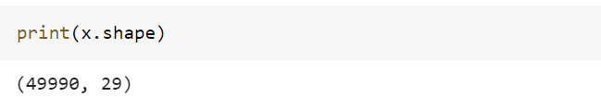

Slide 10
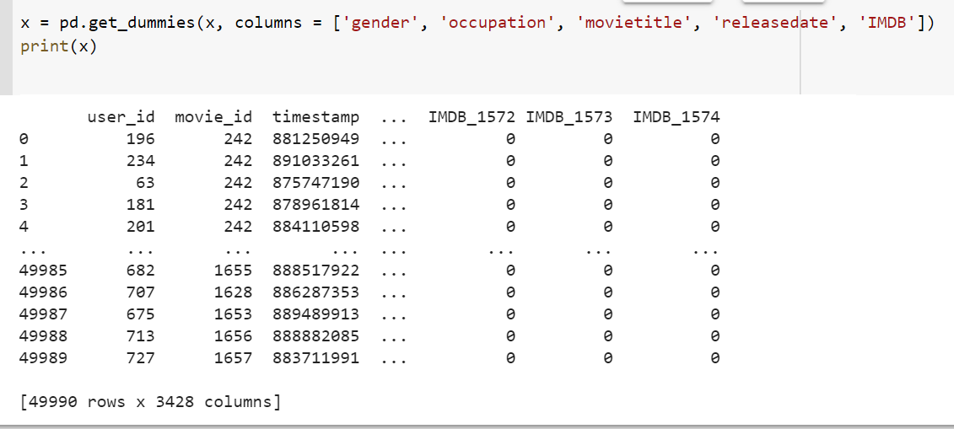
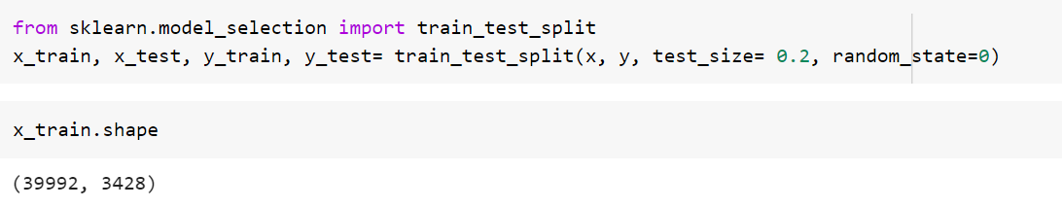

Slide 11

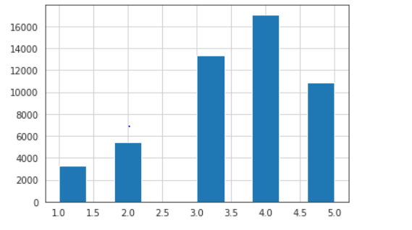
Visualization
Histogram

Slide 12
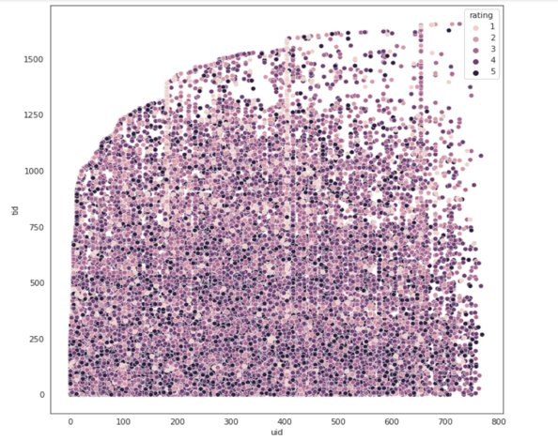


Slide 13
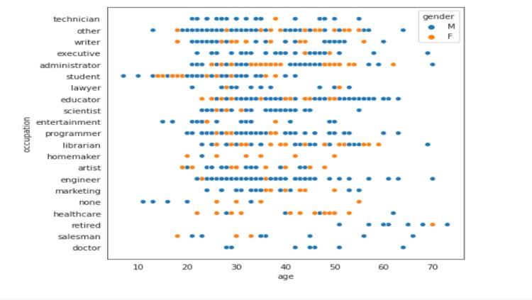


Slide 14
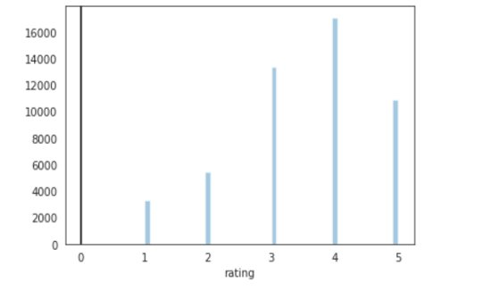


Slide 15
