Slide 1
PEA TOKEN

Slide 2
SMART contract
name = 'PeaToken'
decimals = 2
symbol = 'PEA’
totalSupply = 100000000 (1000000.00)
balances[EasyPeasyWallet] = _totalSupply;
emit Transfer(address(0), EasyPeasyWallet, _totalSupply);
balanceOf(tokenOwnerAddress)
transferFrom(fromAddress, toAddress,value)
transfer(toAddress,value)
approve(senderAddress,value)
allowance(ownerAddress, senderAddress)

Slide 3
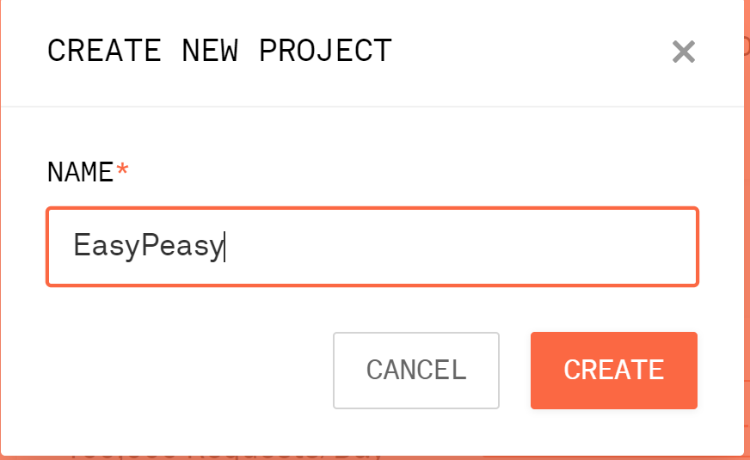
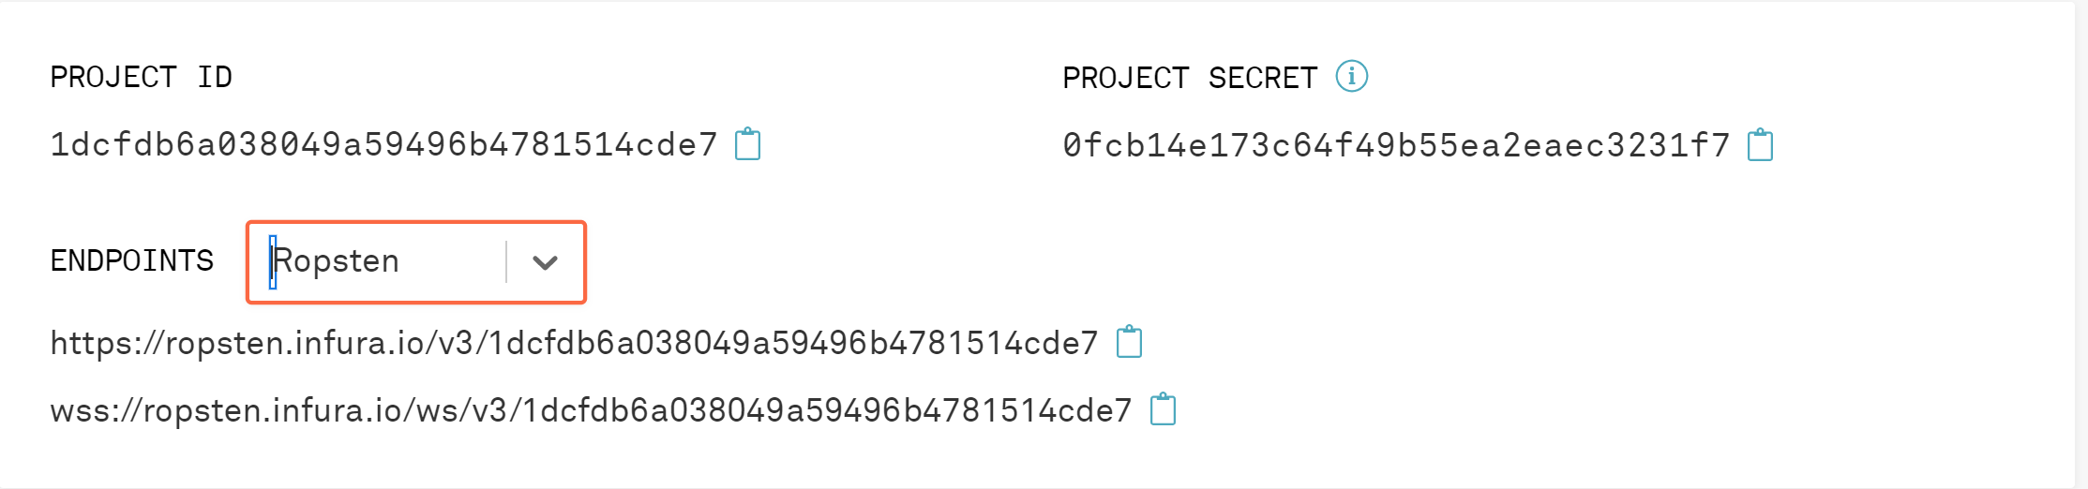
Infura ROPSTEN PROVIDER

Slide 4
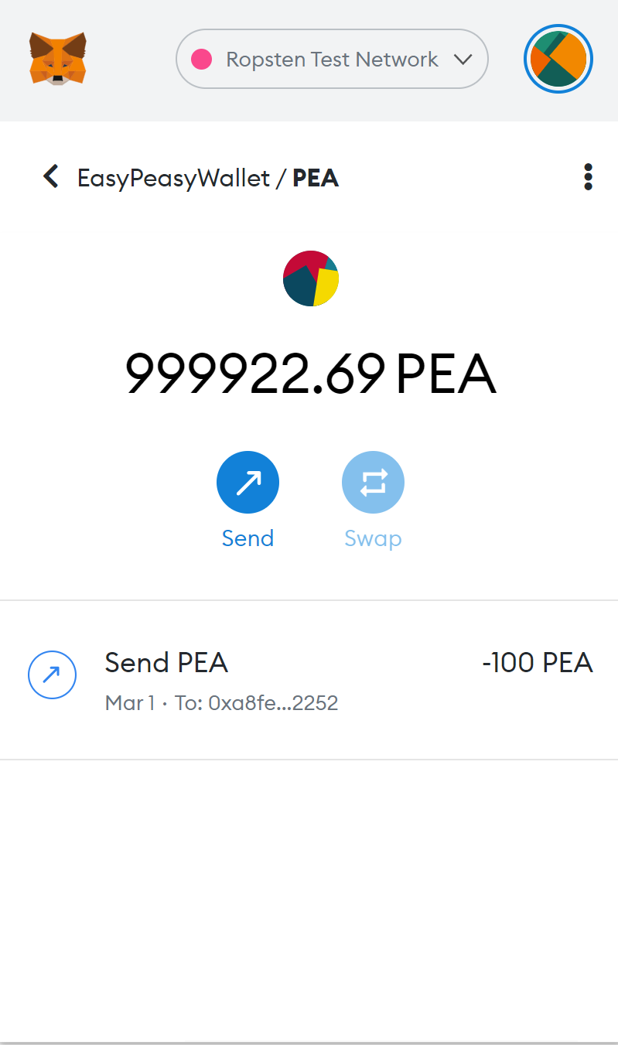
Server’s Wallet

Slide 5
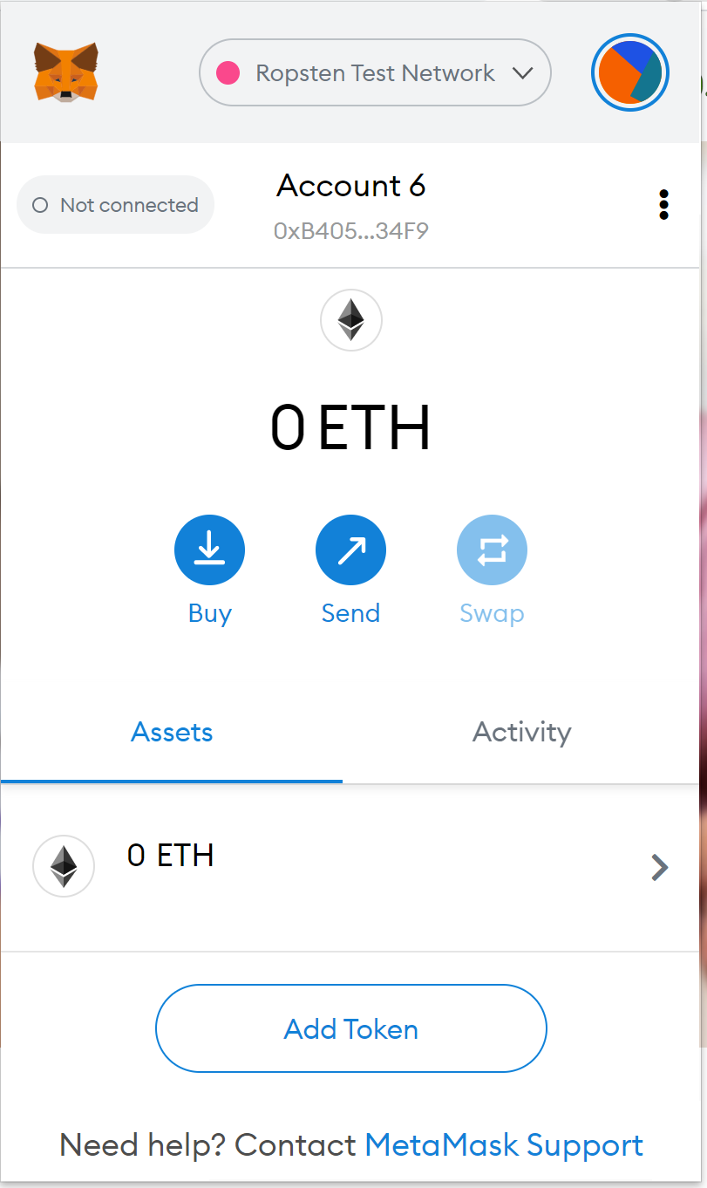
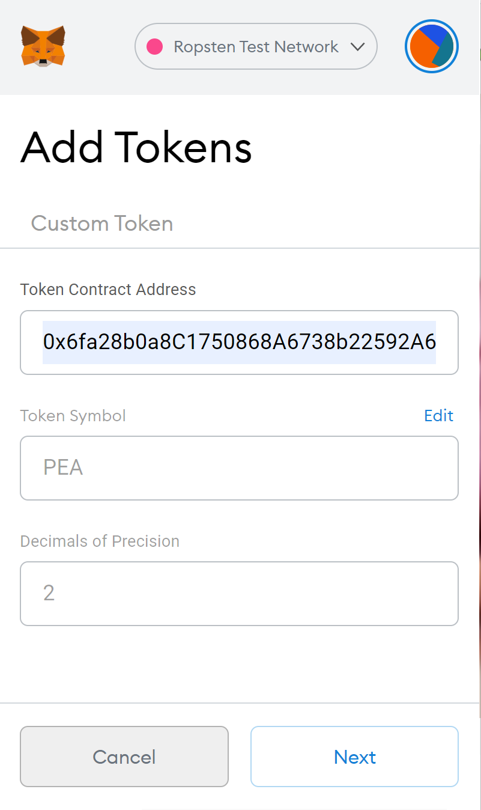
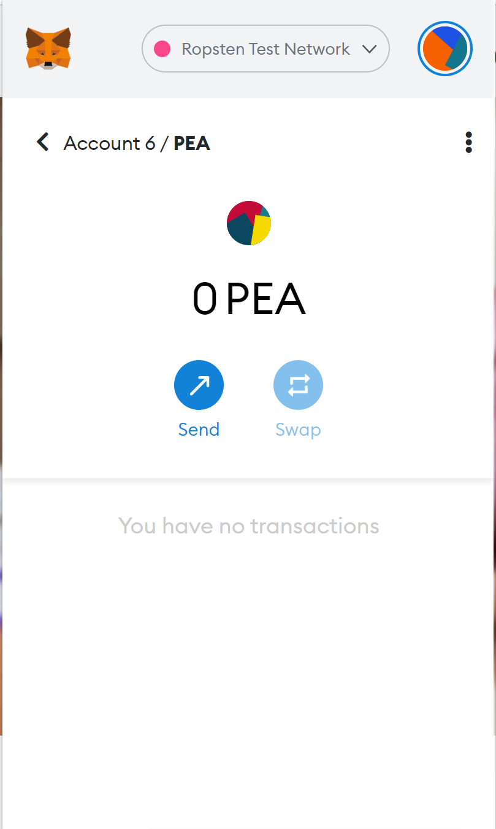
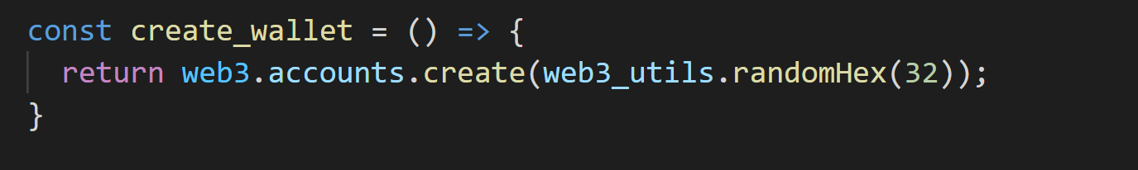
User’s Wallet

Slide 6
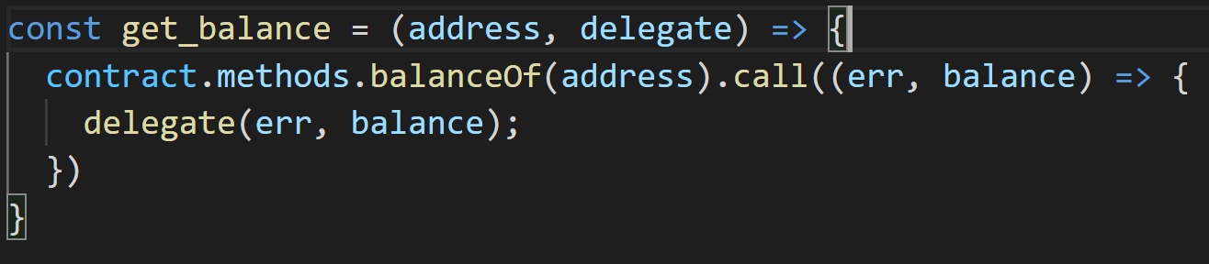
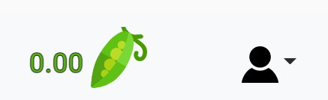
Balance

Slide 7
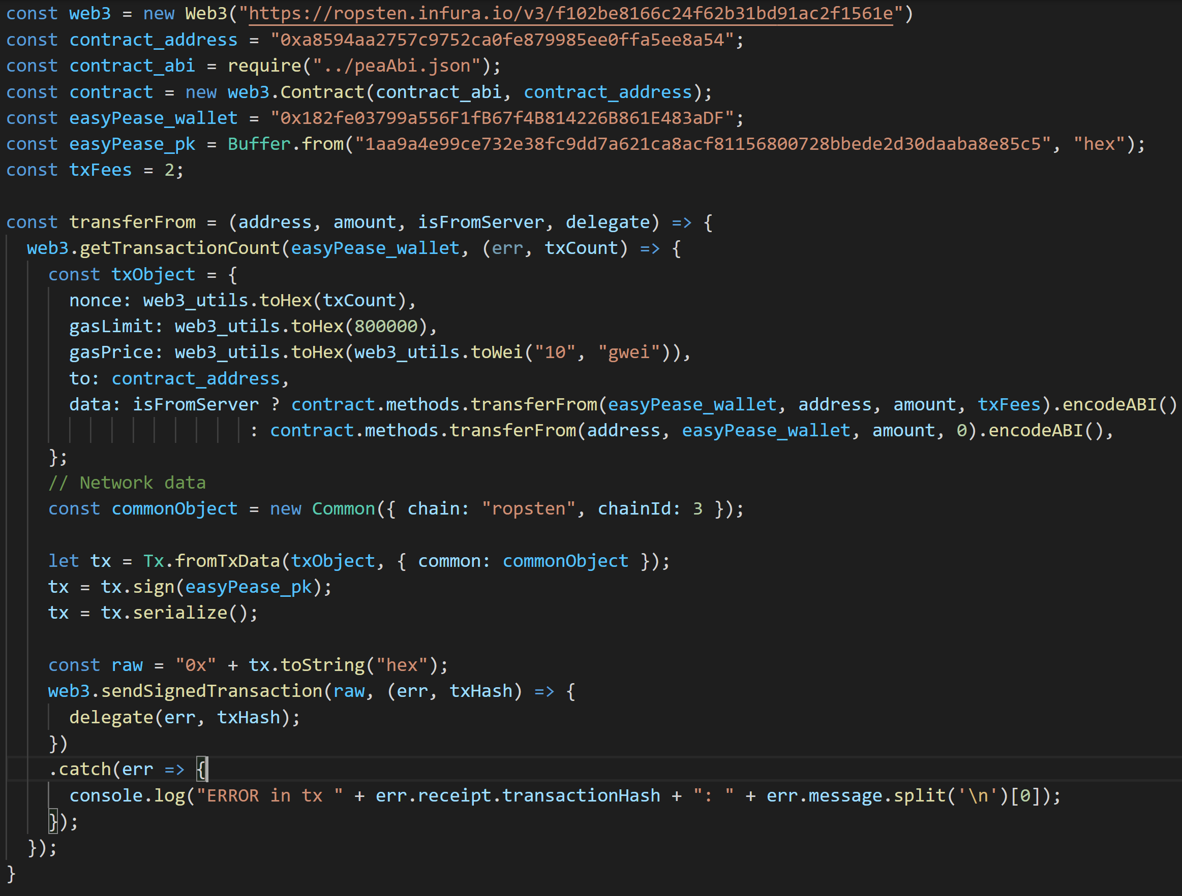
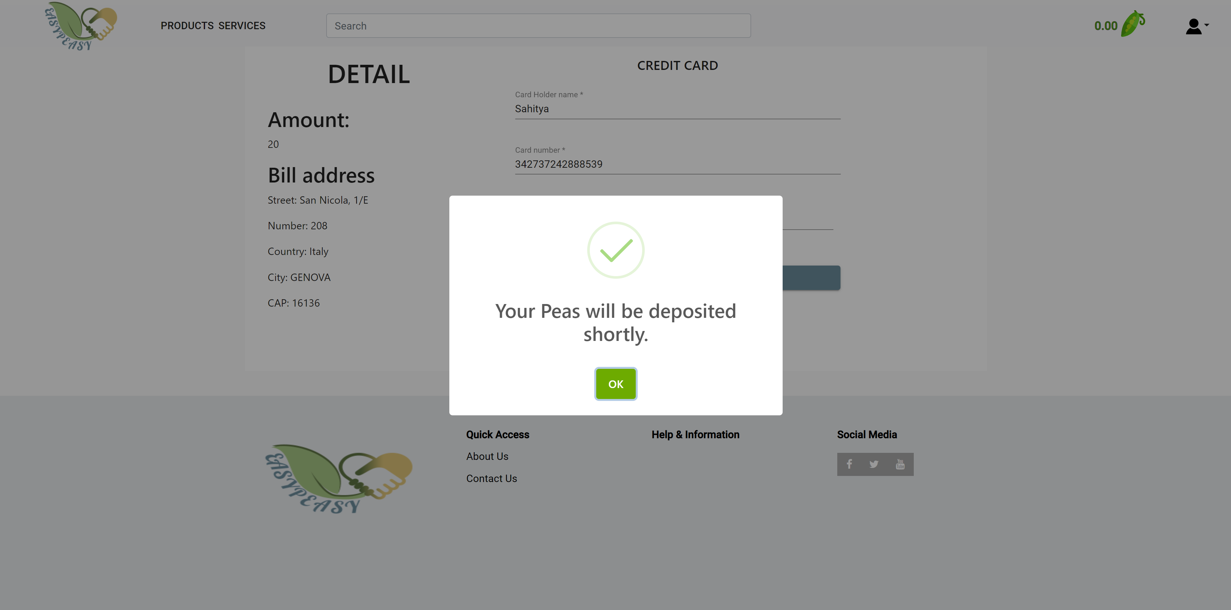
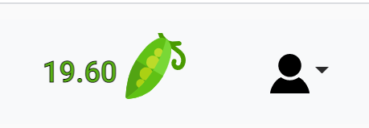
Transaction

Slide 8
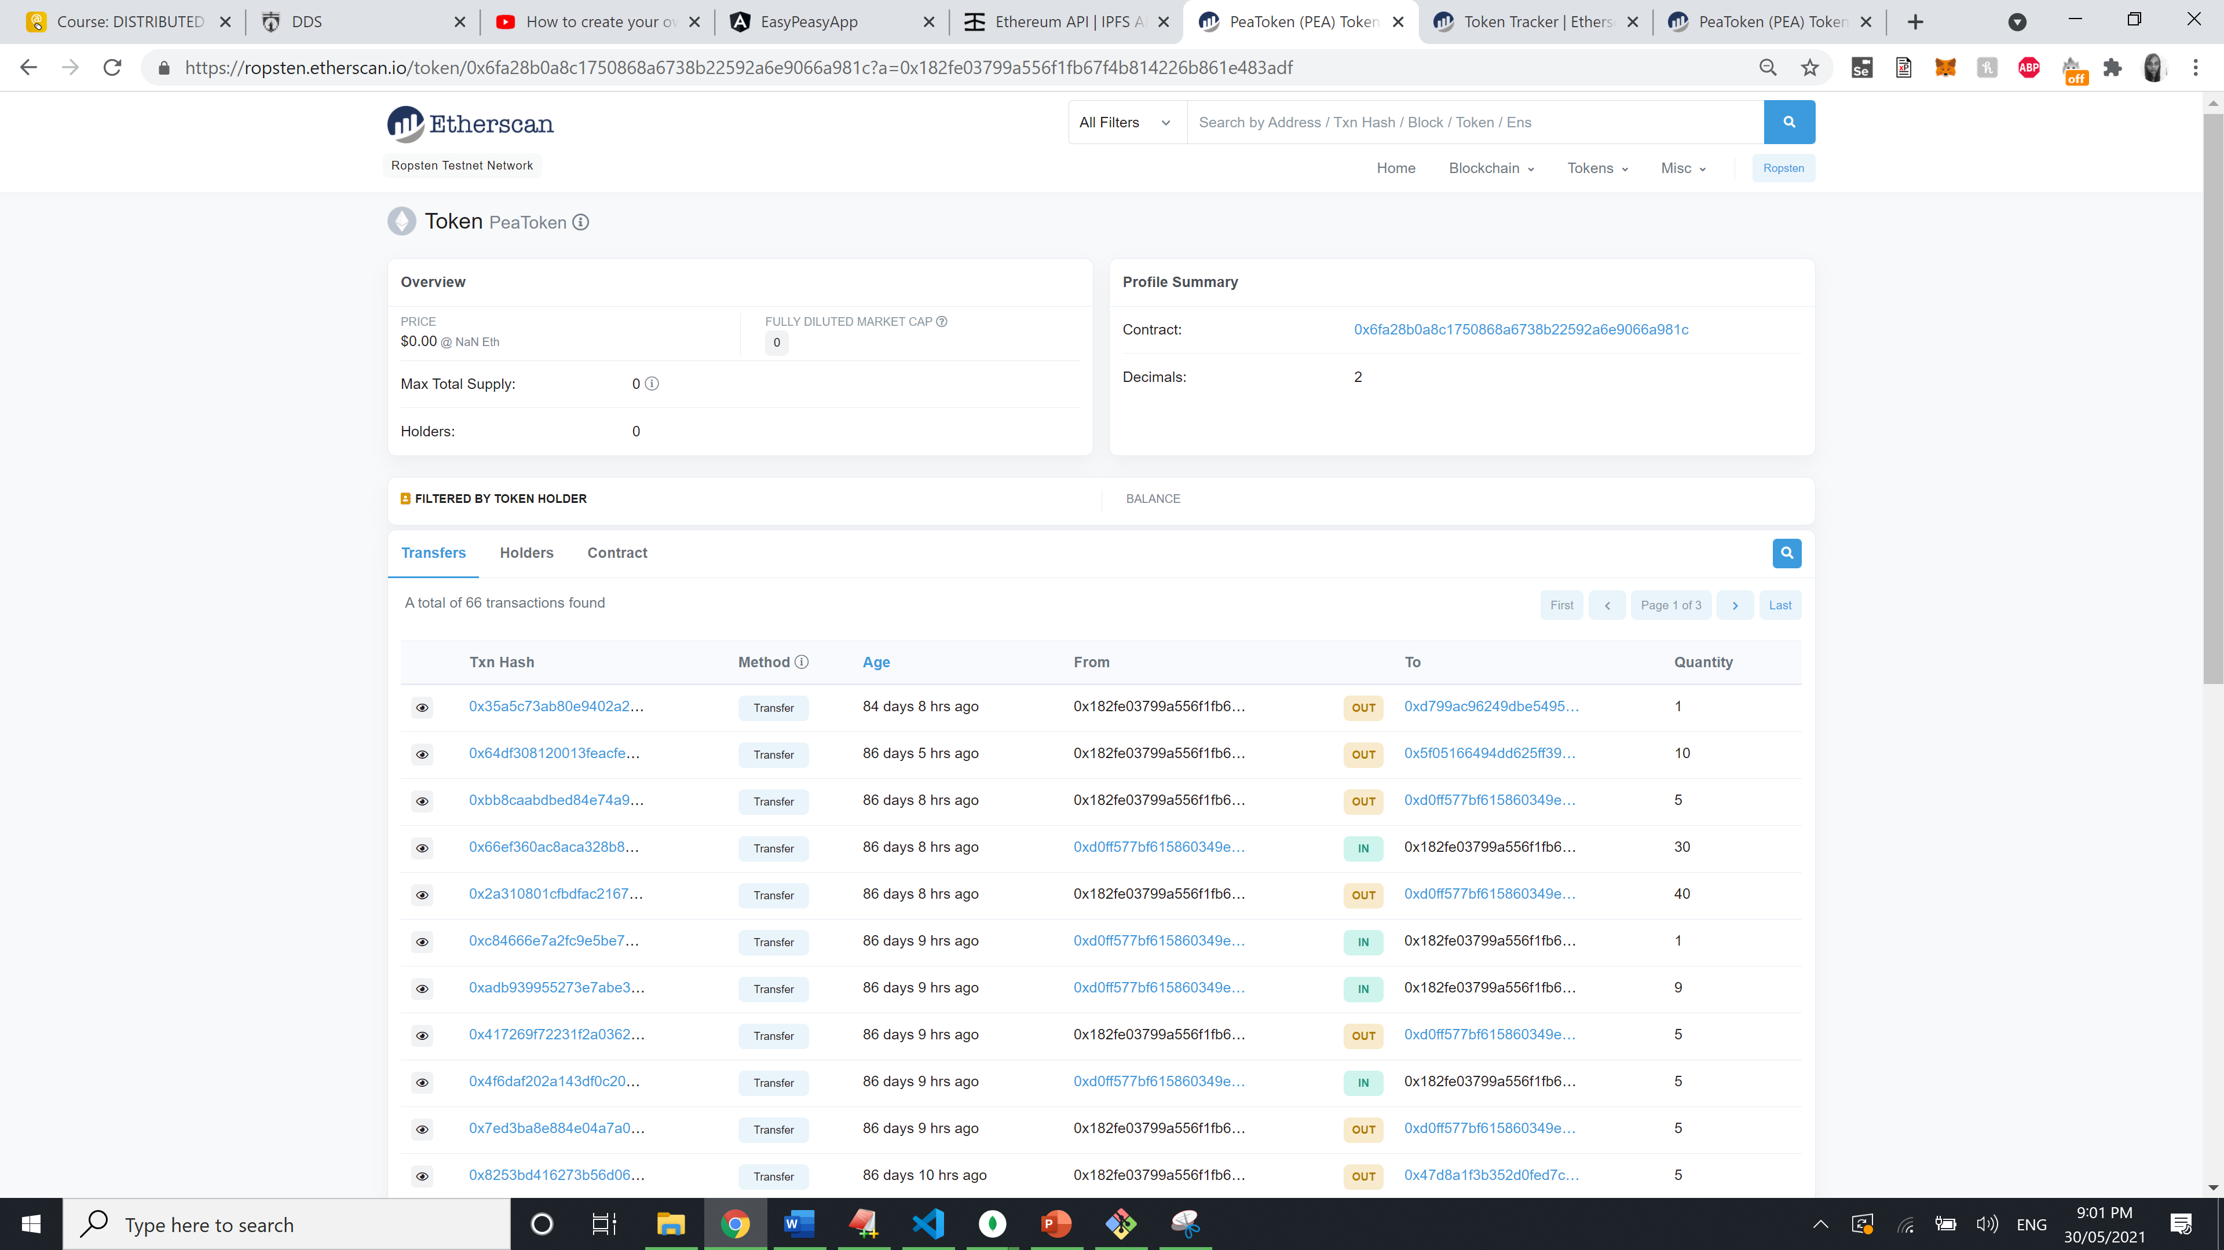

Slide 9
