Slide 1

Virtualization and cloud computing
Final Project
Supervised by : Alessio Merlo
Enrico Russo
Sahitya Reddy Bollavaram
Enas Karaem
Fatima Elgallal
Prepared by :

Slide 2
Objective
To build a distributed architecture consisting of 3 Virtual Machines (Ubuntu Server 16.04). The three machines will be placed in a Docker Swarm and will share a file system with GlusterFS technology.
The Swarm will house the following containers:
Træfik, Joomla, MariaDB, Prometheus, Grafana

Slide 3
VMnet creation
Clone VM
Creation
Setup Docker and Git
Virtual machine creation
New Hard Disk

Slide 4
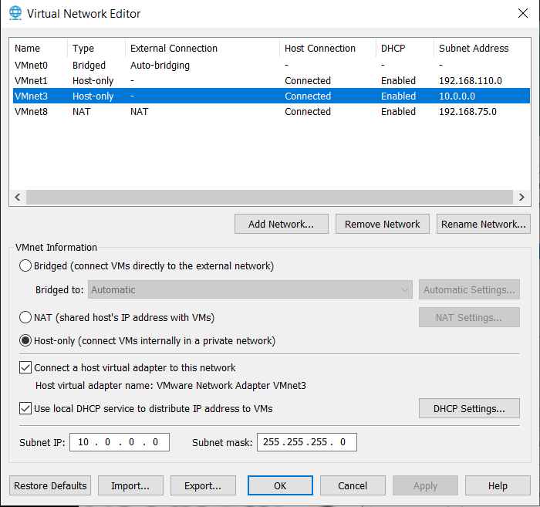
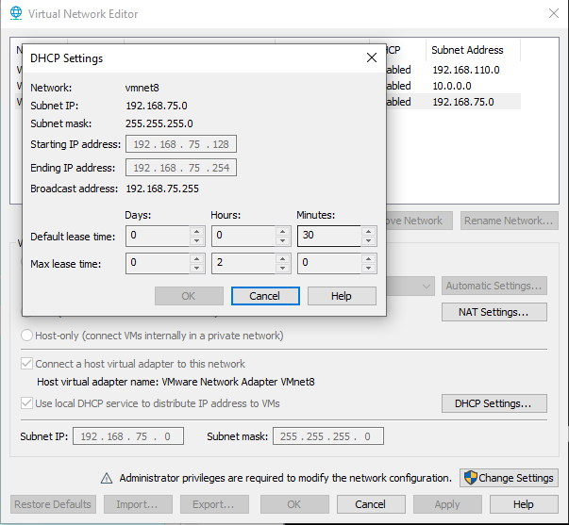
VMnet Creation
VMnet 3
VMnet 8

Slide 5
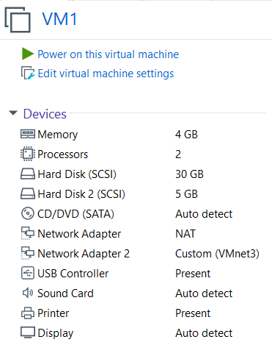
Virtual Machine Creation

Slide 6
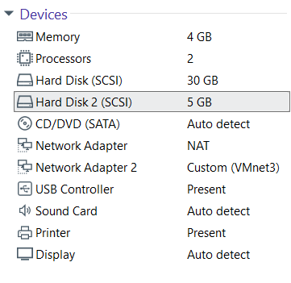
Add New Hard Disk
Settings > Add > Hard Disk (SCSI)
sudo fdisk -l
Formatting :
sudo mkfs.ext4 /dev/sdb

Slide 7

Setup
Docker Compose
sudo curl -L "https://github.com/docker/compose/releases/download/1.24.1/docker-compose-$(uname -s)-$(uname -m)" -o /usr/local/bin/docker-compose
sudo chmod +x /usr/local/bin/docker-compose
sudo apt install curl
sudo curl -fsSL https://download.docker.com/linux/ubuntu/gpg | sudo apt-key add -
sudo apt-get install software-properties-common
sudo add-apt-repository "deb [arch=amd64] https://download.docker.com/linux/ubuntu $(lsb_release -cs) stable"
sudo apt-get update
sudo apt-get install docker-ce docker-ce-cli containerd.io
sudo usermod -aG docker [user]
sudo systemctl restart docker

Slide 8

z
Virtual Machine Clone
VM1>Manage>Clone
VM1
VM2
VM3

Slide 9
Configuration
1
2
3
Network setup
Gluster FS
Docker Swam

Slide 10


GlusterFs net
vm1g
ens38
10.0.0.11
vm2g
ens38
10.0.0.12
vm3g
ens38
10.0.0.13
ens38
10.0.0.0/24
Gluster Volume gfs
External Internet
/gfs
/gfs
/gfs
VM1
Manger
VM2
Worker
VM3
Worker
Host
Docker Swam intnet 192.168.200.0/24
ens33
192.168.75.1/24
Joomla
PHPmyadmin
Miontoring
Grafana
managedb
ens33
192.168.75.11
ens33
192.168.75.12
ens33
192.168.75.13

Slide 11
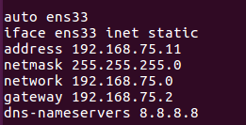

Network Setup
On VM1
sudo nano /etc/network/interfaces
sudo nano /etc/hosts
Naming the Machine
sudo nano /etc/hostname
vm1

Slide 12
Network Setup
Do the same on VM2 changing address with respectively
192.168.75.12
Do the same on VM3 changing address with respectively
192.168.75.13

Slide 13
Network Test
sudo reboot
ifconfig
Test connectivity with names
ping vm2
Test connectivity with IP
ping 192.168.75.12

Slide 14
GlusterFs net
vm1g
ens38
10.0.0.11
vm2g
ens38
10.0.0.12
vm3g
ens38
10.0.0.13
ens38
10.0.0.0/24
Gluster Volume gfs
External Internet
/gfs
/gfs
/gfs
VM1
Manger
VM2
Worker
VM3
Worker
Host
Docker Swam intnet 192.168.200.0/24
ens33
192.168.75.1/24
Joomla
PHPmyadmin
Monitoring
Grafana
managedb
ens33
192.168.75.11
ens33
192.168.75.12
ens33
192.168.75.13

Slide 15
Gluster FS - Setup
VM1
1
sudo nano /etc/network/interfaces
auto ens38
iface ens38 inet static
address 10.0.0.11
netmask 255.255.255.0
network 10.0.0.0
gateway 10.0.0.2
3
sudo nano /etc/hosts
10.0.0.11 vm1g
10.0.0.12 vm2g
10.0.0.13 vm3g
2
sudo reboot
ping vm2g

Slide 16
Gluster FS - Setup
Do the same on VM2 changing address with respectively
10.0.0.12
Do the same on VM3 changing address with respectively
10.0.0.13

Slide 17
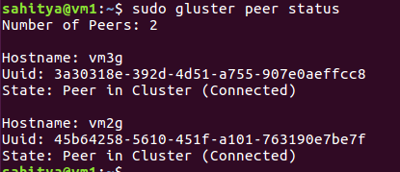
Gluster FS - installation
1
sudo apt update;
sudo apt -y install glusterfs-server glusterfs-client
2
Start the service:
sudo service glusterfs-server start
3
Peer the service
sudo gluster peer probe vm2g
sudo gluster peer probe vm3g
4
Check the status
sudo gluster peer status

Slide 18
Gluster FS - Bricks
1
Bricks folder
sudo mkdir -p /gluster/bricks/1 (on vm1)
sudo mkdir -p /gluster/bricks/2 (on vm2)
sudo mkdir -p /gluster/bricks/3 (on vm3)
2
Add the line to the / etc / fstab file on the VMs to mount the bricks
echo '/dev/sdb /gluster/bricks/1 ext4 defaults 0 0' >> /etc/fstab (on vm1)
echo '/dev/sdb /gluster/bricks/2 ext4 defaults 0 0' >> /etc/fstab (on vm2)
echo '/dev/sdb /gluster/bricks/3 ext4 defaults 0 0' >> /etc/fstab (on vm3)
4
Mount filesystem
sudo mount -a (on vm1, vm2, vm3)

Slide 19
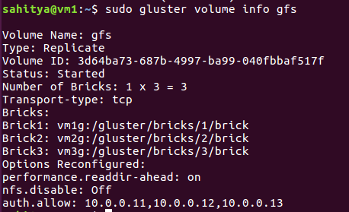
Gluster FS-Replicated Volumes
1
Create gfs volume
sudo gluster volume create gfs replica 3 \
vm1g:/gluster/bricks/1/brick \
vm2g:/gluster/bricks/2/brick \
vm3g:/gluster/bricks/3/ brick
2
Start volume
sudo gluster volume start gfs
4
Check the status
sudo gluster volume info gfs
sudo gluster volume status gfs

Slide 20
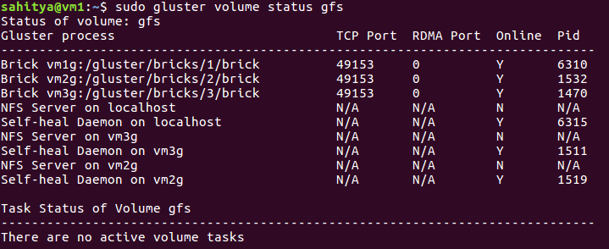
Gluster FS – Replicated Volumes
Connecting to GFS on the three nodes
sudo gluster volume set gfs auth.allow 10.0.0.11, 10.0.0.12,10.0.0.13
sudo gluster volume set gfs nfs.disable Off

Slide 21
Mounting GlusterFs Volume
On each node, mount the volume
sudo mkdir /gfs
sudo su
echo 'localhost:/gfs /gfs glusterfs defaults,_netdev,backupvolfile-server=localhost 0 0' >> /etc/fstab sudo mount -a

Slide 22
Gluster FS – Verify gfs
Create a file on a virtual machine
echo “Hello world”> /gfs/hello.txt
Verify on other two VM
cat /gfs/hello.txt
Create folders
mkdir /gfs/joomla
mkdir /gfs/phpmyadmin
mkdir /gfs/mysql
mkdir /gfs/grafana
chmod -R a=rwx /gfs/grafana/

Slide 23
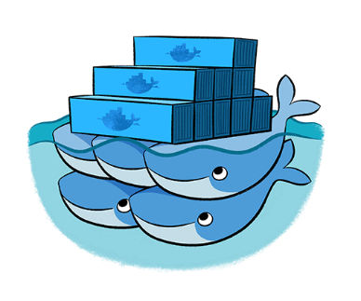
Docker Swarm
Swam Manager
docker swarm init --advertise-addr ens33
docker swarm join-token manager
Swam worker
docker node promote <node name>
docker node demote <node name>

Slide 24
Result
1
2
3
Build
Docker Stack
Services

Slide 25
ClusterFs net
vm1g
ens38
10.0.0.11
vm2g
ens38
10.0.0.12
vm3g
ens38
10.0.0.13
ens38
10.0.0.0/24
Gluster Volume gfs
External Internet
/gfs
/gfs
/gfs
VM1
Manger
VM2
Worker
VM3
Worker
Host
Docker Swam intnet 192.168.200.0/24
ens33
192.168.75.1/24
Joomla
PHPmyadmin
Monitoring
Grafana
managedb
ens33
192.168.75.11
ens33
192.168.75.12
ens33
192.168.75.13

Slide 26

Build
Joomla folder
docker build . -t joomla_img
Phpmyadmin
docker build . -t pmy_img

Slide 27
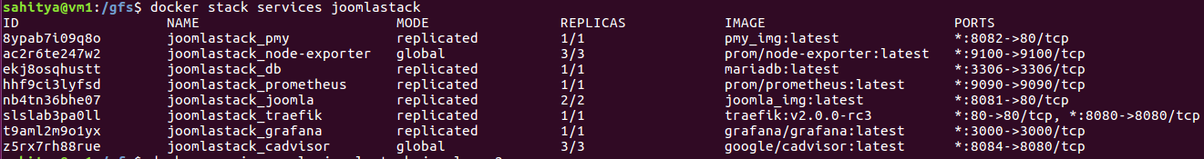
Docker Stack
docker stack deploy joomlastack -c docker-compose.yml
Services docker stack ps joomlastack docker stack services joomlastack

Slide 28

Host File
VMware
192.168.75.11 vm1
192.168.75.12 vm2
192.168.75.13 vm3
VMware GlusterFS
10.0.0.11 vm1g
10.0.0.12 vm2g
10.0.0.13 vm3g
services
192.168.75.11 vm1 joomla.local
192.168.75.11 vm1 managedb.joomla.local
192.168.75.11 vm1 prometheus.joomla.local
192.168.75.11 vm1 monitor.joomla.local
192.168.75.11 vm1 map.joomla.local

Slide 29
GlusterFs net
vm1g
ens38
10.0.0.11
vm2g
ens38
10.0.0.12
vm3g
ens38
10.0.0.13
ens38
10.0.0.0/24
Gluster Volume gfs
External Internet
/gfs
/gfs
/gfs
VM1
Manger
VM2
Worker
VM3
Worker
Host
Docker Swam intnet 192.168.200.0/24
ens33
192.168.75.1/24
Joomla
PHPmyadmin
Monitoring
Grafana
managedb
ens33
192.168.75.11
ens33
192.168.75.12
ens33
192.168.75.13

Slide 30
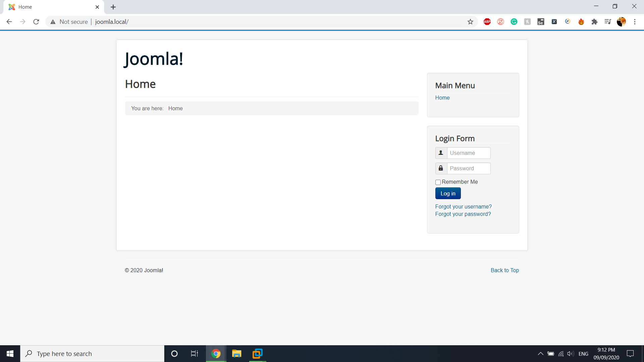
Joomla

Slide 31
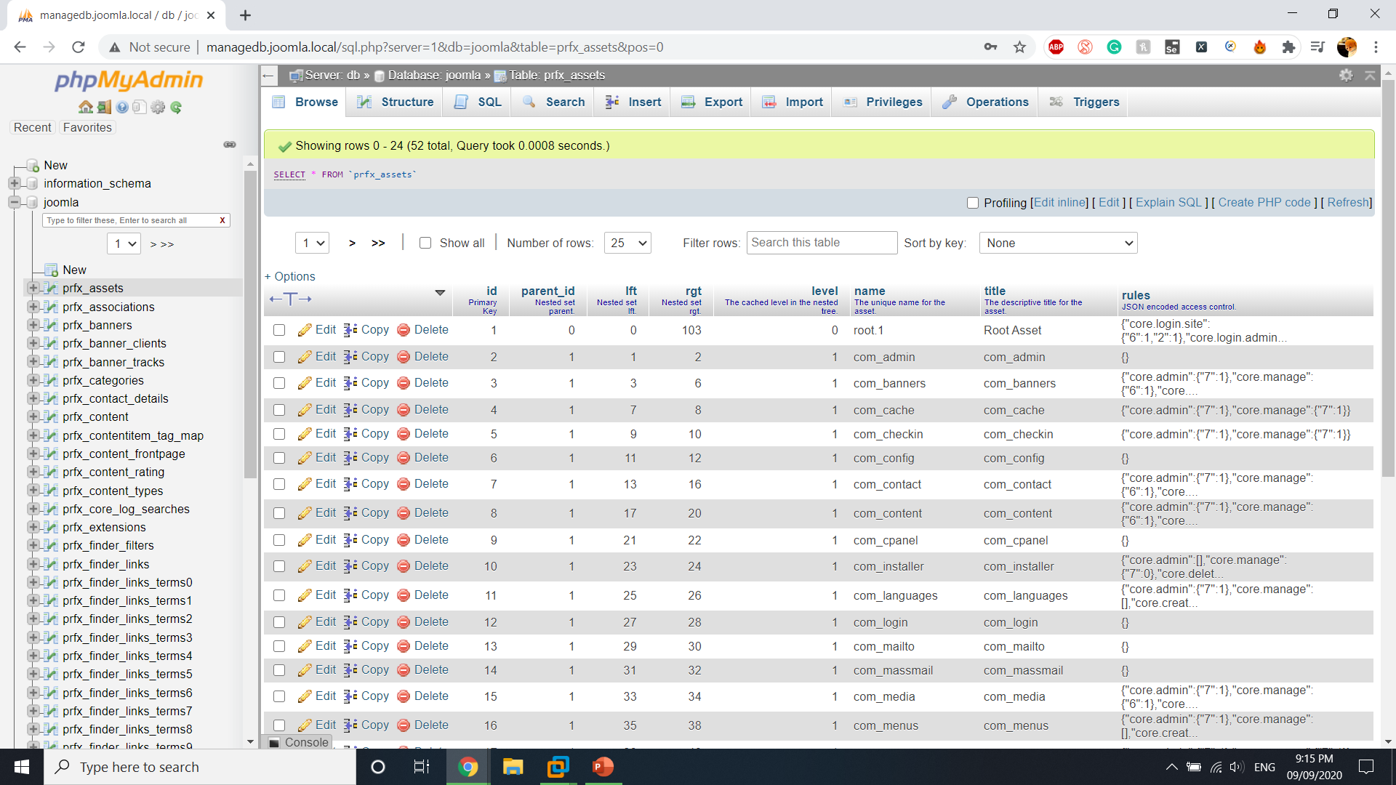
Phpmyadmin

Slide 32
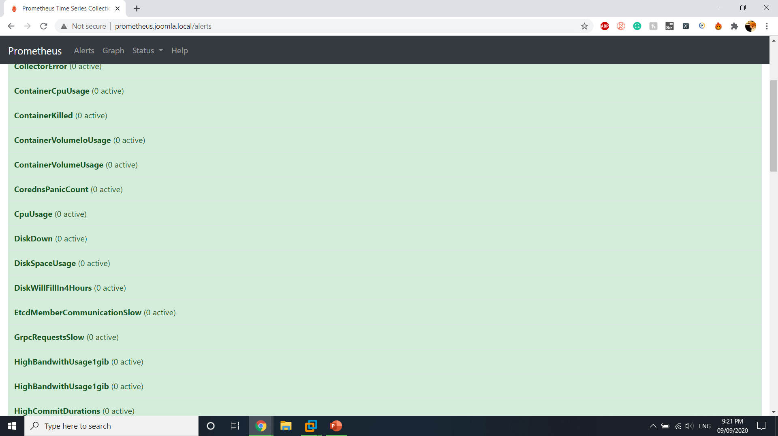

Prometheus

Slide 33
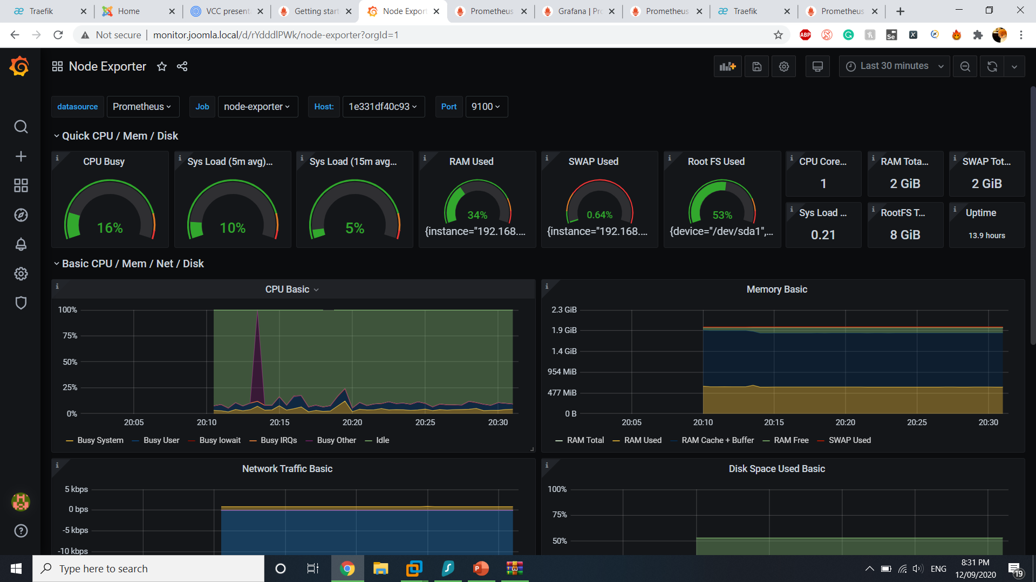

Monitoring
using grafana

Slide 34
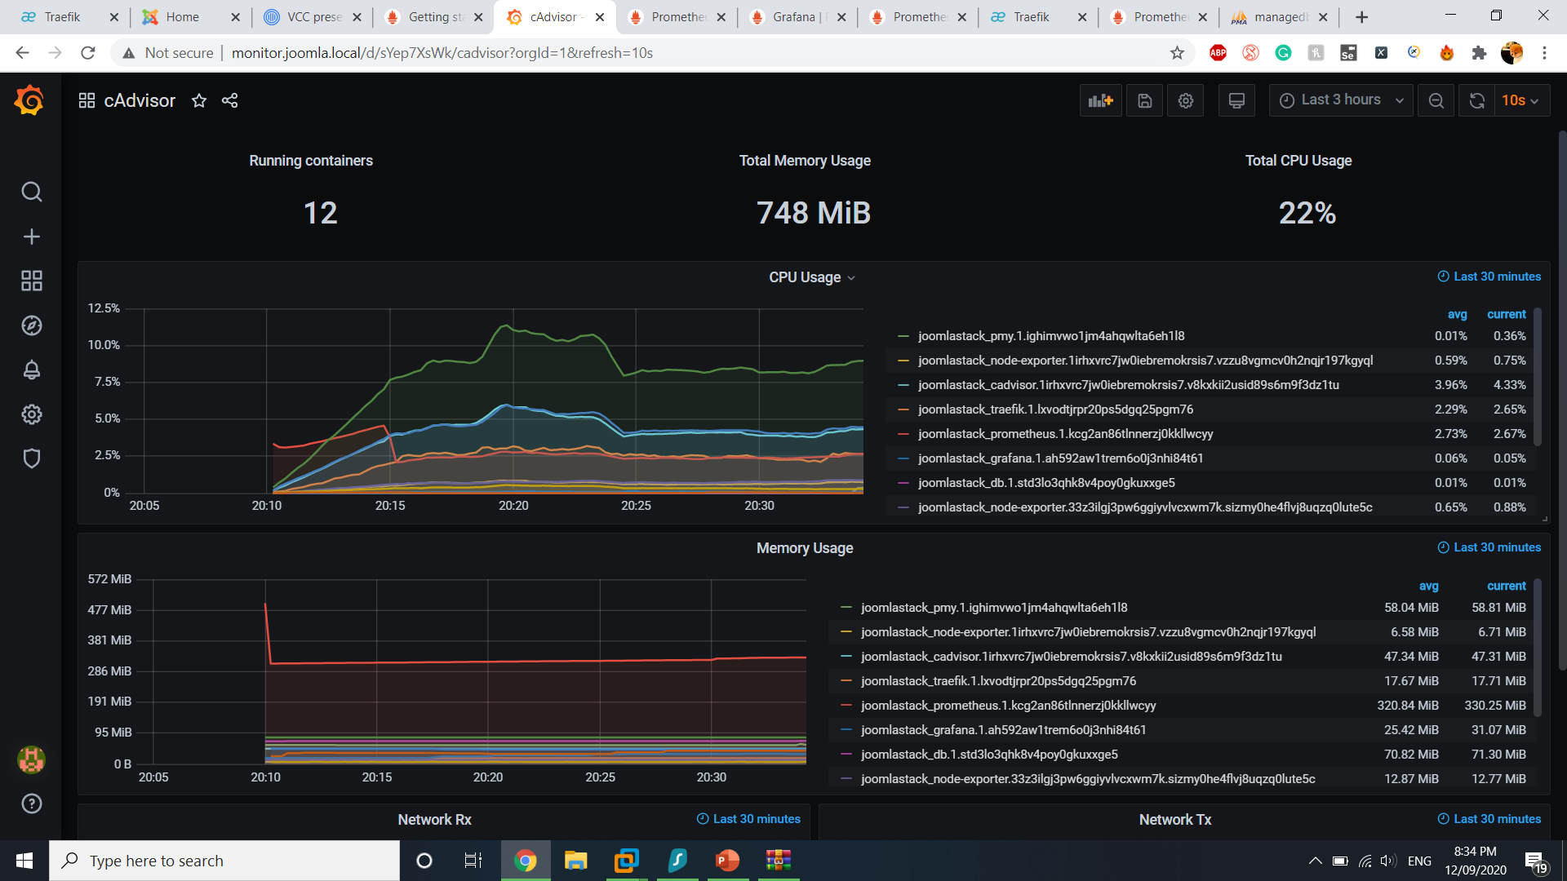
Monitoring
using grafana

Slide 35
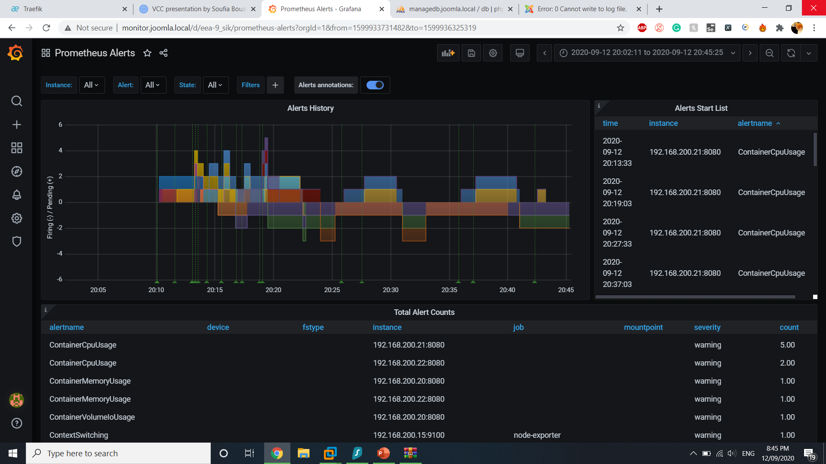

Slide 36

Load Balancing and Reverse Proxy
using Traefik
Traefik is a modern HTTP reverse proxy and load balancer that makes deploying microservices easy.
Traefik. traefik.http.services.map.loadbalancer.server.port = PORT

Slide 37
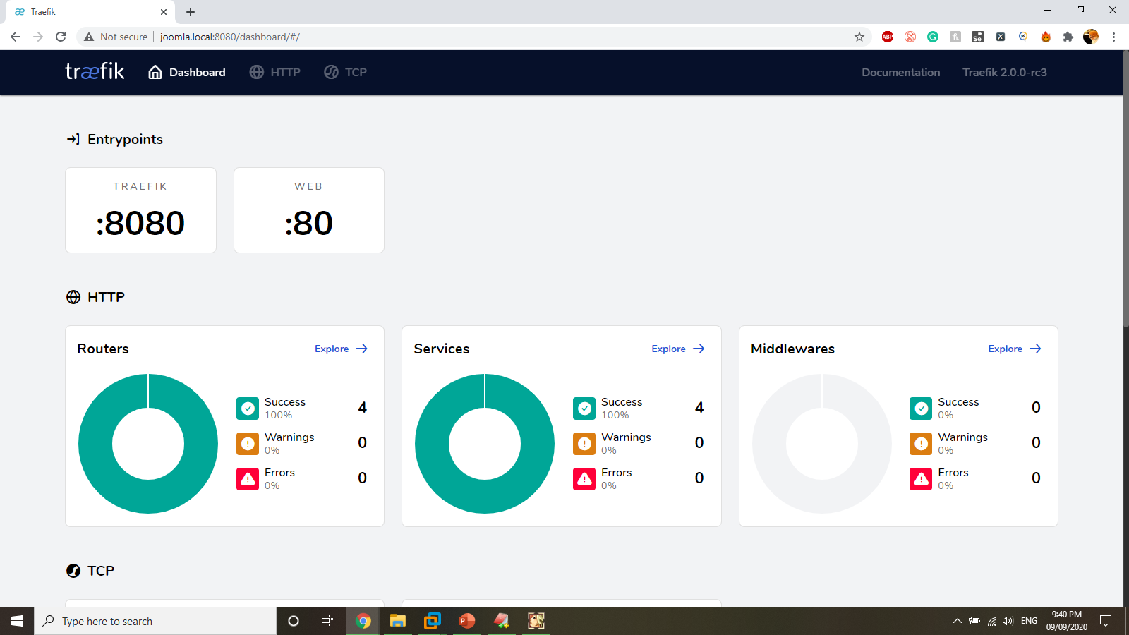

Slide 38
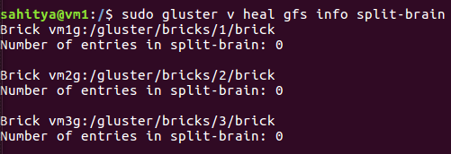
Split-Brain Condition
Inconsistency in data (or file metadata) between bricks of a replica. There is not enough information to authoritatively choose a copy as the original (thus curating
bad copies), despite all the bricks being active and online.
Causes:
Node Crashes
Network problems.
To check if the files are in split brain condition.
gluster volume heal <VOLNAME> info split-brain
Solutions to overcome split-brain condition:
Select the bigger-file as source
Select the file with the latest mtime as source
Select one of the bricks in the replica as the source for a particular file
Select one brick of the replica as the source for all files
Automagic unsplit-brain:
cluster.favorite-child-policy applies to all files of the volume.
It is assumed that this option can be added to resolve split brain.

Slide 39

Session Persistence
Using sticky property in Traefik
Using the default Joomla DB

Slide 40
Improvements
Single Point of failure:
A single point of failure (SPOF) is a potential risk posed by a flaw in the design, implementation or configuration of a circuit or system in which one fault or malfunction causes an entire system to stop operating.
To overcome:
Multiple instances of every component in the service.
Backups which allows a quick switch over on failure.
Allocating more resources, distributing the system and replication are some ways of mitigating the problem of SPOF.

