Slide 1
Fog Computing - Survey
Lalini Wudali
Sahitya Mullapudi
Saloni Mohan
Sudheer Sammeta

Slide 2
Agenda
Introduction to Fog Computing
Characteristics, Motivation & Advantages
Fog Cloud Classification & Services
Fog Cloud Infrastructure
Fog Cloud Architecture
Fog Cloud Applications
Conclusion

Slide 3
What is Fog Computing?
Term introduced by Cisco in 2012
Model to extend Cloud computing by decentralizing computing resources from data center
Resources include servers, storage, applications and services
Main intention is to improve QoS (quality of service) of cloud services

Slide 4
Motivation of Fog Computing
Cloud Computing has these limitations that led to Fog computing
Scalability issues with certain user and data driven applications (e.g. gaming, video streaming)
High cost of mobile bandwidth to cope with explosion of devices - IoT (Internet of Things)
Lack of location awareness
Cloud services unable to adapt to agile real-time response/low latency expected by mobile applications

Slide 5
Characteristics of Fog Computing
Widespread and decentralized geographical distribution of Fog nodes
Mobility access and location awareness
Heterogeneity of devices
Vertical scaling (in addition to cloud supported horizontal scaling)

Slide 6
Advantages of Fog Computing
Reduction of network traffic
Ideal for IoT devices
Dense geographical distribution
Great support for mobility
Low latency
Scalability

Slide 7
Fog Cloud Classification
Based on Nodal Collaboration
Cluster
- Fog clusters can be formed based on homogeneity of nodes and location or functional specifications of the nodes
Peer to Peer
- Peer nodes are user devices or nodes that have spare computational services and are made available in network
Master – Slave
- Master node controls load processing, resource management, functionalities of the underlying slave nodes
- The drawback is high communication between master and slave nodes which requires high bandwidth

Slide 8
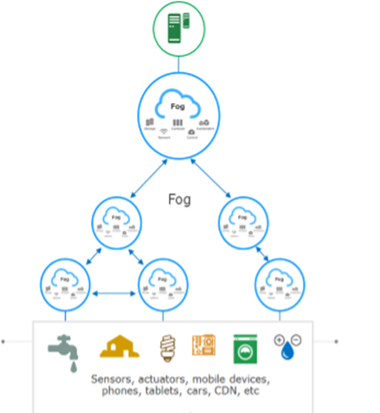
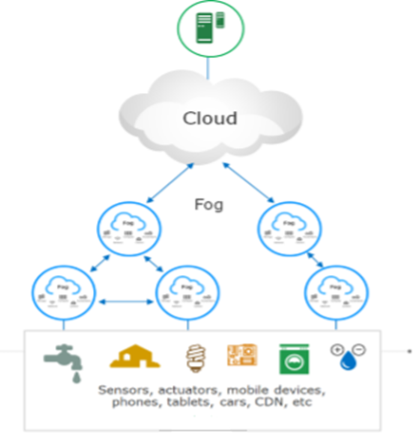
Fog Cloud Classification
Based on Deployment Models
Figure1
Figure2

Slide 9
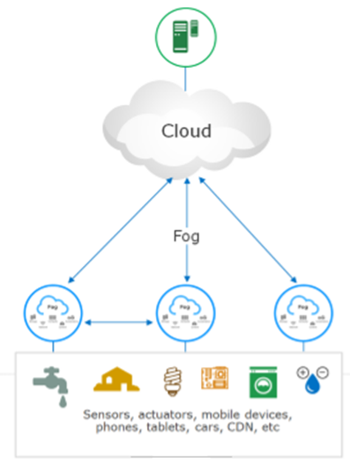
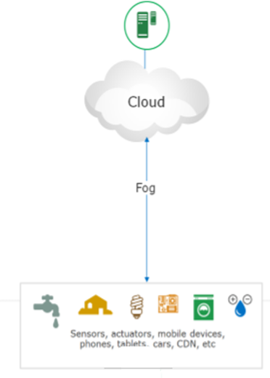
Fog Cloud Classification
Figure3
Figure 4

Slide 10
Fog Cloud Classification
The combination of Fog Cloud and traditional Cloud is widely used. (Figure2 & Figure3)
Only Fog cloud scenarios (Figure1) are applicable when cloud infrastructure is absent or cannot be accessed

Slide 11
Fog Cloud Classification
Based on Service Models
Infrastructure as a Service (IaaS)
- Host applications on fog nodes. Fog applications should be able to communicate with IoT devices that use any protocol.
Platform as a Service (PaaS)
- facilitates development and deployment of applications.
- Device abstraction must be followed.
Software as a Service (SaaS)
- offers MaaS. The services can be managed from fog.

Slide 12
Fog Cloud Services
Network Services
- Network services include storage, computation and connectivity.
Security
- By combining the encryption technologies, strong user access control and decoy technology with user profiling, fog offers improved security than traditional cloud technologies.
- This can be done at Cloud, but the increase in number of requests and data transfers increases latency.

Slide 13
Fog Cloud Services
Improved performance
- the gateways or routers can act as web cache with their local context awareness.
Storage
- Ideal for applications which require just temporary storage
- for time sensitive applications, data is collected , processed, and more meaningful data is generated. Once the data is moved to cloud, the data at fog nodes is erased.

Slide 14
PARAMETERS | FOG COMPUTING | CLOUD COMPUTING
Target users | Mobile users, IoT end devices | General internet users
Location awareness | Yes | No
Distance from user | Physically located much closer to end user devices requesting the service/data | Can be located very far away from the service requester
Server nodes location | At the edge of the network | Within the Internet
Latency | Low | High
Service Providers | Hubs could be centralized or distributed by local Telecom provider or business owners | Centralized and maintained by companies like Amazon, Microsoft etc.
Geographical distribution | Dense and Distributed | Centralized
Storage | Less to none storage provided | Large storage considered infinite
Attacks on data en route | Very low probability | High probability
Mobility | Supported | Limited support

Slide 15
Fog Computing Vs Edge Computing
Fog Computing | Edge Computing
Large computing resources but less than cloud | Limited Computational resources
Fog can provide PaaS and SaaS | Edge does not provide PaaS and SaaS
Fog has a hierarchal and flat architecture with several layers forming a network | Edge computing relies on separate nodes that do not form a network
Fog is inclusive of cloud | Edge excludes the cloud
Fog provides less to none storage | Edge does not provide storage
Fog computing pushes intelligence/ processing capabilities to local area network that is processing data at fog node | Edge computing pushes processing capabilities to the devices

Slide 16
Fog Cloud Infrastructure
Fog Servers
- possess computing, network & storage capabilities
Networking Devices
- gateways, switches, routers
Cloudlets
- between edge devices and cloud servers
Base Stations
Vehicles

Slide 17
Fog Computing Platform
Characterization of Fog Computing
- Latency
requirement of low latency by many critical applications
- Generality
Fog nodes should be able to support and work seamlessly while establishing communication between different networks
- Efficiency
Resources should be used efficiently as fog nodes are limited in terms of computing power and storage capabilities

Slide 18
Fog Computing Platform
Challenges
- Choice of virtualization Technology
whether to go by hypervisor or container
- Fight with Latency
- Network Management
redesign not only south bound and north bound but also east-west bound API
- Security and Privacy
paramount importance at every fog node

Slide 19
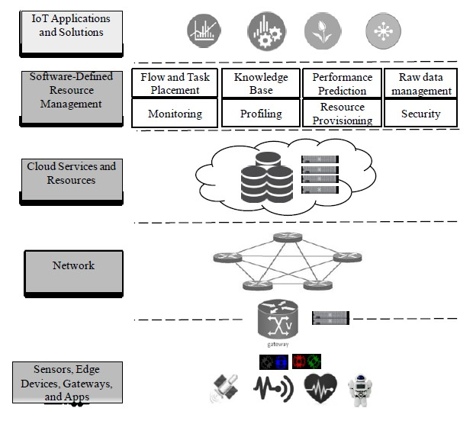
Fog Reference Architecture

Slide 20
Fog Cloud Architecture
It comprises of end devices such as sensors, actuators, edge devices.
Cloud services and resources layer helps the management of resources and computing the tasks
Software Defined Resource Management layer helps the management of infrastructure by allocating resources, monitoring network and providing security.
The topmost layer has the IoT applications and solutions which take leverage of fog computing to provide services to end users (Figure 1)

Slide 21
Fog Computing Applications & Services
The concept of Fog computing was introduced for the applications and services which could not be efficiently supported by cloud computing.
Few applications of Fog Computing
Security in cloud
Satellite Traffic Light System
Internet Of Things (IOT)
Wireless sensors and Actuators netwo rks
Healthcare
Augmented reality

Slide 22
Fog Computing Applications & Services
Internet Of Things
IOT is a concept, wherein, the physical devices connect over the internet and exchange data and information with each other.
Fog Computing is suitable for IOT applications because of the following reasons -
1. IOT applications are low latency applications
2. Geographically distributed
3. Mobile in nature
4. The data generated by IOT applications is humungous and heterogenous

Slide 23
Fog Computing Applications & Services
Mitigating Insider data theft attacks in the cloud
Data security , and more specifically , insider data theft attack is a big security issue in cloud.
Existing solutions not strong and robust enough for data security in cloud.
New solution combining user search behavior anomaly detection and use of decoy information is being proposed.
The Fog server can generate decoy files once the abnormal user search behavior is detected.

Slide 24
Fog Computing Applications & Services
Healthcare
Fog computing is a highly supported computing paradigm for enhancing telehealth because of the below reasons -
low latency - real time data analytics and quick response.
Fault Tolerance -provide backup , in case the link to the cloud is faulty.
Storage and transmission
- reduce the amount of data to be stored and transmitted onto the cloud.
- data cleansing and filtration to avoid space consumption by unwanted data.

Slide 25
Conclusion
Fog computing does not totally replace cloud computing , but does definitely help in overcoming the disadvantages of using cloud computing alone , for upcoming technologies , such as , Internet of Things.

Slide 26


