Slide 1
ATiML
Classification of Gutenberg books
Divya Sasidharan
Mondher Hentati
Poornima Venkatesha
Sinchana Eshwarappa Prameela
Saied Akbar Ahmady
Monday, July 31, 2020

Slide 2
Contents
MOTIVATION
1
ALGORITHMS
3
EVALUATION
DATA SET
2

Slide 3
Motivation
Building a classification model
Gutenberg books
based on genres
Hand Crafted Features
Bag of Words

Slide 4
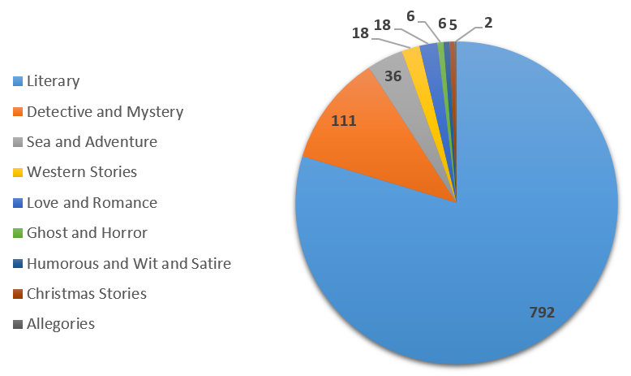
Dataset
selected 19th Century English fiction books
Totally 996 HTML files/books

Slide 5
Preprocessing
selected 19th Century English fiction books
Totally 996 HTML files/books

Slide 6
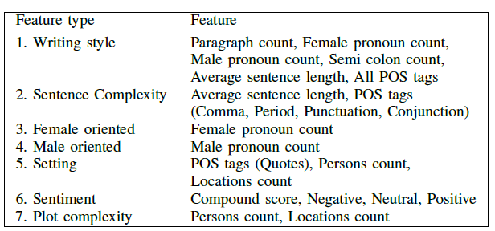
Feature Extraction

Slide 7
NAN values in each feature

Slide 8
Handling features with NAN Values
Dropped features features with many NAN values
Filled NAN Value of features features with few NAN values
Cleaned Dataset
removed features
# | ( | ) | LS | $ | SYM | NNPS | FW | WP$
Filled NAN values with the average
RBS | PDT | `` | UH | ' | PRP | VBD | RP | PRP$
CD | VBZ | VB | JJR | VBP | RB | MD | WRB | VBG
WDT | : | VBN | NNS | JJS | RBR | EX | WP | location_count
47 features remains

Slide 9
Class Imbalance Issue
All the classes are of same importance
Over Sampling
Cross Validation
Proper Metrics
from imblearn.over_sampling import SMOTE
SMOTE(random_state = 42, k_neighbors = 1)

Slide 10
Oversampling

Slide 11
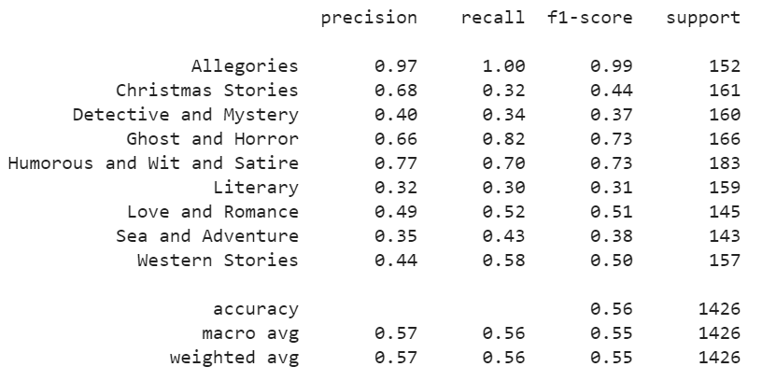
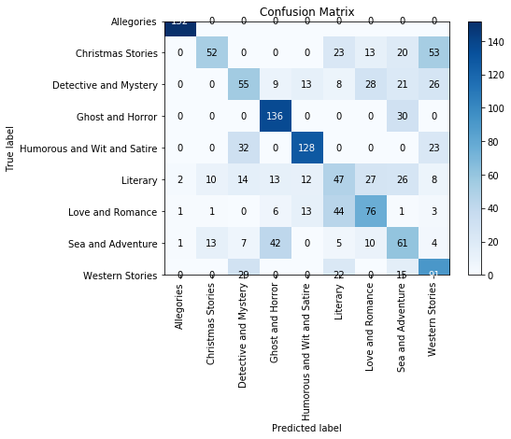
Naive Bayes Classifier
Result of 5-fold cross validation:
Accuracy: 0.570

Slide 12
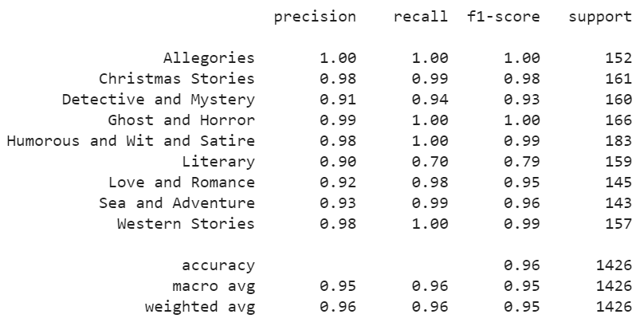
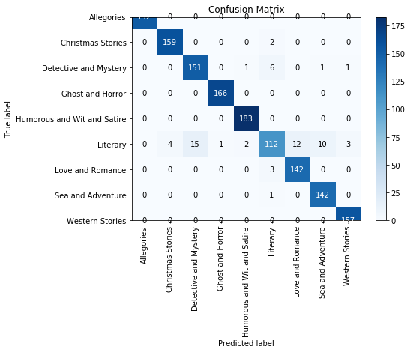
Decision Tree Classifier
Result of 5-fold cross validation:
Accuracy: 0.951

Slide 13
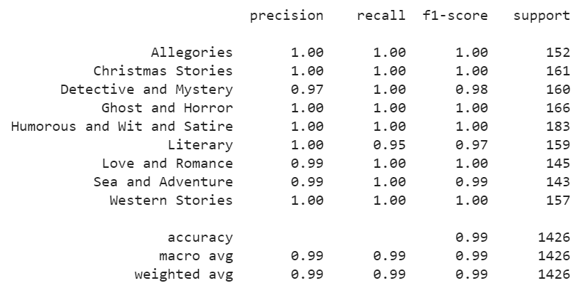
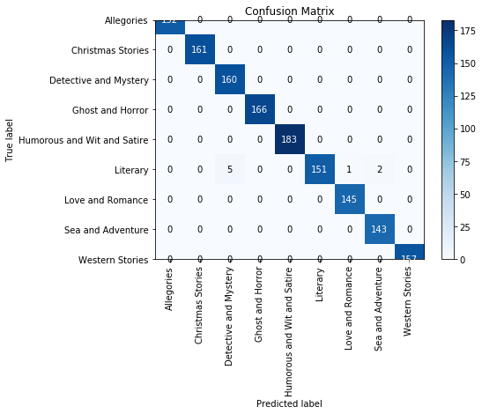
Random Forest Classifier
Result of 5-fold cross validation:
Accuracy: 0.993

Slide 14
Limitations and challenges
Not compared with models based on bag of words
Overall sentiment of the book is taken into consideration while chunks of book would perform better
Class imbalance (solved by over sampling)
Feature extraction / Hand crafted features works quite well even though not compared with BOW

Slide 15
Thank you

