Slide 1

CCSE PROJECT MANAGEMENT SYSTEM
Final Report
IT 4983 : IT CAPSTONE SPRING 2020
Project number: UY11
April 27th, 2020
Devin Greene
Wendy Claver
Syed Ahmed
Faith Kinchen
https://sites.google.com/view/ccse-pmo-capstone/home
https://youtu.be/3sk9St48wLU

Slide 2
The Problem
Kennesaw’s College of Computer and Software Engineering requires a database repository to store and mange many varying projects.
CCSE manages three separate kinds of projects:
Capstone
Contract for Hire
Research
These projects can be Graduate or Undergraduate, and currently files for these projects could be stored on multiple storages across campus
A single unified program was requested by the project sponsor to manage these projects

Slide 3
Solution and Objective
A single program or application that allows CCSE administrators to manage information about the projects
This application should have the ability to
Hold and sort data related to Projects, Sponsors, students, and faculty
Input and manipulate data with a GUI
Create reports that that easily combine relevant data from the areas listed above
Store specific documents such as MOUs and NDA’s for each project
Implement a form of Role Based Access Control (RBAC)

Slide 4
Resources and Planning
The team relied heavily on the following resources:
Official Microsoft documentation
Third party written tutorials
Third party video tutorials
Information provided by Q&A of the project sponsor
The team used Q&A information, as well as ER Diagrams, table schemas, and sketches to plan the database and GUI.

Slide 5
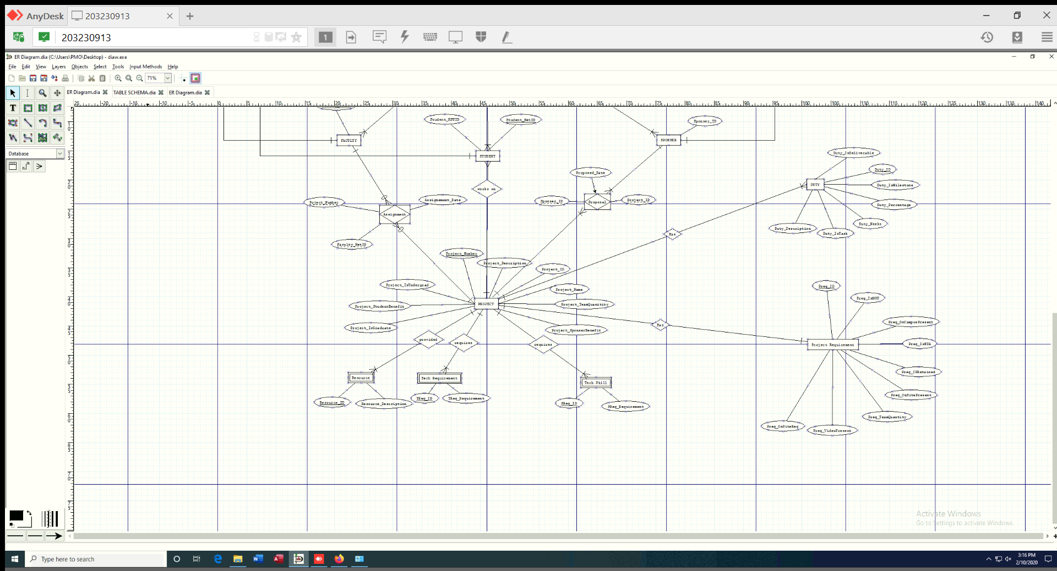
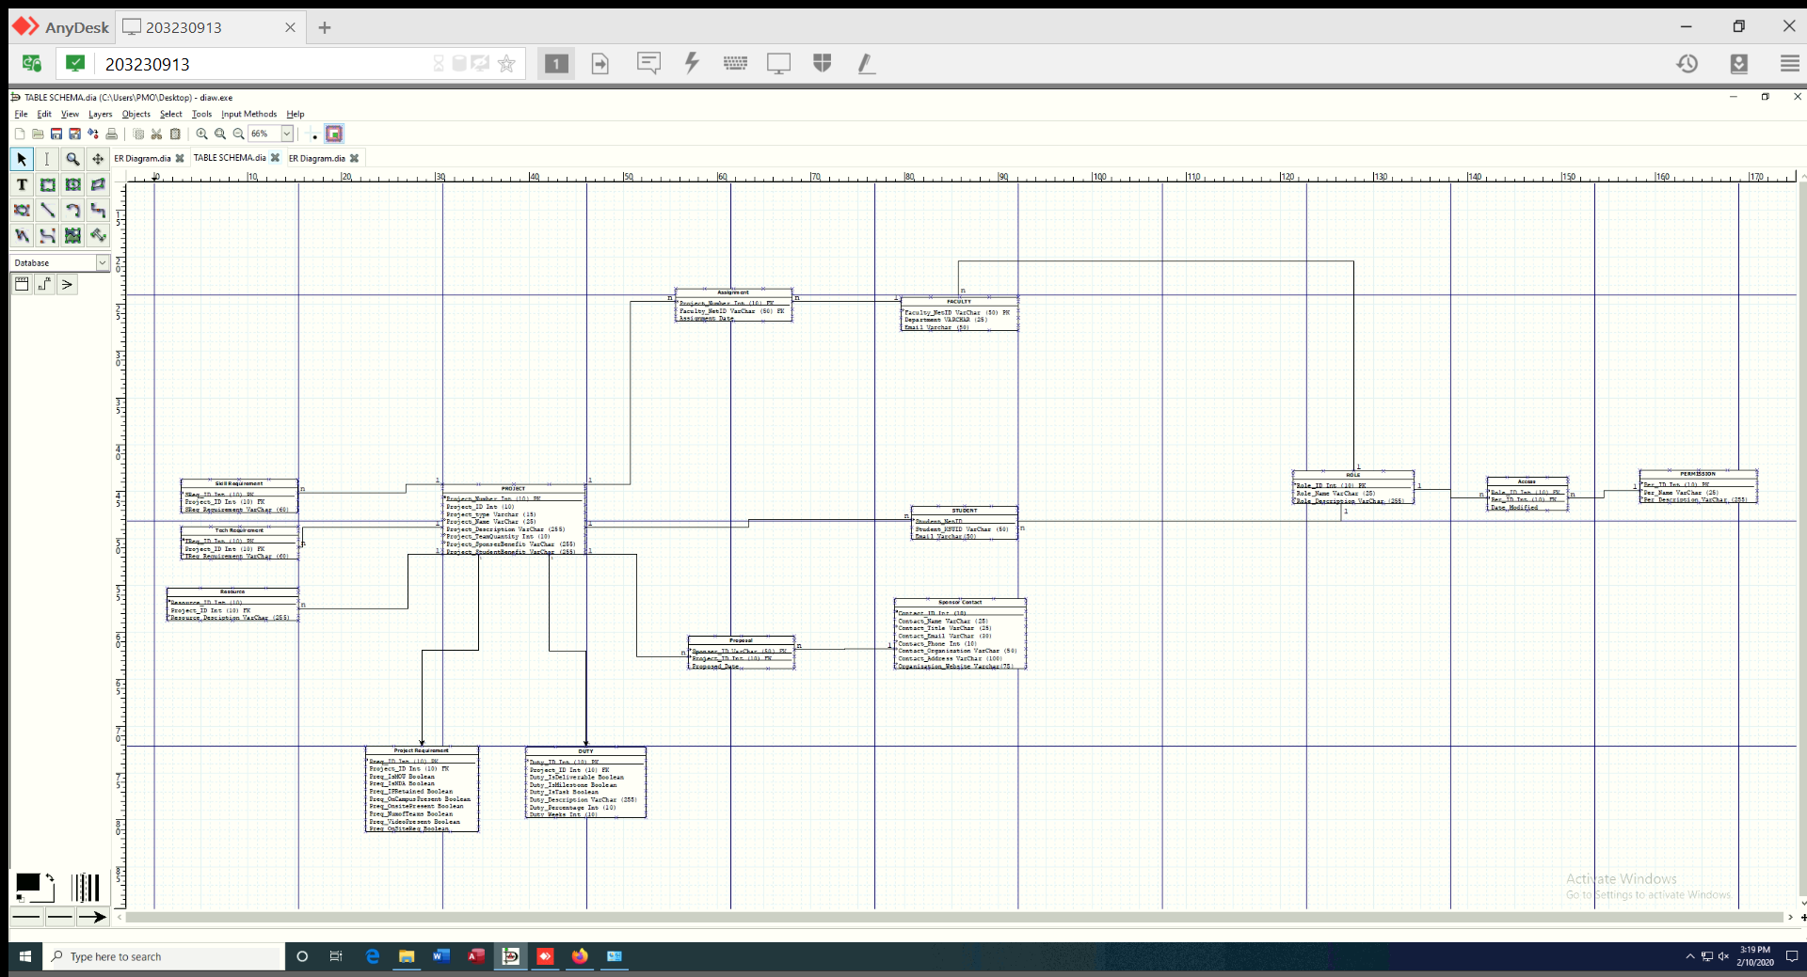
ER Diagram and Table Schema

Slide 6
Project by Milestones
This project was divided into three Milestones deliverables:
Milestone 1: This milestone required that the team show that they had solid plan moving forward with the project. The team presented the following deliverables at this milestone:
ER Diagram (Shown on previous slide)
Table Schema (Shown on previous slide)
Milestone 2: This milestone required that the database for the application be completed and able to store data. The team presented the following deliverables at this milestone:
Database developed using T-SQL
Tentative sketches for the GUI
Tentative design for GUI portal

Slide 7
Project By Milestones Cont.
Milestone 3: This milestone required that the Database be functional, with the ability to input data and make reports. This milestone was also the last chance to demonstrate sponsor request such as RBAC and handling of PDF documents.
The team presented the following deliverables at this milestone:
Final version of the project Database
Ability to enter and sort data using the GUI
Portal with log in capabilities for the three user roles
Ability to upload and store PDF documents in the database

Slide 8
Development Platform and Language
The Project team chose to develop the application using Visual Studio for the following reasons:
Large amount of easily accessible documentation
Large amount of third-party tutorials
experience using the platform in previous classes
This project was developed primarily using C# and the ASP.Net Core framework. HTML is also an integral part of the GUI.
The portal and the GUI use Razer pages as opposed to HTML pages
The database was created in visual studio using Transact SQL

Slide 9
Project Development (Database)
Architecture:
The database is broken down into tables that represent the major entities that require information tracking:
Projects
Sponsors
Students
Faculty
PDF Files
The database also includes junction tables to allow communication and interaction between tables:
Assignments
Proposals

Slide 10
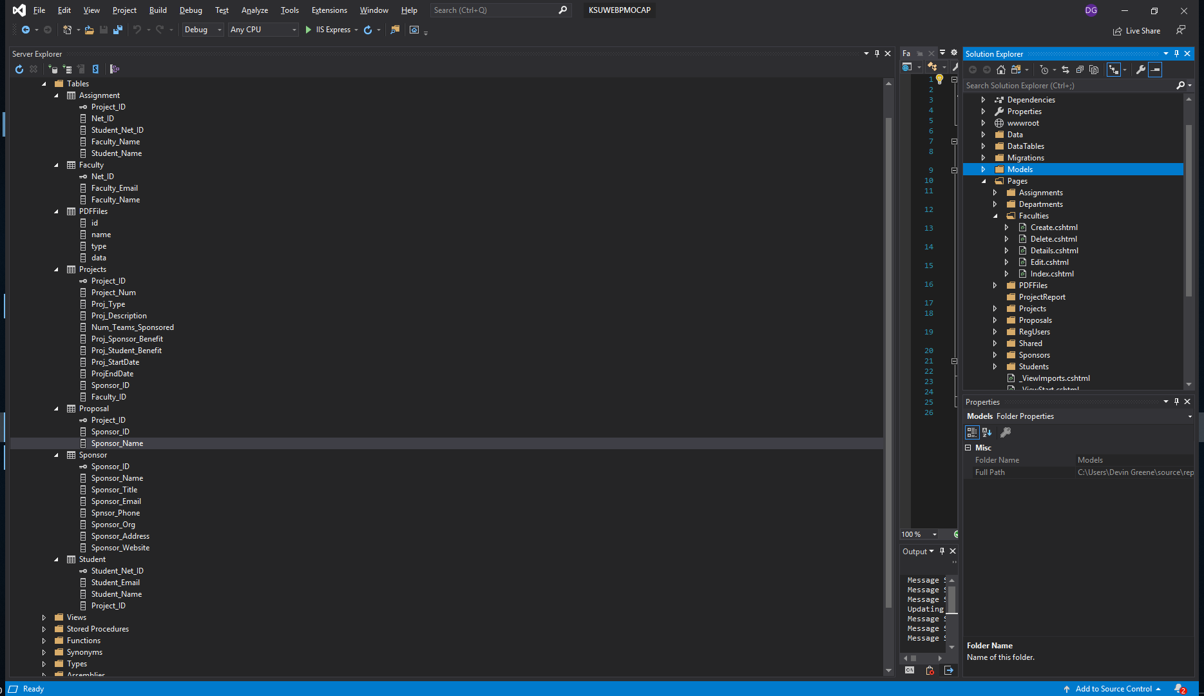
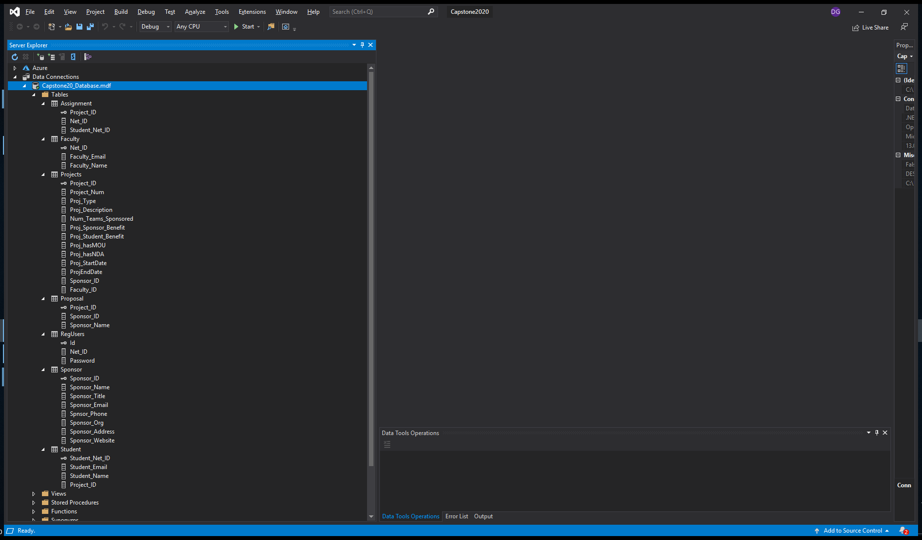
Final Database

Slide 11
Project Development (Portal)
Architecture:
The portal supports three levels of users
Admins – Create, update, delete, and edit data
Users – Edit and view data pertaining to themselves
Viewers – can see project data but cannot edit
The portal has three log in portals, one for each level of user
Each role is brought to its own version of the GUI with varying levels of control
IE the viewer role has the same GUI as the admin, but cannot create or edit data in the database

Slide 12
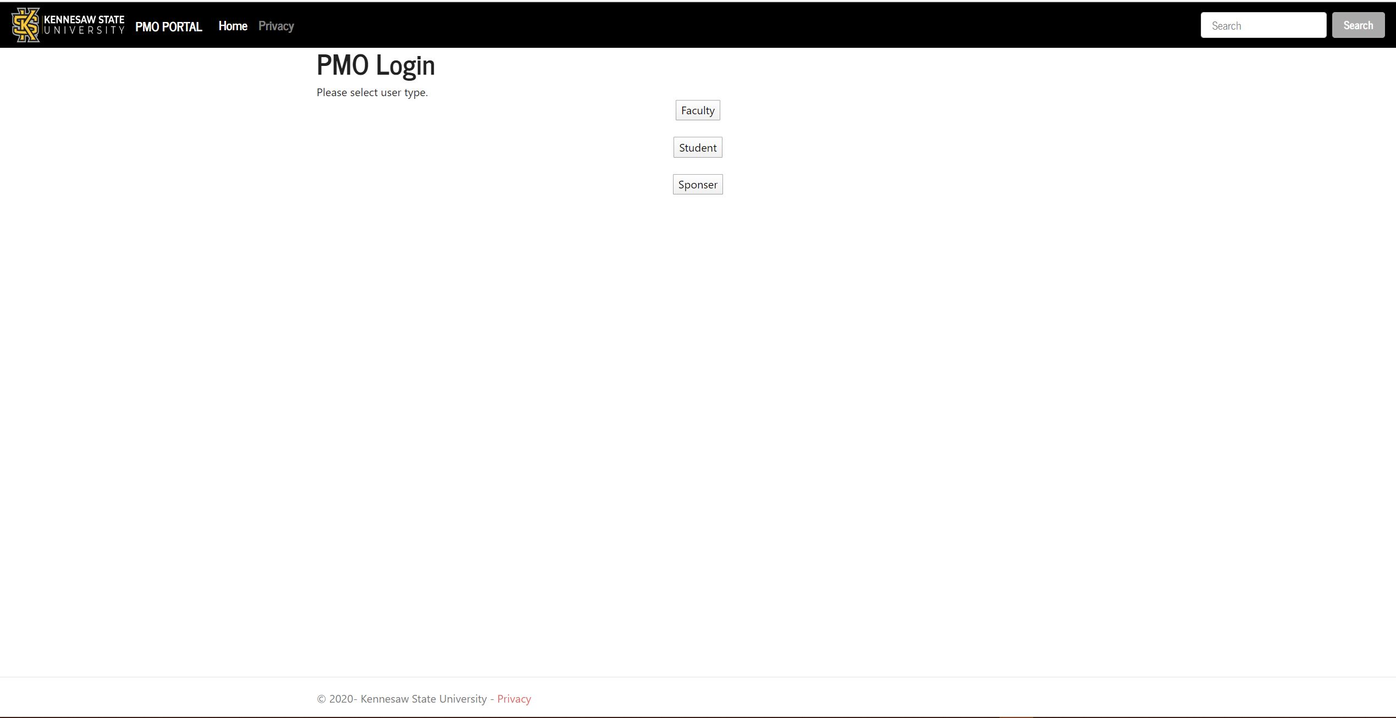
Web Portal

Slide 13
Project Development(GUI)
Architecture:
The GUI allows for entry of data into all database tables
It also hides important columns for database functionality from users (Primary Keys)
The GUI allows for sorting by the following criteria:
Project Number
Project type
Sponsor name
Faculty name
Start date

Slide 14
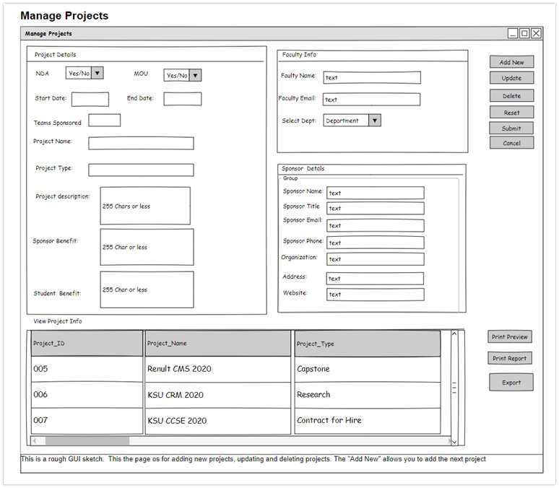
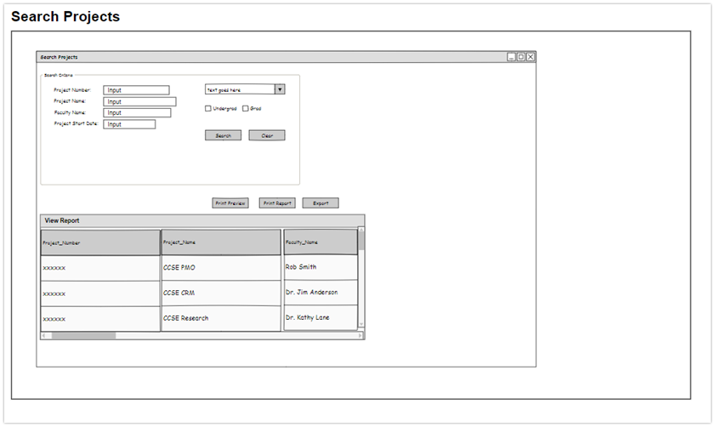
GUI Sketches

Slide 15
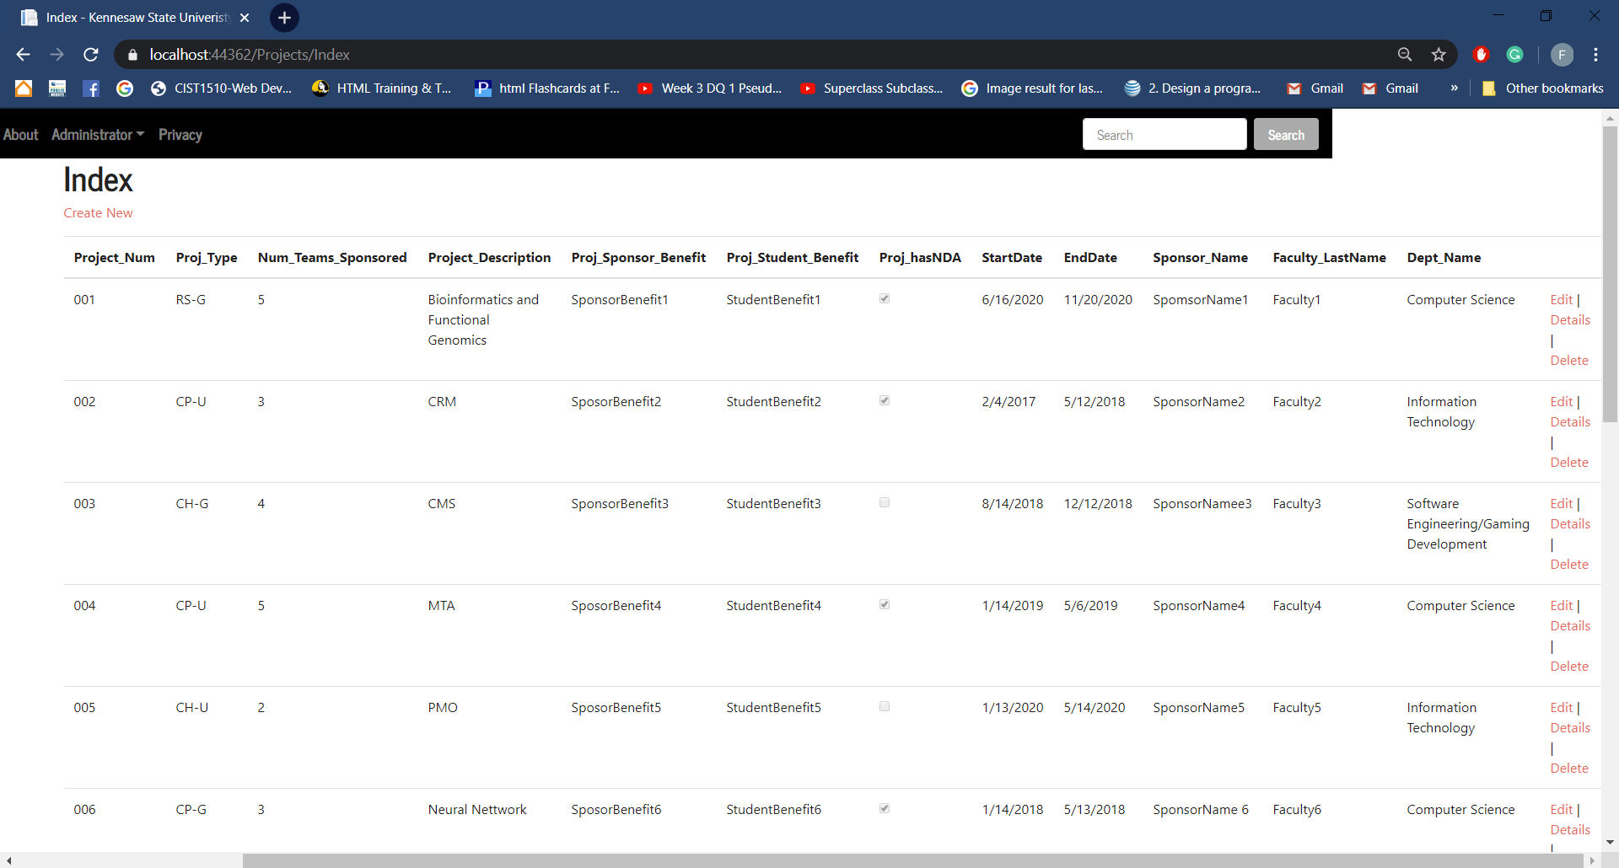
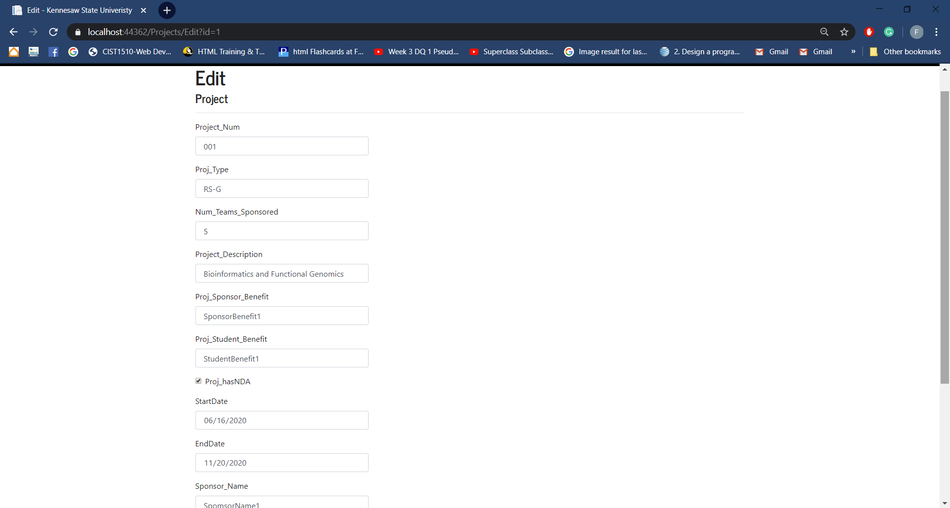
GUI

Slide 16
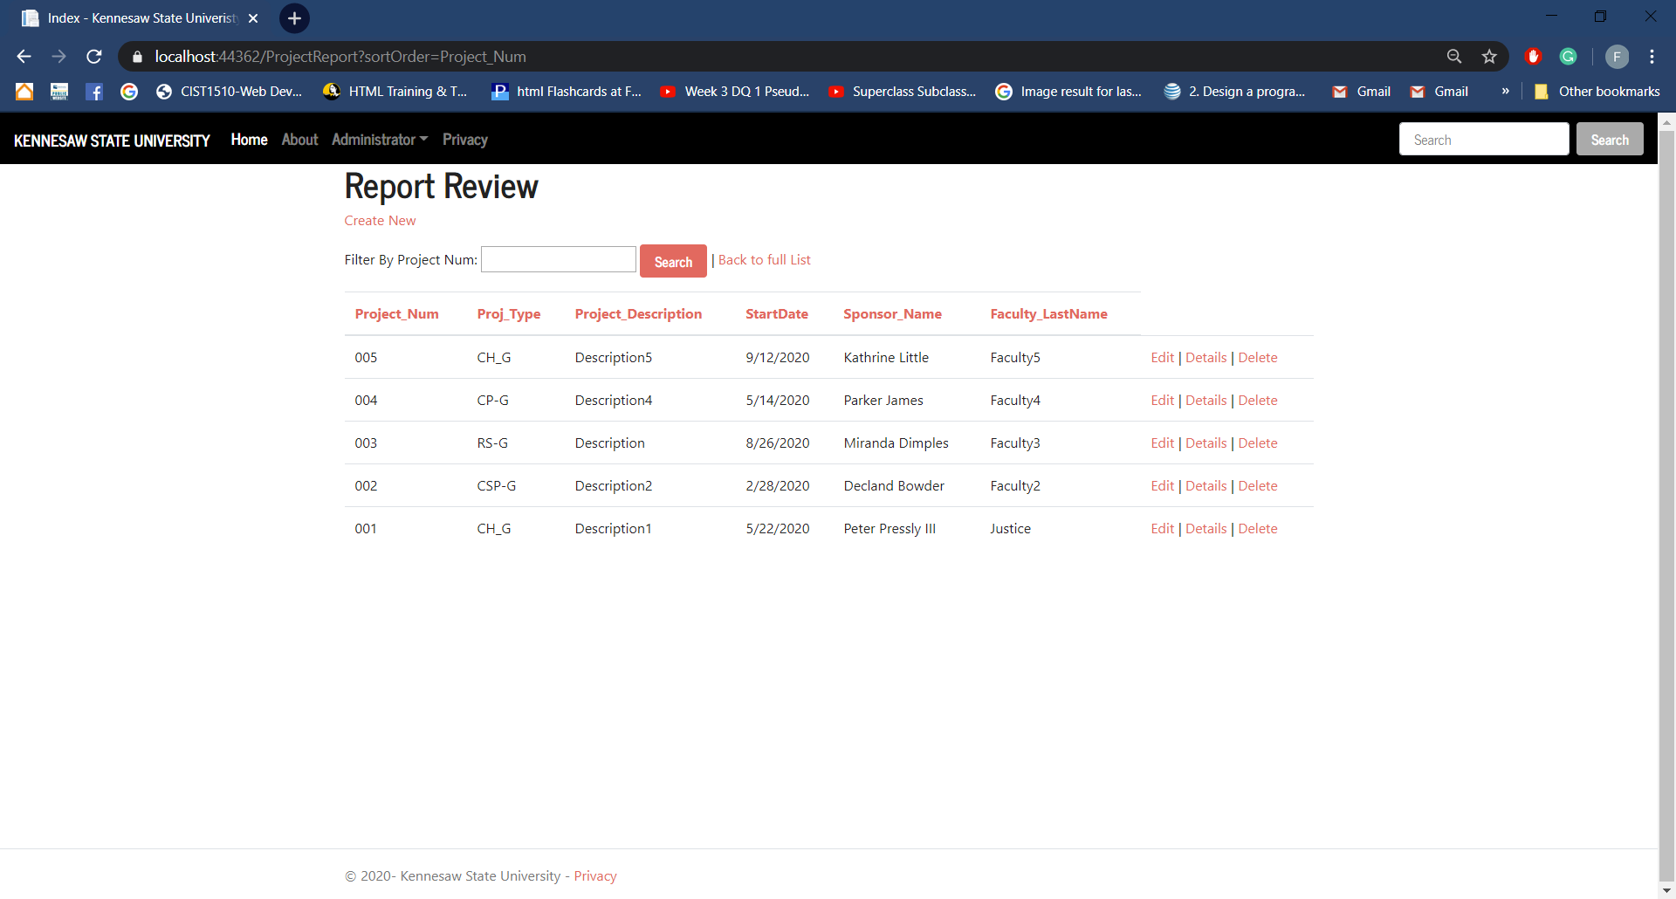
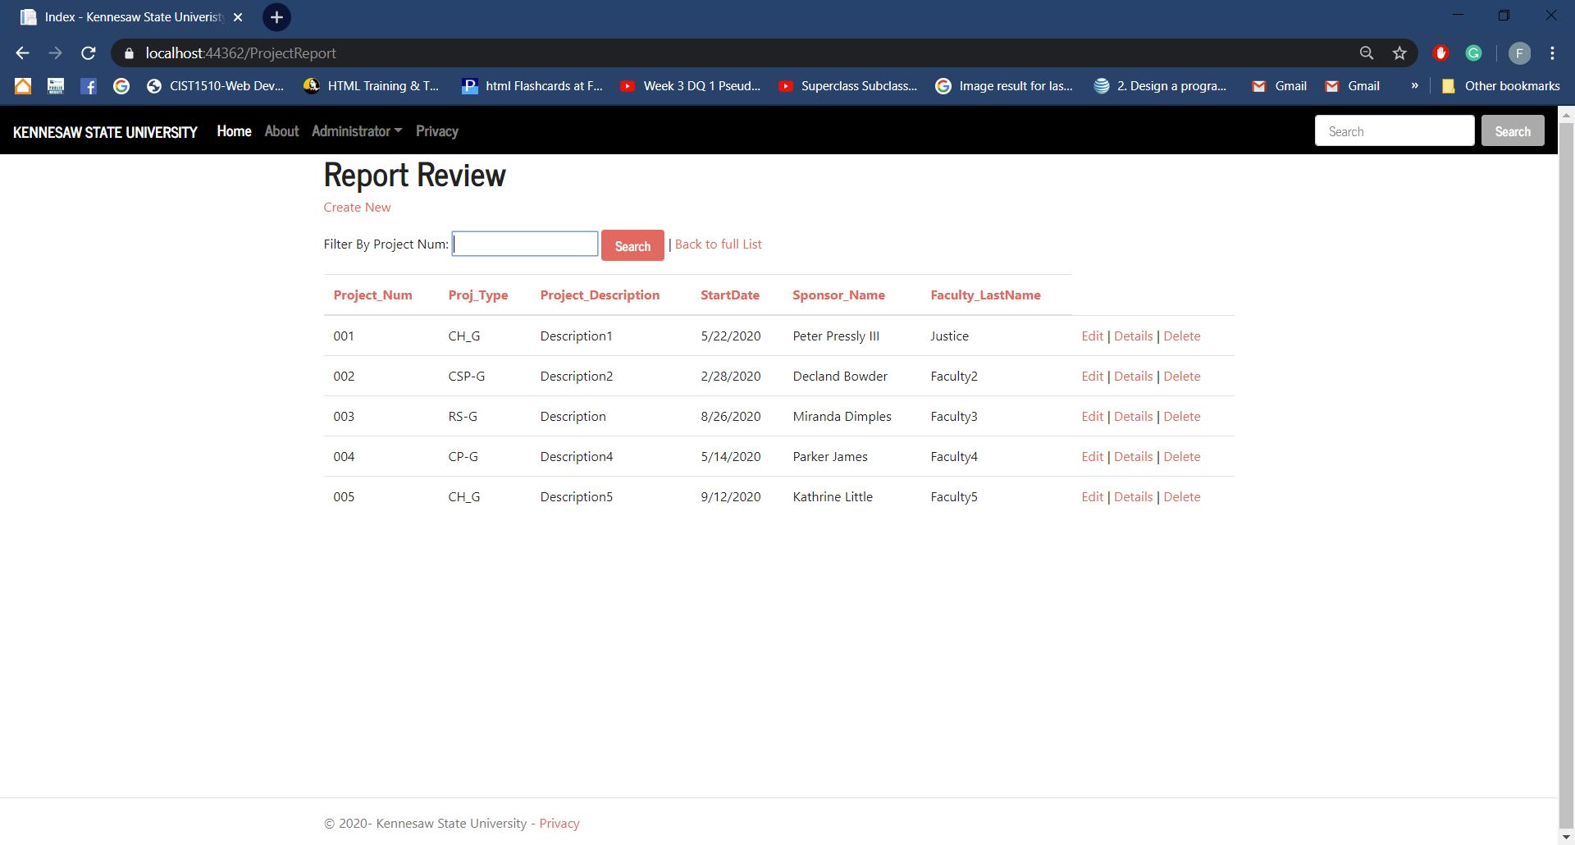
Reporting Feature

Slide 17
Project Development (PDF handling)
This functionality was developed as an Active Server Page Extended file as opposed to at Razer page
This functionality allows for users to upload files to the PDF files table for storage and organization
The table also includes the Project ID to allow PDFs to be associated with their projects
The Functionality also includes the ability to view PDFs that have been uploaded

Slide 18
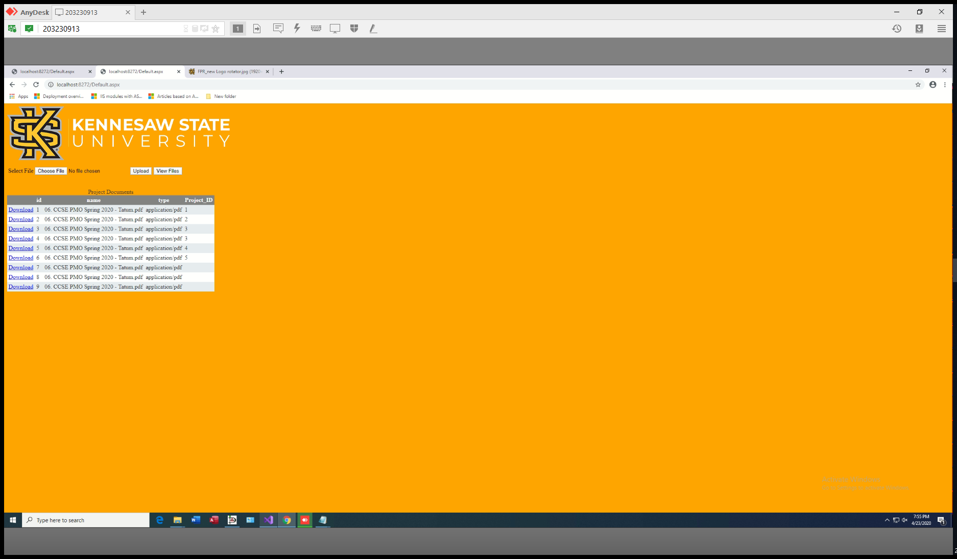
PDF Handling

Slide 19
Project Experience
Challenges:
Creating Organized and intuitive GUI’s
Implementing Role Based Access concepts in SQL
Joining three or more tables in a SQL query
Database layout to facilitate the Joining of multiple tables
Understanding how to best manipulate PDFs in a database
Deciding between an in app or web-based GUI
Changing frameworks to suit project needs
Lessons:
How to join four or more tables in SQL
Different options for Roles Based Access in SQL
Implementation of Razer pages
Implementation of ASP.Net core framework

Slide 20
Contributions
Wendy Claver:
Creation of Web Portal
Implementation of Roles Based Access
Documentation
Database planning
Faith Kinchen:
Creation of GUI
Creation of Reporting functions
Documentation
Database planning
Devin Greene
Creation of SQL scripts
Documentation
Creation of Database
Database Planning
Syed Ahmed:
Upkeep of Project Website
Upkeep of Database
Handling of PDF documents
Database planning

