Slide 1
CCSE PROJECT MANAGEMENT SYSTEM
MILESTONE 1 Report
IT 4983 : IT CAPSTONE SPRING 2020
February 14, 2020
Devin Greene
Wendy Claver
Syed Ahmed
Faith Kinchen

Slide 2
Agenda For Milestone 1 Report
Project Summary
Milestone Assessment
Gantt Chart
Challenges
Planning for Phase II deliverables

Slide 3
Project Summary I
The team is wrapping up Phase I of the project. The project sponsor has been interviewed, the requirements researched and gathered. Planning and designing the database has been completed. The team is ready to move into Phase II, where will create the GUI , the database and the corresponding SQL scripts. The final deliverables for the CCSE PMO PROJECT are:
Project Plan
Database design
Project management system database
Graphical User Interface
Documentation
Notes:
This project summary reviews the final project deliverables and reports the team’s progression so far. As described in the RFP. The CCSE needs a project management system and has commissioned our team to create a GUI and a Database

Slide 4
Project Summary II: Accomplishments
Interviewed project sponsors: Dawn Tatum, KSU Industry Liaison and Adriana Clark
Researched Project Requirements
Created Project Plan
Implemented database planning and design
Began database creation
Notes:
The teams has completed Phase I of the project and is moving into Phase II.

Slide 5
Milestone 1: Assessment
Initial interviews with the Project Sponsor- completed
Research and Requirements gathering - completed
Database planning and design - in progress
Database creation - in progress
WBS and Gantt Chart- completed
Project Plan - completed
Notes:
The following is a brief assessment of the project team’s milestone progression. Anything “in progress” is awaiting pivotal information in order to be completed

Slide 6
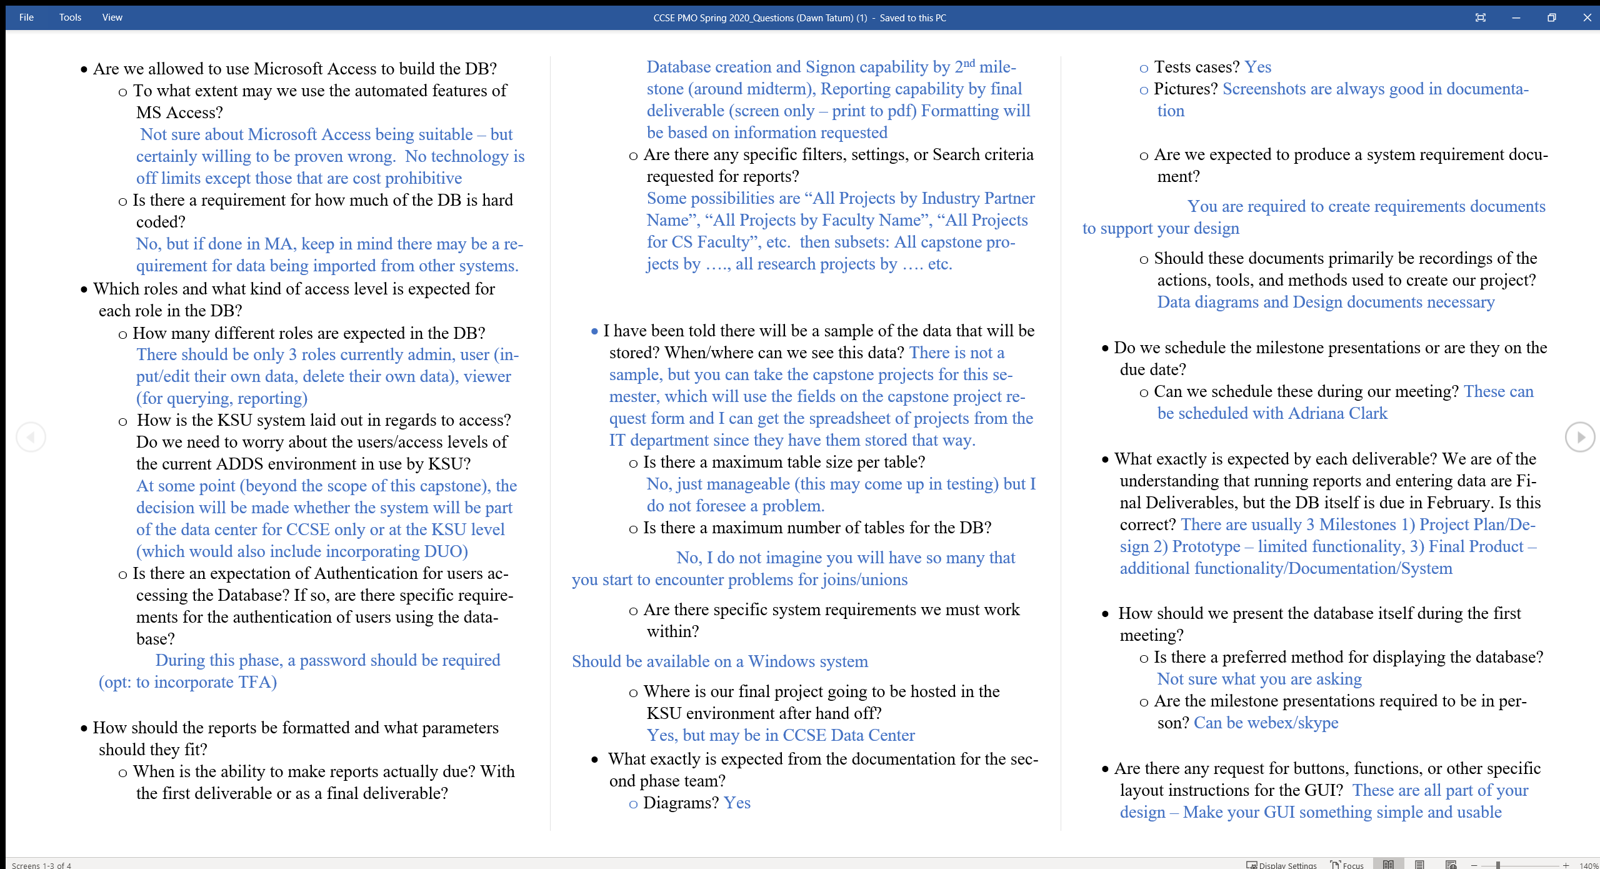
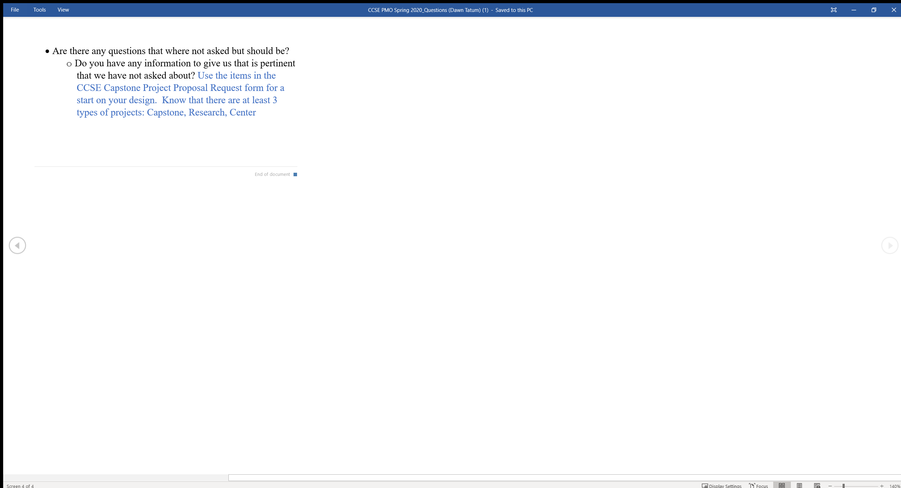
Interview Q&A
Notes:
The initial question presented to the project owner with answers.

Slide 7
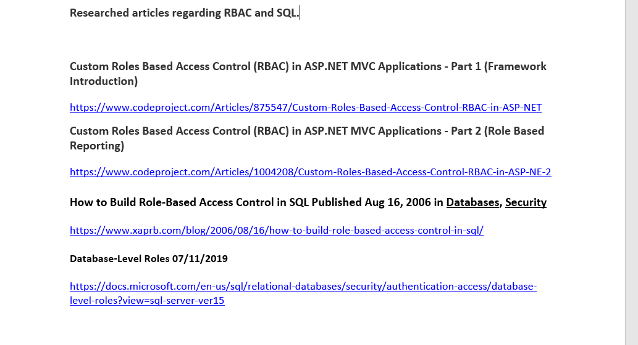
RBAC Research
Notes:
Screenshot of some of the articles researched for RBAC and SQL

Slide 8
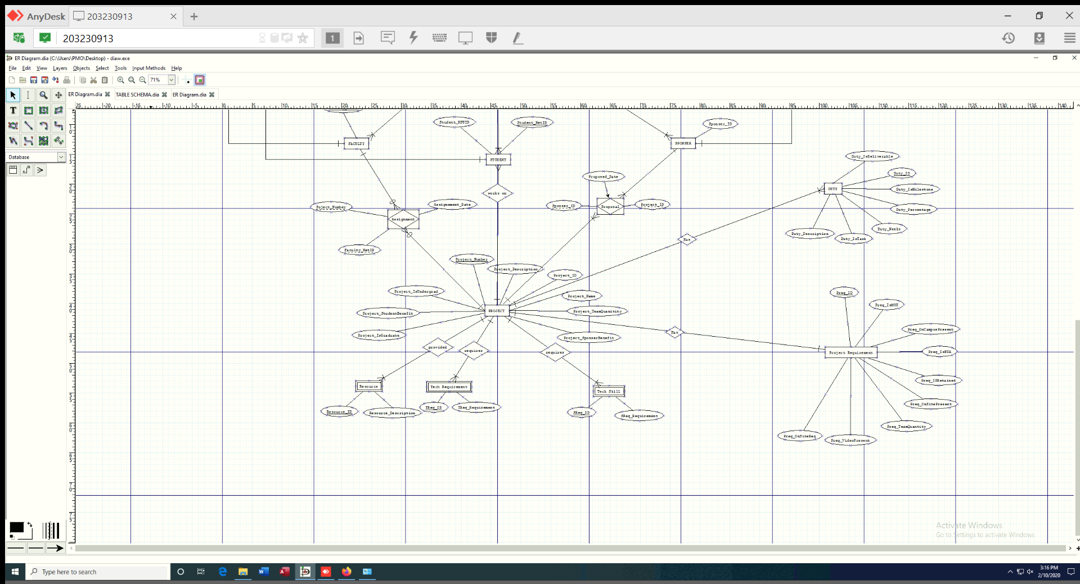
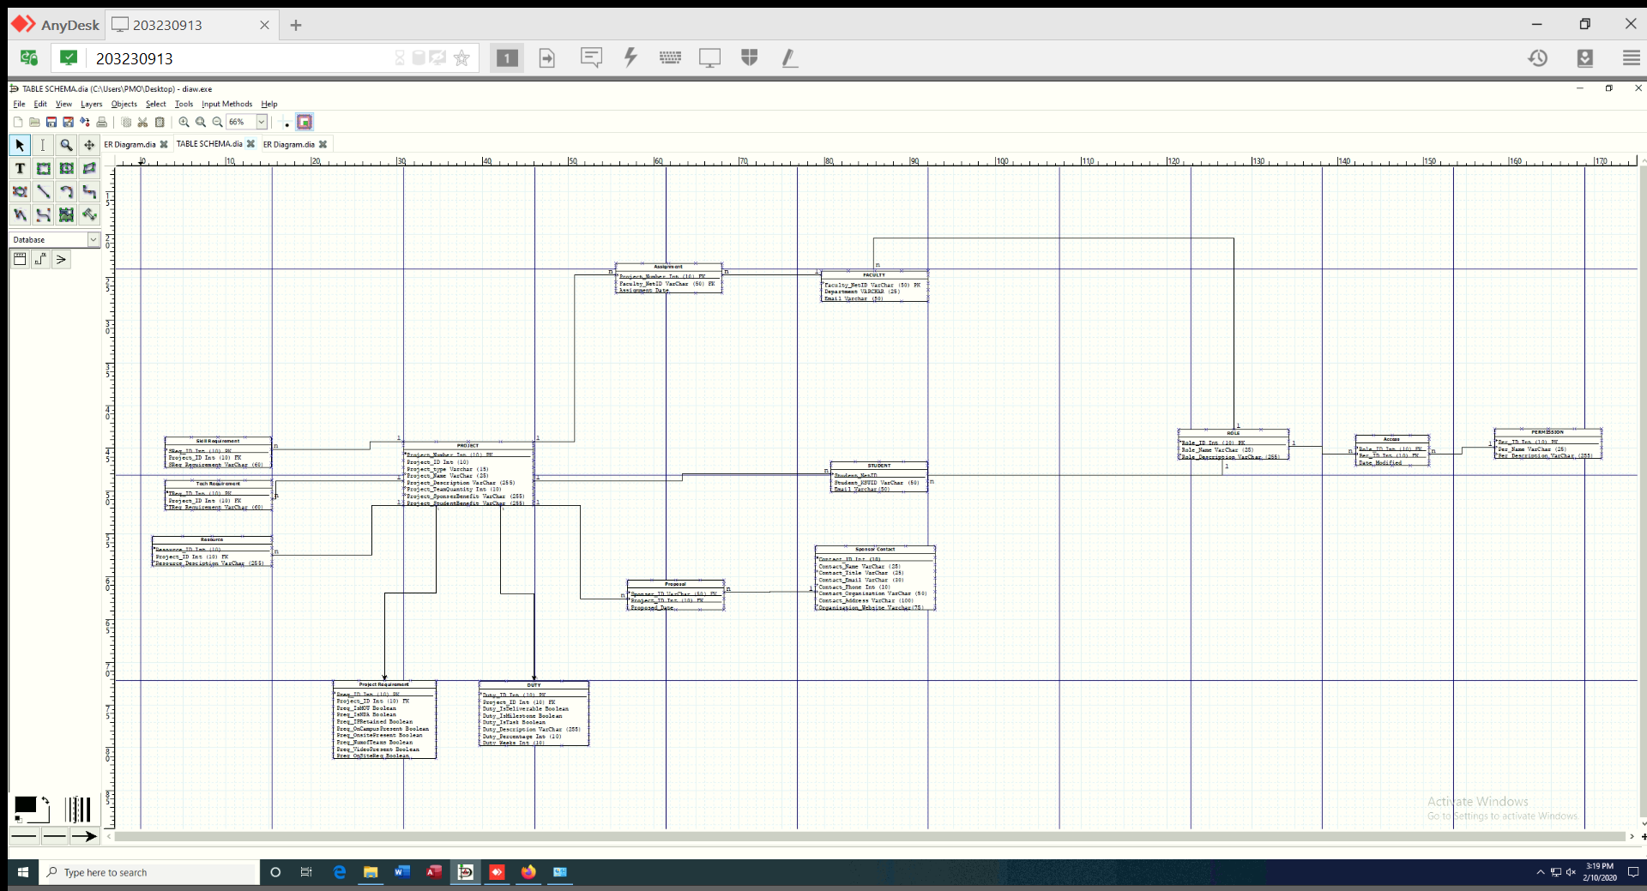
Database Planning and Design
Entity Relationship Diagram
Table Schema

Slide 9
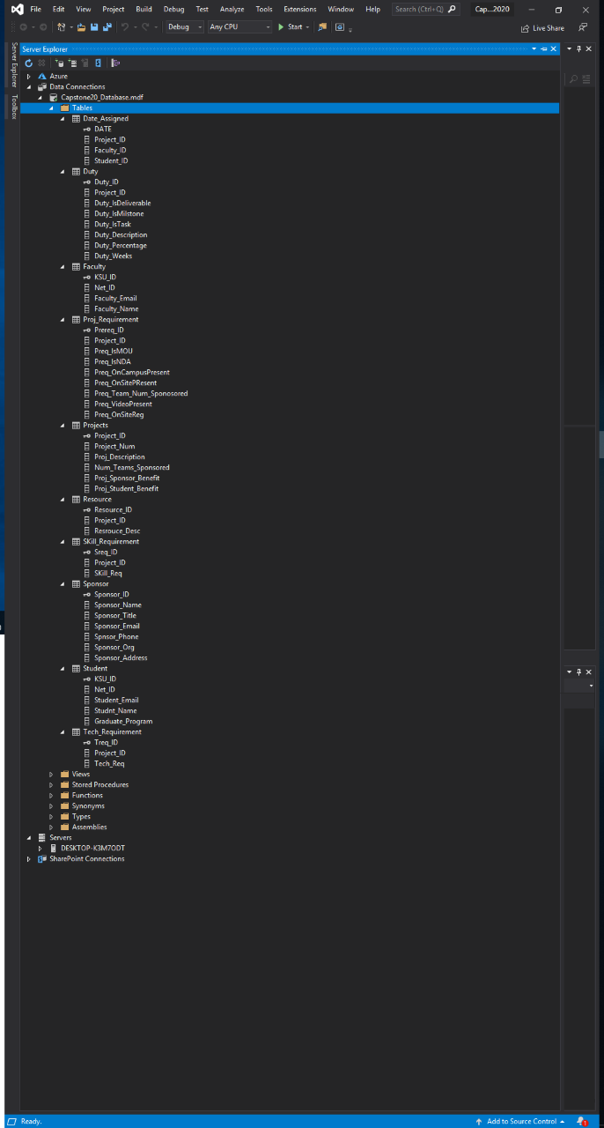
Database Creation
Notes:
Screen Shot of initial db created.

Slide 10
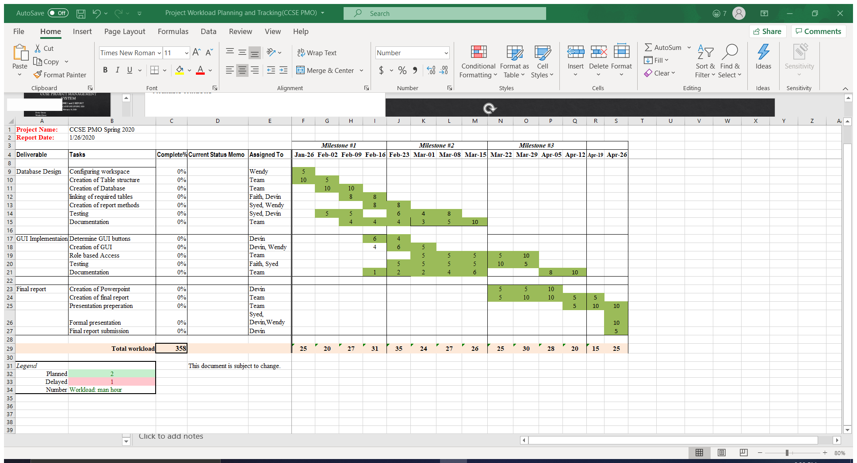
Gantt Chart
Notes:
Our Team is actually running ahead of schedule. Currently, we do not anticipate any delays.

Slide 11
Project Experience
Challenges:
Relearning Visual Studio
Learning Role Based Access concepts in SQL
Organizing projects by type without an excessive amount of tables
Table Schema
Integrating information brought in after Table Schema completion
User Research
Lessons:
Creation of Database using Visual Studio
Basic Roles Based Access in SQL

Slide 12
Milestone 2: Phase II Planning
Update ERD and Table Schema
Create Database
Create GUI
Create SQL Queries
Implement Testing
Documentation
Prepare Milestone 2 presentation and report
Notes:
The team will update the database design to include the contracts for hire and the research project criteria. After making these updates, we will move on to Phase II where will begin creating the actual database and GUI. This phase will also include creating SQL queries. and testing. The team will continue to create the appropriate documentation that will be included.

Slide 13
Other Issues
Creating workspace – solved
Selection of remote access software – solved
Distribution of roles – In Progress

