Slide 1

CCSE PROJECT MANAGEMENT SYSTEM
MILESTONE 2 Report
IT 4983 : IT CAPSTONE SPRING 2020
March 12th, 2020
Devin Greene
Wendy Claver
Syed Ahmed
Faith Kinchen

Slide 2
Agenda For Milestone 2 Report
Project Summary
Milestone Assessment
Gantt Chart
Challenges
Planning for Phase III deliverables

Slide 3
Project Summary I
The team is wrapping up Phase II of the project. We have completed the Database and made required changes suggested by our Sponsor. We have also created sketches for the GUI and began implementation of the GUI in Visual Studios. Most SQL scripts that are needed for reports have been written. Further scripts will be written for the handling of PDFs, or by sponsor request. The final deliverables for the CCSE PMO PROJECT are:
Project Plan
Database design
Project management system database
Graphical User Interface
Documentation
Notes:
This project summary reviews the final project deliverables and reports the team’s progression so far. As described in the RFP. The CCSE needs a project management system and has commissioned our team to create a GUI and a Database

Slide 4
Project Summary II: Accomplishments
Finished implementation of Database in Visual Studio
Finished linking required tables through keys and junction tables
Created GUI sketches
Began implementation of GUI in Visual Studio
Creation and Implementation of web portal
Creation of majority of SQL scripts for reports
Minor testing and debugging of Database during script creation
Notes:
The teams has completed Phase I of the project and is moving into Phase II.

Slide 5
Milestone 2: Assessment
Database creation and table linking - complete
GUI Sketches – complete
Implementation of GUI in Visual Studio – in progress
Web page portal – in progress
SQL scripts for reports – in progress
Update Gantt Chart- completed
Notes:
The following is a brief assessment of the project team’s milestone progression. Anything “in progress” is awaiting pivotal information in order to be completed

Slide 6
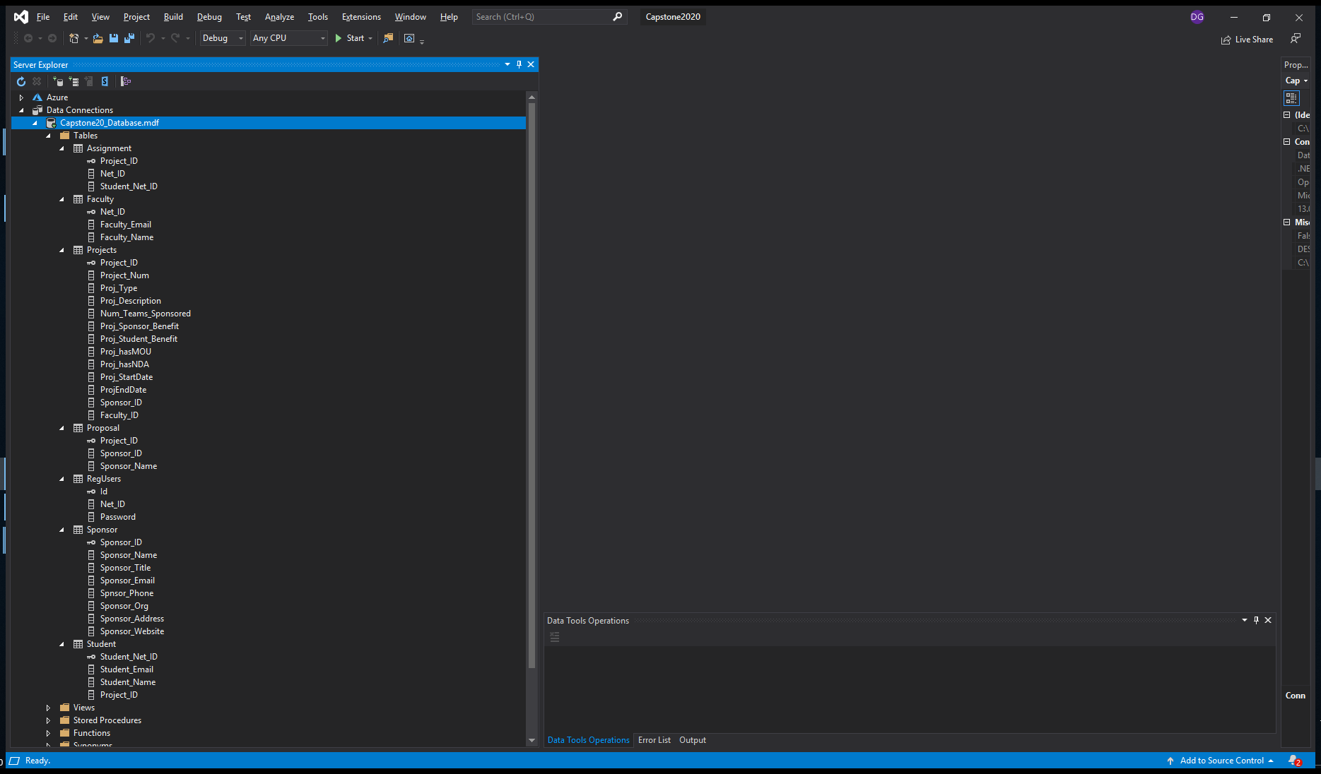
Database creation and linking
Notes:
The initial question presented to the project owner with answers.

Slide 7
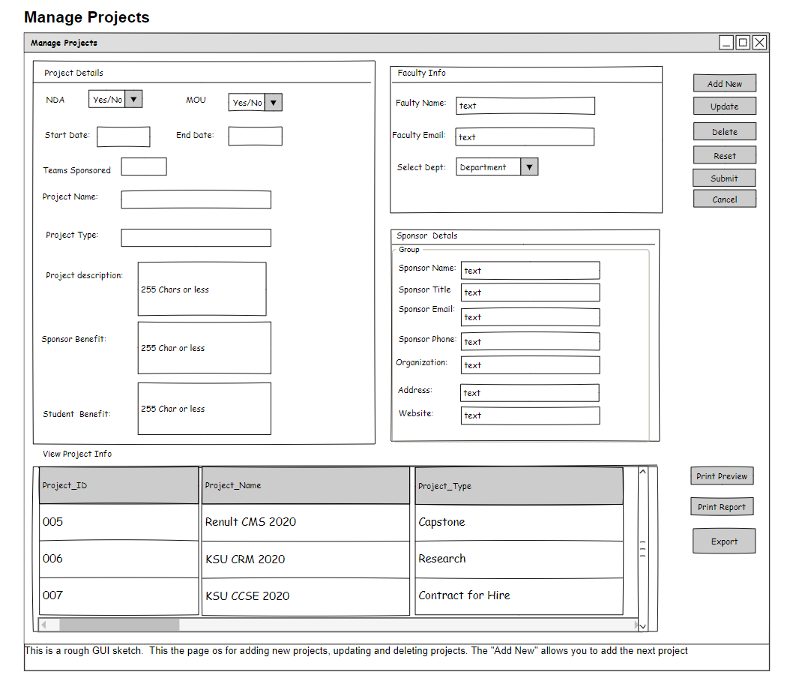
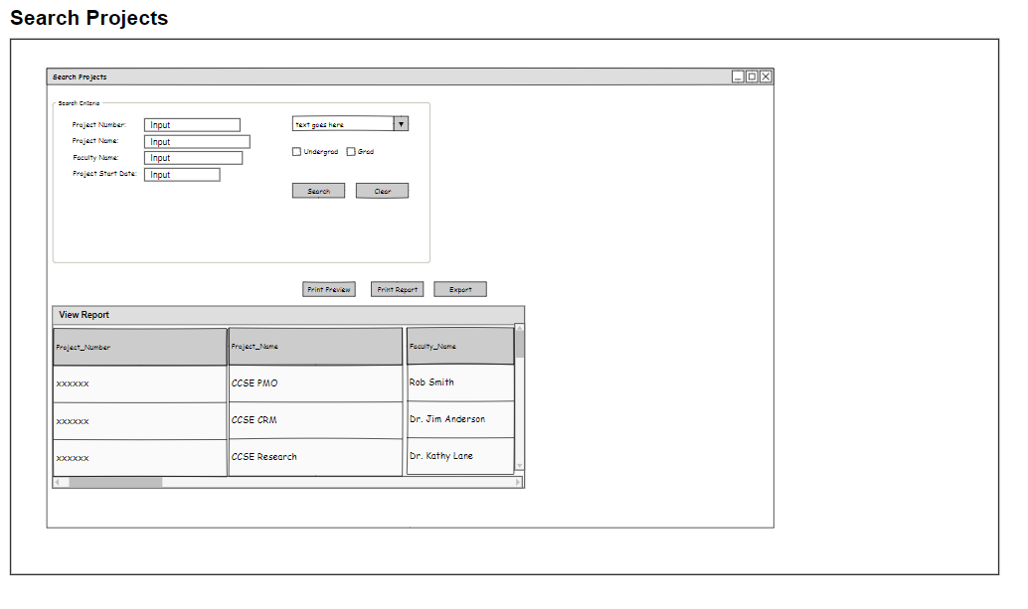
GUI Sketches

Slide 8
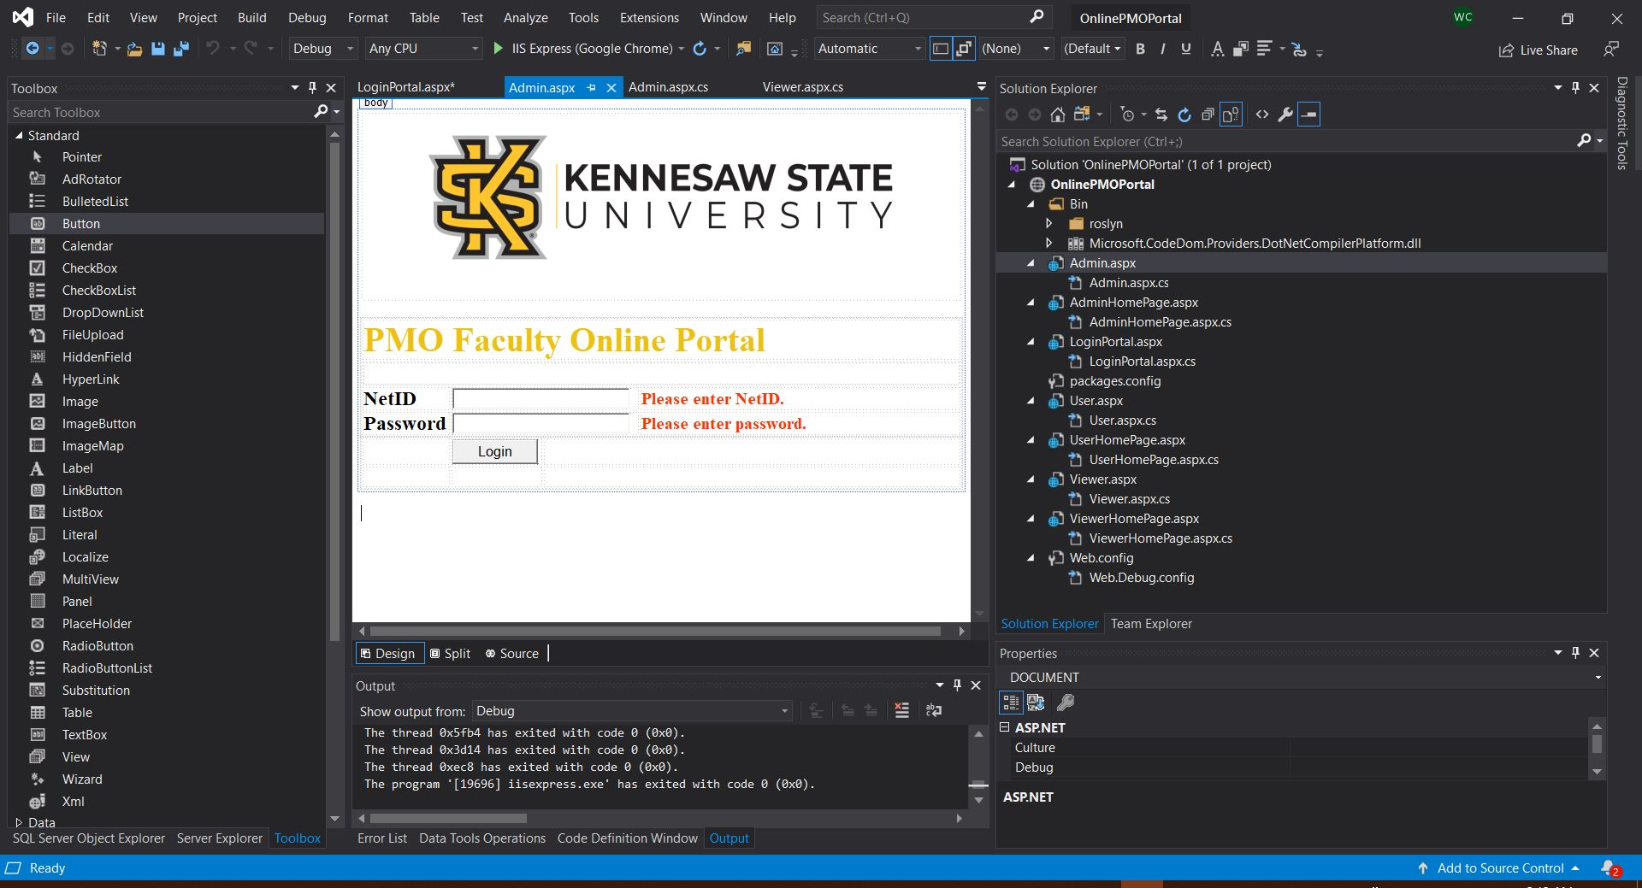
Web Portal

Slide 9
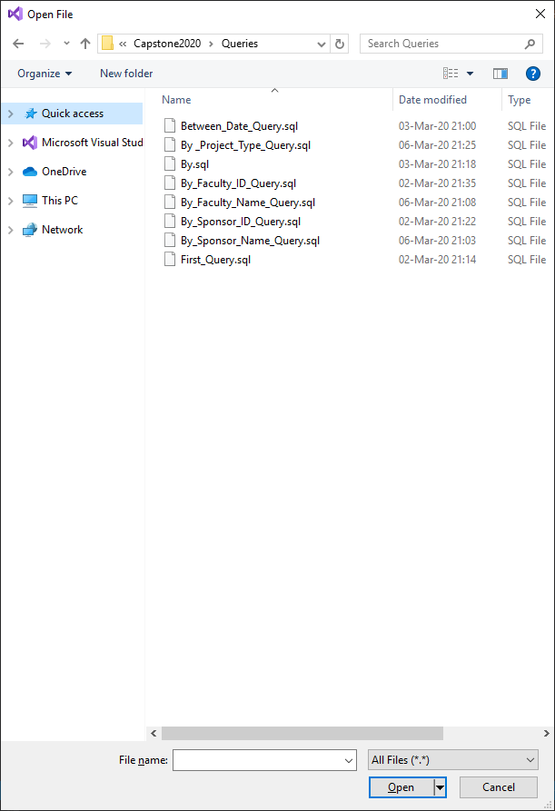
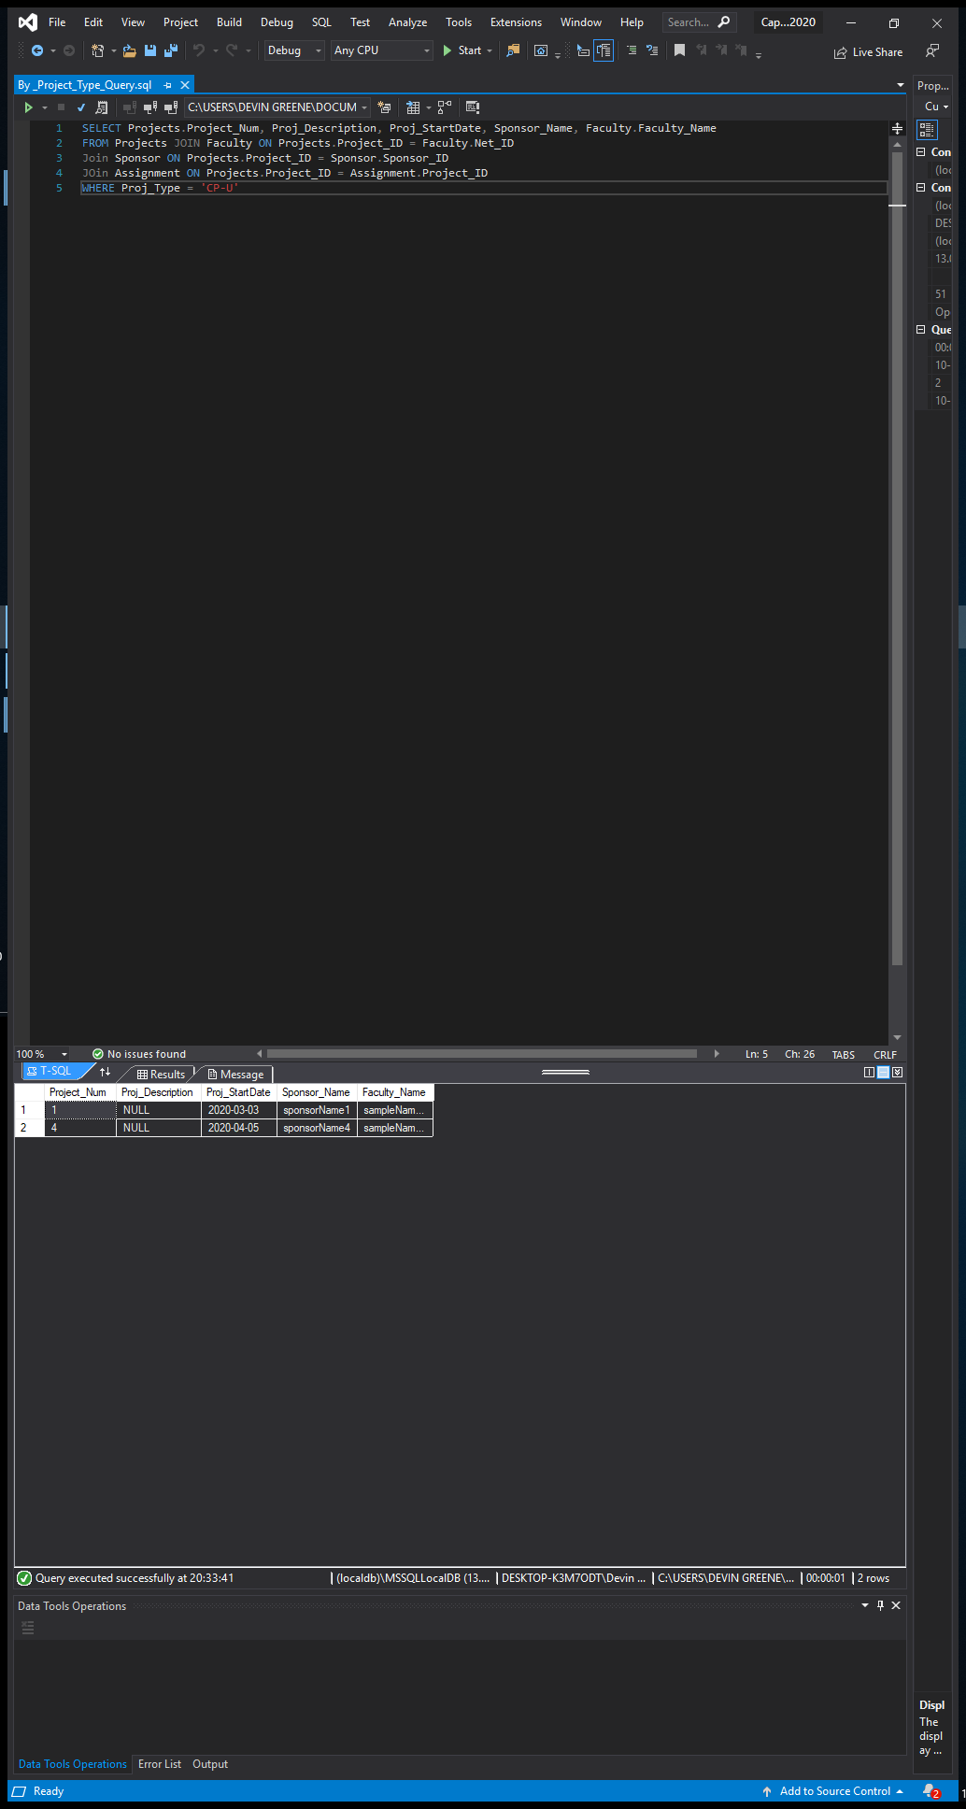
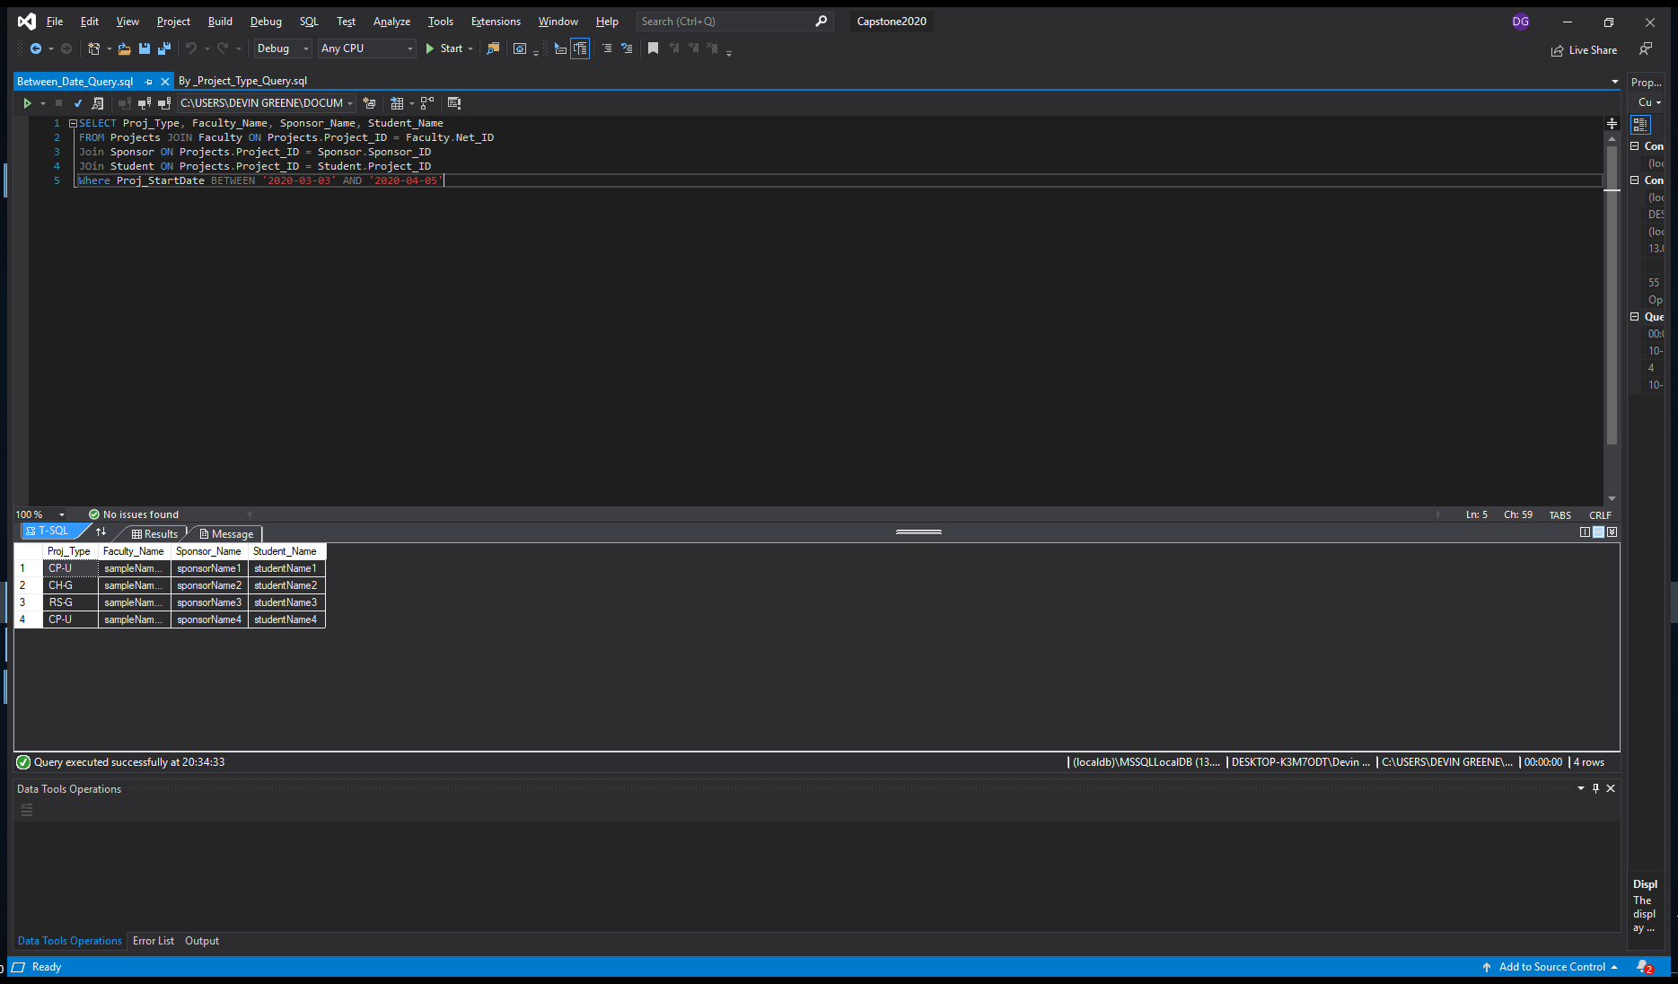
SQL Scripts
Notes:
Screen Shot of initial db created.

Slide 10
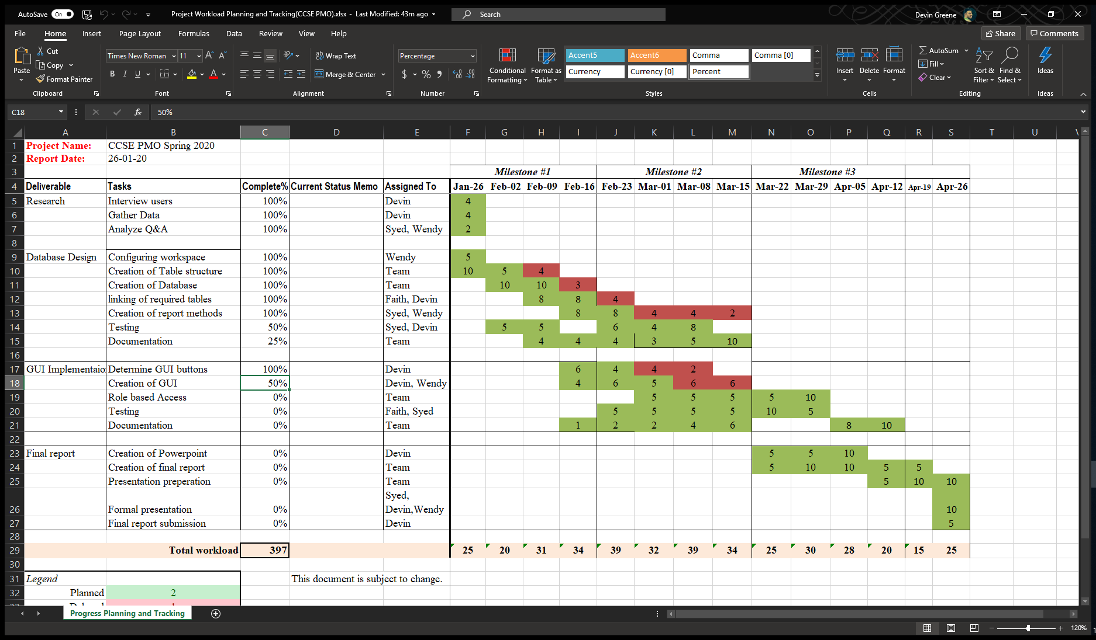
Gantt Chart

Slide 11
Project Experience
Challenges:
Creating Organized and intuitive GUI’s
Implementing Role Based Access concepts in SQL
Joining three or more tables in a SQL query
Database layout to facilitate the Joining of multiple tables
Understanding how to best manipulate PDFs in a database
Deciding between an in app or web-based GUI
Lessons:
How to join four or more tables in SQL
Different options for Roles Based Access in SQL

Slide 12
Milestone 3: Phase III Planning
Pair reporting queries and GUI buttons
Implement Roles Based Access Control
Implement handling of PDFs
Creation of Final Presentation
Implement Testing
Final Documentation
Prepare for Final Presentation
Notes:
The team will update the database design to include the contracts for hire and the research project criteria. After making these updates, we will move on to Phase II where will begin creating the actual database and GUI. This phase will also include creating SQL queries. and testing. The team will continue to create the appropriate documentation that will be included.

Slide 13
Other Issues
Distribution of roles – In Progress
Handling of PDFs in SQL – in progress
Implementing RBAC in a potentially changing system – in progress

