Slide 1

CCSE PROJECT MANAGEMENT SYSTEM
MILESTONE 3 Report
IT 4983 : IT CAPSTONE SPRING 2020
April 16th, 2020
Devin Greene
Wendy Claver
Syed Ahmed
Faith Kinchen

Slide 2
Agenda For Milestone 3 Report
Project Summary
Milestone Assessment
Gantt Chart
Contributions
Challenges

Slide 3
Project Summary I
The team has completed the project. We have fulfilled the overall goals of creating a database repository, and the accompanying GUI. We have also completed the goal of editing Data and running reports. We also implemented a basic version of Role Based Access that is handled at the portal into the GUI. We have gathered documentation and began or final report.
Database design
Project management system database
Graphical User Interface design
Documentation
Role Based Access
PDF handling

Slide 4
Project Summary II: Accomplishments
Adding final tables to Database in Visual Studio
Linking Portal to correct tables for Role Based Access
Finished creation of GUI in Visual Studio
Finished creation and implementation of web portal using Visual Studio
Implementation of basic Role Based Access control
Implementation of PDF handling

Slide 5
Milestone 3: Assessment
Database creation and table linking - complete
Implementation of GUI in Visual Studio – Complete
Web page portal – Complete
Implementation of Role Based Access – Complete
Implementation of Reporting - Complete
Update Gantt Chart- completed

Slide 6
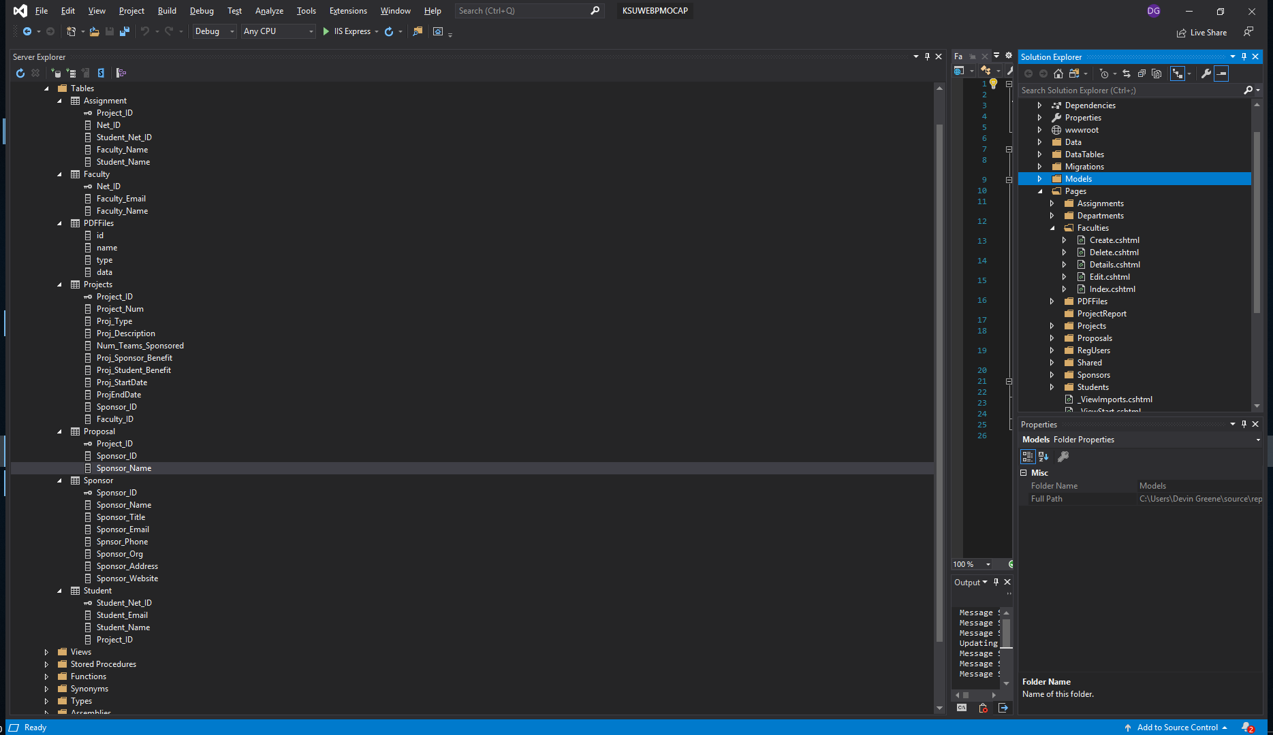
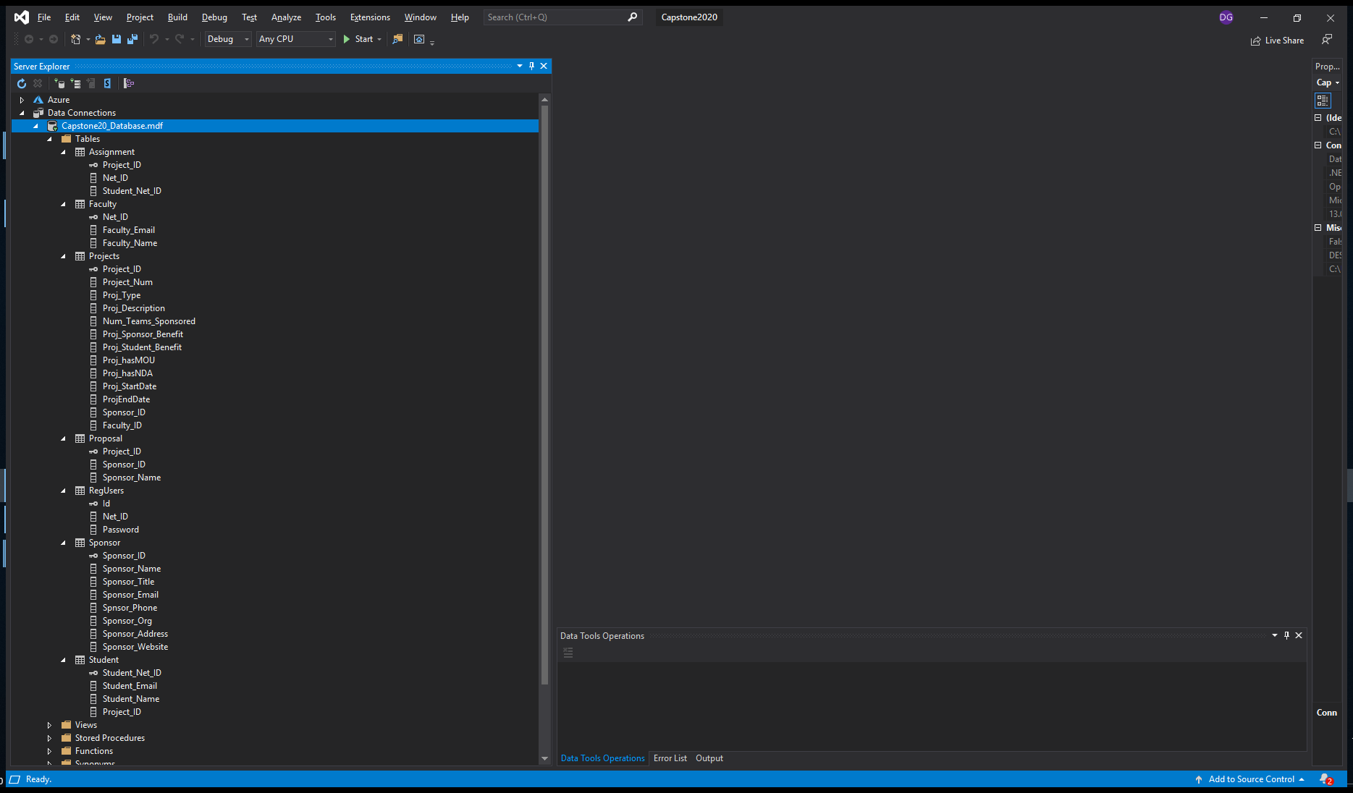
Final Database

Slide 7
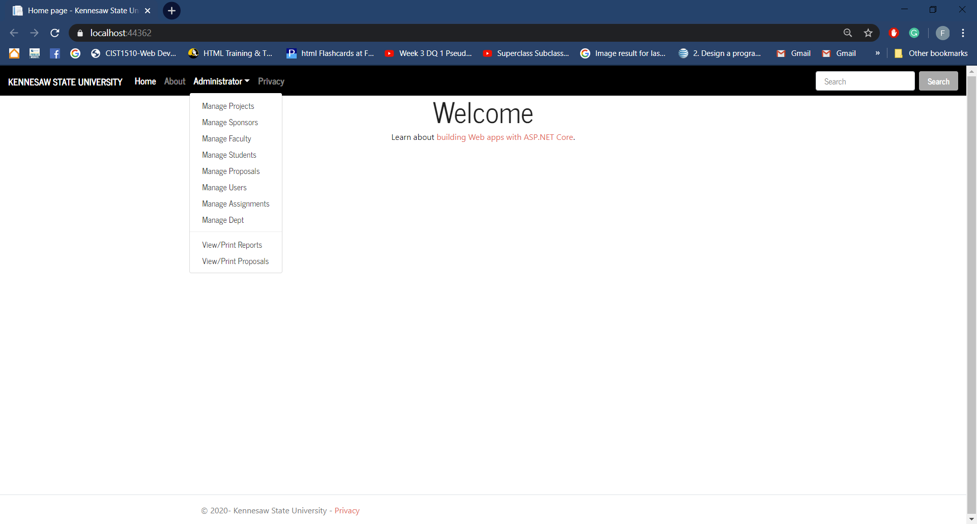
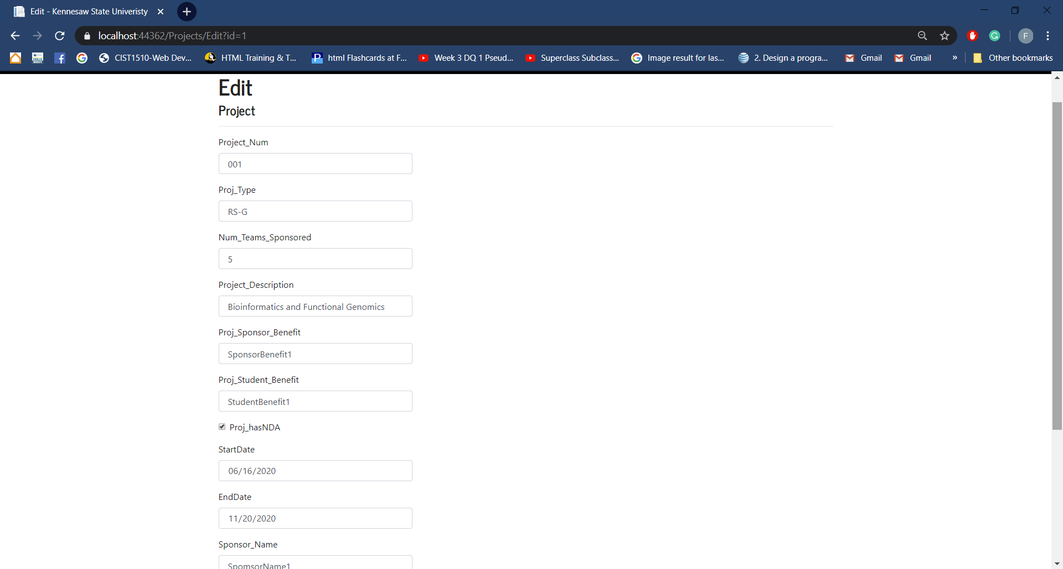
GUI

Slide 8
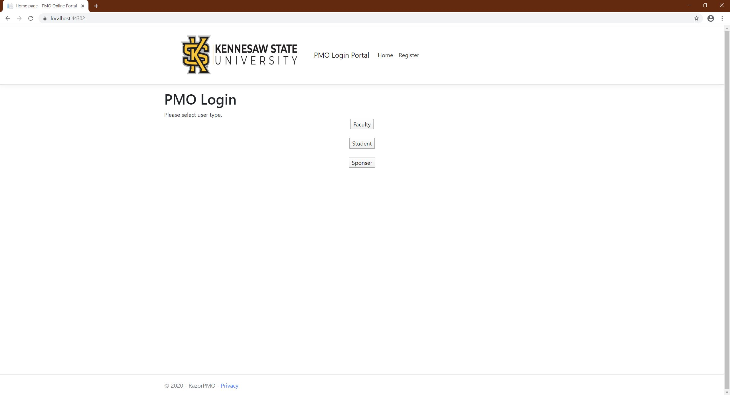
Web Portal

Slide 9
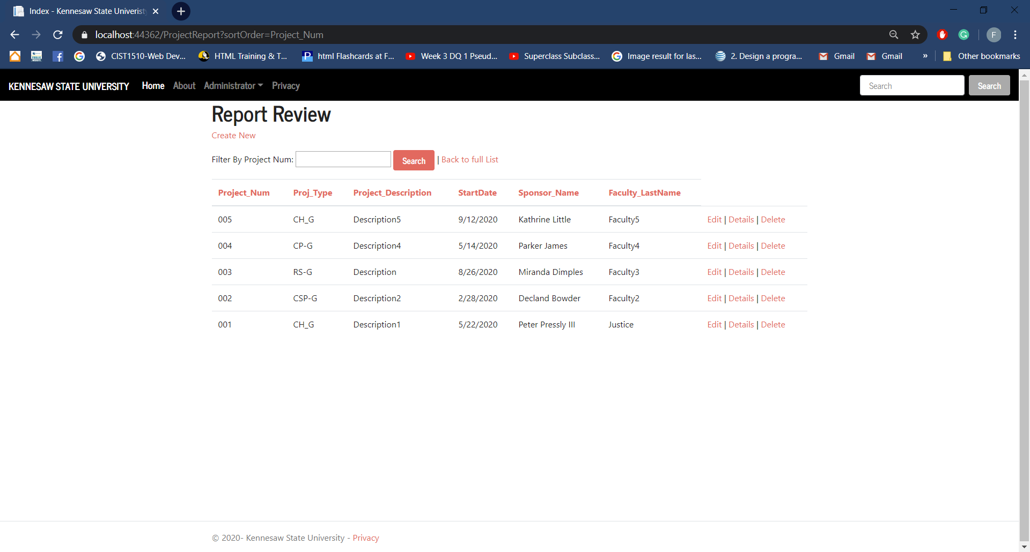
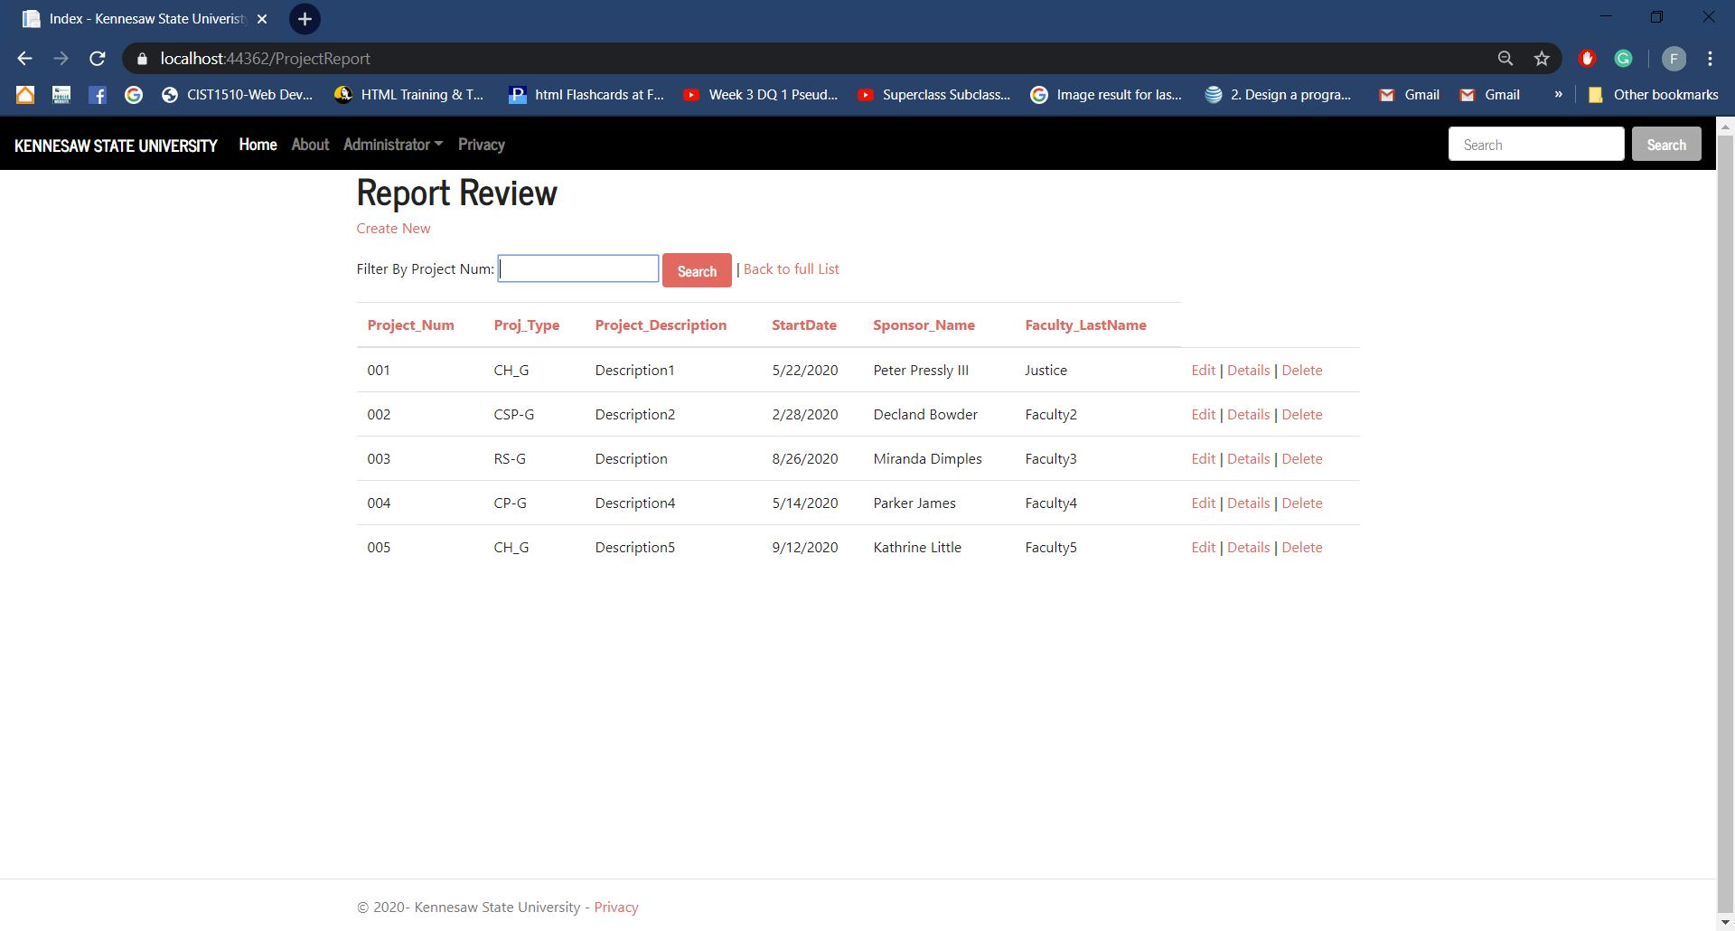
Reporting

Slide 10
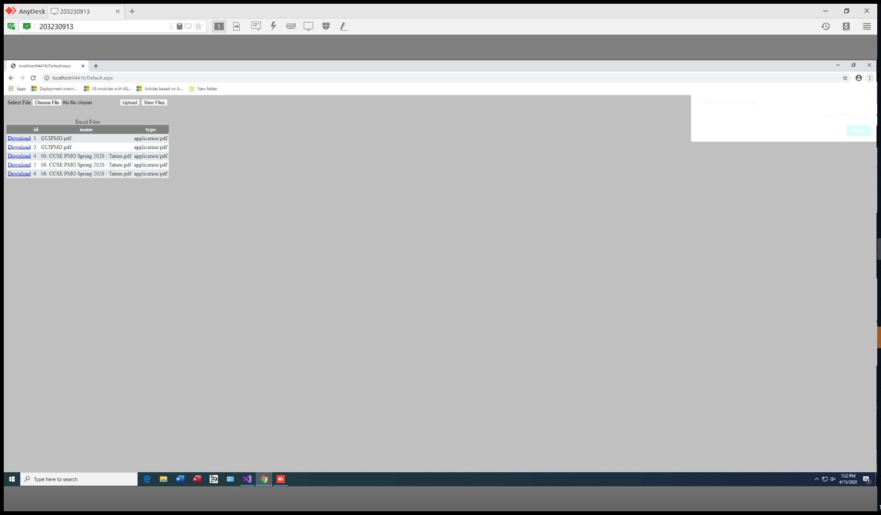
PDF Handling

Slide 11
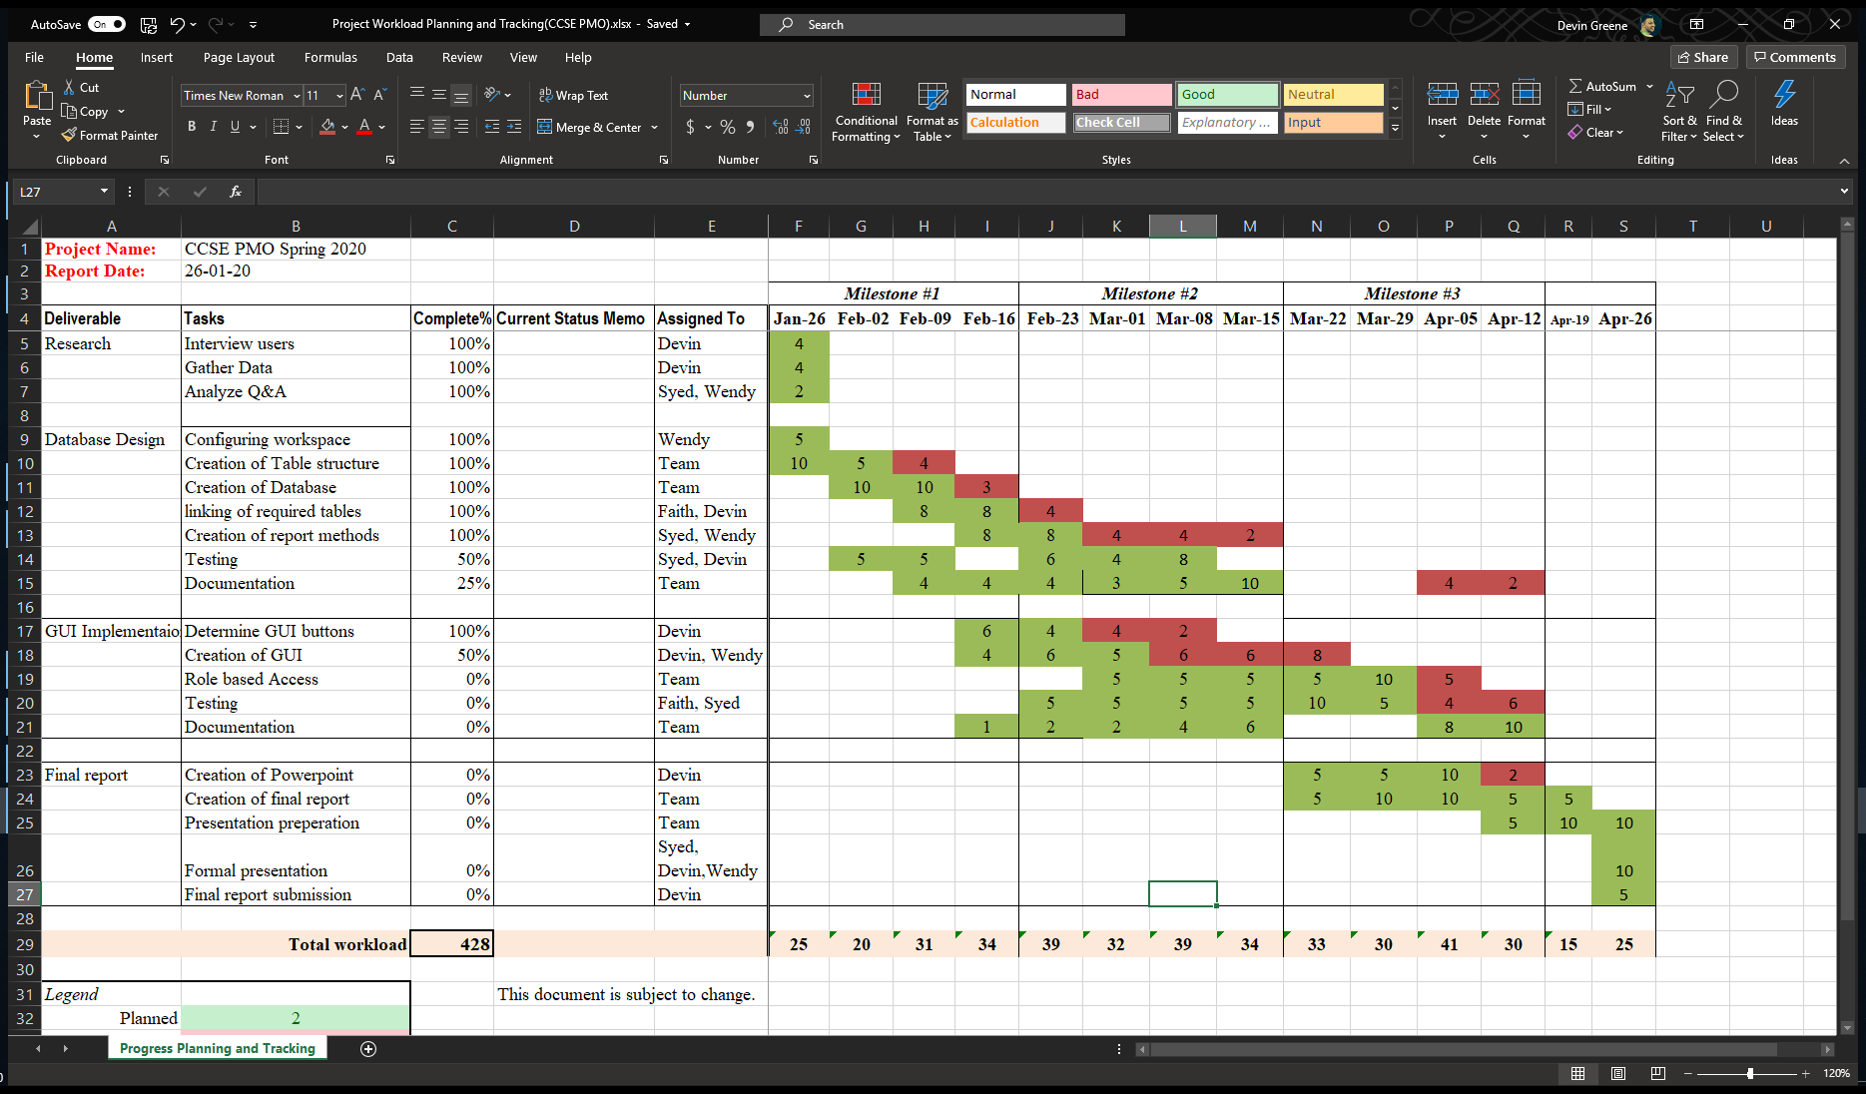
Gantt Chart

Slide 12
Project Experience
Challenges:
Creating Organized and intuitive GUI’s
Implementing Role Based Access concepts in SQL
Joining three or more tables in a SQL query
Database layout to facilitate the Joining of multiple tables
Understanding how to best manipulate PDFs in a database
Deciding between an in app or web-based GUI
Lessons:
How to join four or more tables in SQL
Different options for Roles Based Access in SQL
Implementation of Razer pages
Implementation of ASP.Net core framework

Slide 13
Contributions
Wendy Claver:
Creation of Web Portal
Implementation of Roles Based Access
Faith Kinchen:
Creation of GUI
Creation of Reporting functions
Syed Ahmed:
Upkeep of Project Website
Upkeep of Database
Handling of PDF documents
Devin Greene
Creation of SQL scripts
Documentation
Creation of Database

Slide 14
Other Issues
Distribution of roles – complete
Handling of PDFs in SQL – complete
Implementing RBAC in a potentially changing system – complete
Combining work from across teammates to one solution – in progress

