Slide 1
Results

Slide 2
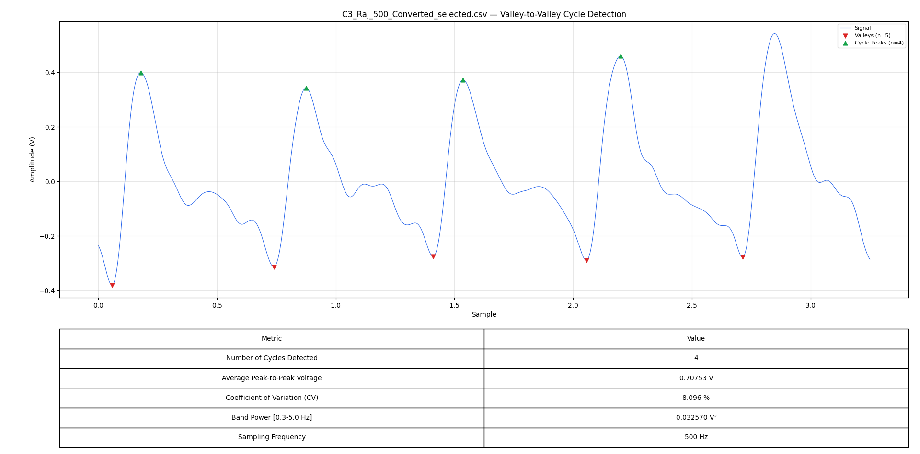
Radial Best C3

Slide 3
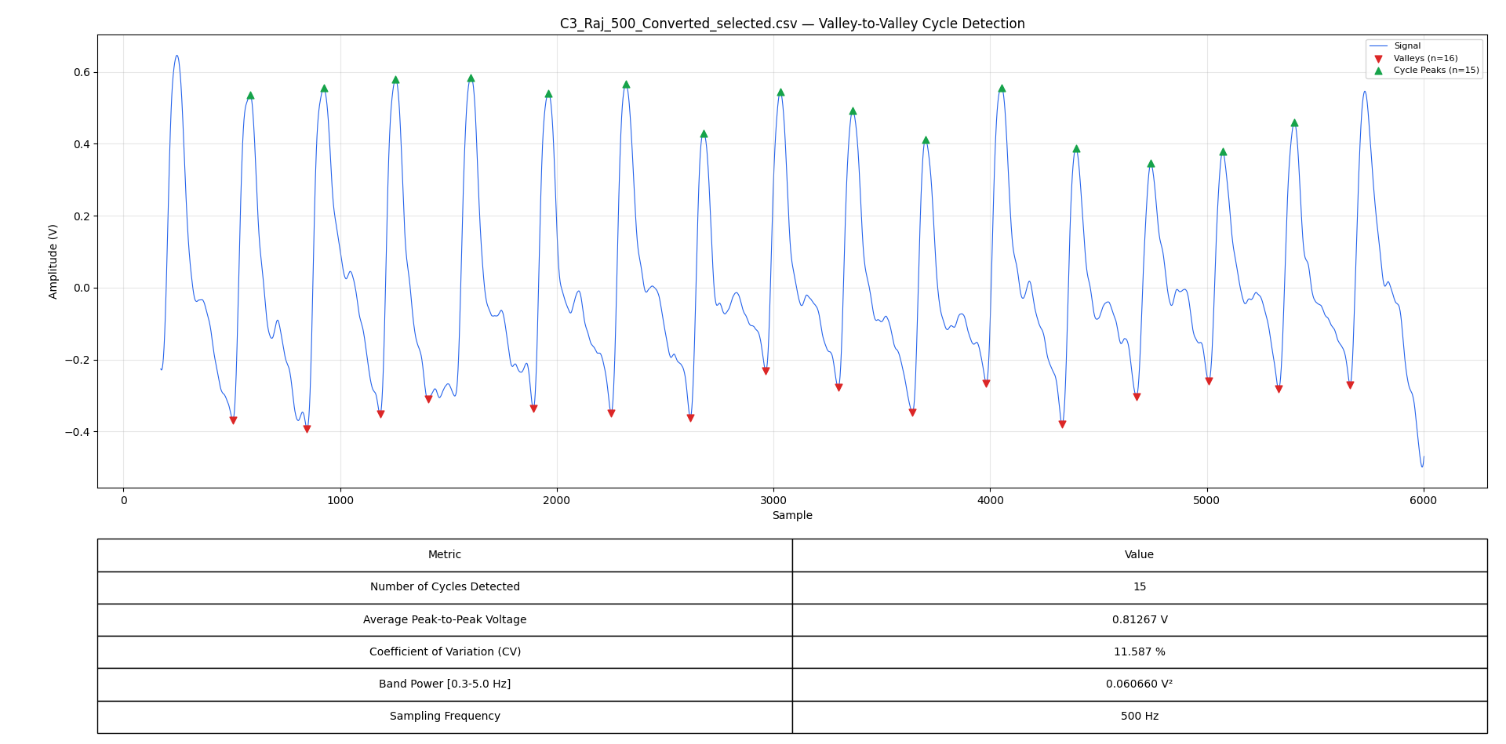
Radial Best C3-Cycle Increased

Slide 4
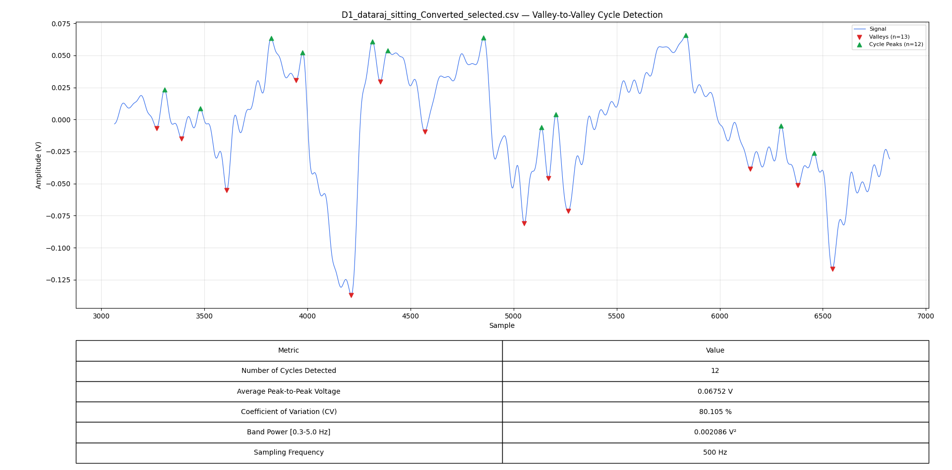
Radial Worst D1

Slide 5
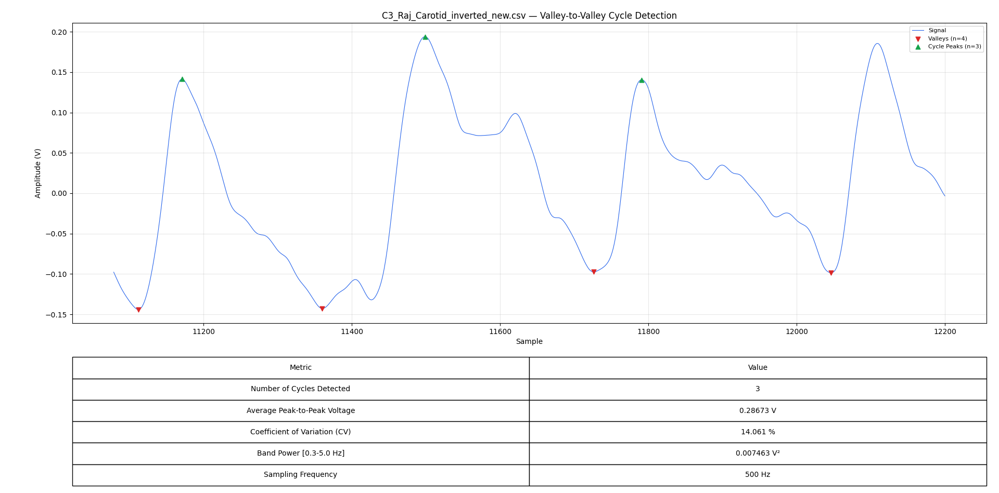
Carotid Best C3

Slide 6
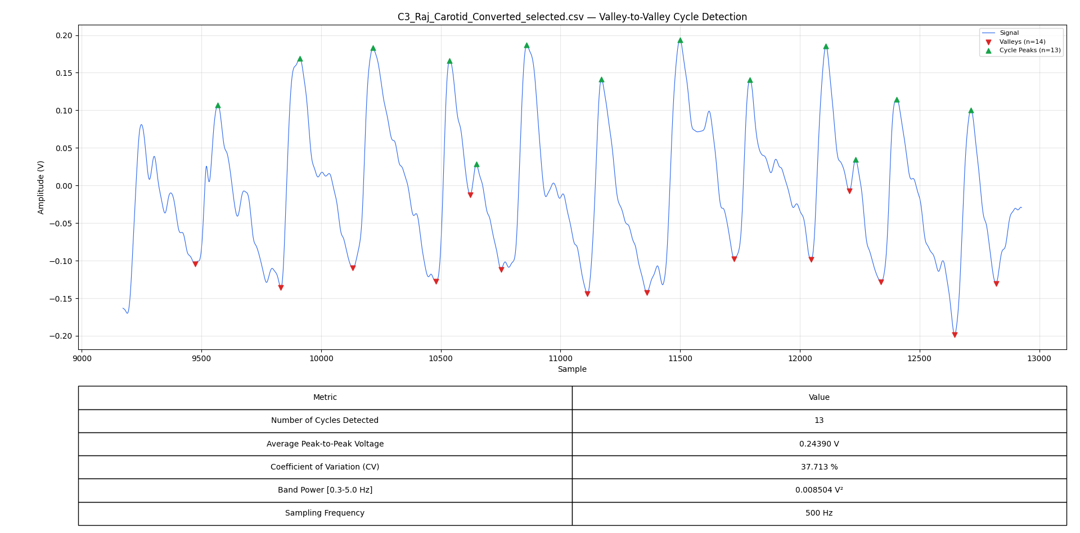
Carotid Best C3-Cycle Increased

Slide 7
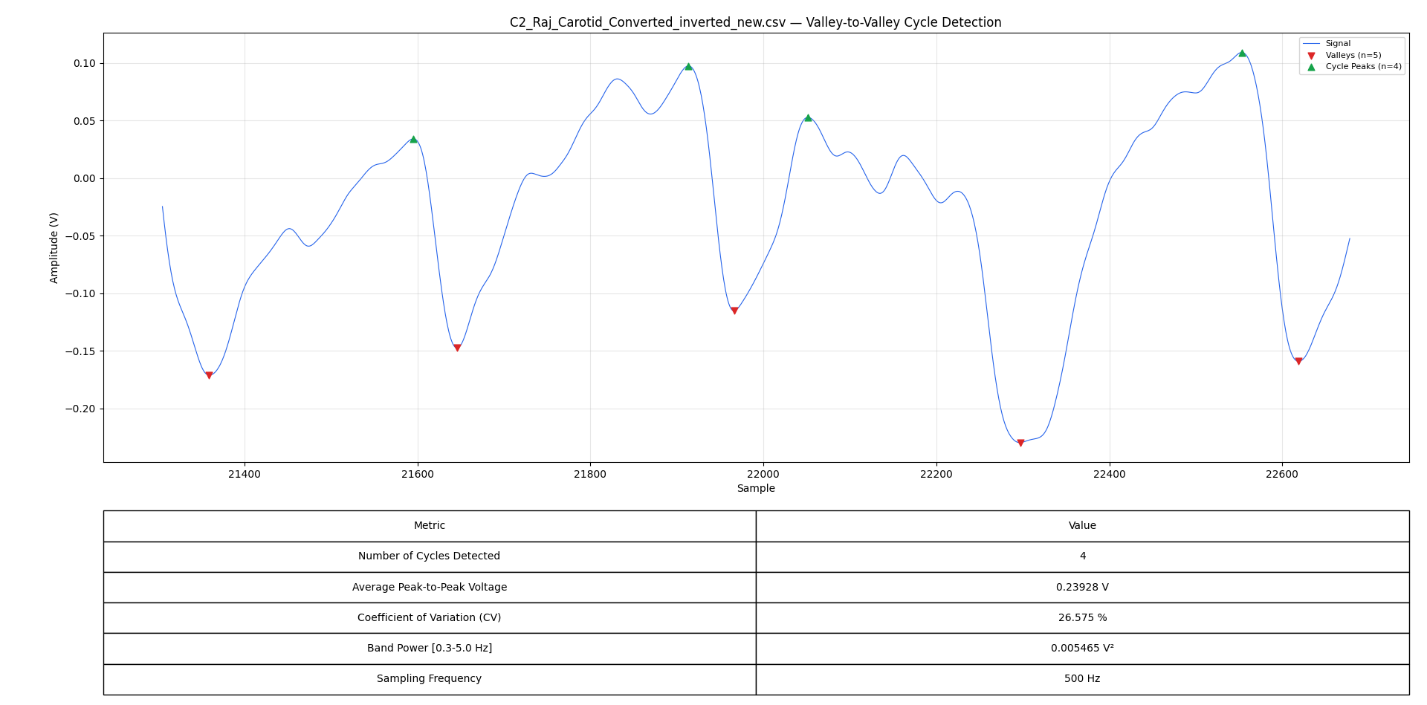
Carotid Worst – C2

Slide 8
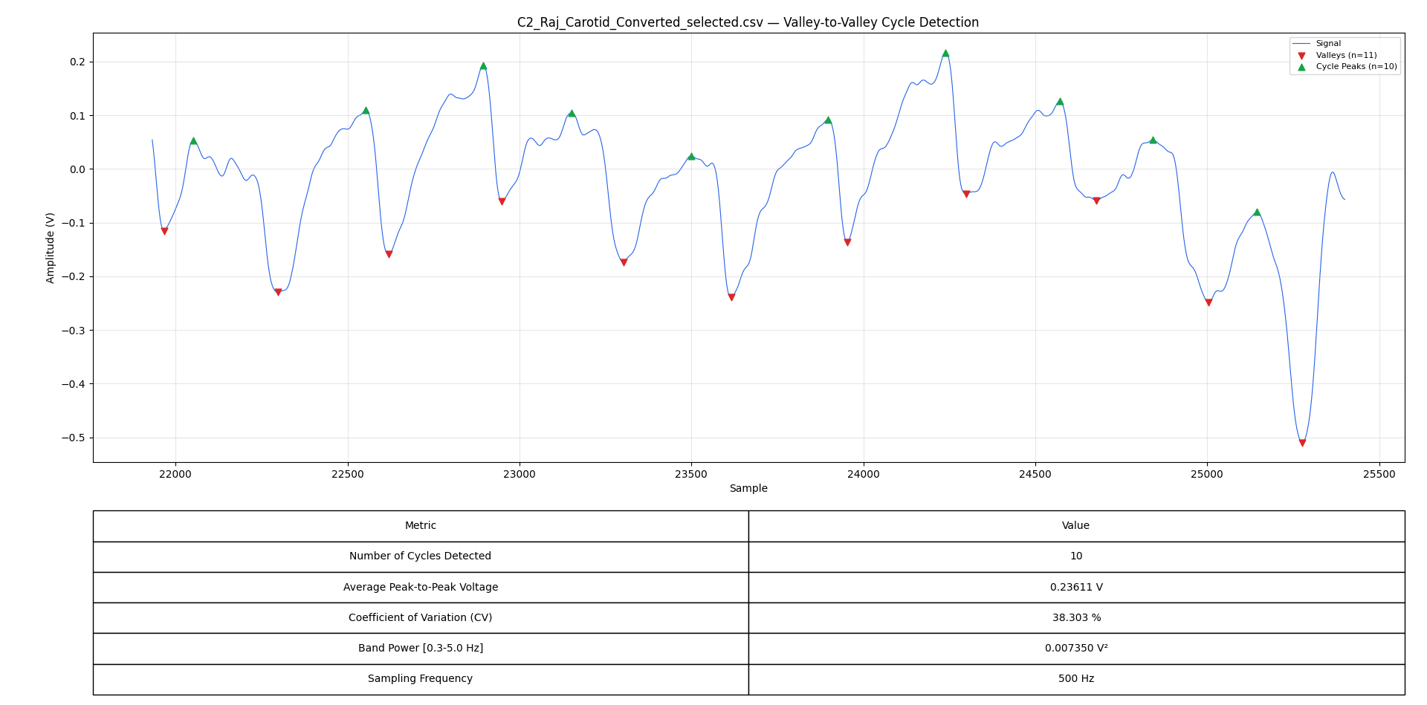
Carotid Worst – C2 Cycle Increased

Slide 9
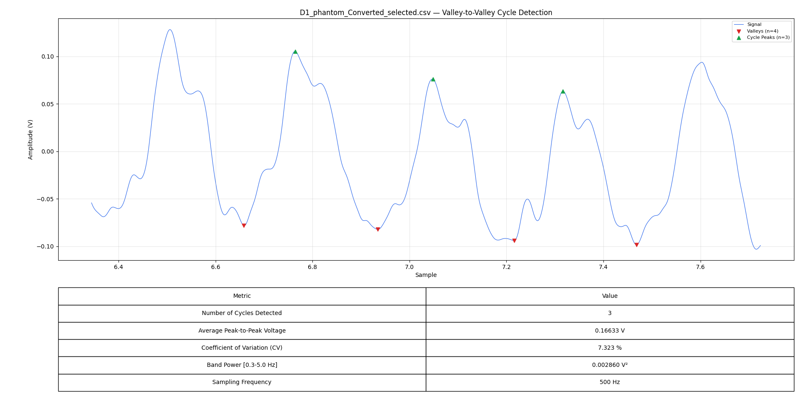
Phantom Best D1

Slide 10
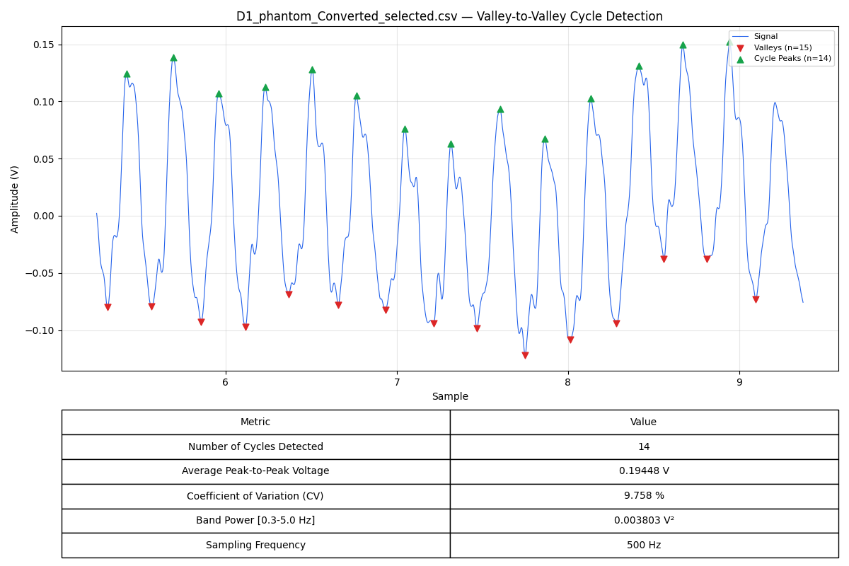
Phantom Best D1 Cycle Increased

Slide 11
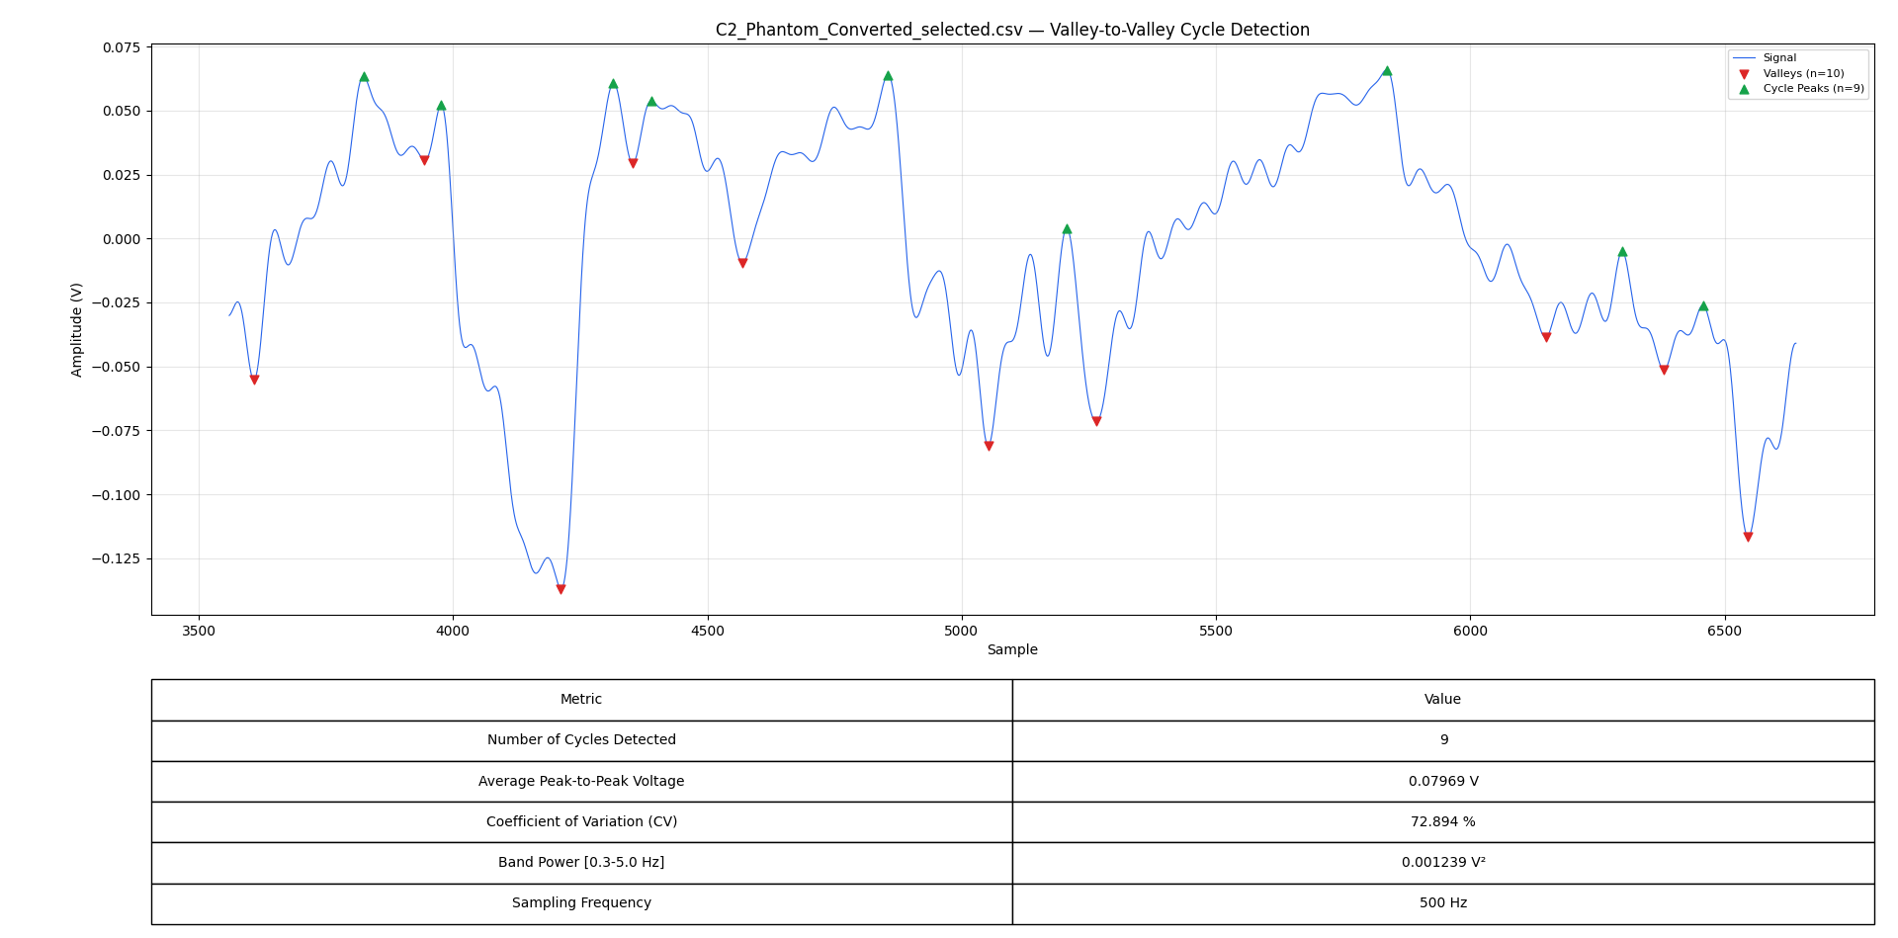
Phantom Worst – C2

Slide 12
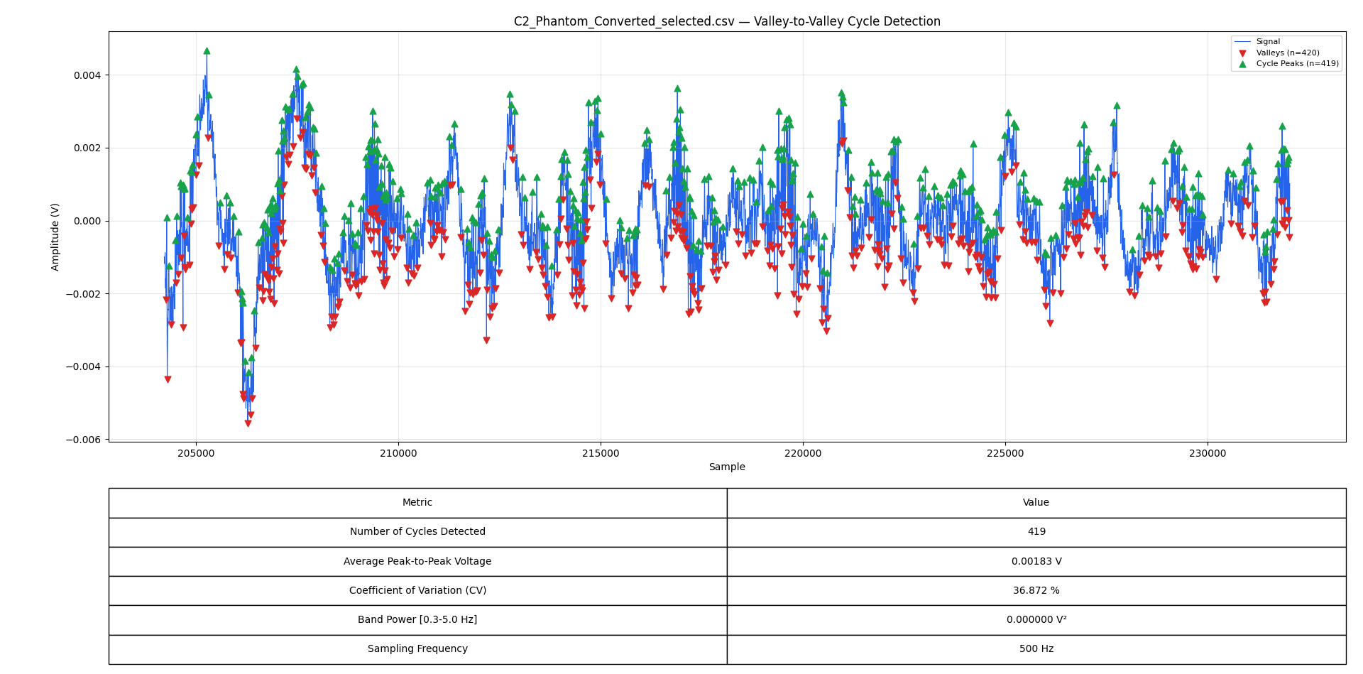
Phantom Worst – C2 Cycle Increased

