Slide 1
Rocket Fuel Project
אביחי יפת
עמית ליכט
הלל מרן

Slide 2
Motivation
We wish to map the topology of an ISP in an accurate and efficient way.
Real topologies are not publicly available.

Slide 3
Rocketfuel article
Rocketfuel runs traceroutes from different servers around the world.
Paths are merged to form a map.
Traceroute server
Traceroute server
ISP
Traceroute server
Notes:
שתי דקות

Slide 4
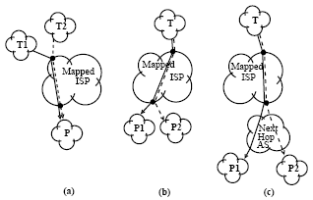
Rocketfuel article
Rocketfuel assumes that there is only one path from a given ingress to a given egress point of an ISP.
Ingress reduction
Egress reduction
Next hop AS reduction
Notes:
אנו משתמים בעובדה זו על מנת לשפר את זמן הריצה. אנו מוכנים להקריב דיוק על מנת להרוויח יעילות.

Slide 5
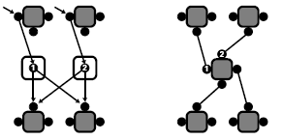
Rocketfuel article
Determinate which interface IP addresses belong to the same router.
Boxes represent routers and circles represent interfaces
Interfaces 1 and 2 are aliases
Notes:
אנו משתמים בעובדה זו על מנת לשפר את זמן הריצה. אנו מוכנים להקריב דיוק על מנת להרוויח יעילות.

Slide 6
Our Rocketfuel
THE ALGORITHM

Slide 7
Algorithm
The algorithm is divided into four segments, each segment is implemented by a module.
We connect with external servers in order to gain a comprehensive view of the internet.
BGP Tables
ISP server list
Traceroute servers
Geolocation data
Dependent prefix discovery
Egress detection
Path detection
Alias resolution

Slide 8
Algorithm – Dependent prefix detection
Stage one: The algorithm uses provided BGP tables to search for all dependent IP prefixes.
Dependent prefix – an IP prefix that either belongs to the ISP or a stub AS which is connected only to the ISP.
BGP Table provided by routeviews.org

Slide 9
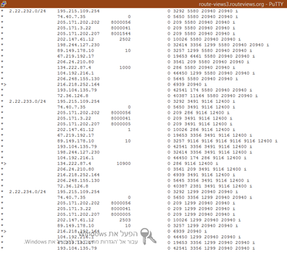
Algorithm – Dependent prefix detection
The algorithm recognizes an entry in the BGP table as dependent prefix when all its routs pass through the ISP AS.
entry
9116 is the ASN of 012-smile

Slide 10
Algorithm – Egress Detection
Stage two: Send traceroute probes to each of the dependent prefixes previously detected and identify the ISP exit servers.
Server classification provided by http://www.he.net/

Slide 11
Algorithm – Path mapping
Stage Three: Use external servers to send traceroute requests to each of the ISP exits and record each path.
Server classification provided by http://www.he.net/
Traceroute servers provided by traceroute.org

Slide 12
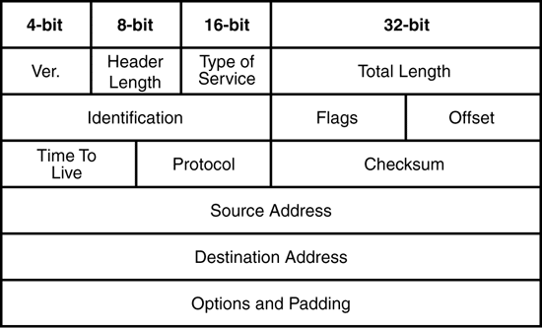
Algorithm – Alias resolution
Alias probe – a traceroute-like probe to a high UDP port (usually 33434) but with TTL=255.
We expect an ICMP response “UDP port unreachable”.

Slide 13
Alias resolution – the old one
Send alias probes to two potentially aliased IP addresses. Two aliases will respond with the same source address.
Not reliable today.
Essentially three other techniques related in the article.

Slide 14
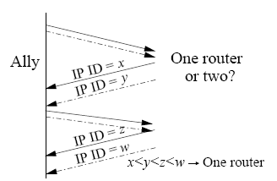
Alias resolution – the basic one
First: Look for nearby IP identifiers, packets sent consecutively will have consecutive IP identifiers.
Notes:
Try to collect evidence that the IP addresses are on the same router by looking for features that are centrally applied

Slide 15
Alias resolution – the basic one
Second: ICMP rate limiting. Where the router’s host processor responds to the first of back-to-back probes.
Third: not sufficient on its own, TTL remaining in the response is useful for providing evidence that two addresses are not aliases.
Notes:
Try to collect evidence that the IP addresses are on the same router by looking for features that are centrally applied

Slide 16
Alias resolution – Improvements
Use geolocation for providing evidence that two addresses are not aliases.
Define “nearby” IP identifiers as 1000 difference rather than 200 like in the article: some central routers are very sought.
Notes:
We observed that only 20 to 25% of the routers sent us a “UDP port unreachable” message

Slide 17
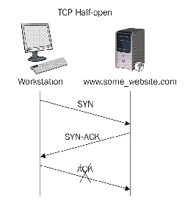
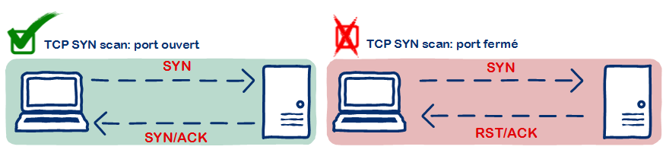
Alias resolution – Improvements
Today, many variations of traceroute exist.
Use “half-open technique” (TCP), intended to bypass firewalls.
Notes:
We wondered why routers we had collect from traceroute runs, thus had previously respond ICMP message, had not respond “UDP port unreachable” ?

Slide 18
Alias resolution – Improvements
We combine the two types of alias probe in order to get a higher rate of responsive addresses.
It also allow to improve the whole process
Two addresses will not be aliases if one of them answered only to the UDP probe and the second only to the TCP probe.
On the other side, if two addresses answered the two types of probe, we run the alias resolution twice (over UDP and then TCP).
Notes:
We wondered why routers we had collect from traceroute runs, thus had previously respond ICMP message, had not respond “UDP port unreachable” ?

Slide 19
Implementation
PYTHON 2.7

Slide 20
Global algorithm
2. Egress detection
1. Dependent prefix discovery
BGP Table
DB
Task list Generation
3. Path detection
4. Alias resolution
ISP Maps

Slide 21
Conclusion

Slide 22
Encountered difficulties
Parts of the article were out of date, we had to find new ways to implement them.
Alias resolution is based on many assumptions that are no longer valid.
We were not able to find a free and accurate way of geolocate IP addresses in order to print a map.

Slide 23
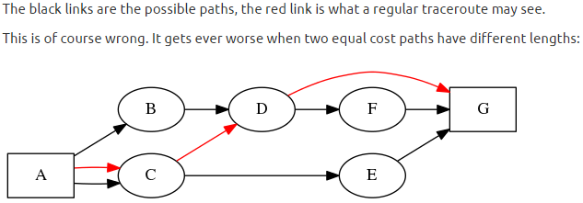
Suggestions for the future
Running Dublin (or Paris) traceroute would improve by a lot the accuracy of the map.

Slide 24
Suggestions for the future
Alias probes have not a satisfying rate of answers.
Still worst than when running traceroute.
It seems that ICMP “TTL expired” responses have more priority than other packet.
Find a way to introduce this in the alias resolution module.

