Slide 1
Automated Campaign Insight Engine
Auto-generated deck from Marketing Campaign Uplift Data

Slide 2
Overall Campaign Performance
Total campaigns: 50
  Average expected uplift: 0.09
  Median uplift: 0.09
  Max uplift: 0.14
  Min uplift: 0.02
  Average duration: 51.0 days

Slide 3
Top Channels by Expected Uplift
Channel | Campaigns | Avg Uplift | Median Uplift | Max Uplift
Affiliate | 11 | 0.10 | 0.10 | 0.14
Paid Search | 11 | 0.09 | 0.10 | 0.14
Display | 9 | 0.09 | 0.10 | 0.14
Email | 11 | 0.07 | 0.09 | 0.14
Social | 8 | 0.07 | 0.06 | 0.14

Slide 4
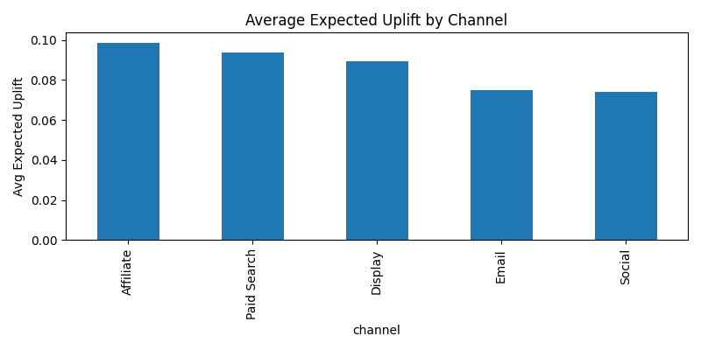
Average Expected Uplift by Channel

Slide 5
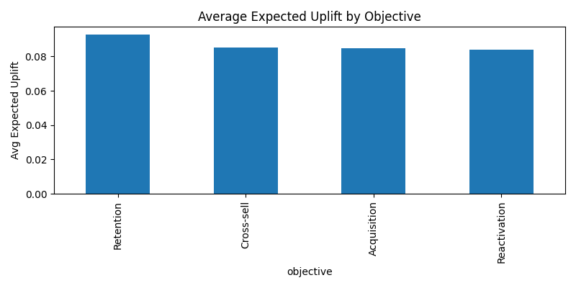
Average Expected Uplift by Objective

Slide 6
Executive Summary
Overall campaign performance shows a healthy average expected uplift of 9%.
Affiliate marketing and broad "All" customer targeting consistently deliver the strongest uplift.
Social media campaigns and those targeting "Churn Risk" customers show the lowest average uplift.
There's significant potential, with top campaigns achieving up to 14% uplift across various categories.

Slide 7
Channel, Objective & Segment Insights
Channels:** Affiliate marketing is the top performer. Social media and Email channels show lower average uplift, though Email campaigns can sometimes achieve very high results.
Objectives:** Retention and Cross-sell campaigns are generally effective, showing strong average and median uplifts. Acquisition and Reactivation objectives have slightly lower average performance.
Segments:** Campaigns targeting the "All" customer segment are highly successful. Campaigns focused on "Churn Risk" customers deliver the lowest average and median uplift.

Slide 8
Recommendations to Improve Uplift
Increase investment and focus on Affiliate channels and "All" customer segments, given their strong track record of high uplift.
Review and optimize strategies for Social media and "Churn Risk" customer campaigns to improve their effectiveness.
Analyze the high-performing campaigns within Email, Social, Acquisition, and Reactivation to understand and replicate their success factors.
Prioritize and develop more campaigns around Retention and Cross-sell objectives, leveraging their proven potential for strong uplift.

