Slide 1
Airbnb
Team: Complex Data Science
Tommy Huang
Amit Sahoo

Slide 2
Outline
Research
Preprocessing
EDA
Feature Engineering
Machine Learning
Conclusion
Further Improvement
What We Learned

Slide 3

Where is a new User going to book his next Vacation???

Slide 4
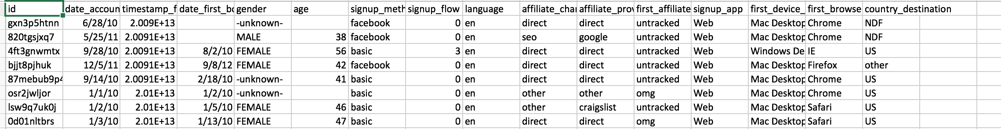
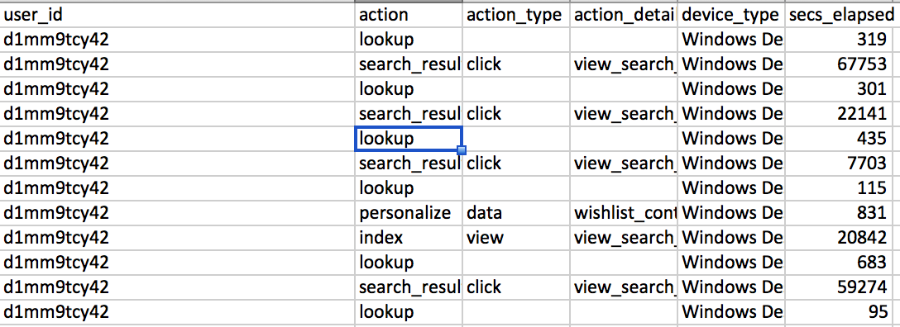
Data Set
Training Data Set
Session File

Slide 5
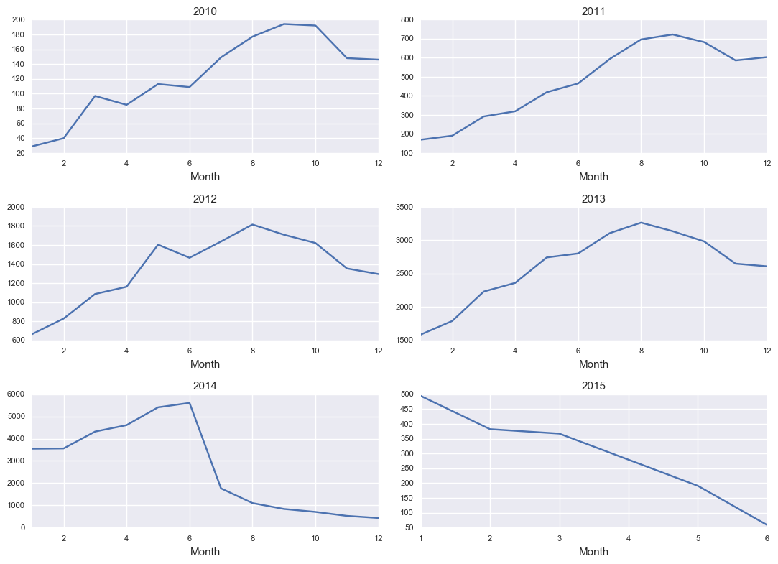
EDA

Slide 6
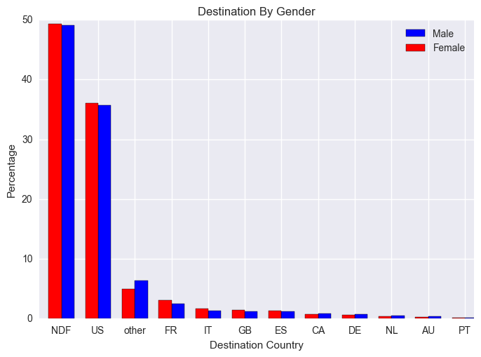
EDA (Con’t)

Slide 7
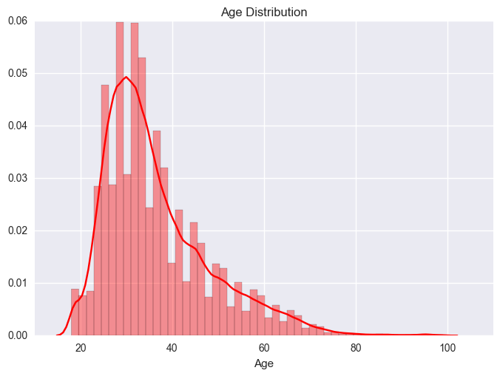
EDA (Con’t)

Slide 8
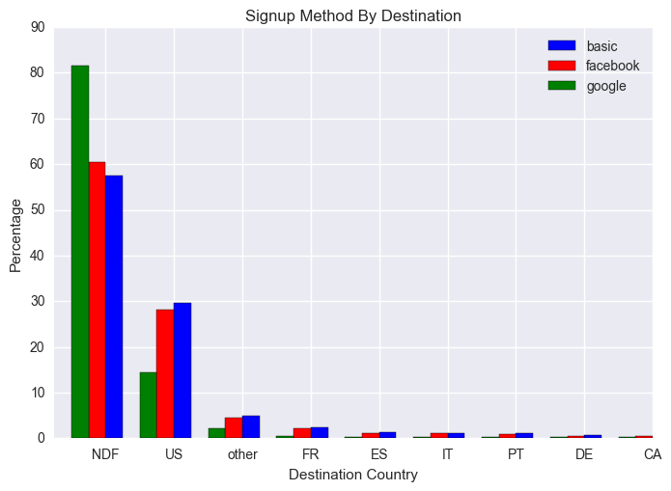
EDA (Con’t)

Slide 9
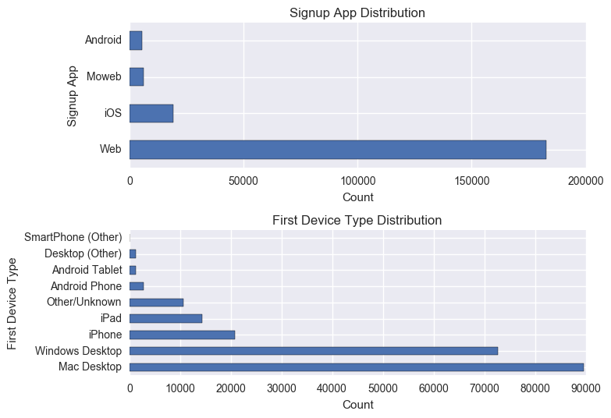
EDA (Con’t)

Slide 10
Feature Engineering
Dummified Features
Extract Datetime
Aggregating session information

Slide 11
Challenges
Imbalanced Data
Not valid Age values
Missing values for some variables

Slide 12
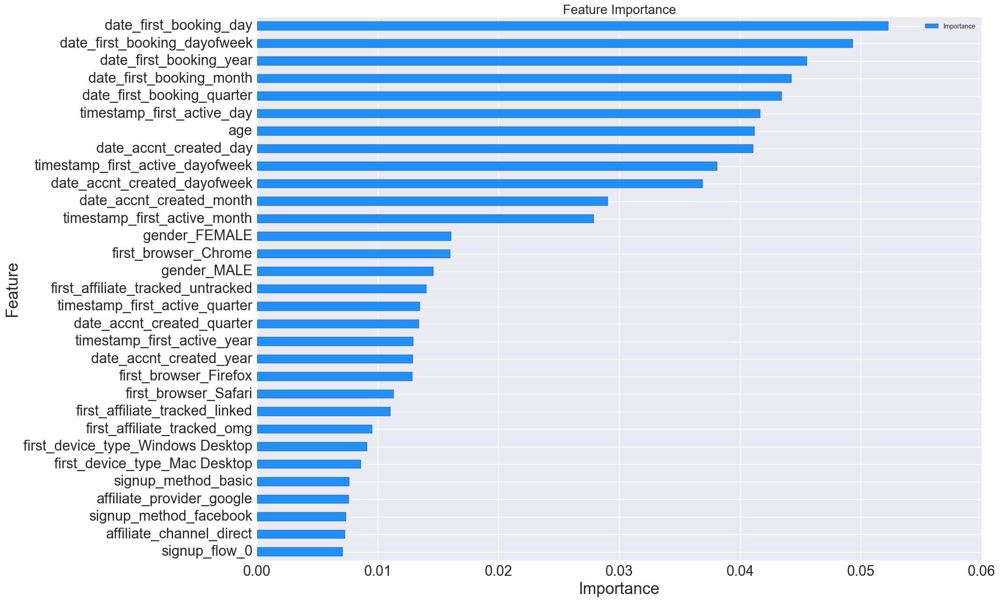
Feature Importance

Slide 13
Imbalanced Data
Putting Class Weight as parameter on different class in the Algos.
Use SMOTE to OverSample and UnderSample different classes.
Finally we took the Probabilities from different class.

Slide 14
Random Forest
Model Parameters
min_samples_leaf =4,class_weight = 'balanced', random_state = 15
Score
0.81870

Slide 15
AdaBoost
Parameters
N_estimators = 25
Learning rate = 0.8
Random_state = 20
Score
0.84395

Slide 16
Gradient Boosting
Parameters
learning_rate=0.1
max_depth=3
n_estimators=100
Score
0.83217

Slide 17
XGBoost
Parameter
param['objective'] = 'multi:softprob' param['eta'] = 0.1 param['max_depth'] = 4 param['silent'] = 1 param['num_class'] = 12 param['eval_metric'] = "mlogloss" param['min_child_weight'] = 1 param['subsample'] = 0.7 param['colsample_bytree'] = 0.7
Score
0.85359

Slide 18
Stacking
Sklearn- Stacking Classifier
Meta Classifier – XGBoost
Score
0.68778

Slide 19
Things to improve on
Stacking and ensemble packages.
More feature engineering.
Parameter Tuning
Neural Net(RBM sickit learn)

Slide 20
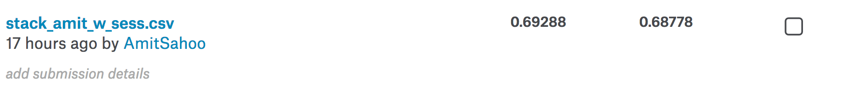
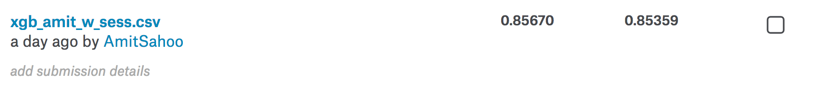
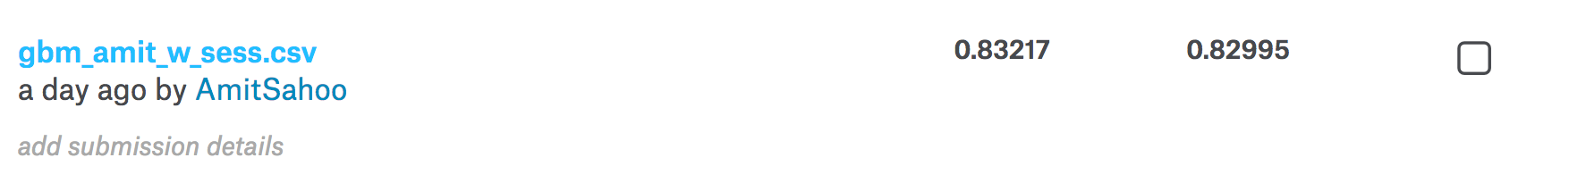
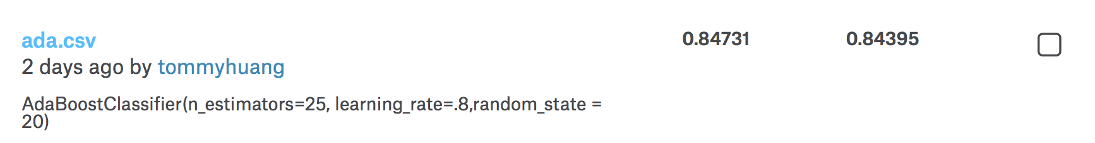
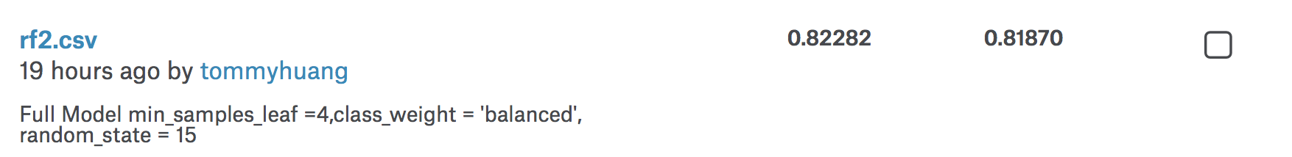
Score

Slide 21
Thank You..
Q & A

