Slide 1
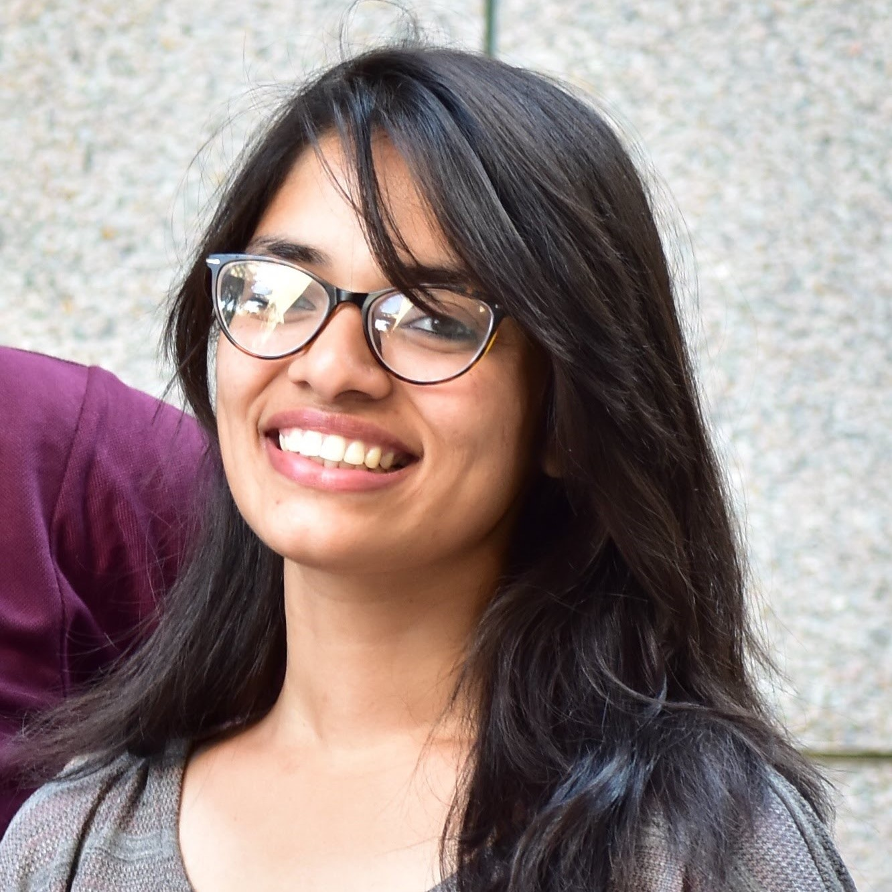
Sonal Goel
Analyst, CoRe Automation COE
Hyderabad
Tel:+1 678 299 5730
songoel@deloitte.com
Insert photo
If passion drives you, let reason hold the reins.
– Benjamin Franklin
Background and Interests/Professional Affiliations
Introduction
Relevant Experience
A UiPath Developer and a Solution Designer who works with the RPA team. We build software bots (solutions) that aim at reducing the manual efforts by a human and thus increase efficiency in our day to day processes.
I have been working on UiPath for about 2 years and building codes(5 bots so far) for various process/teams across CoRe. Have built automation solutions(both developer & designer) for platforms such as ServiceNow, SharePoint, Ariba.
UiPath Advance Certified along with Certification in UiPath’ s Solution Architecting. Post Graduation in Management with Marketing & Finance as majors. Inclined towards AI Machine Learning & Data Analytics. Learnt R, Python, Tableau. Exploring PowerBi.

