Slide 1





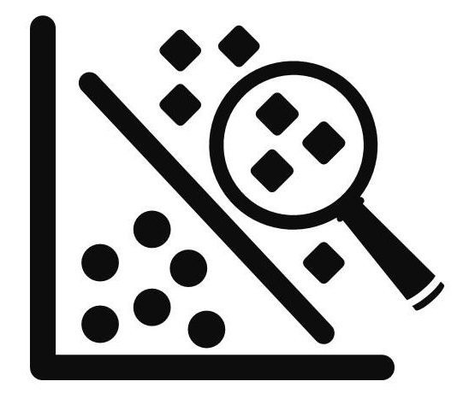

Netflix Movies and TV Shows Clustering
To apply unsupervised machine learning for clustering Netflix’s movies and TV shows based on descriptive features enhancing content discoverability, enabling nuanced genre exploration, and supporting personalized recommendations without user interaction data.
Data Acquisition, Data Cleaning and Preprocessing
Netflix Movies & TV Shows datasets with Title, Description, Genre, Director, Cast, Country, etc. Handling missing values; Standardizing & normalizing text data. Removing unnecessary columns.
Feature Engineering (NLP)
Converting text fields (description, cast, etc.) to features;
Techniques: TF-IDF for vectorization
Infographic Presentation Templates
Dimensionality Reduction
Applying PCA to reduce high-dimensional vectors; Balancing interpretability and information retention
Clustering, Cluster Evaluation
K-Means Clustering; Hierarchical Agglomerative Clustering; Metrics: Silhouette, Calinski-Harabasz, Davies-Bouldin ; Assessing quality and separation of clusters.
Visualization and Content-Based Recommendation
Scatter plots; Word clouds and Bar charts for distribution in clusters. Finding similar titles using cosine similarity. Suggesting items within or across clusters.

Slide 2
Understanding your data
Description
Understanding the variables
Variables Description
show_id : Unique ID for every Movie/Show
type : Identifier - Movie/Show
title : Title of the Movie/Show
director : Director of the Movie/Show
cast : Actors involved in the Movie/Show
country : Country where the Movie/Show was produced
date_added : Date it was added on Netflix
release_year : Actual Release year of the Movie/Show
rating : TV Rating of the Movie/Show
duration : Total Duration - in minutes or number of seasons
listed_in : Genre
description : The Summary description
The unique values of all the features were analysed.
By utilizing these features, we plan to create a cluster column and implement both K-means and Hierarchical clustering algorithms.
Knowing your data
Finding Unique values

Slide 3
Exploratory data analysis and data cleaning
Description
Analysis of all columns
The goal of EDA is to gain insights into the data, identify patterns, and discover relationships and trends. It is an iterative process that helps to identify outliers, missing values, and any other issues that may affect the analysis and modeling of the data.
EDA revealed key content trends—movies dominate the catalog (69%), with genres like dramas, comedies, and international films being most common. Frequent keywords such as “love,” “life,” and “family” highlight emotional and relational themes central to Netflix’s content.
Data cleaning may include tasks such as removing duplicate records, filling in missing values, correcting errors, and standardizing data formats. Except for the release year, almost all of the data are presented in text format.
The textual format contains the data we need to build a cluster/building model. Therefore, there is no need to handle outliers.
Exploratory data analysis (EDA)
Removing the missing values
Removing the Duplicate values
Handling Outliers

Slide 4
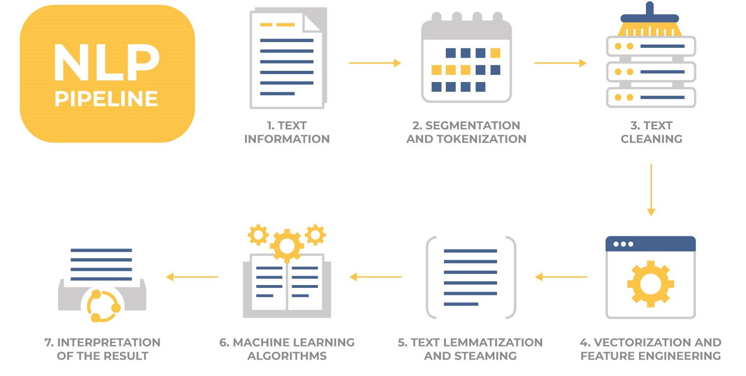
NLP/Text Transformation
Modeling Approach
Choose the attributes that you want to cluster.
Text Preprocessing: Change all textual data to lowercase and eliminate all punctuation marks and stopwords. Removing commonly occurring words such as "the", "and", "a", etc. that don't carry much meaning.
Stemming or Lemmatization: Normalizing the words by reducing them to their base form.
Tokenization: Breaking the text into smaller units, such as sentences or words.
Dimensionality reduction.
Unsupervised training ML algorithms to cluster the movies and various techniques to determine the optimal number of clusters.
Visualization of optimal number of clusters (using scatter plot, bar plot) and use wordclouds to display the contents of each cluster.

Slide 5
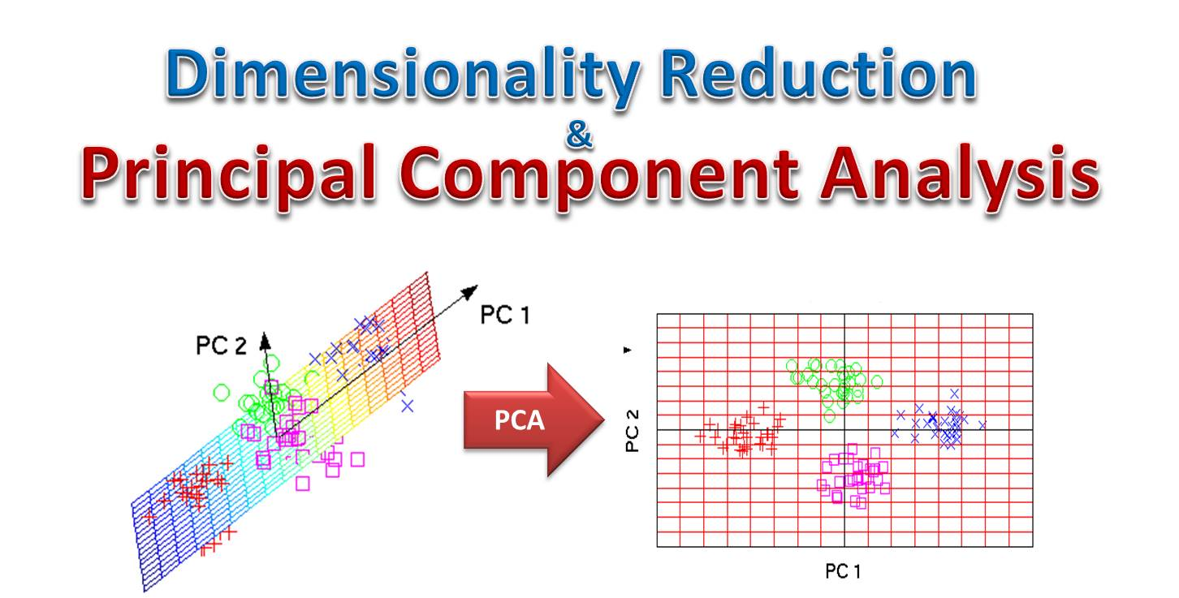
Principal Component Analysis
Dimensionality Reduction:
Dimensionality reduction simplifies high-dimensional data while preserving important patterns and structures.
It helps improve model performance
Reduce overfitting
Enable better visualization
Techniques included: PCA (Principal Component Analysis)t-SNE, Autoencoders, etc.
In our case, we use PCA to project the data into lower dimensions for easier clustering and visualization.
Also, we have used t-SNE to scatter-plot our clustered shows in 2D space, showing how different genres or types group together after clustering.

Slide 6
Unsupervised Machine Learning
Algorithm | Key Idea | Best For | Core Parameter(s)
K-Means Clustering | Partitions data into K clusters by minimizing intra-cluster variance. | Spherical, equally sized clusters | n_clusters
Hierarchical Clustering | Builds a tree (dendrogram) of nested clusters via merging or splitting. | Hierarchical or nested groupings | linkage, distance_threshold
K-Means is an unsupervised learning algorithm that partitions data into K clusters based on similarity.
Each cluster is represented by a centroid, and points are grouped by their proximity to it.
Objective: Minimize the distance between data points and their cluster centroids.
Evaluation: Elbow Method: Optimal K ≈ 6 (point of diminishing returns).
Silhouette Score: Highest at K = 6, indicating well-separated clusters
Result: Built 6 optimal clusters capturing distinct content groupings.
To assess how well the data has been clustered, we use three key evaluation metrics:
Silhouette Score Measures how similar each point is to its own cluster vs. others. Range: –1 to 1 → Higher is better (well-separated clusters).
Calinski-Harabasz Score Ratio of between-cluster dispersion to within-cluster dispersion. Higher values indicate better-defined clusters.
Davies-Bouldin Score Measures average similarity between clusters (lower is better). Lower values imply better separation and compactness.
Elbow method
Selection of optimum value of K
Silhouette analysis
Calinski-Harabasz Score
Evaluation Metrics
Davies-Bouldin Score

Slide 7
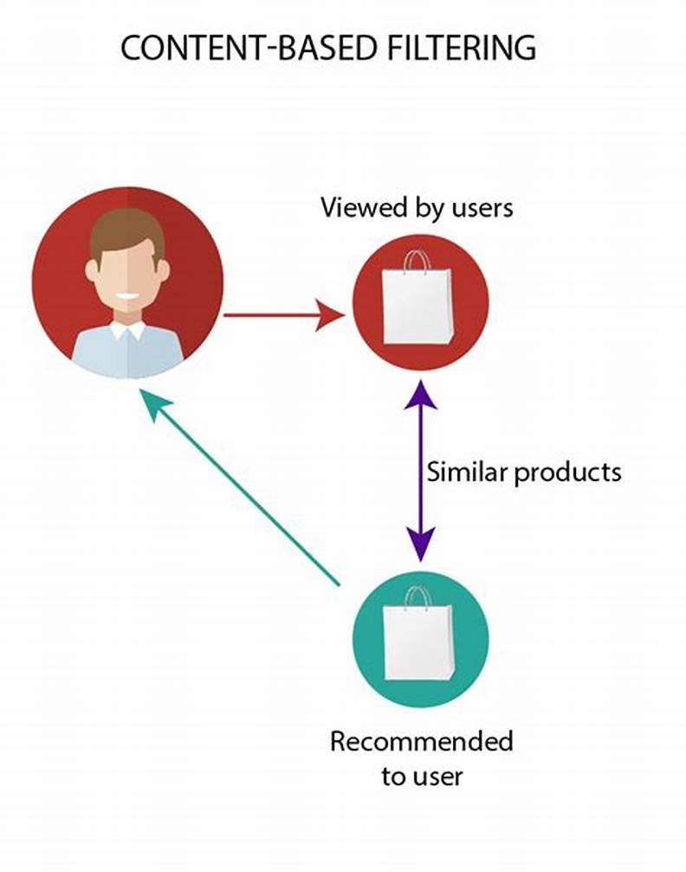
User Recommendation System
A content-based recommender suggests shows similar to those a user already liked, using show attributes.
We have used cosine similarity to measure how alike two shows are?
A higher similarity score means closer content match.
Helps personalize suggestions based on user preferences.

Slide 8
Conclusion
In this project, we focused on clustering Netflix shows based on textual attributes to group similar content together.
Starting with a dataset of 7,787 records and 11 features, we handled missing data and performed exploratory data analysis (EDA).
We found that Netflix primarily hosts movies, with most content produced in the United States, and the overall content volume is rapidly increasing.
We selected key textual attributes, such as cast, country, genre, director, rating, and description and processed them using TF-IDF vectorization, resulting in around 10,000 features.
To manage high dimensionality, PCA was applied, reducing it to 3,000 components that captured over 80% of the variance.
Clustering was performed using K-Means, where the optimal number of clusters was found to be 4, based on the elbow method and Silhouette score.
We also applied Agglomerative Hierarchical Clustering, with the dendrogram suggesting 13 clusters.

Slide 9
Conclusion
Finally, we built a content-based recommendation system using cosine similarity, which provides personalized suggestions by recommending 10 similar shows based on user input.
Regional/Genre-Specific Trends: Example: Cluster 0: Documentaries, International Movies; Cluster 2: International TV Shows, TV Dramas; Impact: Enables targeted content acquisition by understanding audience preferences by region and genre.
Improved User Experience: Thematic Clusters help viewers explore content based on mood or theme rather than rigid genres. Examples: Users interested in Comedies & Family Movies can explore Cluster 1 easily.Encourages organic discovery and longer engagement on the platform.

