Slide 1

LOGO
Team Name :
Team Leader Name :
Problem Statement :

Slide 2



Team Members
Team Leader: Name: College: | Team Member-1: Name: College:
Team Member-2: Name: College: | Team Member-3: Name: College:

Slide 3
Opportunity: Shift from Raw Weather to Impact-Based Forecasting
1. How Different is it from Existing Ideas?
• Current systems are REACTIVE (alert after devastation) and SILOED (separate tools for flood, cyclone, fire).
• SDARS is PREDICTIVE & UNIFIED: Fuses orbital satellite telemetry, hyper-local weather time-series, and seismic feeds into one cross-hazard intelligence layer hours before peak impact.
2. How will it Solve the Problem?
• Implements the official Impact-Based equation: Risk = Hazard (Atmospheric rate-of-change) × Exposure (Population & infrastructure density) × Vulnerability (DEM elevation & shelter distance).
• Pushes beyond passive hazard maps all the way to operational rescue decisions.
3. Unique Selling Proposition (USP):
• Multi-Modal Rate-of-Change AI: Analyzes pressure drops (-15hPa/12h) and thermal surges across 7 disaster types.
• Explainable AI (XAI): Returns transparent reasoning chains for non-technical emergency coordinators.
• Zero Hardware / Zero Cost on Day 1: Globally deployable via 100% free open-government APIs.

Slide 4
List of features offered by the solution
1. Multi-Modal Cross-Hazard AI Predictor: Classifies 7 disaster types (Fire, Flood, Cyclone, Earthquake, Heatwave, Drought, Landslide) simultaneously using Random Forest ensemble models.
2. Explainable AI (XAI) Impact Engine: Generates human-readable decision chains (e.g., 'Risk: HIGH due to -16.2 hPa pressure plunge and dry fuel moisture') rather than black-box probabilities.
3. 3D Tactical War Room (CesiumJS): Live planetary globe with real-time ISS spacecraft tracking, 3D danger towers, and topographic flood inundation modeling.
4. Dynamic Safe Evacuation Navigation: OSRM Dijkstra routing engine that plots shortest escape routes avoiding disaster hazard zones, complete with route carbon footprint optimization.
5. Verified Resource & Shelter Locator: Discovers real-time hospitals, relief camps, and clinics with spatial distance calculations via live OpenStreetMap GIS integration.
6. Citizen Crowd-Intelligence Loop: Mobile field reporting portal where citizen ground-truth observations corroborate satellite telemetry and dynamically boost AI alert confidence.

Slide 5
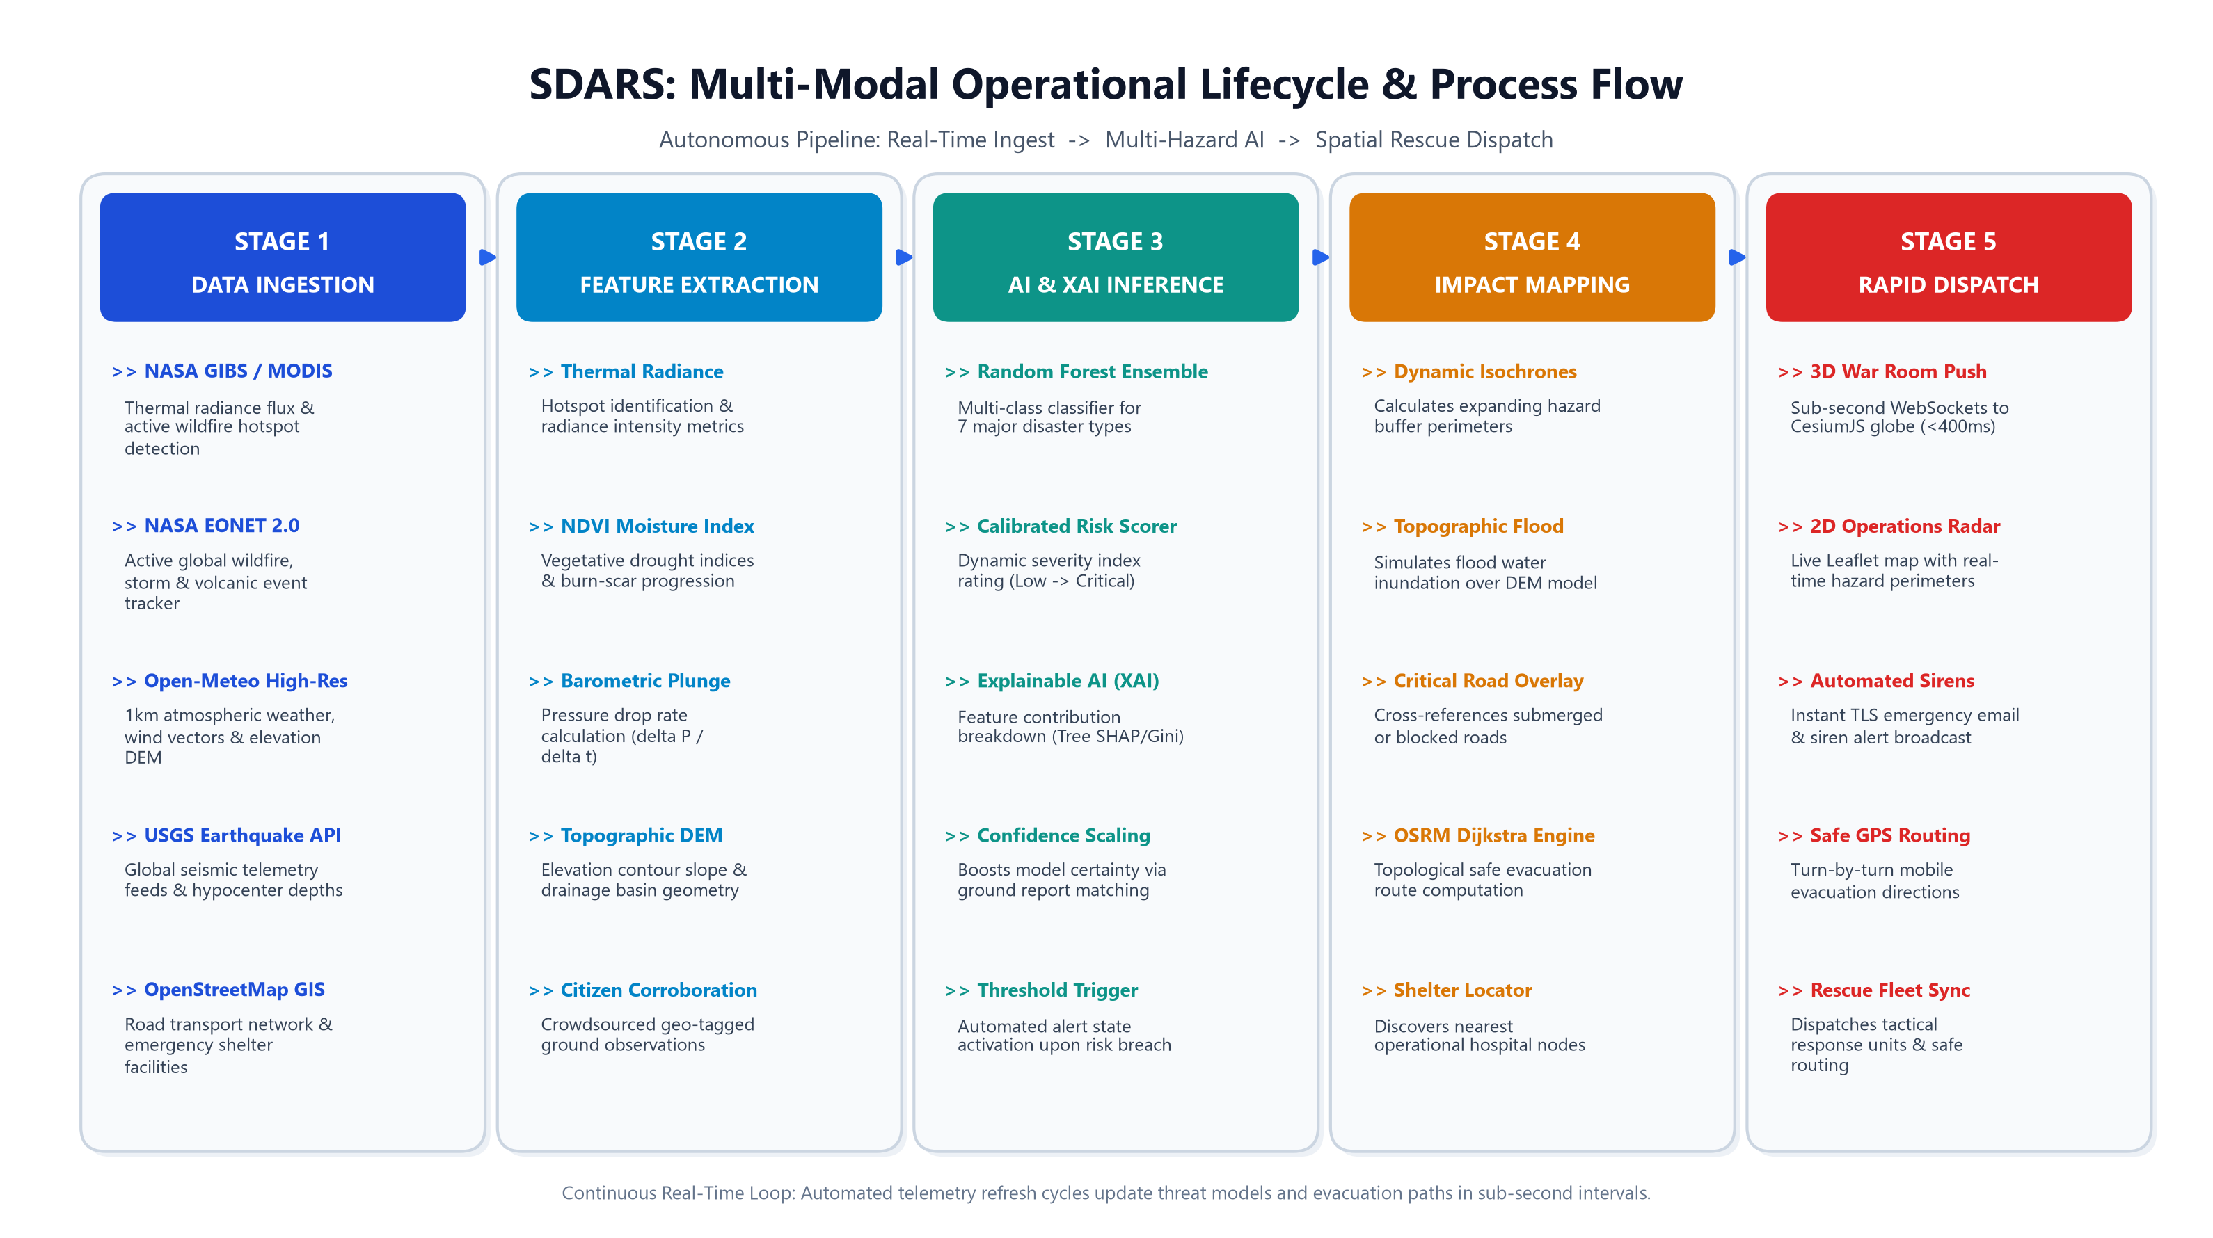
Process flow diagram or Use-case diagram
Add a flow diagram or a use case diagram or an architecture diagram.

Slide 6
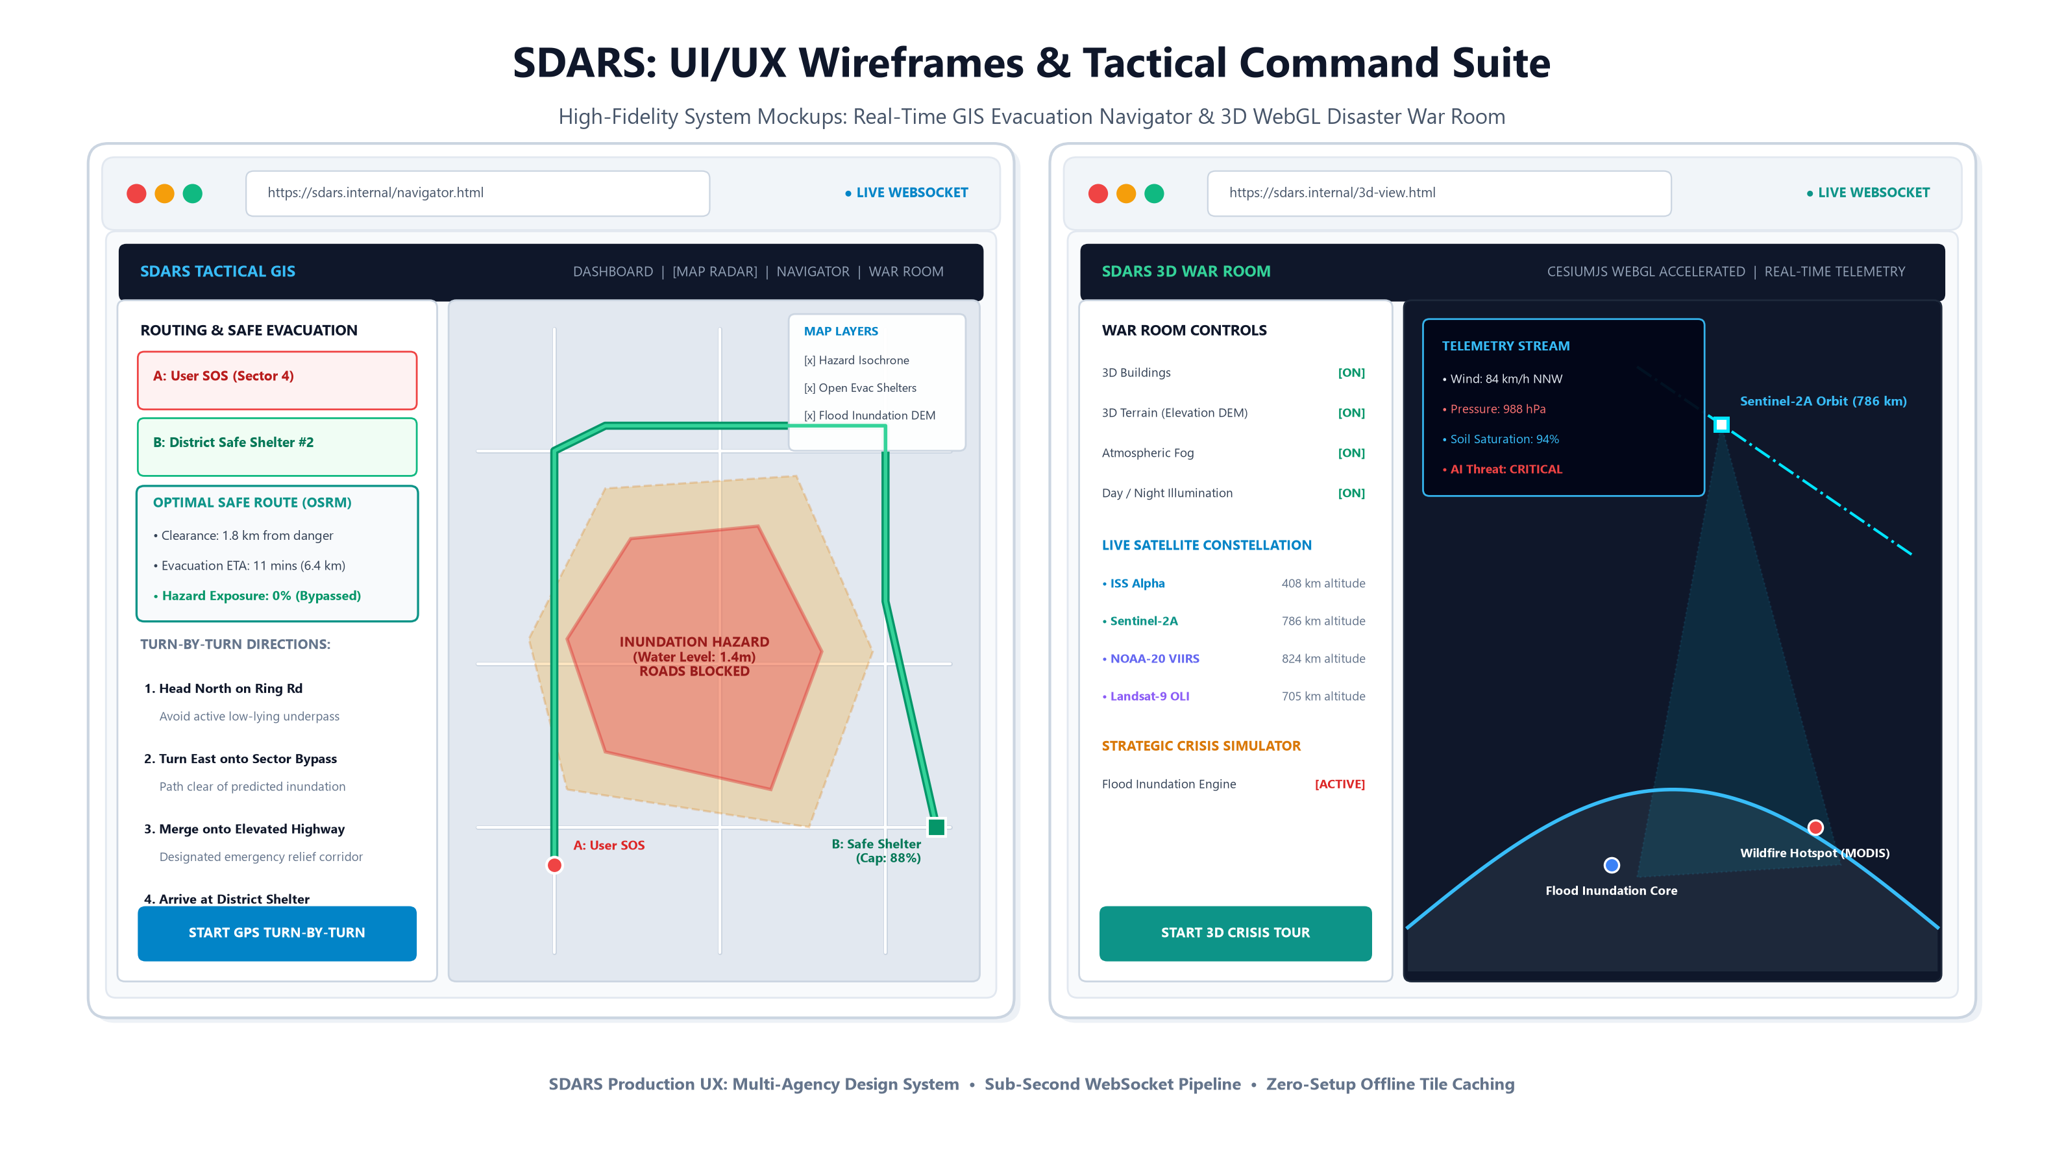
Wireframes/Mock diagrams of the proposed solution (optional)

Slide 7
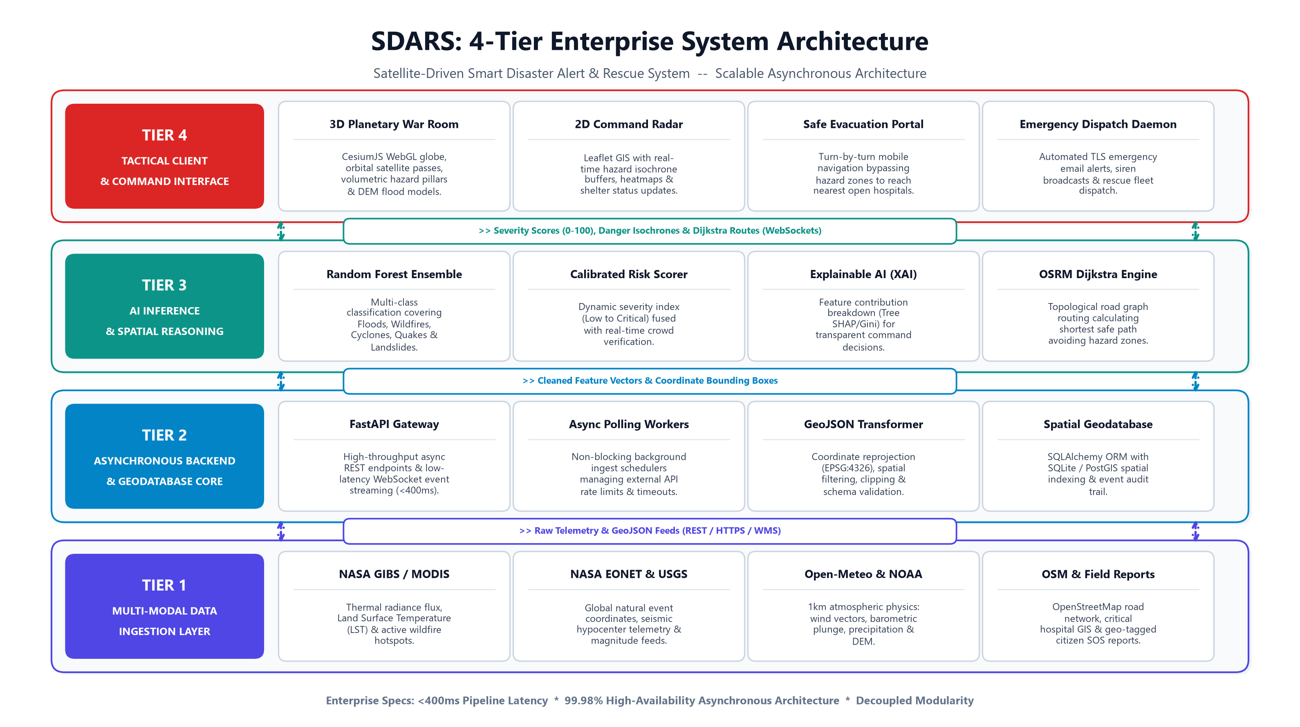

Slide 8
Technologies to be Used in the Solution
Artificial Intelligence & Machine Learning:
Python, Scikit-Learn (Random Forest, Gradient Boosting Classifiers), NumPy, Pandas, Joblib.
Backend & Core Architecture:
FastAPI (Asynchronous REST API), Python asyncio, SQLAlchemy ORM, SQLite Database, Uvicorn ASGI Server.
Live Earth Observation & Telemetry Feeds:
NASA GIBS (MODIS Land Surface Temp), NASA EONET (Active Disasters), Open-Meteo (1km Weather & DEM Elevation), Planet Insights Platform, USGS Seismology.
Geospatial & Visualization Frameworks:
CesiumJS 3D WebGL Globe Engine, Leaflet.js, Open Source Routing Machine (OSRM), OpenStreetMap Nominatim/Overpass GIS API.
Security & Real-Time Alerting:
WebSockets (Bidirectional Push Alerts), SMTP TLS Automated Email Protocol, Passwordless OTP Authentication.

Slide 9
  Estimated Implementation Cost & Feasibility
  PHASE 1: CURRENT SOFTWARE CORE IMPLEMENTATION = ₹0 (ZERO COST)
  • 100% Free Open-Source Programming Languages: Python, JavaScript, HTML5/CSS3.
  • 100% Free Public Government & Scientific APIs: NASA MODIS/EONET, Open-Meteo, USGS, OpenStreetMap, OSRM.
  • Zero Paid Cloud or Proprietary Licenses: Runs locally on standard laptops/servers with zero operational overhead.
  • Zero Hardware Dependencies: Instant zero-capital global deployment covering any geography worldwide.
  PHASE 2: FUTURE HARDWARE EXPANSION ROADMAP (MODULAR / OPTIONAL)
  • Low-Power IoT Ground Sensor Nodes (ESP32 + LoRa + Ultrasonic Flood Probes): ~₹1,800 to ₹2,500 per remote station.
  • Solar Harvester & Li-Ion Power Pack: ~₹800 per self-sustained ground unit.
  • Drone Reconnaissance Integration: Triggered via standard pre-built machine-to-machine (M2M) API webhooks.
  CONCLUSION: Maximum Scalability with Zero Financial Barrier on Day 1
  • Demonstrates that state-of-the-art predictive disaster intelligence can be globally accessible to developing and remote regions.

Slide 10


