Slide 1
Welcome To Android Permissions Implementation

Slide 2
Types Of Permissions
Normal Permission :
which is little risk to the user's privacy or the operation of other apps
android.permission.BOOT_COMPLETED
com.android.alarm.permission.SET_ALARM
Signature
android.permission.FORCE_STOP_PACKAGES
android.permission.INJECT_EVENTS
Dangerous Permission
which involves the user's private information, or could potentially affect the user's stored data or the operation of other apps.
android.permission.SEND_SMS
android.permission.CALL_PHONE
Special Permission
android.permission.SYSTEM_ALERT_WINDOW
android.permission.WRITE_SETTINGS
Runtime permission is applicable for Dangerous and Special Permission

Slide 3
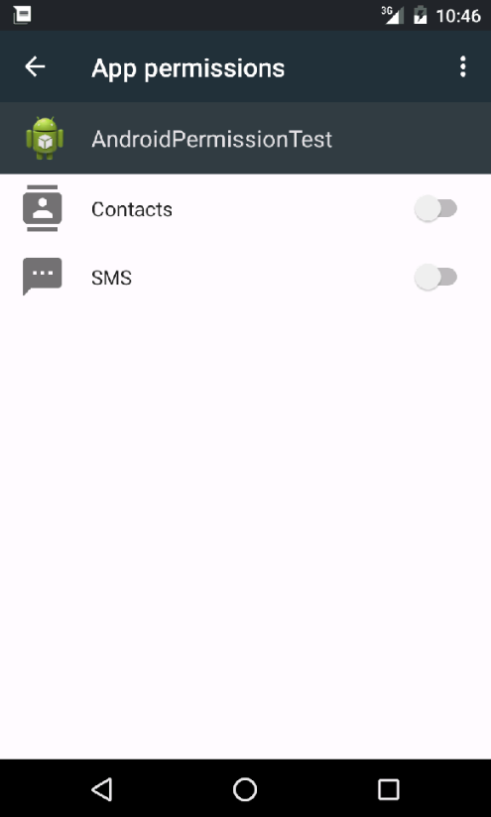
How to manage Permission?
There are two ways to manage permissions for an app
Via Settings Screen
Settings -> Apps -> Select an App -> Permissions

Slide 4
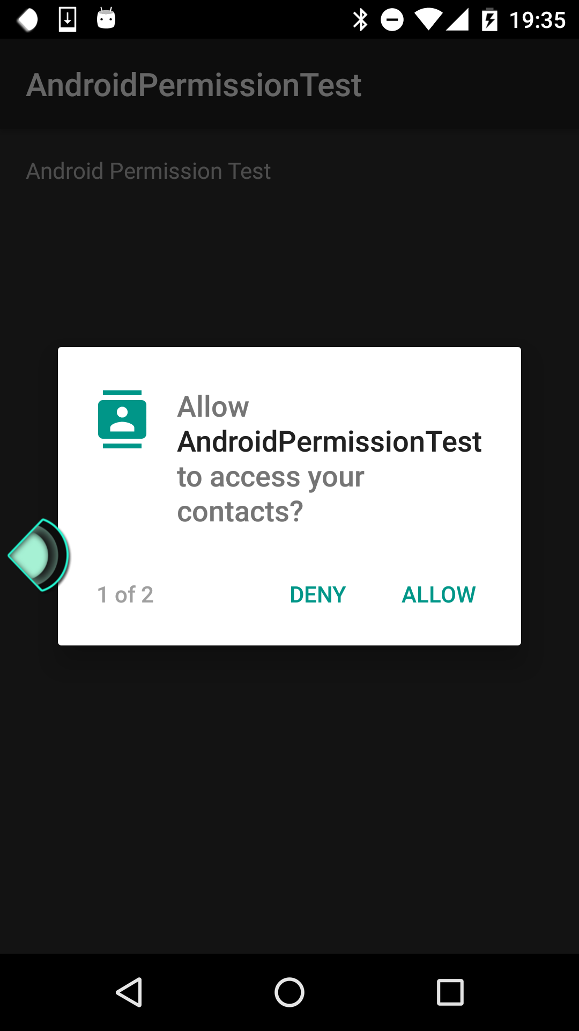
How to manage Permissions Contd..
2) Via Application (Runtime)
Application needs to implement requestPermissions to display manage permission dialog to user

Slide 5
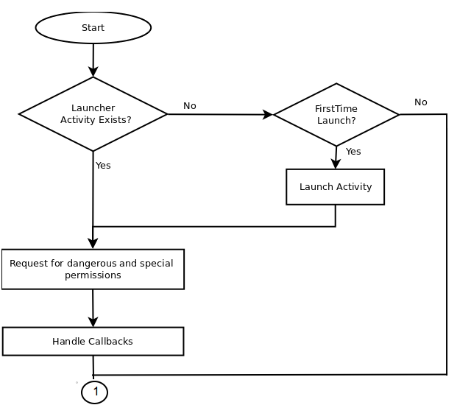
Flowchart to use Permissions

Slide 6
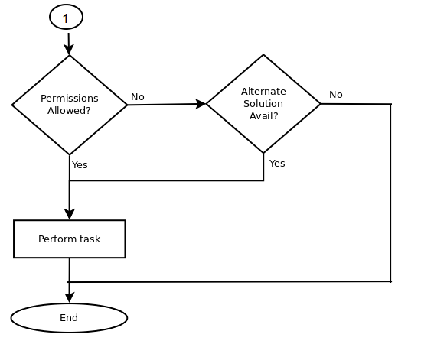
Flowchart to use Permissions Contd..

Slide 7
How to Use Permissions
List Permissions in AndroidManifest.xml
(Same as older devices)
<uses-permission android:name="android.permission.SYSTEM_ALERT_WINDOW" />
<uses-permission android:name="android.permission.READ_SMS" />
<uses-permission android:name="Manifest.permission.RECEIVE_SMS”/>
<uses-permission android:name="android.permission.RECEIVE_BOOT_COMPLETED" />

Slide 8
How to Use Permissions
Contd...
2) Grant Dangerous Permissions at run time
Check whether the Permission is granted
context.checkSelfPermission(Manifest.permission.READ_SMS) ==
PackageManager.PERMISSION_GRANTED;
Request permission for ungranted permissions
String[] ALL_PERMISSIONS = new String[] {Manifest.permission.READ_SMS,
Manifest.permission.RECEIVE_SMS };
activity.requestPermissions(ALL_PERMISSIONS,
GRANT_PERMISSION_REQUEST_CODE);
Handle Response
@Override
public void onRequestPermissionsResult(int requestCode,
String[] permissions, int[] grantResults) {
//TODO perform tasks
}

Slide 9
How to Use Permissions
Contd...
3) Grant Special Permissions at run time
Check whether the Permission is granted
Settings.canDrawOverlays(this);
Launch activity to manage permission
if (!Settings.canDrawOverlays(this)) {
Intent systemSettingsIntent = new Intent(
Settings.ACTION_MANAGE_OVERLAY_PERMISSION,
Uri.parse("package:" + getPackageName())); systemSettingsIntent.addFlags(Intent.FLAG_ACTIVITY_NEW_TASK);
startActivityForResult(systemSettingsIntent,
Utils.GRANT_PERMISSION_OVERLAY_REQUEST_CODE);
}
Handle Response
@Override
protected void onActivityResult(int requestCode, int resultCode, Intent data) {
if (requestCode == Utils.GRANT_PERMISSION_OVERLAY_REQUEST_CODE) {
// TODO perform task on result of grant permission for system alert
}

Slide 10
How to Use Permissions in Service/ Receivers
Permissions are available to a package not to individual component. requestPermissions() is available only to Activity. NonActivity components (eg BroadcastReceiver/Service) cannot use this directly. They can use only by launching Activity
Step -1 : Create an activity (say MainActivity) write request permissions implementations.
(For background applications which dont need launcher no need to write intent-filter for the activity in AndroidManifest.xml)
Step -2 : Check for permissions in service/receiver
context.checkSelfPermission(permission) == PackageManager.PERMISSION_GRANTED;
Step -3 : Launch the Activity from Service/receiver
Intent activityIntent = new Intent(context, MainActivity.class);
activityIntent.addFlags(Intent.FLAG_ACTIVITY_NEW_TASK);
context.startActivity(activityIntent);

Slide 11
Things to consider during permission implementation
Implementation may vary depending on which type of application it is. For UIDriven applications (eg Camera) request permission in launcher activity. For TaskDriven applications (eg iFloatSms)request permission only for the first time after BOOT_COMPLETED.
Understand your application requirement properly, which will help to categorize permissions mandatory and optional permissions. For example in iFloatSms READ_SMS is mandatory, so application will not function without this permisison but READ_CONTACTS is optional (if user denies this permission this app will display contact number instead of name)
Better way is to Implement requestPermissions() in onCreate() not in onResume()of Activity
Better way is to request permissions for ungranted permissions (not all permissions eg. in an applications some permissions may be granted while few are not by user)

Slide 12

Things to consider during permission implementation Contd..
Better way is to call requestPermissions() with an array of all ungranted permissions instead of calling requestPermission() for each permission
Instead of
Check for permission before executing the block which needs permission

Slide 13
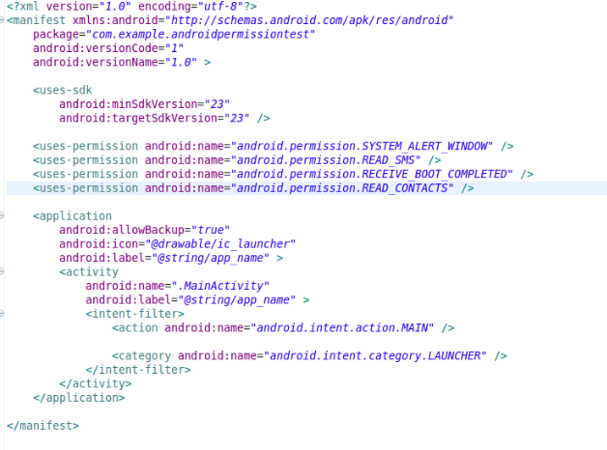
AndroidManifest.xml

Slide 14
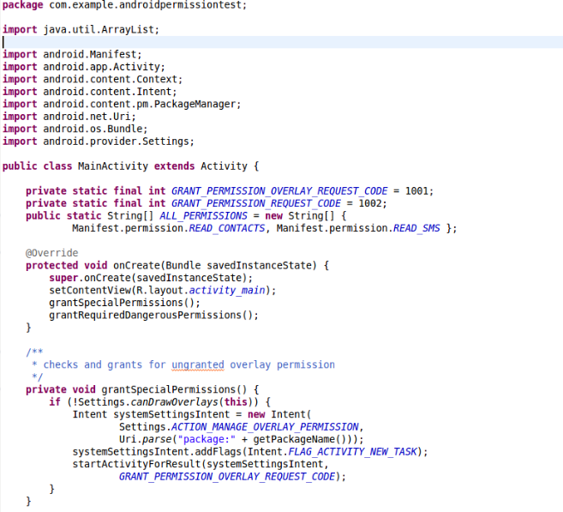
MainActivity.java

Slide 15
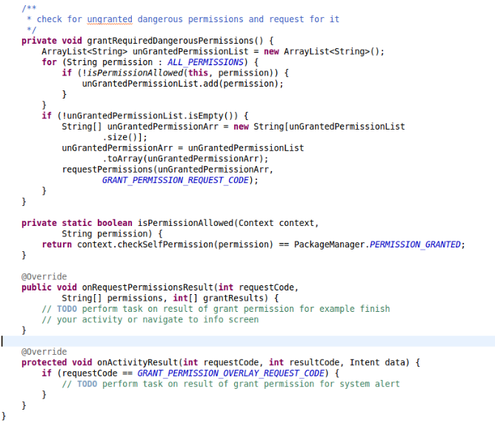
MainActivity.java Cntd..

Slide 16
Dangerous Permission Access

Slide 17
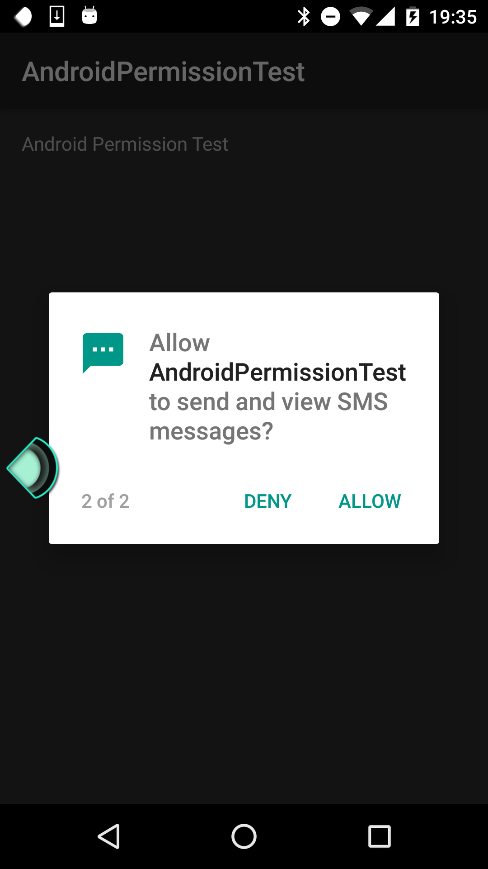
Dangerous Permission Access

Slide 18
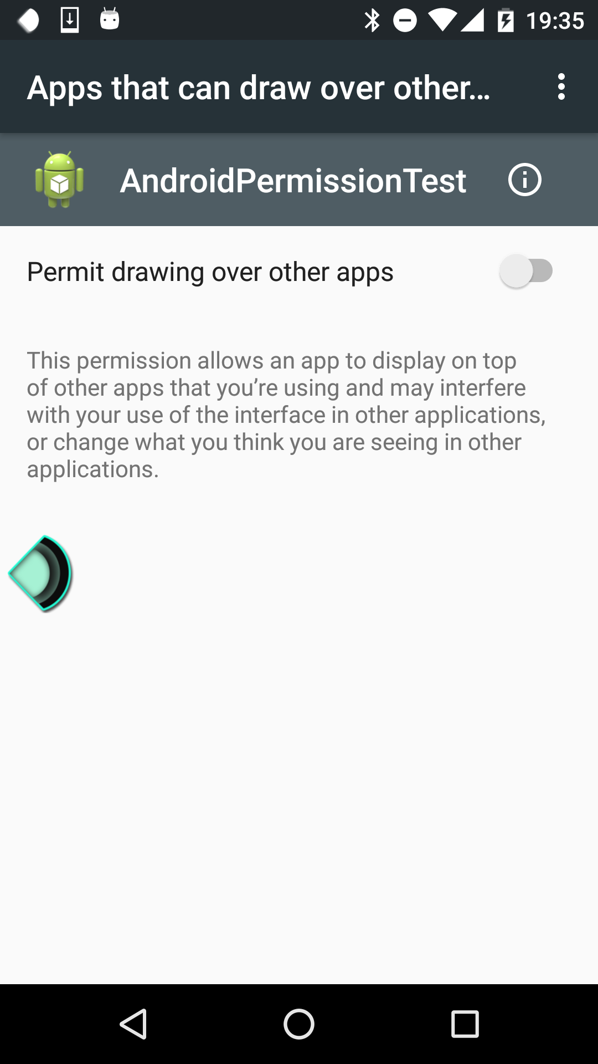
Special Permission Access

Slide 19
Thank You!
Sunil Kumar Sahoo

