Slide 1
Introduction To Google Analytics
And Integration into application

Slide 2
Why Analytics
To know details about user and its interaction on our app
Lets consider an SMS application which is available to wide range of users.
How to answer few questions like the following?
What OS versions are using the app
What device models are using it.
What is the most used functionality eg (Read Msg, Next Msg, Delete Sms)
Whether this app has any fatal crash?
Which screen User used most number of times?
Which country uses this app most?
How long was your application used by users ?

Slide 3
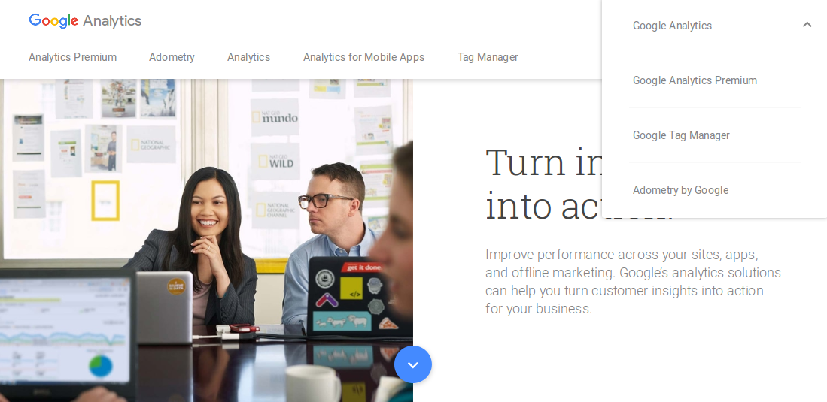
Check Apps Analytics
Open Analytics Home Page
https://www.google.co.in/analytics/
Click On “SIGN IN”
Select “Google Analytics”
Enter your Google Credentials

Slide 4
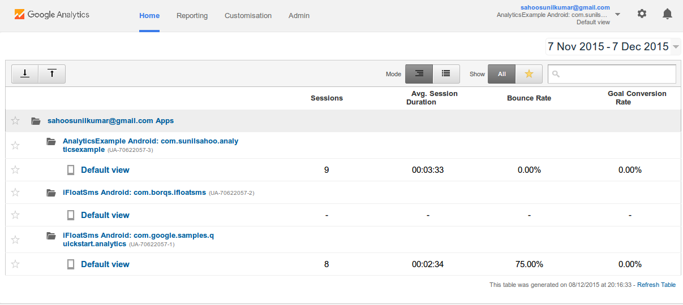
Check Apps Analytics...
User will be navigated to Home screen with list of all aplications for which analytics service is enabled.
Click Default view of the app
User will be navigated to Dashboard of the app

Slide 5
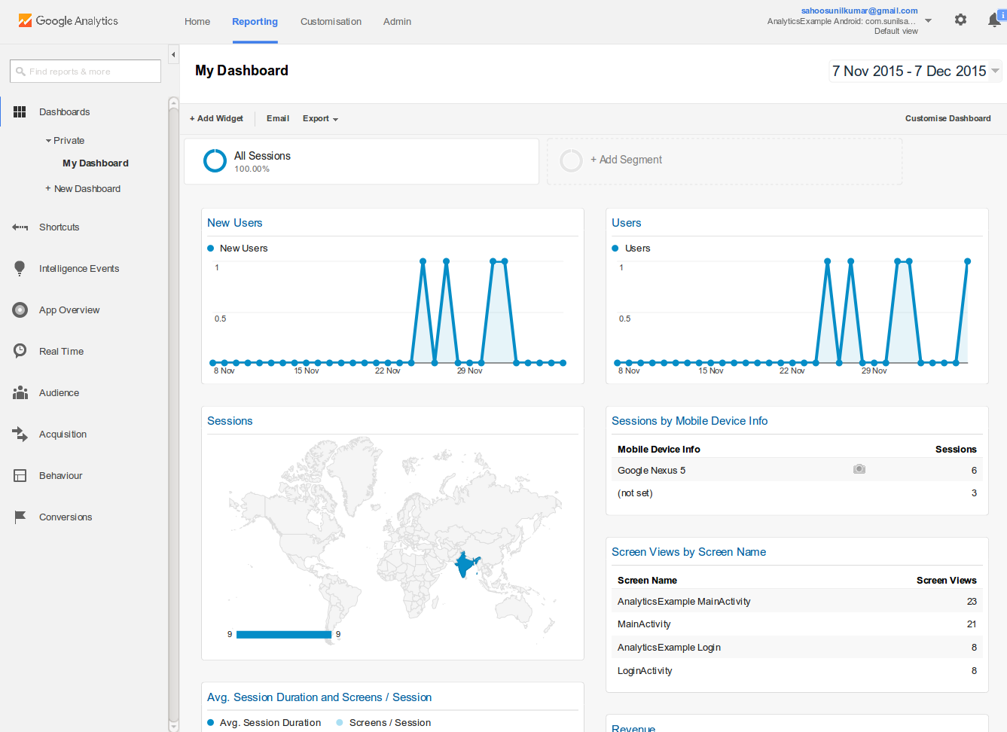
Dashboard Report

Slide 6
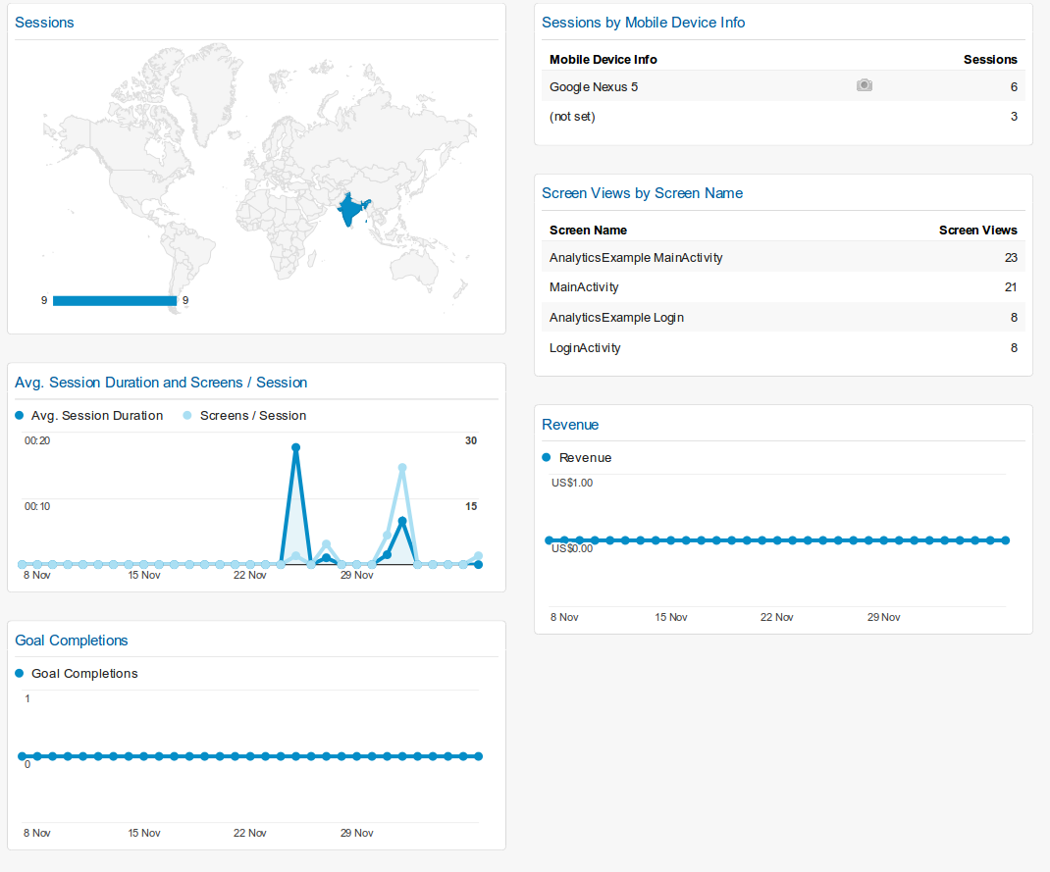
Dashboard Report Contd..

Slide 7
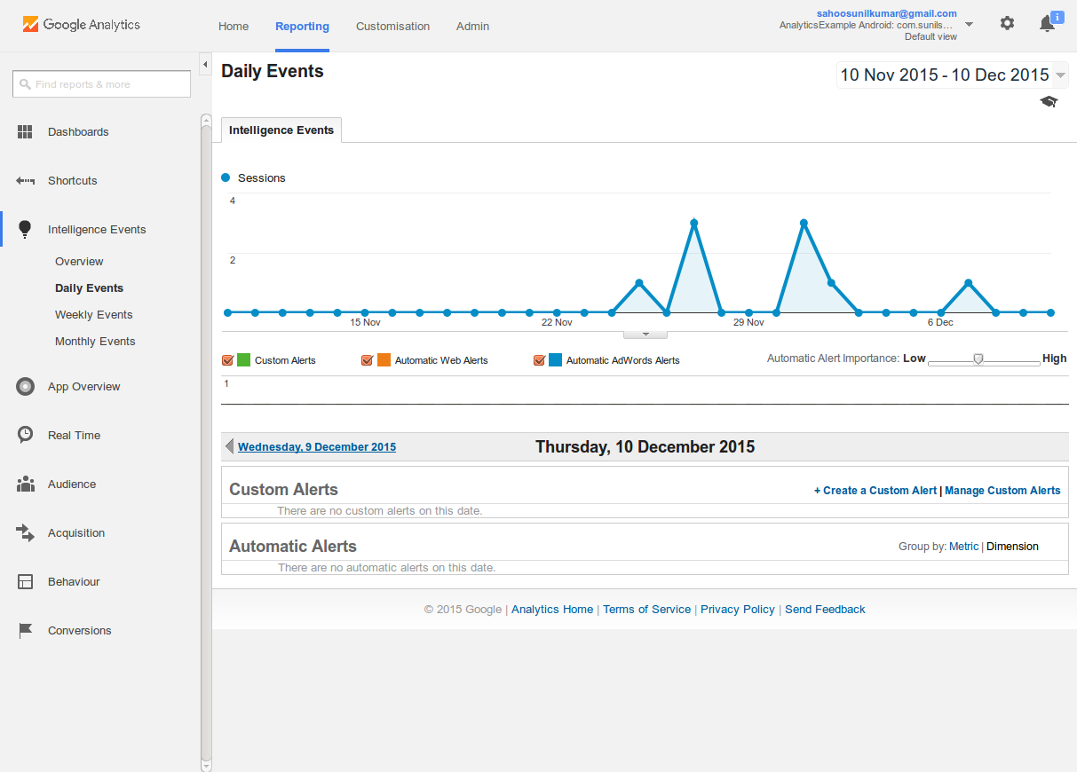
Why Google Analytics
Intelligence Report: It helps user to receive email notification when any alert triggers (eg bounce rate reduced, avg user session time reduced etc)

Slide 8
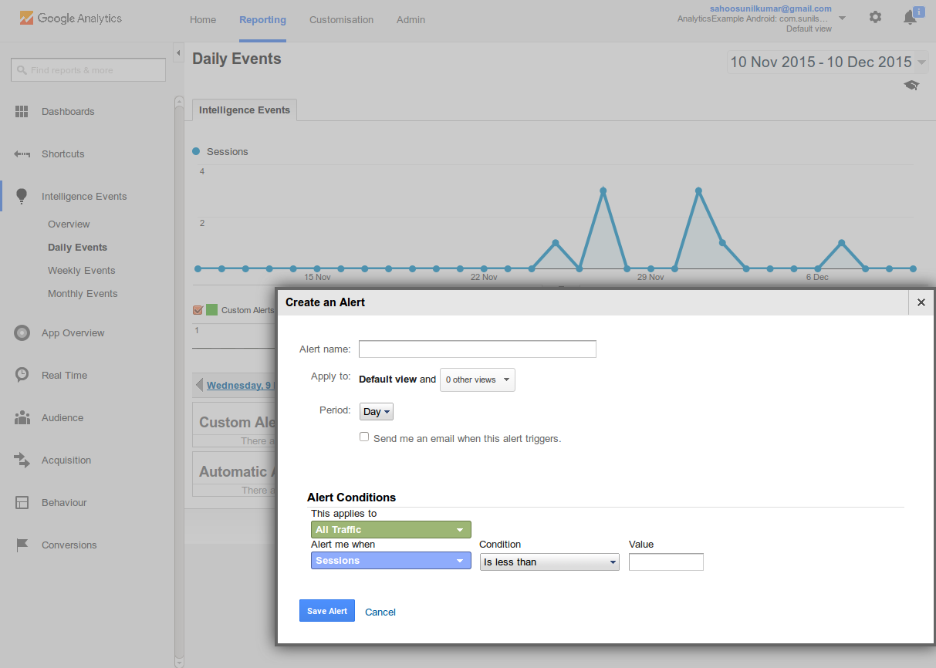
Why Google Analytics

Slide 9
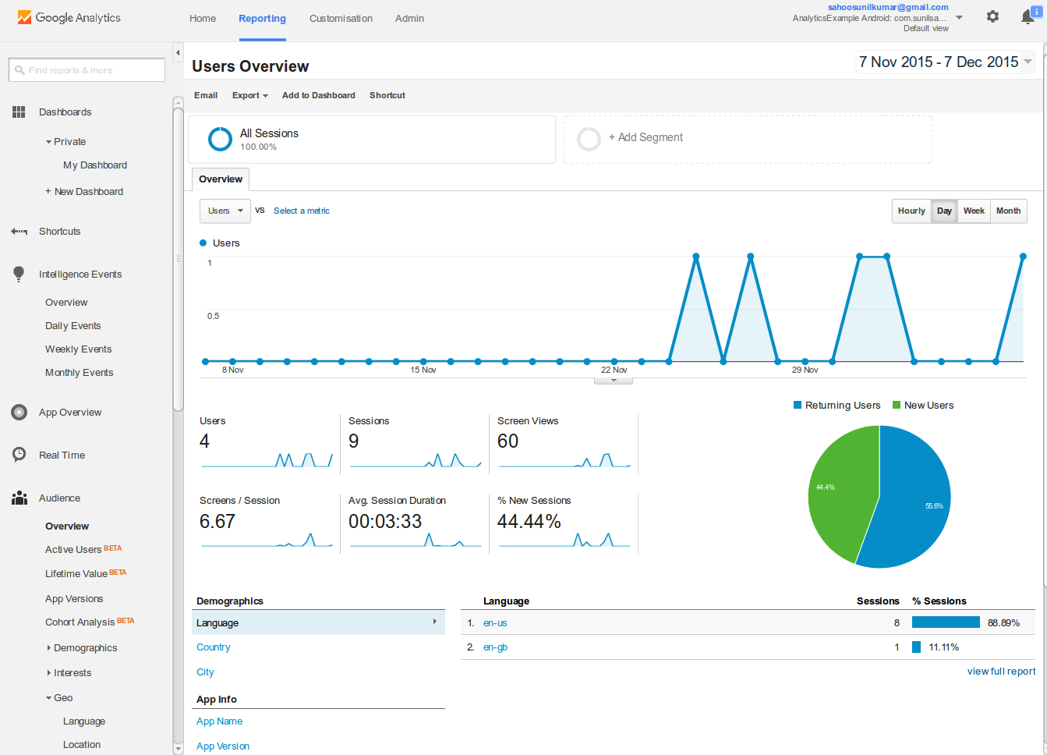
Why Google Analytics
Audience: section tells you about new vs returning app users and how many people are using different versions.

Slide 10
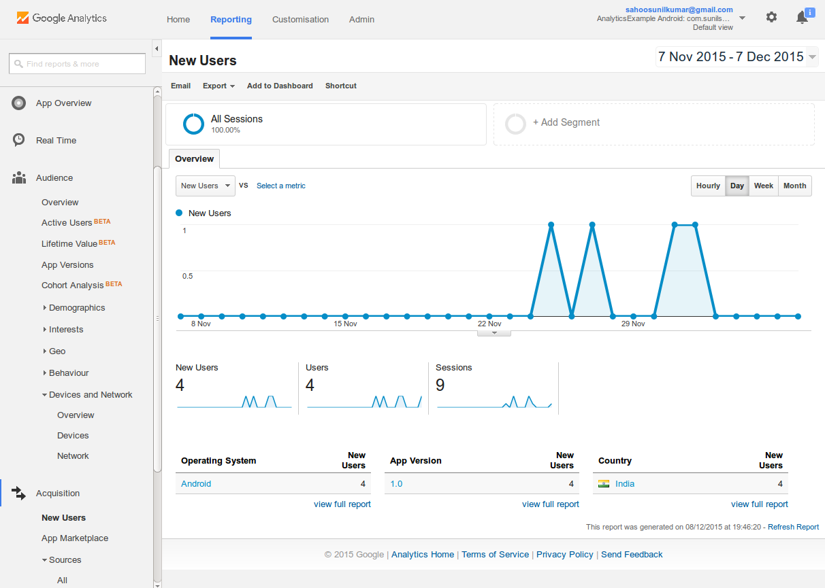
Why Google Analytics
Acquisition: section let’s you discover how new app users are accessing it for the first time.

Slide 11
Why Google Analytics
Behaviour : It gives detail in terms of what users do once they’re inside your mobile app. For Example
Number of screen views
Average time on screen
Number of screens per session
Number of crashes.
User Events
Application Flow

Slide 12
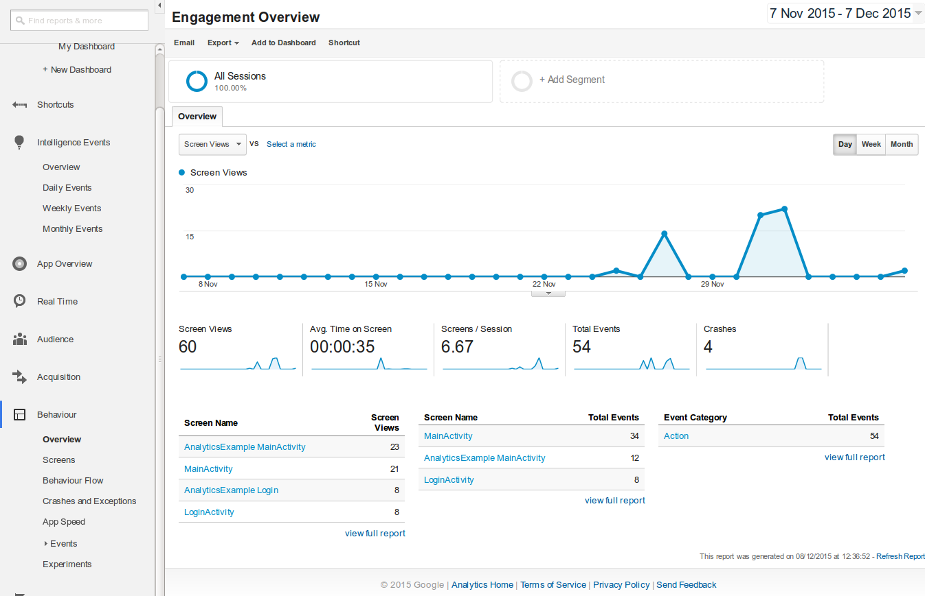
Behaviour Overview

Slide 13
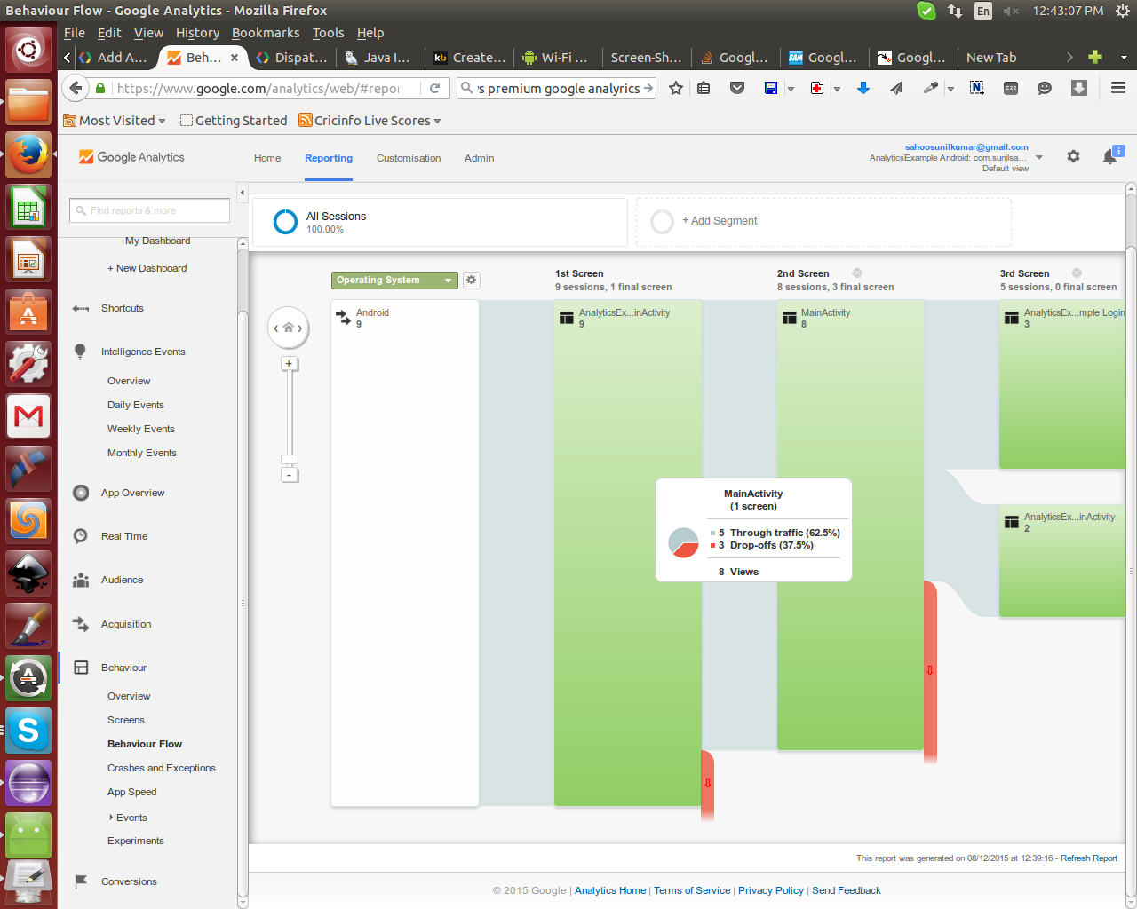
Behaviour Flow

Slide 14
Why Google Analytics
Conversions :It is perfect for business owners using an app for mobile commerce purposes and enables you to create a trigger every time you sell a product. You can set-up goals, track conversions and see the flow of each goal. It also provides useful funnel visualisations and useful E-commerce data on the performance of individual products.

Slide 15
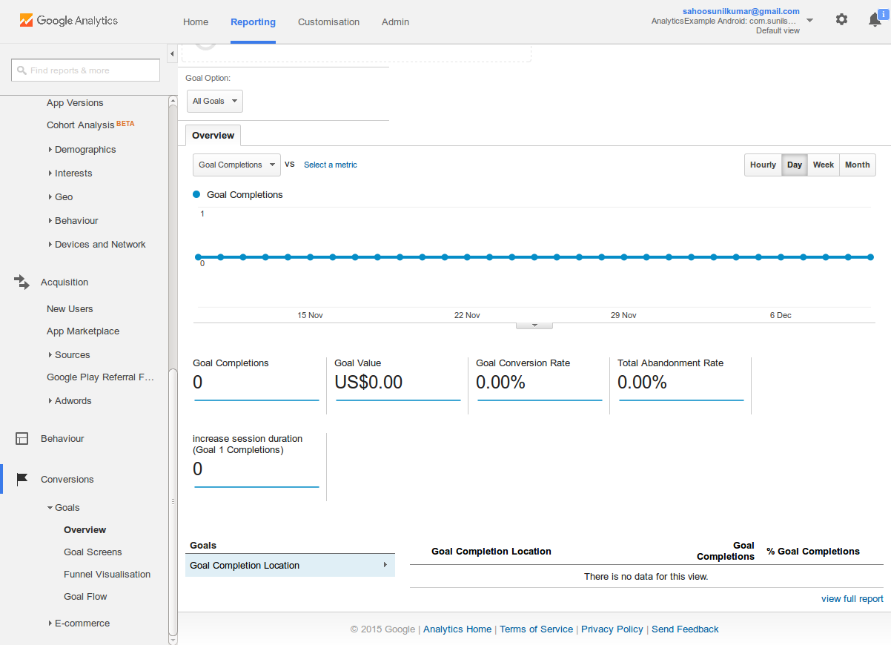
Why Google Analytics..

Slide 16
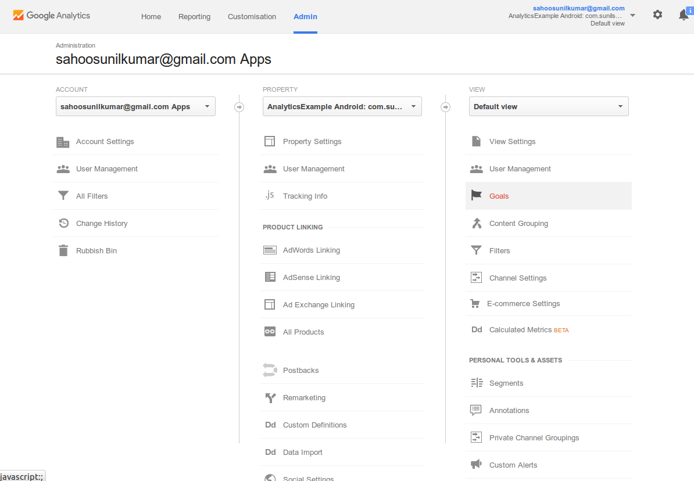
Why Google Analytics..

Slide 17
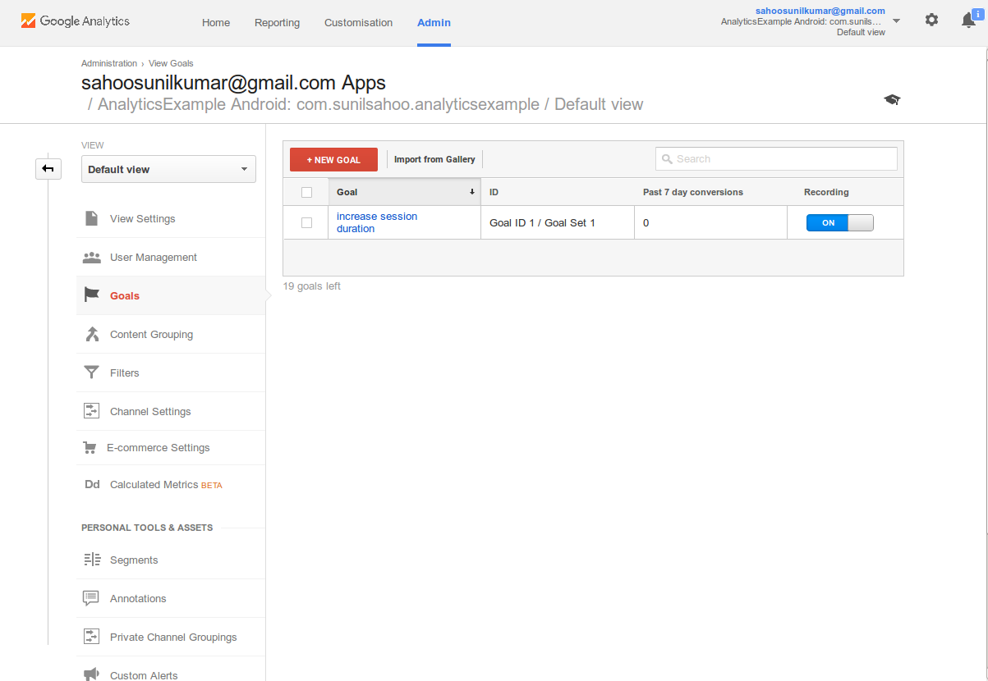
Why Google Analytics

Slide 18
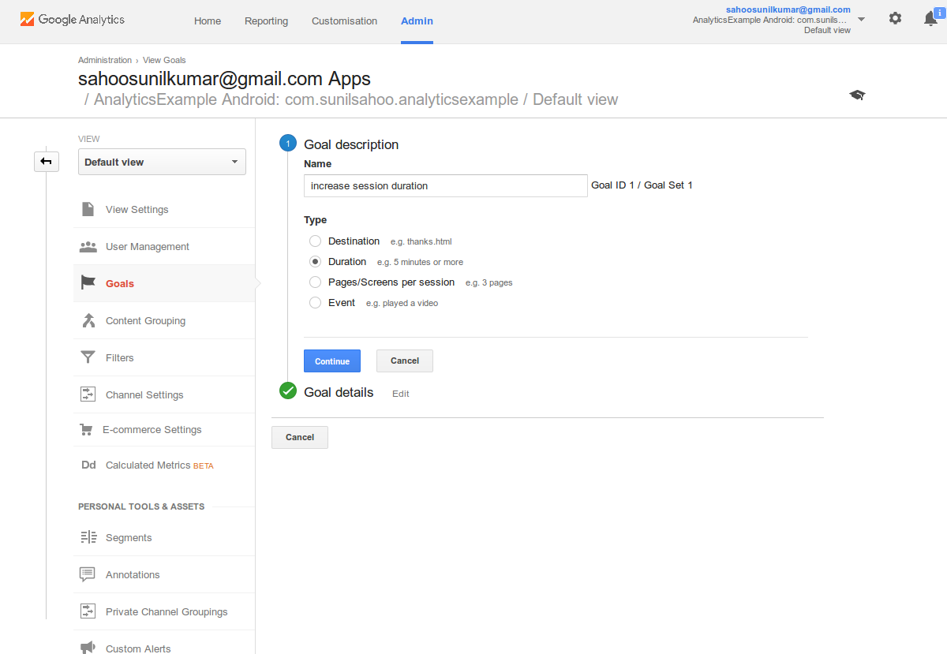
Why Google Analytics

Slide 19
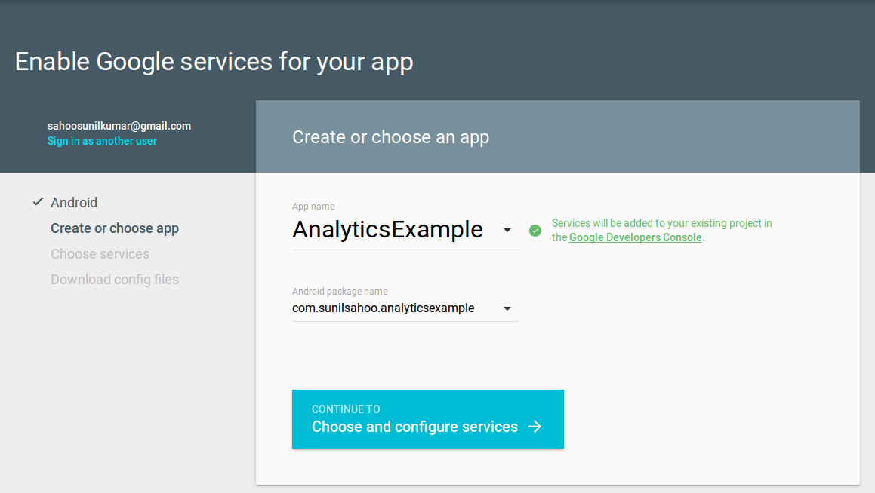
How Add Analytics
Get configuration file
Open Google Analytics Page
Enter google Credentials
Enter App Name and package Name
Click “continue to choose and configure service”

Slide 20
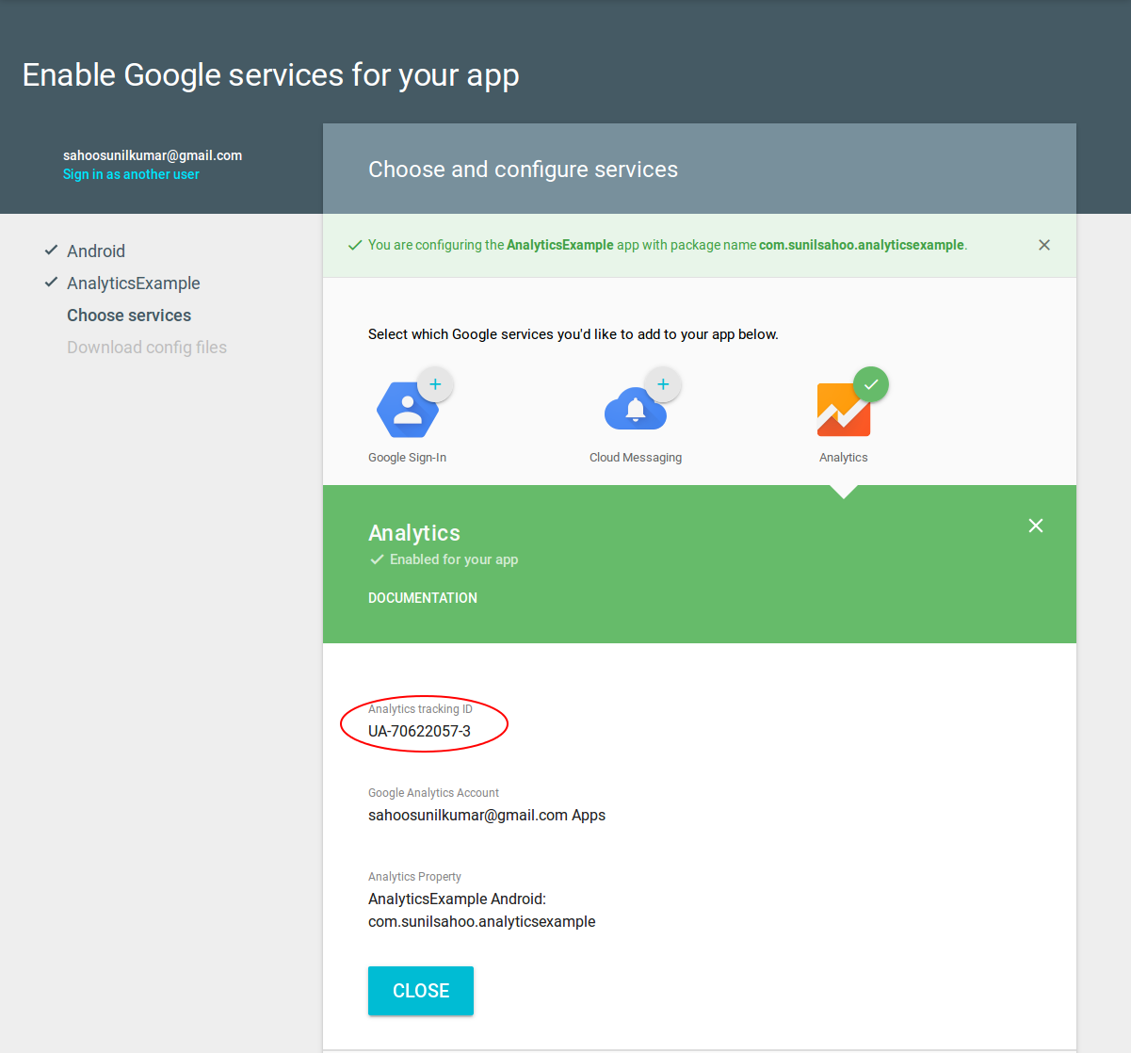
How Add Analytics Cntd..
Choose “Analytics” Service
Download Configuration file
Note the Tracker Id. For example UA-70622057-3

Slide 21
How Add Analytics Cntd..
Create global_tracker.xml in res/xml
<?xml version="1.0" encoding="utf-8"?>
<resources>
<integer name="ga_sessionTimeout">300</integer>
<bool name="ga_autoActivityTracking">true</bool>
<screenName name="com.sunilsahoo.analyticsexample.MainActivity">AnalyticsExample MainActivity</screenName>
<string name="ga_trackingId">UA-70622057-3</string>
<int name="ga_dispatchPeriod">30</int>
</resources>

Slide 22
How Add Analytics Cntd..
Create Custom Application class
import android.app.Application;
import com.google.android.gms.analytics.GoogleAnalytics;
import com.google.android.gms.analytics.Tracker;
public class AnalyticsApplication extends Application {
private Tracker mTracker;
synchronized public Tracker getDefaultTracker() {
if (mTracker == null) {
GoogleAnalytics analytics = GoogleAnalytics.getInstance(this);
// To enable debug logging use: adb shell setprop log.tag.GAv4 DEBUG
mTracker = analytics.newTracker(R.xml.global_tracker);
}
return mTracker;
}
}

Slide 23
How Add Analytics Cntd..
Add Permissions and Application in AndroidManifest.xml
Add following two permissions in AndroidMnifest.xml
<uses-permission android:name="android.permission.INTERNET" />
<uses-permission android:name="android.permission.ACCESS_NETWORK_STATE" />
Insert appplication name
<application android:name="com.sunilsahoo.analyticsexample.AnalyticsApplication" android:allowBackup="true"
android:icon="@drawable/ic_launcher"
android:label="@string/app_name" >

Slide 24
How Add Analytics Cntd..
Add google-play-services.jar to libs/ dir
If you want to track your screen launches:
in onResume() write the following code to send screen name
Tracker mTracker =((AnalyticsApplication) getApplication()).getDefaultTracker();
mTracker.setScreenName(MainActivity.class.getSimpleName());
mTracker.send(new HitBuilders.ScreenViewBuilder().build());

Slide 25
How Add Analytics Cntd..
If you want to track actions performed by user e.g. Login Button Click:
Inside onClick(View view) write the following code to send event
Tracker mTracker =((AnalyticsApplication) getApplication()).getDefaultTracker();
String actionName = “LogIn”
mTracker.send(new HitBuilders.EventBuilder()
.setCategory("Action")
.setAction(LogIn)
.build());

Slide 26
How Add Analytics Cntd..
If you want to track Crash/Errors in your application :
Inside catch(Exception ex) write the following code to send crash report
Tracker mTracker =((AnalyticsApplication) getApplication()).getDefaultTracker();
mTracker.send(new HitBuilders.ExceptionBuilder()
.setDescription("onClick(Error)" + ":" + "Line 48")
.setFatal(true)
.build());

Slide 27
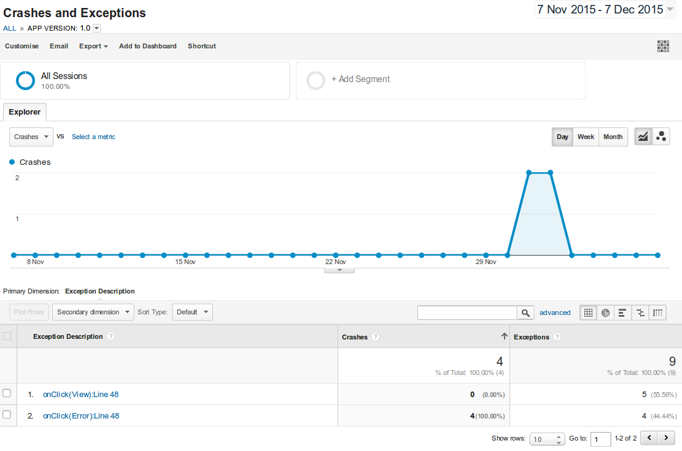
Behaviour Crash Report

Slide 28
How Add Analytics Cntd..
If you want to track perfomance of any resource in your app and app usage timing
To send Time report
mTracker.send(new HitBuilders.TimingBuilder()
.setCategory("Time")
.setValue(System.currentTimeMillis())
.setVariable("BackKeyTime")
.setLabel("LoginBackKeyTime")
.build());

Slide 29
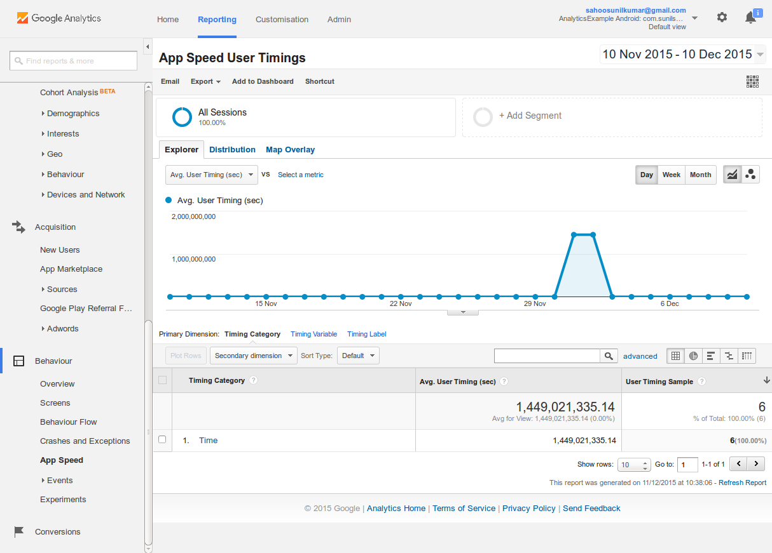
Behaviour Speed Report

Slide 30
How Add Analytics Cntd..
Periodic Dispatching
By default, data is dispatched from the Google Analytics SDK for Android every 30 minutes.
To set the dispatch period programmatically:
// Set the dispatch period in seconds.
GoogleAnalytics.getInstance(this).setLocalDispatchPeriod(15);
To set the dispatch period in the XML configuration file:
<int name="ga_dispatchPeriod">15</int>
Manual Dispatching
Disable periodic dispatch by setting dispatch period to a value less than 1.
GoogleAnalytics.getInstance(this).setLocalDispatchPeriod(0);
GoogleAnalytics.getInstance(getActivity().getBaseContext()).dispatchLocalHits();

Slide 31
Google Analytics..
Pros:
Its Free
It has Real-time feature
Its API supports android and iOS
Cons:
Free account is very limited
Data is 24+ hours older
Results are unpredictable for Web Profile
Flury is one of the best alternatives (free) of Google Analytics

Slide 32
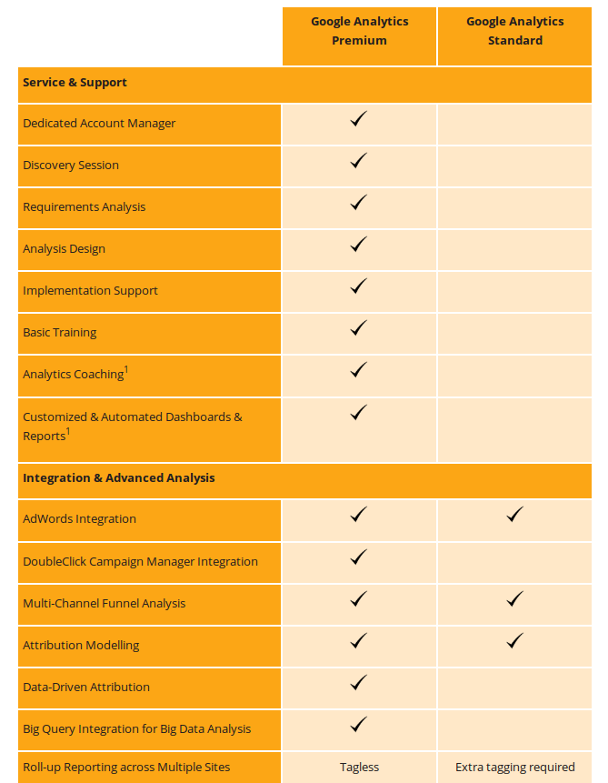
Free Vs Premium Account

Slide 33
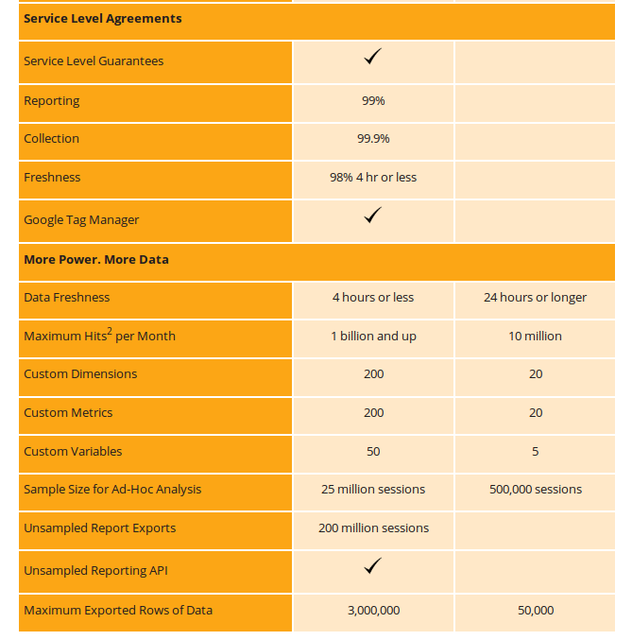
Free Vs Premium Account

Slide 34
Thank You!
Sunil Kumar Sahoo

