Slide 1
Ui Testing
The Android SDK provides the following tools to support automated, functional UI testing on your application:
uiautomatorviewer - A GUI tool to scan and analyze the UI components of an Android application.
uiautomator - A Java library containing APIs to create customized functional UI tests, and an execution engine to automate and run the tests.
Minimum Requirements to set Environment
JDK 1.6
Android SDK Tools, Revision 21 or higher
Android SDK Platform, API 16 or higher
Ant

Slide 2
Analyzing Your Application's UI
To analyze the UI components of the application
Connect your Android device to your development machine.
Open a terminal window and navigate to <android-sdk>/tools/ and Run the tool with this command:
./uiautomatorviewer
To Start analyze click on Device Screen shot button in ui automator viewer tool
Reference URL:
http://developer.android.com/tools/testing/testing_ui.html#uianalysis

Slide 3
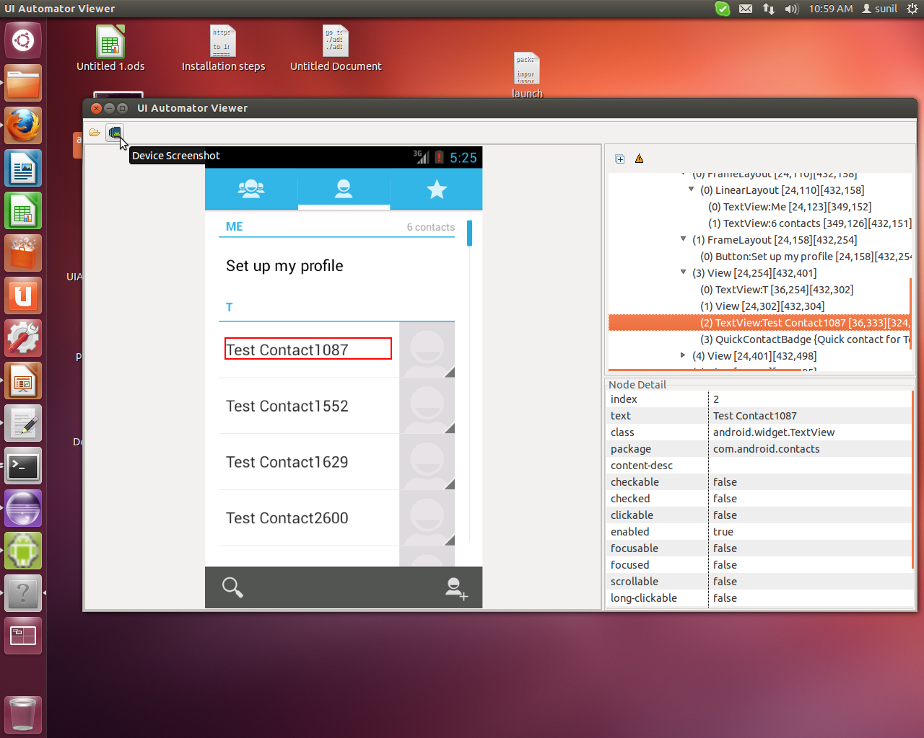
UI Automator Tool

Slide 4
Configuring development environment
Create a new Java project in Eclipse, and give your project a name that is relevant to the tests you’re about to create (for example, "MyAppNameTests"). In the project, you will create the test cases that are specific to the application that you want to test.
From the Project Explorer, right-click on the new project that you created, then select Properties > Java Build Path, and do the following:
  Click Add External JARs... and navigate to the SDK directory. Under the platforms directory, select the latest SDK version and add both the uiautomator.jar and android.jar files.

Slide 5
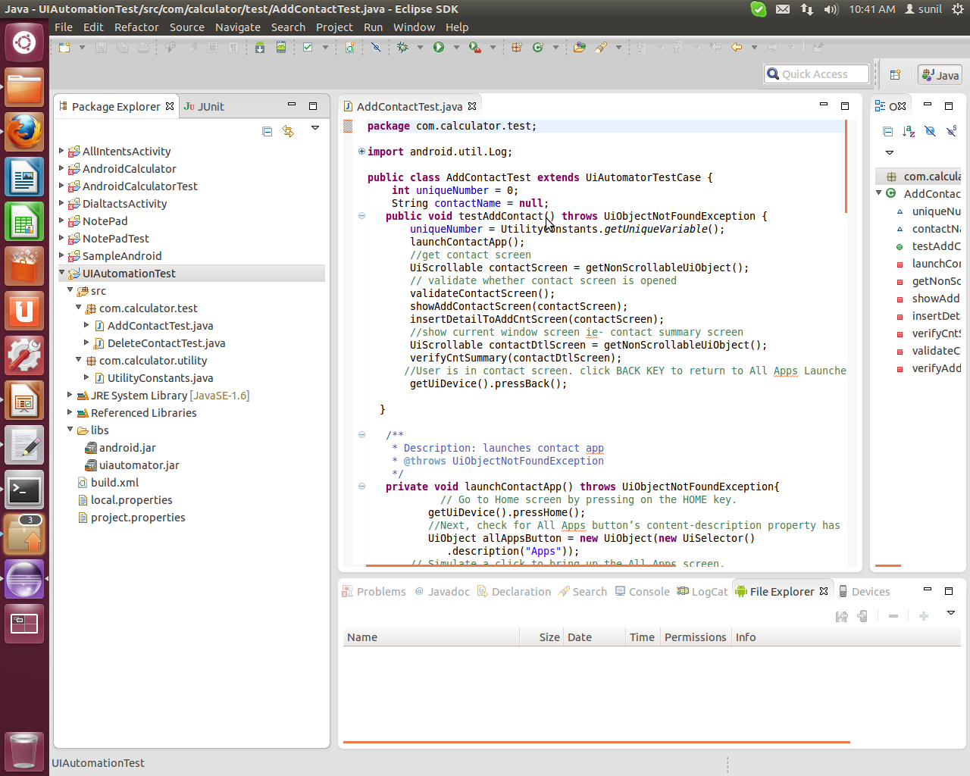
Development Project Structure

Slide 6
Developing
For further reference please have a look on following link
http://developer.android.com/tools/testing/testing_ui.html#creating

Slide 7
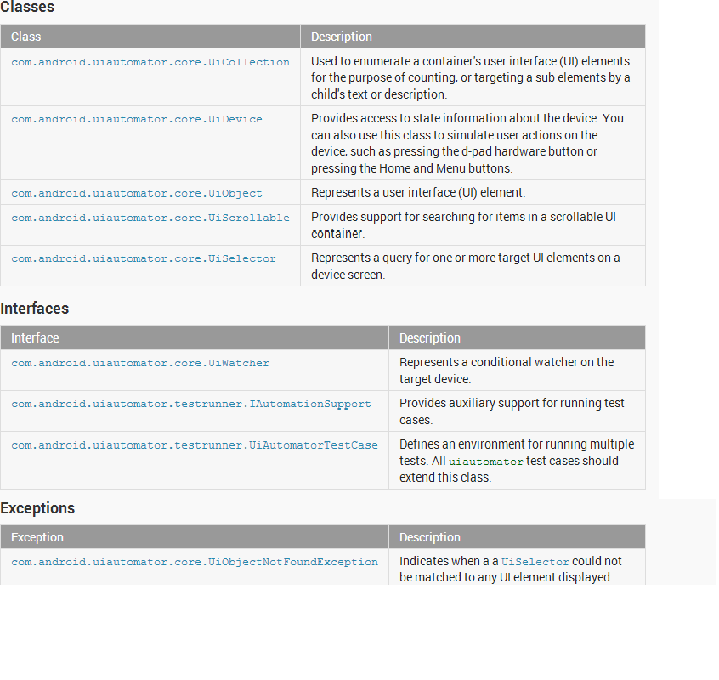
Ui Elements

Slide 8
Deploying And Running uiautomator Tests
First check list of android devices that you have. Use following syeps
Open your terminal. Navigate to tools
Example: Run following command
cd /home/sunil/Development/android-sdk-linux/tools/
Run following command in your terminal to get list of devices and its id.
./android list targets
Create the required build configuration files i.e. (build.xml) .
Run the following command: in terminal
<android-sdk>/tools/android create uitest-project -n <name> -t 1 -p <path>
<name> is the name of the project that contains your uiautomator test source files, and the <path> is the path to the corresponding project directory.
Example: ./android create uitest-project -n UIAutomationTest -t 6 -p /home/sunil/workspace/UIAutomationTest
O/p: build.xml will be generated if not generated before, otherwise build.xml file will be updated
From the command line, set the ANDROID_HOME variable:
In Windows:set ANDROID_HOME=<path_to_your_sdk>
In UNIX:export ANDROID_HOME=<path_to_your_sdk>

Slide 9
4. Go to the project directory where your build.xml file is located and build your test JAR.ant build
Example:
cd /home/sunil/workspace/UIAutomationTest
And run following command in terminal to generate jar file
ant build
5.Deploy your generated test JAR file to the test device by using following command
./adb push command:adb push <path_to_output_jar> /data/local/tmp/
Example:
cd /home/sunil/Development/android-sdk-linux/platform-tools/
push the jar file
./adb push /home/sunil/workspace/UIAutomationTest/bin/UIAutomationTest.jar /data/local/tmp/
Running uiautomator Tests
Example:
./adb shell uiautomator runtest UIAutomationTest.jar -c com.calculator.test.AddContactTest

Slide 10
4. Go to the project directory where your build.xml file is located and build your test JAR.ant build
Example:
cd /home/sunil/workspace/UIAutomationTest
And run following command in terminal to generate jar file
ant build
5.Deploy your generated test JAR file to the test device by using following command
./adb push command:adb push <path_to_output_jar> /data/local/tmp/
Example:
cd /home/sunil/Development/android-sdk-linux/platform-tools/
push the jar file
./adb push /home/sunil/workspace/UIAutomationTest/bin/UIAutomationTest.jar /data/local/tmp/
Running uiautomator Tests
Example:
./adb shell uiautomator runtest UIAutomationTest.jar -c com.calculator.test.AddContactTest

Slide 11
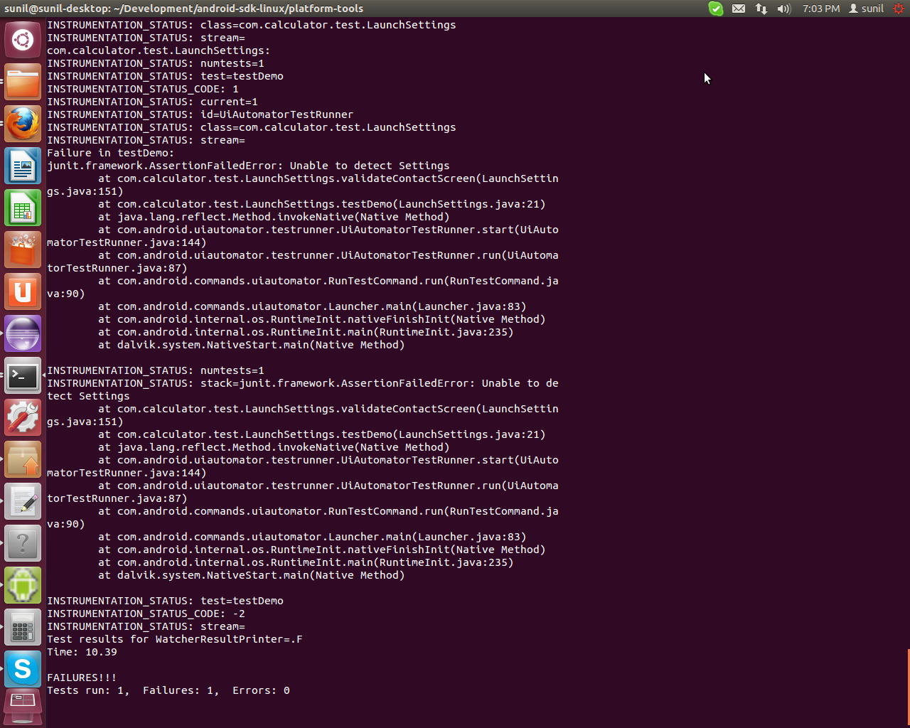
Assertion Failure Message

Slide 12
Thank You

