Slide 1
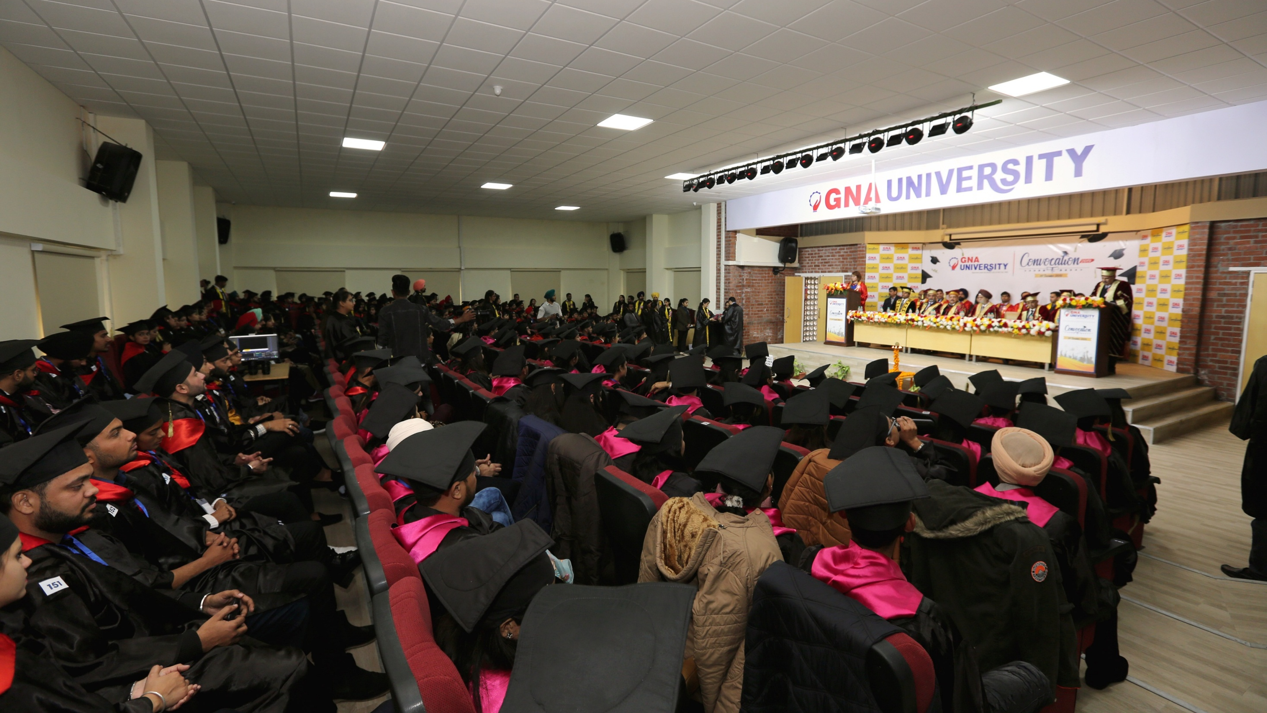


Online Voting System
www.gnauniversity.edu.in
Presented by : Simran Kaur, Manvir Singh, Tripta, Gobind Ram
Roll no.: GU-2022-3409,3410,3412,3411
Class: MCA 1
SESSION 2022-2024
We Make The Difference

Slide 2



Online Voting System:
“ONLINE VOTING SYSTEM” is an online voting technology.
In this system, authorized voters can give their vote online without going to any physical pooling station.
A database is maintained in which all the names of voters with complete information are stored.

Slide 3
Why We Introduced Online Voting System:
Enhanced credibility
Less expensive
Time saving and convenient
Easy to vote
Techno-friendly
Speedy
Low voter turnout
No coercive voting

Slide 4
Who Can Involved In This System:
Visitors
Voters
Candidates
Admin

Slide 5
Future Scope Of This Project:
This system can be used for elections of university level since it can save time, increase flexibility if more security features are added to it.
This can be easily modified as per guidelines as election process is in itself is dynamic.
With more utilities provided various reports and useful results can be generated .
Trouble reporting and other added facilities can be added thereafter.

Slide 6
Advantages:
Flexibility of use
Reduced cost
Saved Ballot Templates
Email usage and Reminders
On-demand Paper Ballots
Automated Tallying
Archived Election Results
Ability to correct mistakes

Slide 7
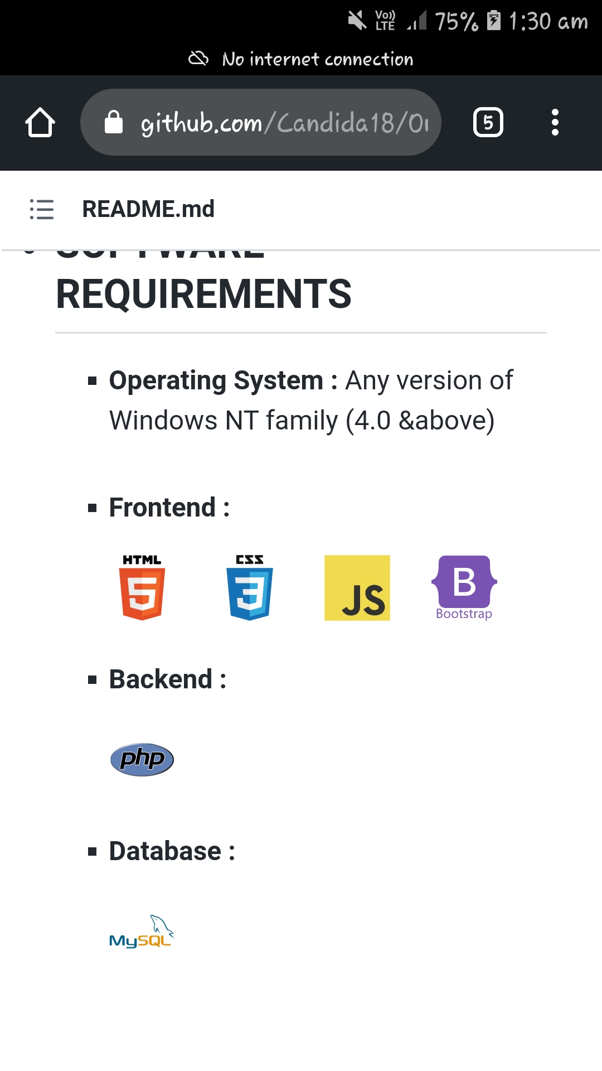
Software Requirements:

