Slide 1
Asynchronous Development
Sync
Async
Sync or Async?
Differences between Async and Sync
When Use Async?
When Use Sync?

Slide 2
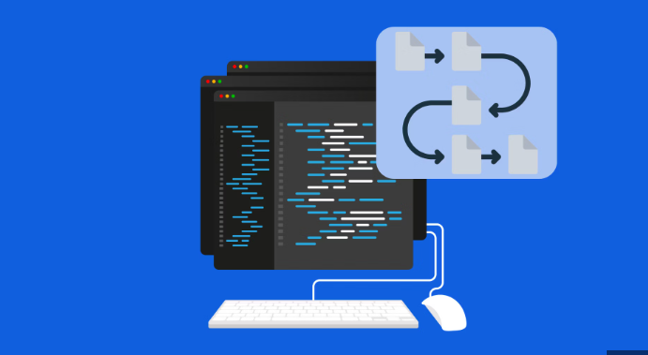
Synchronous

Slide 3
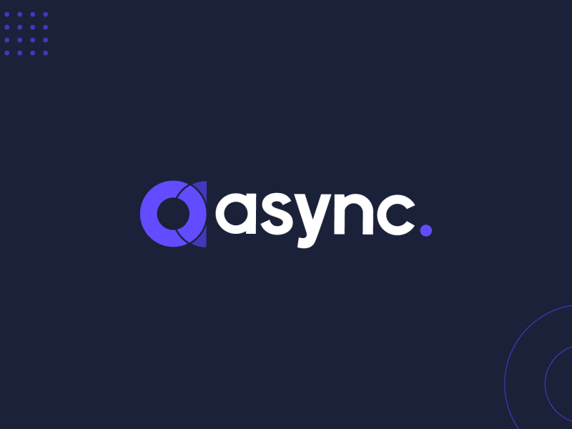
Asynchronous

Slide 4
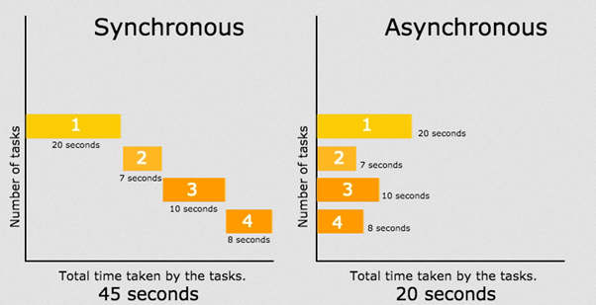
Differences between Async and Sync

Slide 5
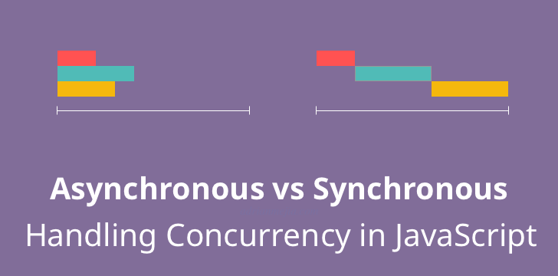
When Use Async?

Slide 6

When Use Sync?

