Slide 1


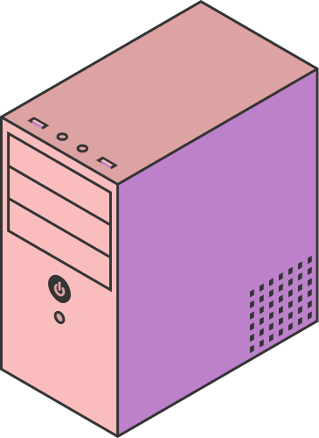
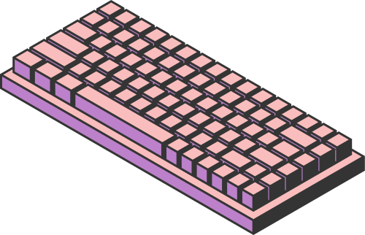
MNIST DIGIT CLASSIFICATION
ACCELERATED WITH CUDA
Sahrish Mustafa 22i0977
Aalyan Raza Kazmi 22i0833
Page 01

Slide 2
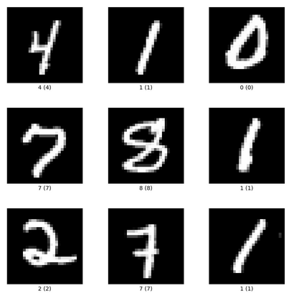
MNIST
(Modified National Institute of Standards and Technology database)
Handwritten Digits
70,000 Images
28x28 pixels
10 classes (0-9)
Page 02

Slide 3
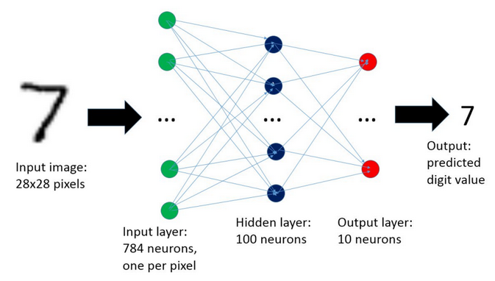
NEURAL NETWORK - V1
INPUT LAYER
OUTPUT LAYER
Size: 784 neurons
28x28 pixel grayscale images. Flattened, each image becomes a 784-dimensional vector.
Size: 10 neurons
Weights (W2): A matrix of size 10 x 128
Biases (b2): A vector of size 10
Activation Function: Softmax (raw outputs to probabilities)
128
HIDDEN LAYER
Size: 128 neurons
Weights (W1): A matrix of size 128 x 784
Biases (b1): A vector of size 128
Activation Function: ReLU (max(0, x))
Page 03

Slide 4
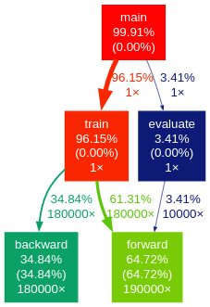
ACCELERATION PLAN
parallelize forward() and backward() by converting loops to kernels running on the GPU
Page 04

Slide 5
FORWARD PROPAGATION
V1
V2
FUNCTION FORWARD_PROPAGATION(INPUT):
// COMPUTE HIDDEN LAYER
FOR I IN RANGE(HIDDEN_SIZE):
SUM = BIAS1[I]
FOR J IN RANGE(INPUT_SIZE):
SUM += W1[I][J] * INPUT[J]
HIDDEN[I] = RELU(SUM)
// COMPUTE OUTPUT LAYER
FOR I IN RANGE(OUTPUT_SIZE):
SUM = BIAS2[I]
FOR J IN RANGE(HIDDEN_SIZE):
SUM += W2[I][J] * HIDDEN[J]
OUTPUT[I] = SUM // SOFTMAX APPLIED LATER
KERNEL FORWARDHIDDEN(W1, B1, INPUT, HIDDEN):
I = THREADIDX.X
IF I < HIDDEN_SIZE:
SUM = B1[I]
FOR J IN RANGE(INPUT_SIZE):
SUM += W1[I][J] * INPUT[J]
HIDDEN[I] = RELU(SUM)
KERNEL FORWARDOUTPUT(W2, B2, HIDDEN, OUTPUT):
I = THREADIDX.X
IF I < OUTPUT_SIZE:
SUM = B2[I]
FOR J IN RANGE(HIDDEN_SIZE):
SUM += W2[I][J] * HIDDEN[J]
OUTPUT[I] = SUM // SOFTMAX ON HOST
Page 05

Slide 6
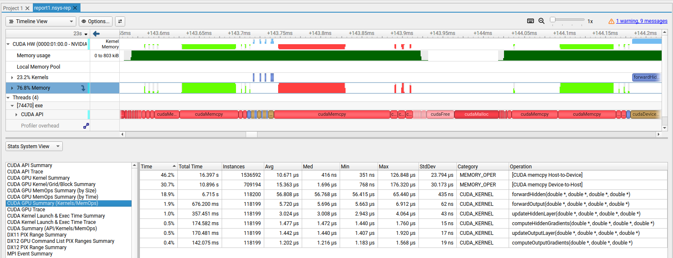

ACCELERATION PLAN
TOO MUCH MEMORY TRANSFER TIME!
. . . . REDUCE MEMORY TRANSFER (DTH / HTD)
Page 06

Slide 7

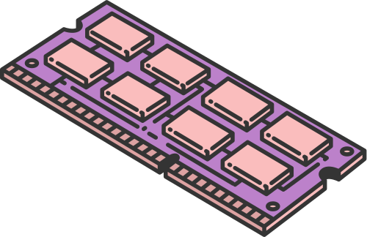
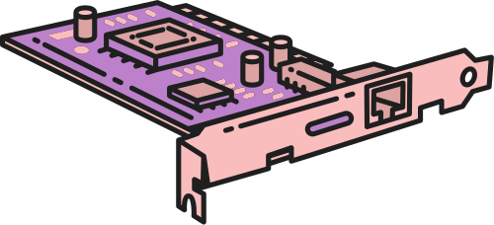
previously, we were copying each image from the host to the device 60,000 times per epoch during training. Now, we copy the entire dataset in the beginning only once
CPU RAM (HOST STORAGE)
GPU GLOBAL MEMORY (DEVICE STORAGE)
Page 07

Slide 8
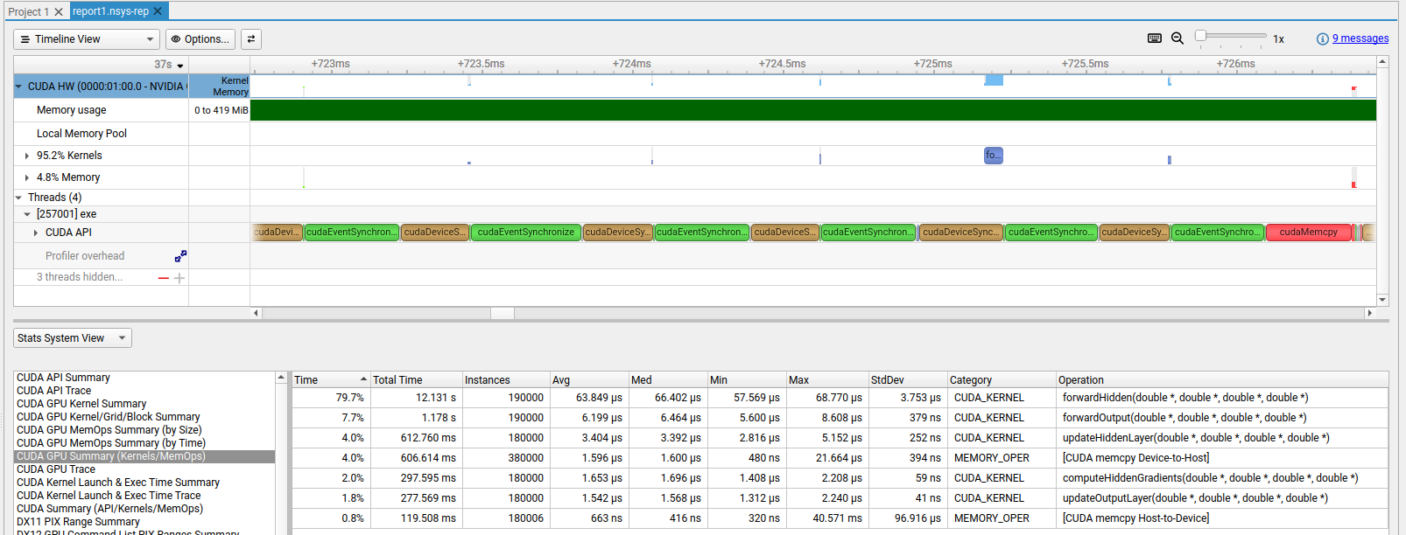
ACCELERATION PLAN
> 13 SECONDS ON KERNELS
. . . SPEED UP KERNELS
Page 08

Slide 9
OPTIMIZED GPU VERSION - V3
Optimizing launch configurations
Shared memory
Half-precision (FP16) datatype
Coalesced memory access
Page 09

Slide 10
LAUNCH CONFIGURATIONS
FORWARDHIDDEN<<<4, 32>>>
FORWARDOUTPUT<<<1, 64>>>
COMPUTEHIDDENGRADIENTS<<<16, 4>>>
UPDATEOUTPUTLAYER<<<OUTPUT_SIZE, HIDDEN_SIZE>>>
UPDATEHIDDENLAYER<<<HIDDEN_SIZE, INPUT_SIZE>>>
Page 10

Slide 11

OPTIMIZED GPU VERSION - V3
SHARED MEMORY
MEMORY COALESCION
Shared memory is used to cache input data, hidden layer activations, and output gradients within each thread block. This reduces global memory access and speeds up forward and backward passes in the neural network.
The weight matrix is transposed to ensure memory coalescing during access by parallel threads. This improves global memory access efficiency, reducing latency during matrix multiplications.
Page 11

Slide 12


FP 16
HALF PRECISION
Uses half type to store inputs, weights, and activations.
Functions like __float2half() and __half2float() are used to convert between 32-bit and 16-bit values.
Reduces memory usage and enables faster computation on supported GPUs.
Ideal for deep learning workloads where precision trade-offs are acceptable.
Page 12

Slide 13
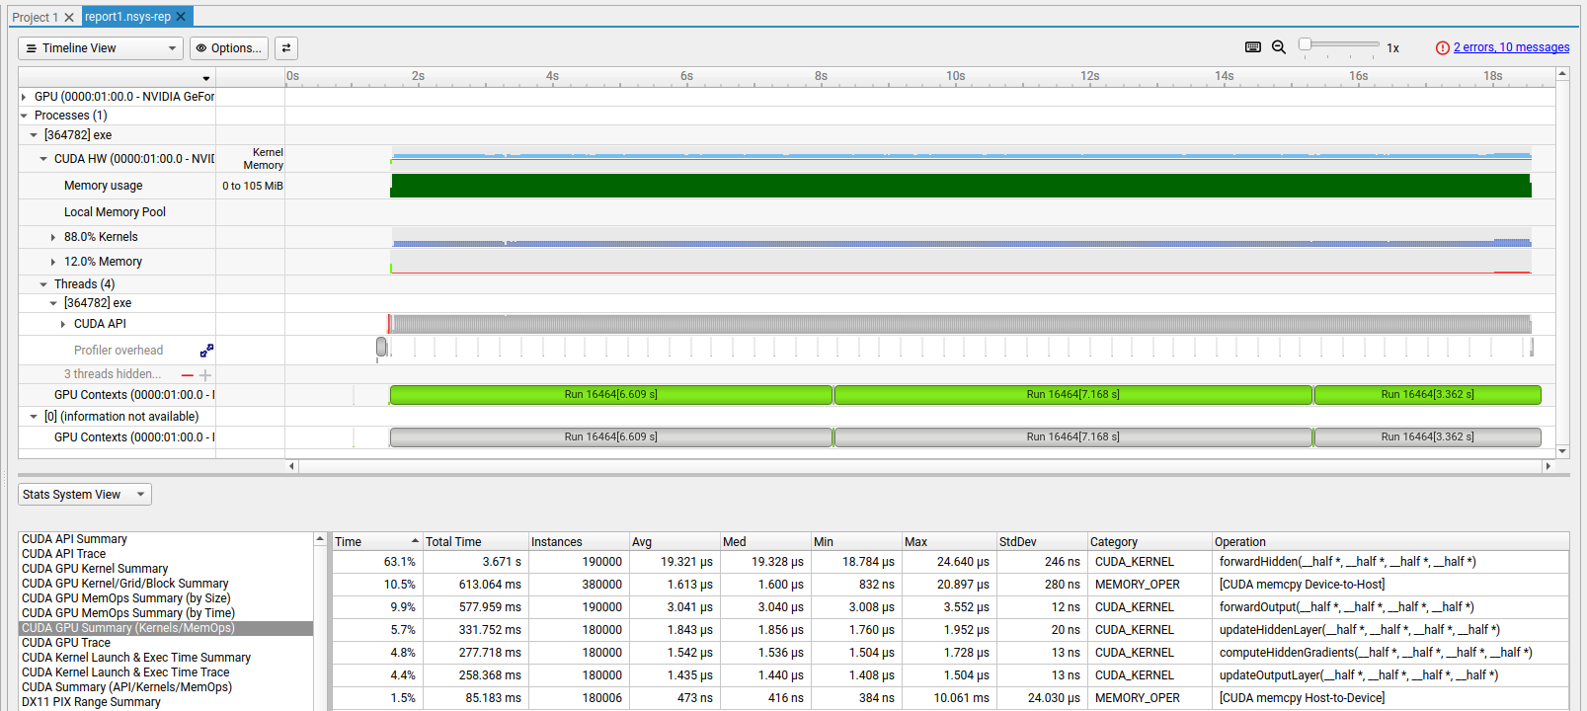
ACCELERATION PLAN
BATCH PROCESSING
TENSOR CORES
Page 13

Slide 14

FORWARD PROPAGATION
1
2
3
4
5
6
cublasDgemm (cuBLAS) for W1 @ input_batch.
addBiasBatch adds biases to all samples
reluActivation kernel
cublasDgemm for W2 @ hidden_activations.
addBiasBatch adds biases to all samples
softmaxBatch kernel
*requires atomic operations
BACKWARD PROPAGATION
1
2
3
4
5
computeLossAndGradients
cublasDgemm computes W2^T @ output_gradients.
reluDerivativeBatch
updateWeightsBatch (for W1/W2)
updateWeightsBatch (for W1/W2)

Slide 15
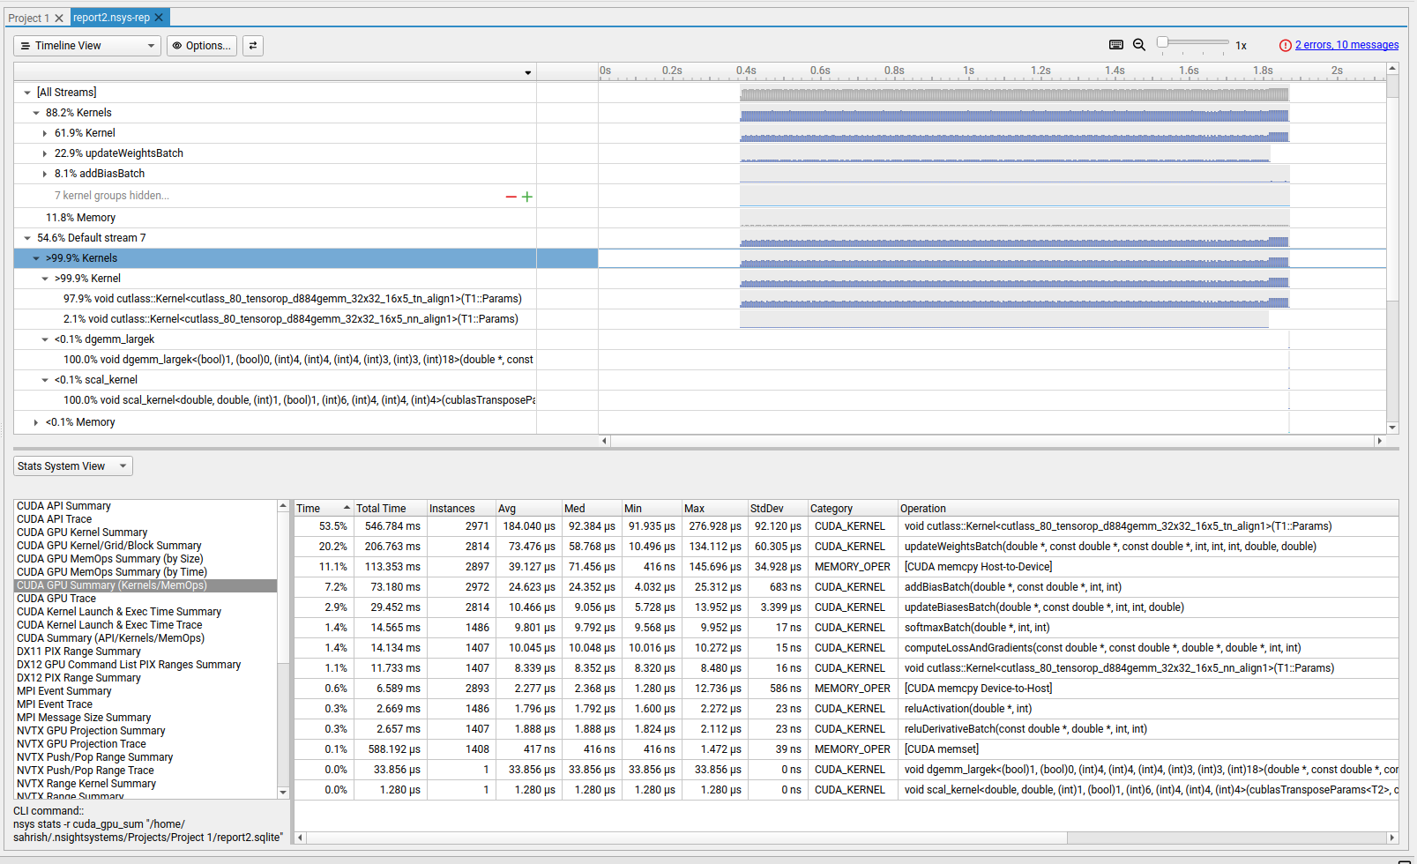
~2 SECOND EXECUTION TIME
Page 15

Slide 16


CONCLUSION

Slide 17



THANK YOU
Page 10

