Slide 1

Internet Software Architecture Tutorial – Week 2
Instructor:
Karan Shrestha

Slide 2
What you learn at Lecture Class (Quick Revision)
UML Diagrams
Activity diagram
Sequence diagram
Deployment diagram

Slide 3
UML Diagrams
1.1. UML Diagrams
1.2. Activity Diagram
1.3. Sequence Diagram
1.4. Deployment Diagram
A set of standardized graphical notations used to represent design and architecture of software system
Widely used in software development, as they can help to improve understanding, communication and documentation of complex systems
A visual representation of the design and architecture of system, making it easier to identify potential issues and to collaborate with other developers and stakeholders.

Slide 4
Activity diagram
1.1. UML Diagrams
1.2. Activity Diagram
1.3. Sequence Diagram
1.4. Deployment Diagram
Behavioral diagram representing the flow of activities or actions within a system or process
Elements / Notation of activity diagram:
Activity
Decision
Fork
Join
Initial node
Final node
Object
Control Flow

Slide 5
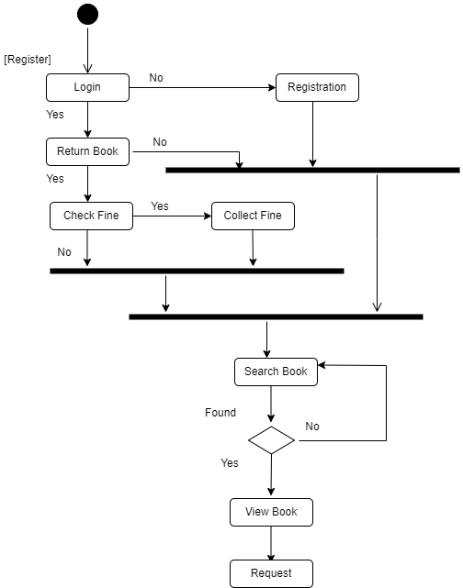
1.1. UML Diagrams
1.2. Activity Diagram
1.3. Sequence Diagram
1.4. Deployment Diagram

Slide 6
Sequence diagram
1.1. UML Diagrams
1.2. Activity Diagram
1.3. Sequence Diagram
1.4. Deployment Diagram
Interaction diagram illustrating the relationships between objects or components in a system over time
Elements / Notations of Sequence diagram:
Object
Lifeline
Message
Self Message
Return message
Destroy message
Create message
Activation Bar

Slide 7
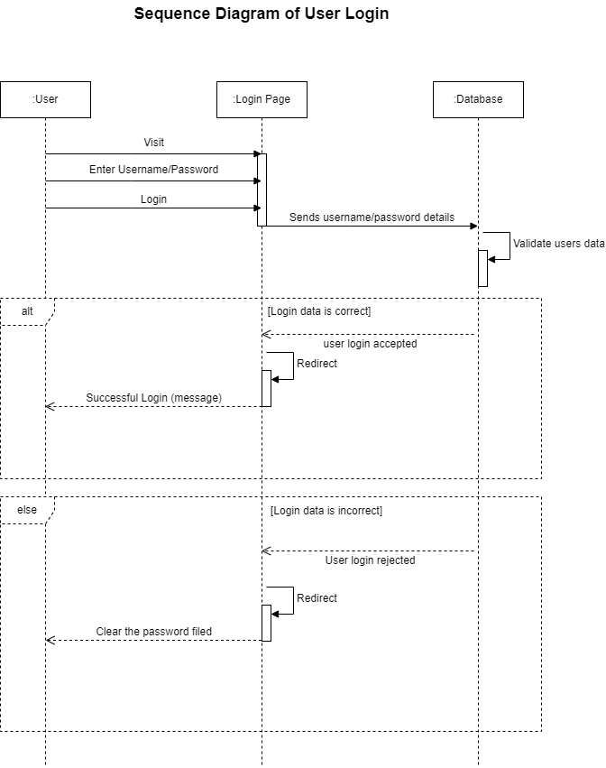
1.1. UML Diagrams
1.2. Activity Diagram
1.3. Sequence Diagram
1.4. Deployment Diagram

Slide 8
Deployment diagram
1.1. UML Diagrams
1.2. Activity Diagram
1.3. Sequence Diagram
1.4. Deployment Diagram
Structural diagram showing physical deployment of software components and hardware in a system or application
Elements / Notations of deployment diagram:
Node
Component
Artifacts
Deployment specification
Communication path/association

Slide 9
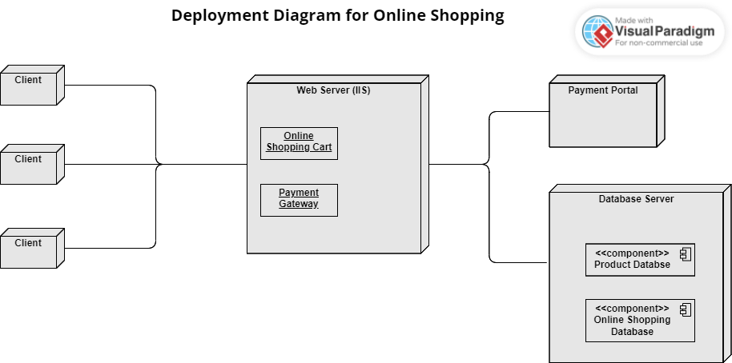
1.1. UML Diagrams
1.2. Activity Diagram
1.3. Sequence Diagram
1.4. Deployment Diagram

Slide 10
Exercise to be done in Workshop
2.1. Exercise to be done in Workshop
Creation of activity, sequence and deployment diagram for different software systems using different drawing tools.

Slide 11


