Slide 1





Bug Bounty Automation

Slide 2
Objectives
It is the collection of pentesting tools. It's scan the target and generates the reports in text format.
Benefits
Easily identify low-hanging vulnerabilities.
Continuous recon to capture changing environments.
Maximize time and profit by automating repetitive tasks.

Slide 3
Data Sharing Agreement(Domain URL)
Data Folder Name: Domain_Name
Number of Files: 8+ (Depends on number of Subdomains)
Number of Folder: <User Defined>
Files Name: NmapScan_$url.txt, Subdomains.txt, SubdomainsSorted.txt, Whois_$url.com, aliveSubdomains.txt , JsAliveSubdomains.txt, DomainsTakeover.txt
File type: .TXT format

Slide 4
Architecture
Domain URL
Nmap Scan
Find Subdomains
WHOIS lookup
Sorting Subdomains
Checking domain takeover
JS live or not
Checking live or not

Slide 5
Download Tool from GitHub

Slide 6
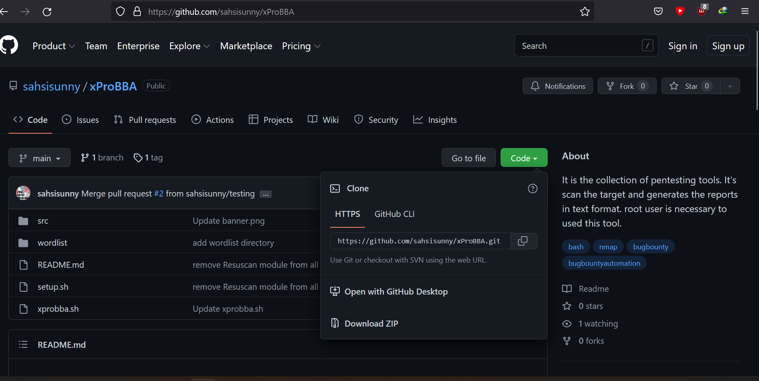
Step 1: Copy the HTTPS Link

Slide 7
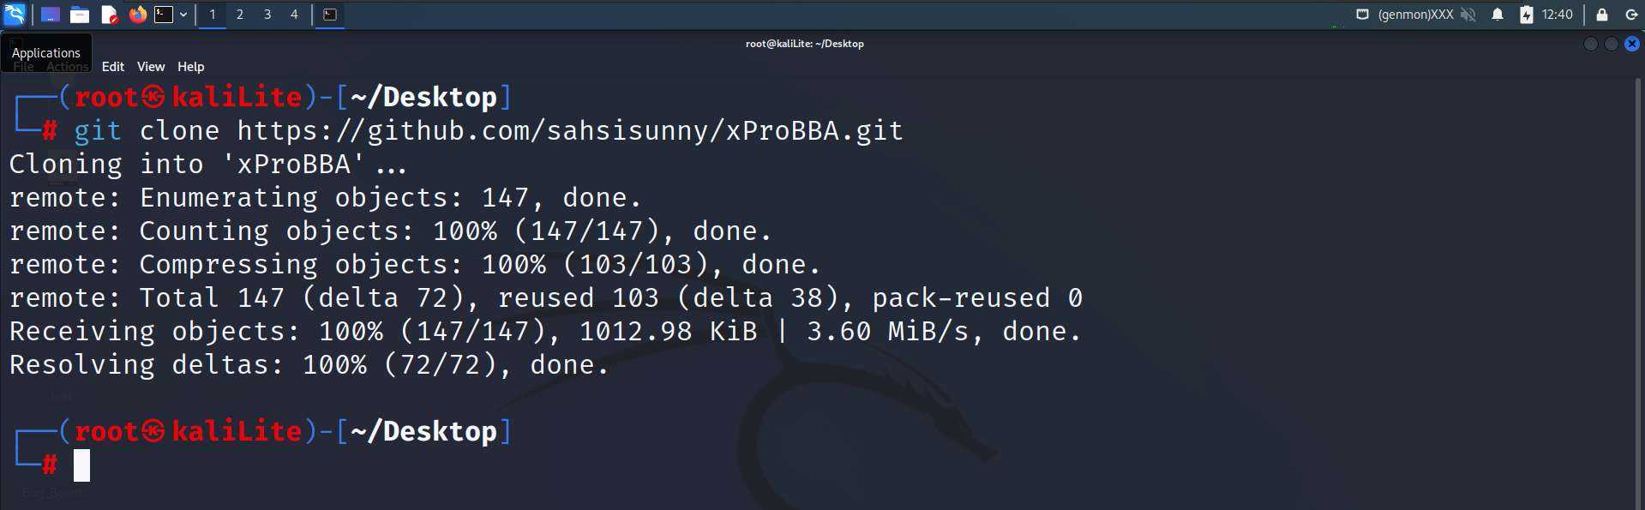
Step 2: Clone on Kali Linux Machine

Slide 8
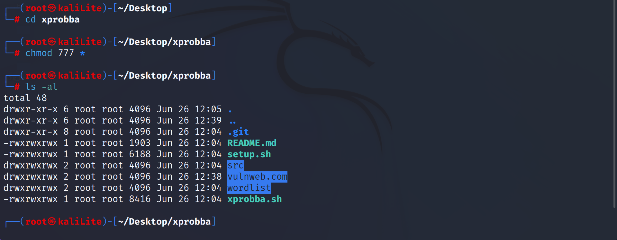
Step 3: Give executable permission to the files

Slide 9
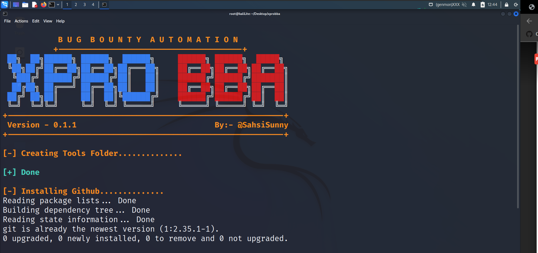
Step 4: Run “setup.sh” file

Slide 10
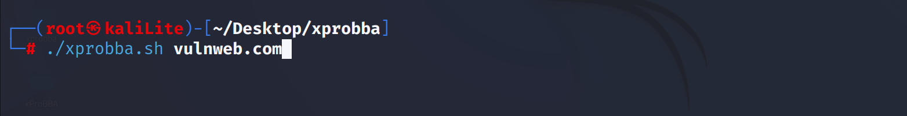
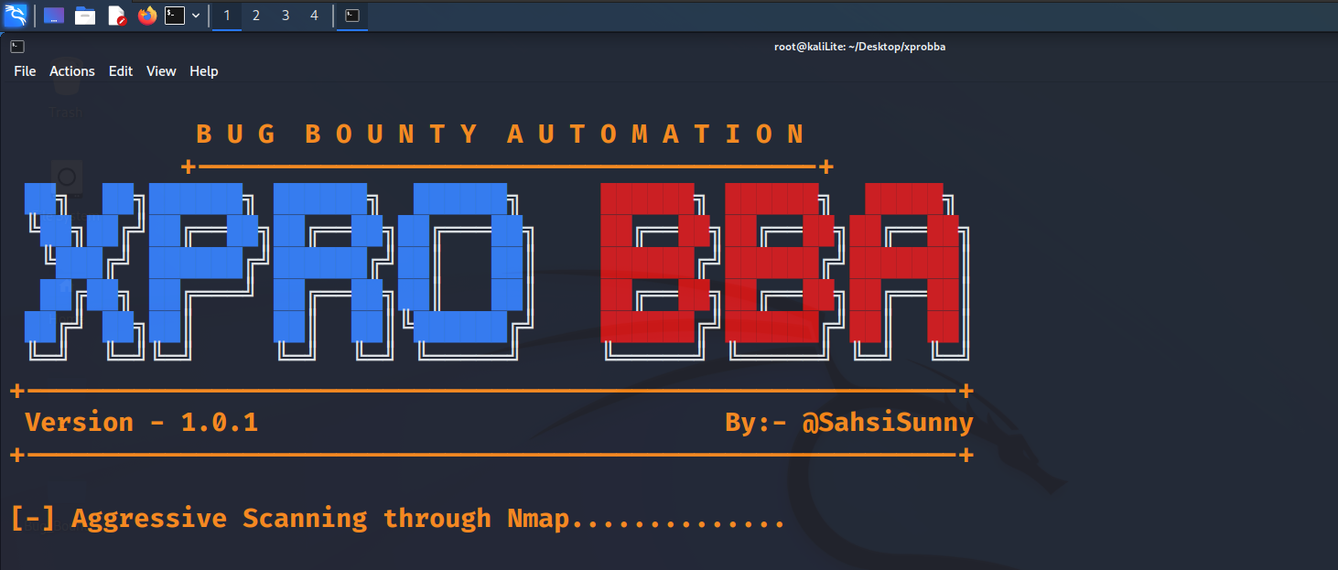
Step 5: Run “xprobba.sh” script for BBA

Slide 11
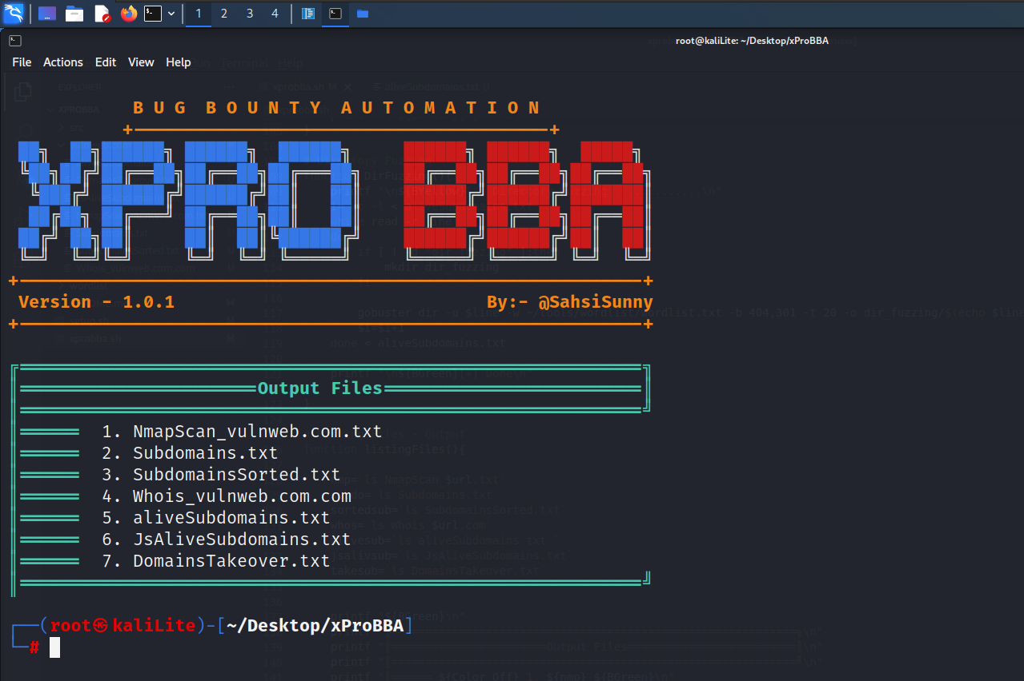
Step 6: Output Data Saved files

Slide 12
Steps to Deploy and Use
git clone https://github.com/sahsisunny/xProBBA.git
cd xProBBA
chmod 777 *
./setup.sh
./xprobba.sh {DOMAIN_URL}

