Slide 1





Website Scraper

Slide 2
Objectives
Extract the Website Data like Twitter tweets , YouTube Comments, Facebook Comments and Other website data.
Benefits
Extract tweets from specific User.
Extract tweets from using Twitter Advance Search Query.
Extract data from Flipkart Mobile Data .

Slide 3
Data Sharing Agreement(Username)
Data File Name: TwitterData_<USERNAME>_.csv
Number of Columns: 7
Number of Rows: <User Defined>
Columns Name: Index, Username, Date, Tweets, Like Count, Reply Count, Retweet Count.
Columns Datatype: Number, Date, String

Slide 4
Data Sharing Agreement(Query)
Data File Name: TwitterDataQuery.csv
Number of Columns: 7
Number of Rows: <User Defined>
Columns Name: Index, Username, Date, Tweets, Like Count, Reply Count, Retweet Count.
Columns Datatype: Number, Date, String

Slide 5
Data Sharing Agreement(Flipkart)
Data File Name: Flipkart Mobile Data_<Page Number>csv
Number of Columns: 7
Number of Rows: <User Defined>
Columns Name: Index, Model Name, Price, Image
Columns Datatype: Number, String

Slide 6
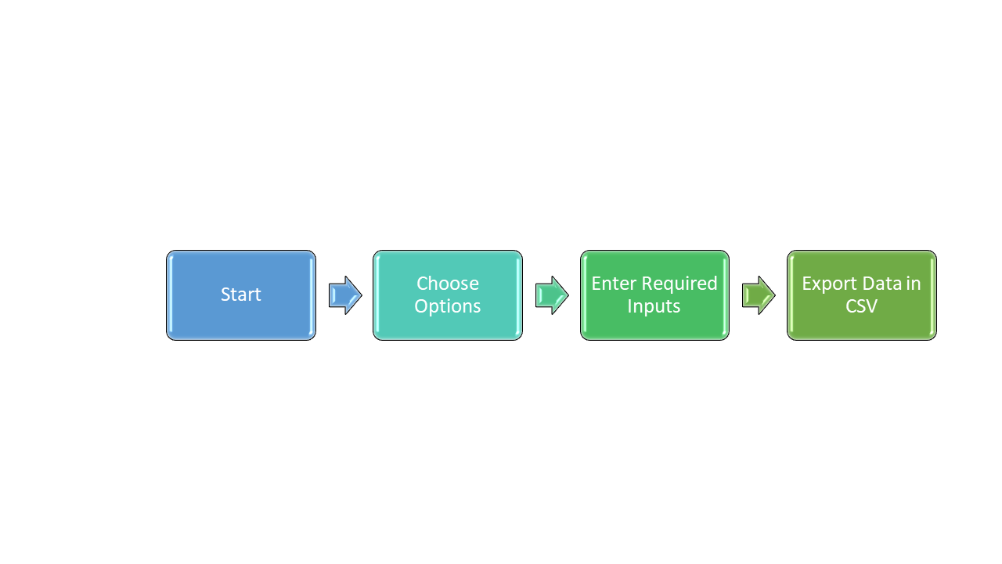
Architecture

Slide 7
For Twitter by Username

Slide 8
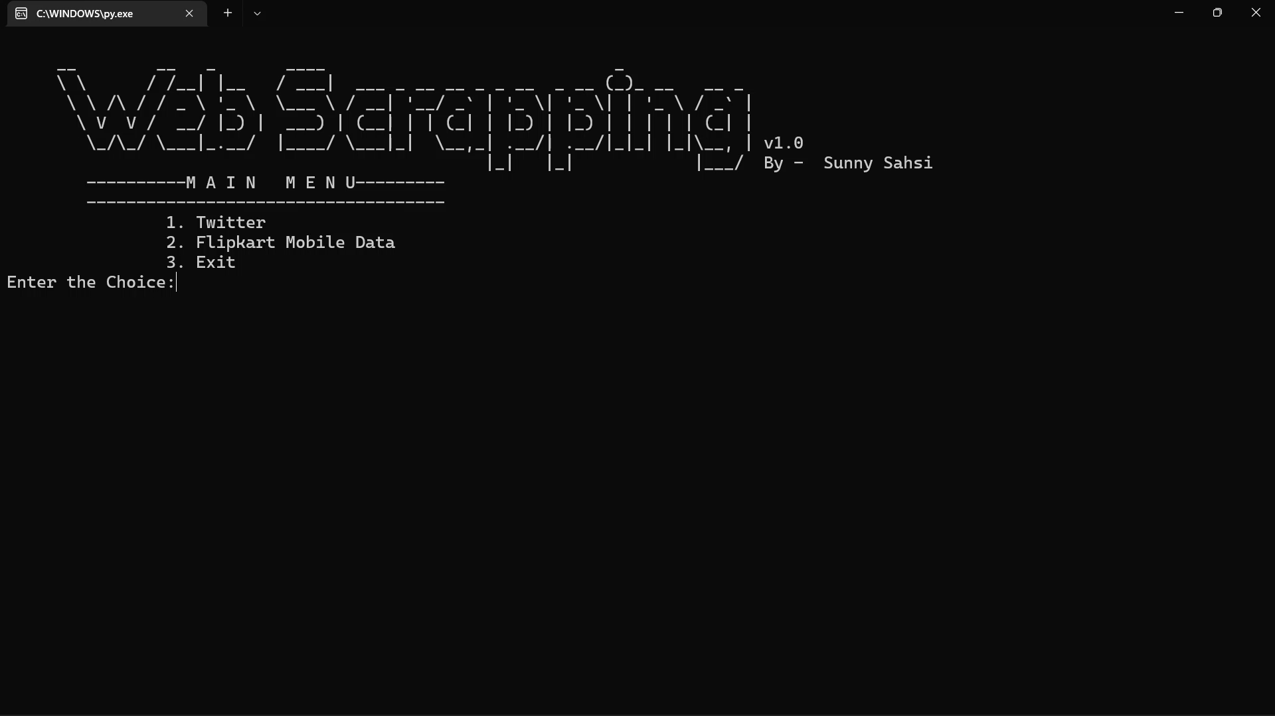
Step 1: Choose the Choice

Slide 9

Step 2: Enter the Username and Number of Tweets

Slide 10
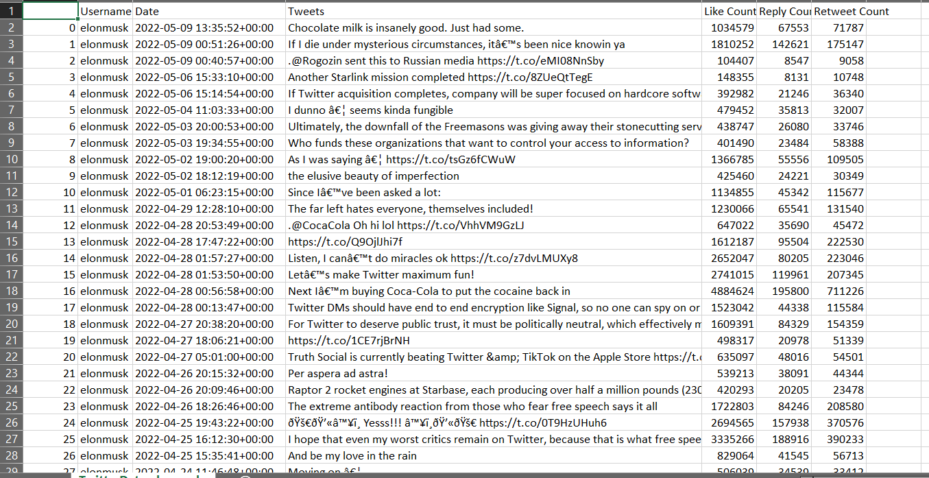
Step 3: Output Data Saved in .csv file

Slide 11
For Twitter by Query

Slide 12
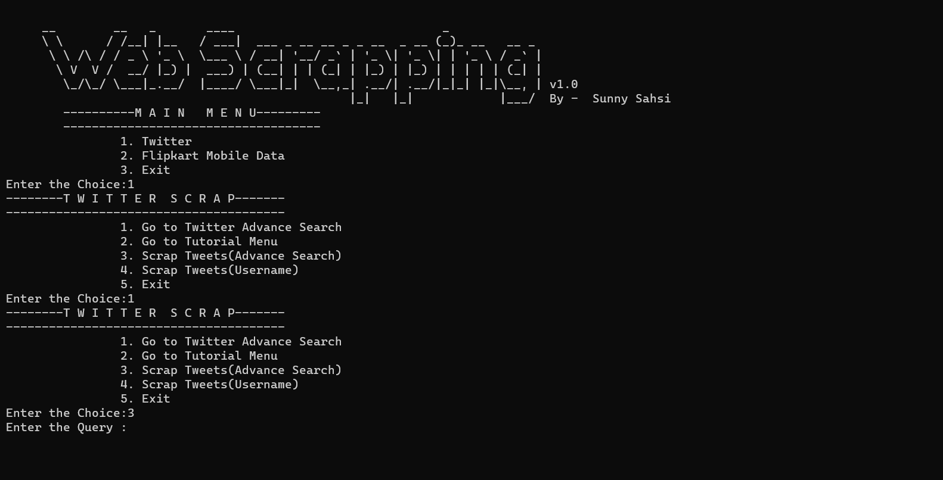
Step 1: Choose the Choice

Slide 13
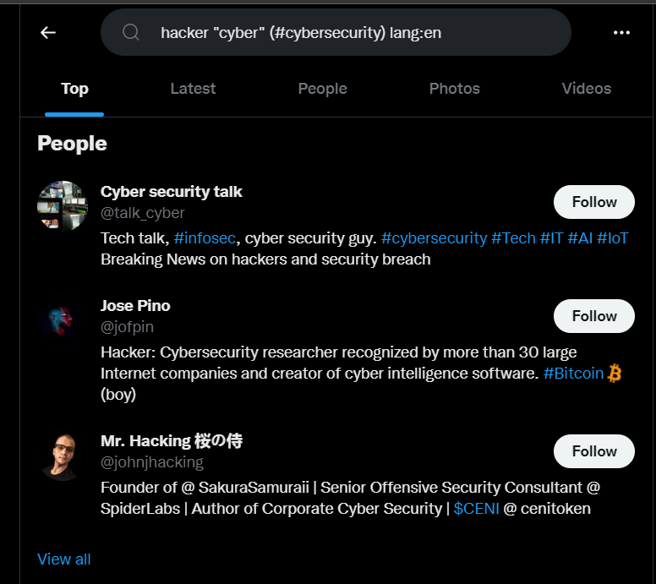
Step 1: Create Twitter Advance Search Query

Slide 14
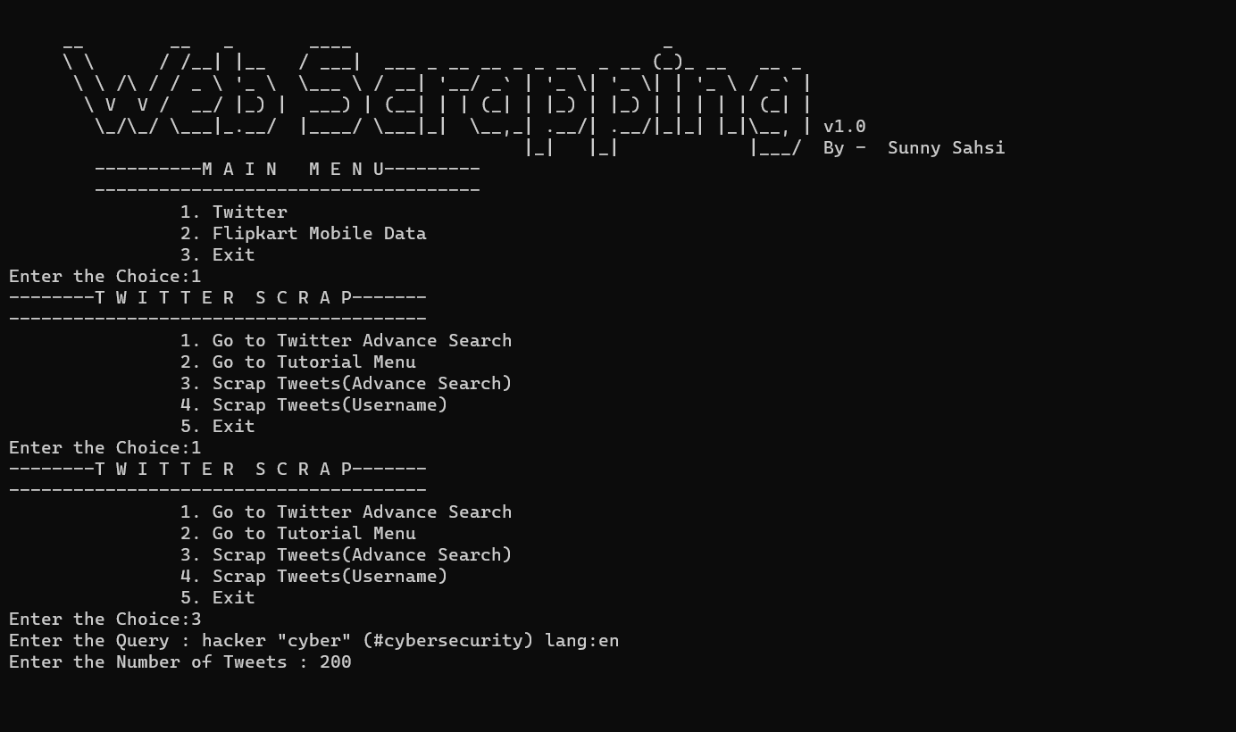
Step 1: Enter the Query and Number of Tweets

Slide 15
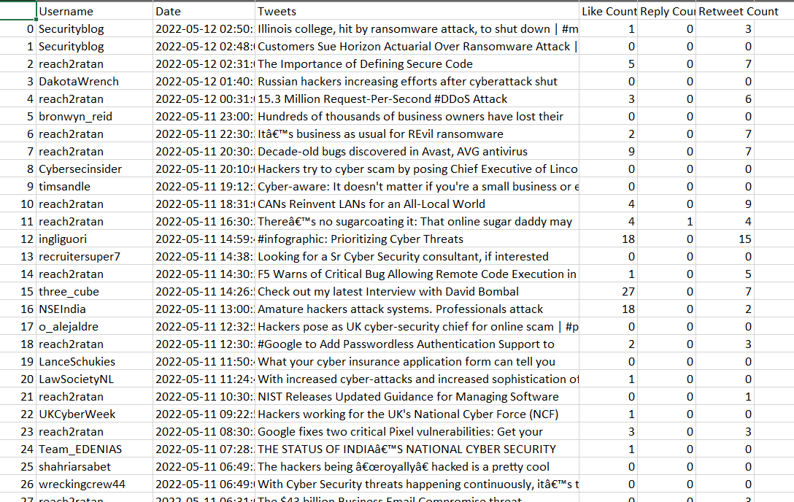
Step 1: Output of Query Result

Slide 16
Steps to Deploy
git clone https://github.com/sahsisunny/WebsiteScrapperProjectVIEH
cd WebsiteScrapperProjectVIEH
pip install –r requirements.txt
python WebScrapper.py

