Slide 1
Digital Credit Access and Financing Constraints Amongst Firms
Evidence from India and peer economies
Aryan Srivastava (IIT2024501)
Aditya Agrawal (IEC2024116)
Jaydeep Ghosh (IEC2024032)

Slide 2
INTRODUCTION
Why firms can't get the credit they need
~$5 trillion
Opaque borrowers
No hard collateral
Young, asset-light firms with no audited accounts
Lender cannot tell good from bad
Banks price risk on land and fixed assets
Intangible-heavy SMEs get rationed
global MSME credit gap (IFC/GPFI, 2024)
~$500 billion
Thin credit history
The digital promise
First-time borrowers have no bureau record
High screening cost per small loan
Use payments, platform and tax data instead
Screen cheaply, lend at scale
India MSME credit gap (industry estimates)
Our question: does digital access go with fewer credit-constrained firms, and where does India stand?
2
Notes:
Opening: SMEs are most of the world's firms but are systematically underserved. Figures: IFC/GPFI 2024 global gap ~ $5T; India estimates ~$500B (Avendus via ETV Bharat 2024).

Slide 3
CORE CONCEPTS
Theory: from information asymmetry to financing constraints
Information asymmetry
Credit rationing
Financing constraint
Forgone investment
Borrower knows more than lender
Lenders refuse or cut loans instead of raising rates
Wedge between internal and external cost of funds
Lower innovation, growth, resilience
Classic theory
How constraint is measured
Our measure
Stiglitz & Weiss (1981): rationing arises even in equilibrium
Pecking order: external funds cost more than internal
Indices: KZ, WW (imperfect proxies)
Cash-flow sensitivity (debated)
Outcome-based: actual loan applications and outcomes
Kuntchev et al. (World Bank): not needing / unconstrained / partially / fully constrained
We use % partially + fully constrained
3
Notes:
Stiglitz & Weiss (1981): adverse selection and moral hazard cause equilibrium credit rationing. Fazzari-Hubbard-Petersen (1988) cash-flow sensitivity; Kaplan & Zingales (1997/2000) critique; Whited & Wu (2006) WW index. Kuntchev et al. (World Bank) use actual loan outcomes.

Slide 4
BACKGROUND
A short history of digital credit
1981
2005
2009
2016
Credit rationing theory
Stiglitz & Weiss
Peer-to-peer lending
Zopa, UK
Digital identity
India: Aadhaar
Instant payments
UPI launched
1983
2007
2014
2021
Microfinance scales
Grameen Bank
Mobile money
M-Pesa, Kenya
Mass inclusion
Jan Dhan accounts
Data-sharing consent
Account Aggregator
Pattern: each wave removed one lender blind spot — identity, payments history, or consent to share data.
4
Notes:
Dates: Grameen Bank formalised 1983; Zopa (first P2P lending platform) 2005; M-Pesa launched in Kenya 2007; Aadhaar 2009; Jan Dhan Aug 2014; UPI Apr 2016; Account Aggregator framework live 2021.

Slide 5
MECHANISMS IN THE LITERATURE
How digital finance eases constraints
1. Alternative data
2. Transparency
3. Bank–FinTech coopetition
Transactions, mobile, e-commerce and tax records replace collateral
Evidence: Wang & Chen 2022; Lu et al. 2022
Platforms make firms visible; investor and lender confidence rises
Evidence: Yang et al. 2022
Banks bring capital, FinTechs bring data and speed
Evidence: Larsson et al. 2023
Downstream: eased constraints are channelled into
Breakthrough innovation
Green innovation
Resilience
Asset discipline
India's public digital stack — Aadhaar, Jan Dhan, UPI, GST data, Account Aggregator — does part of what collateral does elsewhere. Most causal evidence so far is from China, not India.
5
Notes:
Literature: Wang & Chen 2022; Yao & Yang 2022; Han & Zhang 2023; Feng et al. 2023 (mostly Chinese listed firms); Larsson et al. 2023 on bank-FinTech coopetition.

Slide 6
OUR APPROACH
From literature review to measurement
Gap in the literature
Research questions
Relies on KZ/WW index proxies
Chinese listed firms dominate
Little benchmarking of India
RQ1 How constrained is India vs peers?
RQ2 Do digital indicators add explanatory power?
RQ3 What does a simple ML model imply for India?
Open data
Baseline
Improve
India lens
World Bank API
Kuntchev-style outcome, financial depth
+ digital features, RF / GB
Prediction + counterfactual
All code in one notebook; every number in the report and slides comes from it.
6
Notes:
The first term paper was a literature review with no data. This revamp measures constraint directly, focuses on India, and adds a simple ML comparison.

Slide 7
DESIGN
Data and method
215
142
2013–24
30%
observations
economies
survey years
mean firms constrained (14% fully)
Outcome and features
Outcome: % firms constrained
GDP per capita
Private credit / GDP
Lending spread
Inflation, growth
Internet users
Mobile subs
Broadband
Secure servers
Account ownership
Blue = traditional baseline features Orange = digital features added
Models
Validation
Ridge baseline → + digital ridge → Random Forest → Gradient Boosting
5-fold, country-held-out CV; R² and MAE; permutation importance
7
Notes:
215 country-year observations, 142 economies, 2013-2024. Findex account ownership is triennial so latest value carried forward within country. GroupKFold(5) by country avoids leakage.

Slide 8
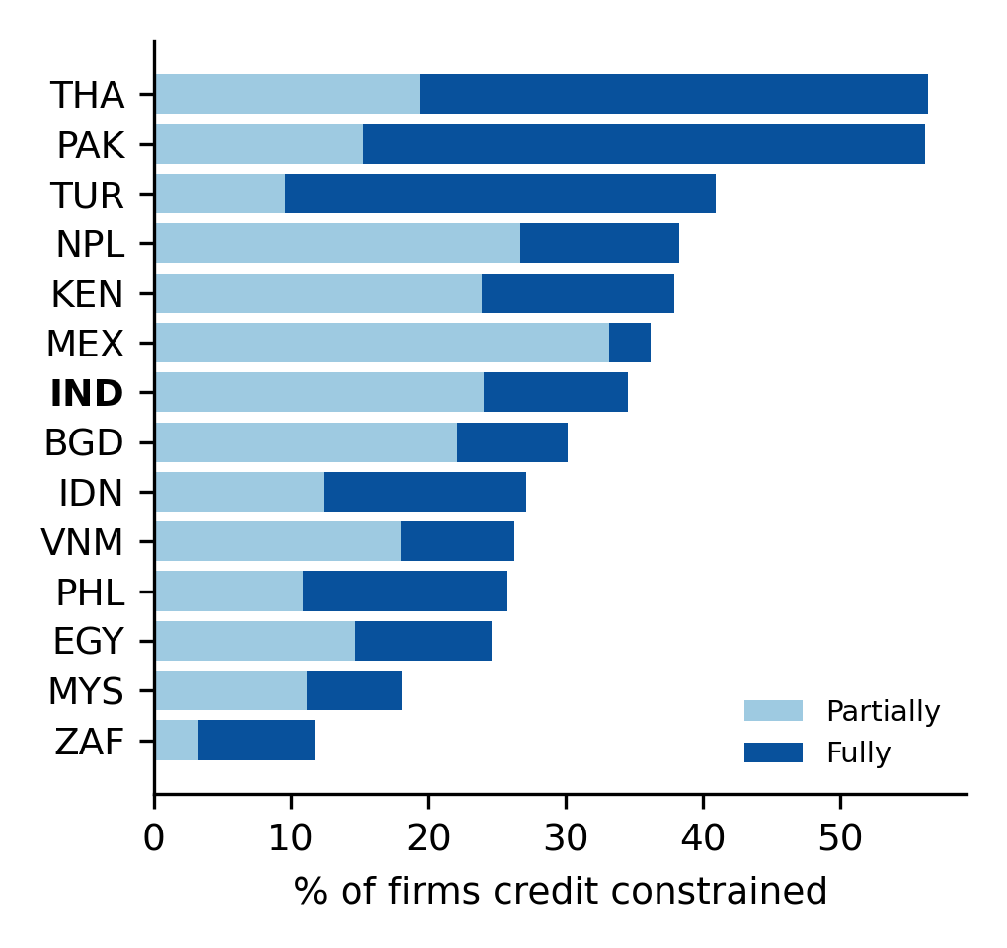
RESULT 1
India in context: 34.5% of firms are credit constrained
34.5%
26.7%
India constrained (2022)
sample median
India 2014 → 2022
Firms using banks for investment: 30% → 56%
Internet users: 13.5% → 55.9%
Adults with an account: 53% → 78% (2021)
Private credit / GDP: 52% → 38%
Digital reach up sharply; bank-credit depth down
8
Notes:
India 2022: 10.5% fully, 24.0% partially constrained; sample median 26.7%; 36% of observations are more constrained than India. India 2014->2022: firms using banks to finance investment 30.3% -> 56.1%; internet 13.5% -> 55.9%; account ownership 53.1% (2014) -> 77.5% (2021); private credit/GDP 51.9% -> 38.2%.

Slide 9
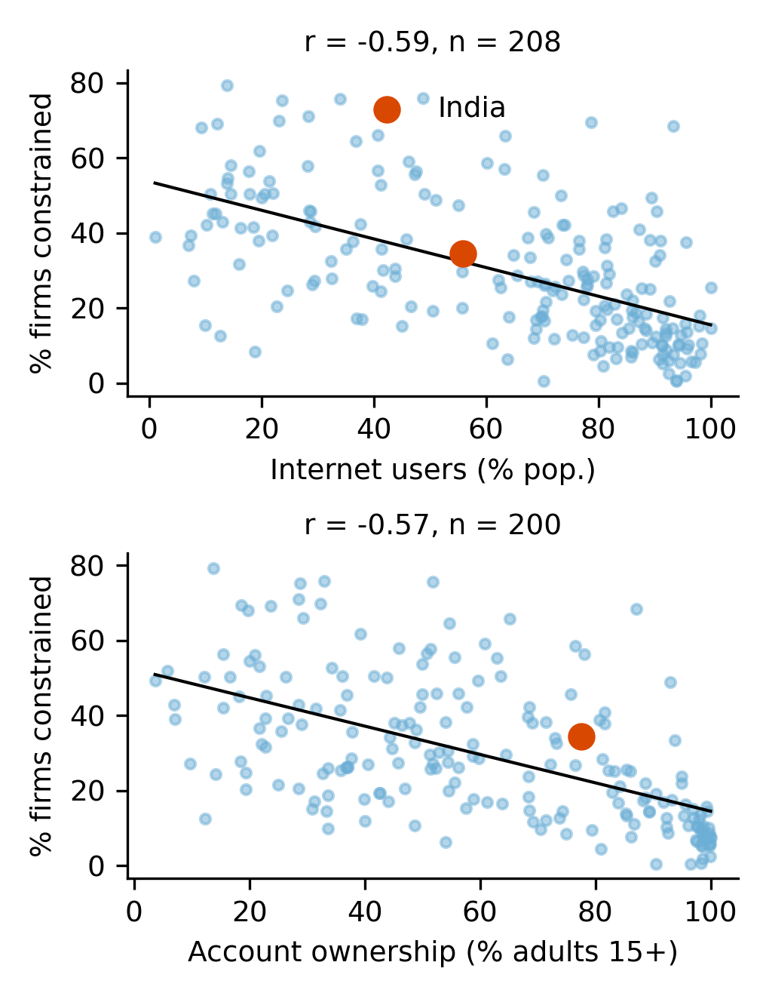
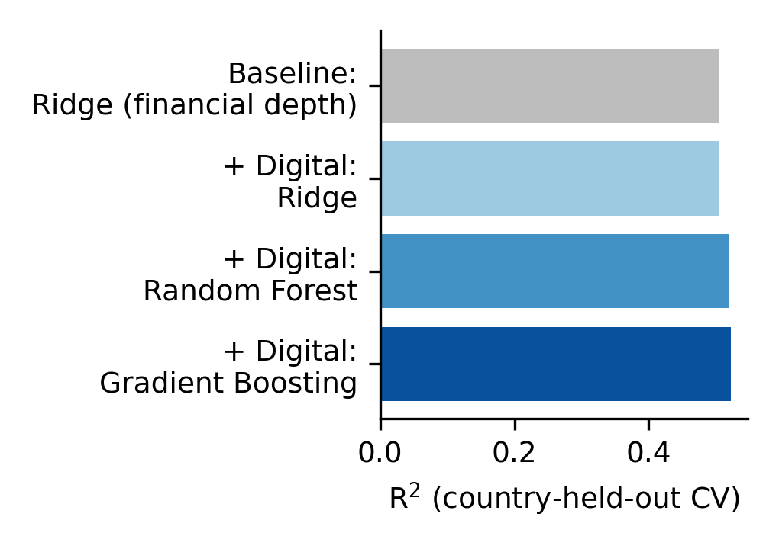
RESULT 2
Digital access tracks lower constraint, but adds little beyond income
r = −0.59
internet use vs % constrained
r = −0.57
account ownership vs % constrained
Do digital features improve prediction?
R² 0.505 → 0.522 and MAE 10.2 → 10.0 pp with digital features + gradient boosting
A modest gain: income per capita already carries most of the signal
Digital reach and income are highly collinear
9
Notes:
Correlations: internet r=-0.59 (n=208); account ownership r=-0.57 (n=200). Country-held-out CV: baseline ridge R2 0.505 / MAE 10.16; +digital ridge 0.506 / 10.30; RF 0.520 / 9.88; GB 0.522 / 9.99.

Slide 10
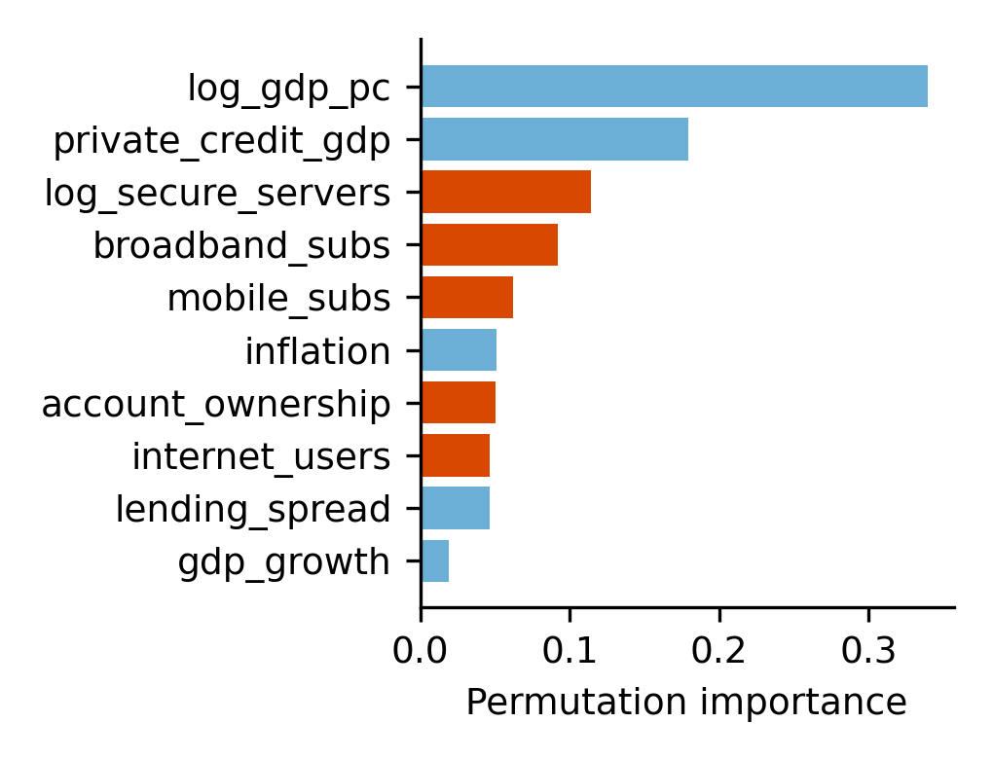
RESULT 3
What drives constraint, and what it implies for India
India, predicted out of sample (actual 34.5%)
38.8%
31.8%
27.3%
baseline
digital model
digital at top quartile
Reading this carefully
Digital model fits India better than the baseline
Lifting India's digital indicators to the top quartile: −4.5 pp
A benchmark of headroom, not a causal effect
India has a single outcome observation (2022)
Income dominates (0.34); private credit next (0.18).
Digital features matter jointly (orange).
10
Notes:
Permutation importance (GB): log GDP/capita 0.34, private credit/GDP 0.18, secure servers 0.11, broadband 0.09, mobile 0.06, account ownership 0.05, internet 0.05. India held out of training: baseline 38.8%, digital model 31.8%, counterfactual 27.3% (-4.5 pp). Associational, not causal.

Slide 11
WRAP-UP
Implications, limits and takeaways
Implications
Limitations
Next steps
Policy: bank–FinTech data sharing; watch falling credit depth
Managers: digitise accounts and payments to become visible
Lenders: don't exclude thin digital footprints
Country aggregates, n = 215: associational
One India outcome observation
Population-level digital indicators
Findex carried forward
India Enterprise Survey microdata
State-level UPI and credit data
Quasi-experimental designs
Key takeaways
34.5% of Indian firms are credit constrained (2022), above the sample median of 26.7%
Digital access adds modest predictive power beyond financial depth (R² 0.505 → 0.522)
A digital counterfactual points to several points of headroom, as an association not a causal claim
11
Notes:
Policy: bank-FinTech data sharing; avoid excluding thin-footprint firms. Managers: digitise accounts and payments. Limits: country-level aggregates (n=215), one India outcome observation, population-level digital indicators, Findex carried forward. Next: India Enterprise Survey microdata, state-level UPI/credit data, quasi-experimental designs.

