Slide 1
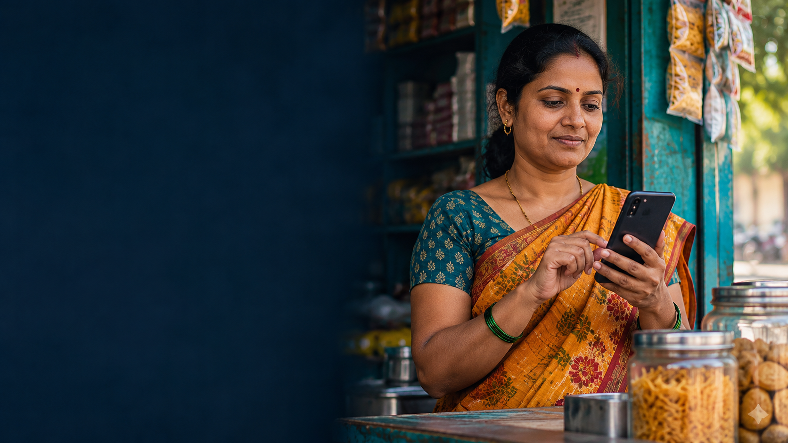
Mobile Banking,
Financial Inclusion
and Cybersecurity Risk
Evidence from India’s Global Findex survey
Rushal Verma
Vichanshu Raj
Sudhanshu
Notes:
Source: World Bank Global Findex 2025 India microdata (2024), https://doi.org/10.48529/c9vy-pq51. Estimates calculated using wgt; sample sizes unweighted. Cover image is AI-generated, conceptual and not a survey respondent.

Slide 2
INTRODUCTION
Why safe digital finance matters
89.0%
Access
Digital use
Adults with an account
Accounts can support saving, receiving money and payments.
Phone access and skills shape whether accounts are used digitally.
48.5%
Safety
Research question
Made or received a digital payment
Scam calls and misleading requests may undermine trust.
How are digital payment use and reported money requests related?
2024 weighted estimates among adults aged 15+, n = 3,000.
An account is a starting point; usable and trusted services matter too.
2
Notes:
Source: World Bank Global Findex 2025 India microdata (2024), https://doi.org/10.48529/c9vy-pq51. Estimates calculated using wgt; sample sizes unweighted.

Slide 3
CONCEPTS
From access to safe and confident use
1 Account
2 Connectivity
3 Digital use
4 Safety
Access to a formal financial account.
Phone ownership, internet access and skills.
Making or receiving digital payments.
Device security, fraud prevention and redress.
Why trust matters
Our distinction
World Bank guidance identifies awareness, safeguards and dispute resolution as contributors to confidence in digital services.
A phone lock protects access to a device. It does not necessarily prevent a user from authorizing a deceptive payment.
These mechanisms inform our interpretation; the survey cannot establish causality.
3
Notes:
Source: World Bank Global Findex 2025 India microdata (2024), https://doi.org/10.48529/c9vy-pq51. Estimates calculated using wgt; sample sizes unweighted. World Bank: https://digitalfinance.worldbank.org/topics/digital-financial-literacy/trust ; https://digitalfinance.worldbank.org/topics/financial-consumer-protection.

Slide 4
RESEARCH DESIGN
India survey: data and method
3,000
2,145
2024
219
adult respondents
phone owners
interview year
reported requests
Measures
Analysis
Account and payment indicators: all adults.
Device lock and request exposure: phone owners.
Sent money: only those reporting a request.
Weighted proportions and group comparisons.
Weighted logistic model adjusts for demographics.
A focused review interprets institutional guidance.
All counts are unweighted; percentages use the survey weight.
The survey is cross-sectional and self-reported; no cause-and-effect claim is made.
4
Notes:
Source: World Bank Global Findex 2025 India microdata (2024), https://doi.org/10.48529/c9vy-pq51. Estimates calculated using wgt; sample sizes unweighted.

Slide 5
FINDING 1
Account ownership exceeds digital use
40.5 percentage points
Account ownership
Digital payment use
Difference between account ownership and digital payment use among all adults.
Interpretation
Access alone does not guarantee digital use. Device access, confidence, affordability and preferences may all play a role.
89.0% of adults
48.5% of adults
Each ring is a separate share of adults. Payment includes making or receiving; n = 3,000.
The figures describe separate indicators; the gap does not identify its cause.
5
Notes:
Source: World Bank Global Findex 2025 India microdata (2024), https://doi.org/10.48529/c9vy-pq51. Estimates calculated using wgt; sample sizes unweighted.

Slide 6
FINDING 2
Digital use and phone locks vary by group
11.5 pp
Gender gap in digital payment use.
12.4 pp
Gender gap in phone locks among phone owners.
Payment: all adults. Lock: phone owners with valid answers. Gaps use unrounded values.
Different denominators require care: these are not the same population in each bar.
6
Notes:
Source: World Bank Global Findex 2025 India microdata (2024), https://doi.org/10.48529/c9vy-pq51. Estimates calculated using wgt; sample sizes unweighted.

Slide 7
FINDING 3
Payment use and reported unsolicited requests
13.1% vs 4.3%
Request rate among phone-owning payment users versus non-users.
Read this carefully
An unknown person asking for money is not necessarily a scam. The difference may reflect other factors and cannot establish causality.
Users n = 1,283; non-users n = 862. Weighted percentages.
The 8.8-point difference is an association, not a measure of fraud losses.
7
Notes:
Source: World Bank Global Findex 2025 India microdata (2024), https://doi.org/10.48529/c9vy-pq51. Estimates calculated using wgt; sample sizes unweighted.

Slide 8
FINDING 4
An adjusted association, with limits
3.45
2.24–5.30
2,145
Adjusted odds ratio for payment users.
Approximate 95% interval.
Phone owners in the model.
Model controls
Uncertainty and interpretation
Gender, age, education, income quintile, workforce participation and rural/urban residence.
Odds ratios are not relative risks. The public file lacks full survey design identifiers, so intervals assume independent observations.
Results remain exploratory: selection and unmeasured differences can affect the association.
8
Notes:
Source: World Bank Global Findex 2025 India microdata (2024), https://doi.org/10.48529/c9vy-pq51. Estimates calculated using wgt; sample sizes unweighted.

Slide 9
QUALITATIVE RESEARCH
What published guidance suggests
1 Trust and adoption
2 Shared responsibility
3 Accessible support
World Bank guidance connects consumer trust with awareness, safeguards and effective dispute resolution.
Provider safeguards and clear redress complement user education. A phone lock alone is not protection against every scam.
Gaps by gender and income suggest testing local-language guidance and low-cost-device access.
Approach: focused interpretation of World Bank and RBI materials; no interviews or focus groups were conducted.
These themes generate hypotheses to test; they are not respondent quotations.
9
Notes:
Source: World Bank Global Findex 2025 India microdata (2024), https://doi.org/10.48529/c9vy-pq51. Estimates calculated using wgt; sample sizes unweighted. Qualitative sources: World Bank https://digitalfinance.worldbank.org/topics/digital-financial-literacy/trust and https://digitalfinance.worldbank.org/topics/financial-consumer-protection ; RBI https://www.rbi.org.in/commonman/Upload/English/Notification/PDFs/256CIRCULARE6521761166042728106B78DFA3D78A1.PDF.

Slide 10
ENTREPRENEURIAL OPPORTUNITY
A safety companion and a practical pilot
Proposed service
Potential customer
Short lessons in local languages, a payment checklist and verified routes to assistance. Never request a PIN or OTP.
A bank, payment provider or merchant network could support distribution. Demand and pricing are untested.
Pilot measures
Business test
Scenario comprehension, help-channel discovery and usability on low-cost devices.
Compare partner revenue with onboarding, content, support and infrastructure costs.
Test user demand and unintended friction before claiming commercial viability.
10
Notes:
Source: World Bank Global Findex 2025 India microdata (2024), https://doi.org/10.48529/c9vy-pq51. Estimates calculated using wgt; sample sizes unweighted.

Slide 11
WRAP-UP
Takeaways, limitations and next steps
Key findings
Limitations
Next steps
89.0% account ownership; 48.5% digital payment use.
Phone-owning users reported more unsolicited requests.
Device-lock use differs across groups.
Self-reported, cross-sectional adult survey.
Requests are not verified fraud losses.
Model uncertainty is not design-based.
Interview and test with users.
Pilot comprehension and reporting.
Seek survey-design information and study verified losses.
The strongest conclusion is a need to study safe digital use, not proof of a causal effect.
11
Notes:
Source: World Bank Global Findex 2025 India microdata (2024), https://doi.org/10.48529/c9vy-pq51. Estimates calculated using wgt; sample sizes unweighted.

