Slide 1
RiskPulse AI
Explainable financial risk intelligence
and portfolio scenario analysis
Trace an event to the positions that carry exposure
Local FinBERT / Multi-source fusion / Financial transmission paths
RiskPulse AI V2 / Synthetic data and stress assumptions / Decision-support prototype
01
Notes:
Individual hackathon prototype. Candidate name, college and college email remain to be completed in README. No real client or current market data is used in the demo.

Slide 2
The Problem
Headlines arrive without balance-sheet context
Repeated reports can inflate apparent event activity.
Sentiment alone does not identify exposed positions.
A loss total is difficult to challenge without its assumptions.
The analyst needs an auditable path from evidence
to exposure, scenario loss and the largest contributors.
RiskPulse AI V2 / Synthetic data and stress assumptions / Decision-support prototype
02
Notes:
Problem and scope derive from the supplied case study. Domain benefits describe a workflow, not measured business savings or production banking deployment.

Slide 3
From Signals to Portfolio Risk
SIGNAL
→
INTELLIGENCE
→
EXPOSURE
→
STRESS
→
IMPACT
Evidence first
Portfolio reasoning
24 observations form 12 event clusters.
Normalized copies add no corroboration.
Source credibility and recency affect priority.
Severity stays separate from confidence.
One transmission path per position.
Conditional repricing from actual assets.
Sector and position totals reconcile.
Counterfactual inputs are explicit.
Hero: 2 sources, 1 distinct text, Critical effective risk 8.36 / 10
RiskPulse AI V2 / Synthetic data and stress assumptions / Decision-support prototype
03
Notes:
Source: data/news.csv, social_posts.csv, portfolio.csv and docs/demo-results-v2.json. Distinct wording does not prove independent reporting. Effective risk is raw impact × recency × evidence confidence.

Slide 4
Risk Propagation Architecture
News + social
→
Ingestion
→
Normalization
↓
Entity extraction
→
FinBERT sentiment
→
Event classification
→
Credibility + recency
↓
Signal fusion
→
Risk signal
→
Propagation graph
→
Sector / portfolio exposure
↓
Stress engine
→
Loss attribution
→
Dashboard
Next.js interface ↔ FastAPI services ↔ SQLite evidence and arrival history
RiskPulse AI V2 / Synthetic data and stress assumptions / Decision-support prototype
04
Notes:
The rows follow pipeline order. Entity extraction uses portfolio dictionaries. Event classification and fusion use TF-IDF plus constraints/rules. Source and recency assumptions are deterministic. The original V1 finance service handles repricing. SQLite persists seven tables including RiskHistory. Demo execution is local and offline.

Slide 5
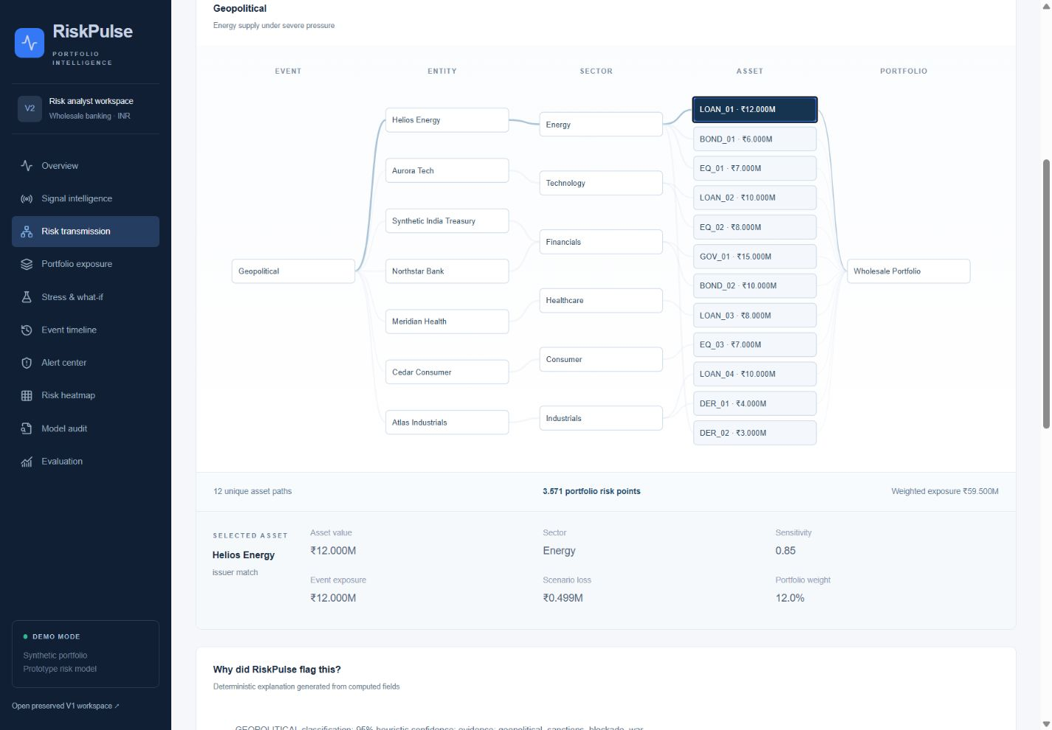
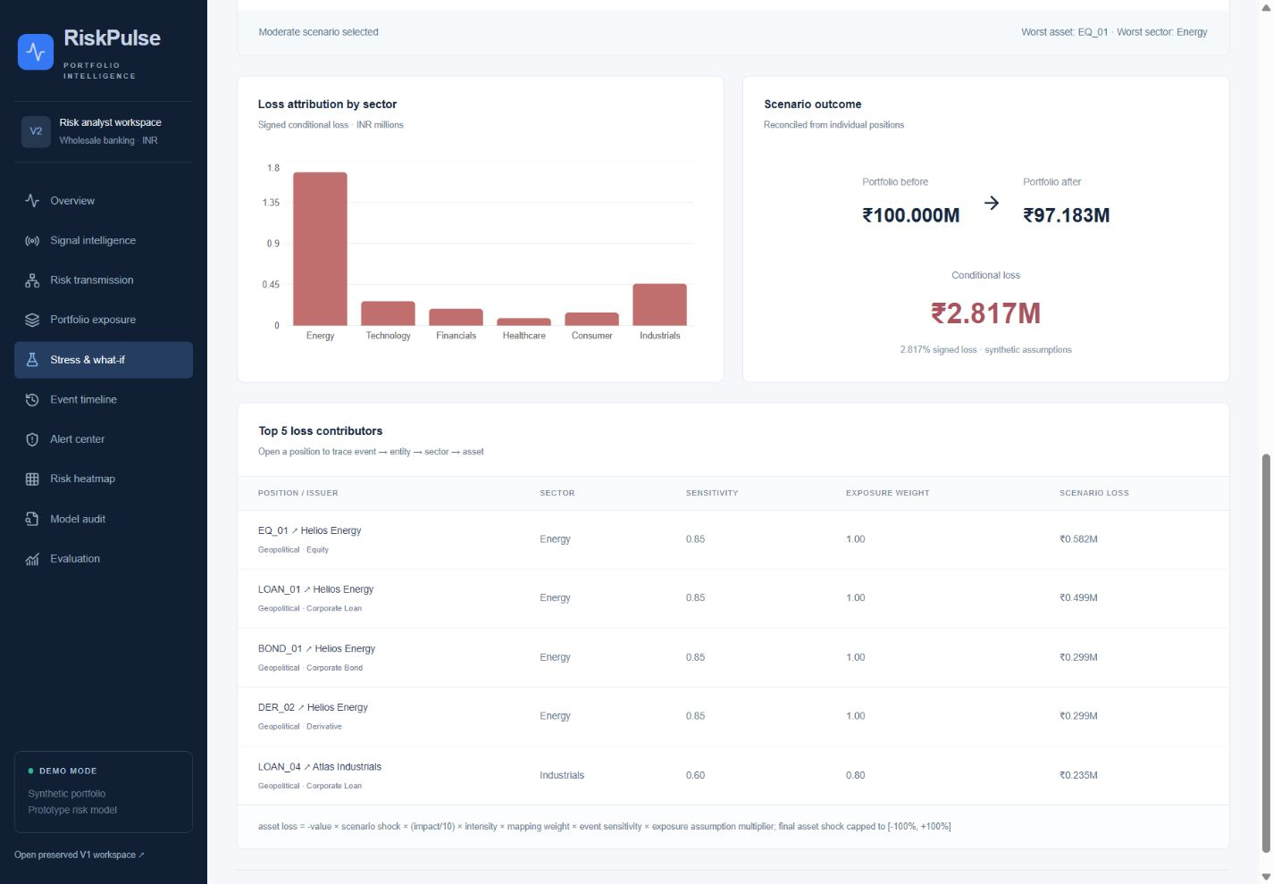
Live Event → Exposure → Stress Test
Event → Risk signal → Propagation → Exposure → Stress → Attribution
12 asset paths / INR 59.5M weighted exposure
INR 100M → 97.183M / Loss INR 2.817M
Actual production application screenshots. Intensity 1.5× gives INR 4.226M loss.
RiskPulse AI V2 / Synthetic data and stress assumptions / Decision-support prototype
05
Notes:
Source: actual localhost production application screenshots and docs/demo-results-v2.json. Geopolitical news and its copied social post form cluster_4eddb6faefff. Direct exposure is INR 42M and weighted exposure INR 59.5M. Moderate loss INR 2,817,031.20 reconciles to assets and sectors. Hero values require cached FinBERT. The map screenshot highlights LOAN_01, value INR 12M and sensitivity .85.

Slide 6
Results + Explainability + Domain Impact
Measured on the local prototype
Traceable financial results
59 automated tests pass (V1: 25)
24 synthetic records / 12 paired copies
Event-label agreement: 100%
Sentiment agreement: 91.67%
CPU median sentiment inference
Sequential: 24.833 ms per record
Batched: 20.713 ms per record
Energy loss: INR 1.679M
Largest asset: EQ_01, INR .582M
Inputs, evidence and edge weights
remain available in the audit view.
Analysts can challenge assumptions
and compare conditional outcomes.
Small correlated synthetic evaluation. Agreement does not establish real-world accuracy.
RiskPulse AI V2 / Synthetic data and stress assumptions / Decision-support prototype
06
Notes:
{"environment":"Windows-11-10.0.26300-SP0","python":"3.14.6","model":"finbert","device":"CPU","rounds":3,"batch_size":8,"sequential_ms_per_record":[24.832858332956675,24.531887499809574,25.297008333533693],"batched_ms_per_record":[21.29492916719755,20.712937500017386,20.370529166636214],"sequential_median_ms":24.832858332956675,"batched_median_ms":20.712937500017386,"warm_cache_ms_per_record":0.007341666787397116,"labels_identical":true,"max_score_difference":0} Small synthetic examples share rule vocabulary; no independent validation. Historical V1 timing is not a controlled comparison. Controlled arms alternate order, clear result caches and exclude model loading; batching may be slower on this CPU. Current pipeline includes batched NLP/entity/impact, excludes SQLite, HTTP and V2 fusion. Stress timing excludes SQLite; V1 stress timing included a scenario read. Fusion/graph total reported separately. Source: docs/metrics-v2.json and backend/tests. Three alternating-order rounds, batch size eight, CPU, result caches cleared. Both arms produced identical rounded sentiment scores and labels. No measured bank productivity improvement is claimed.

Slide 7
Limitations + Future Work
Current limits
Validation path
Small correlated synthetic dataset
Dictionary entities and lexical similarity
Heuristic confidence and source weights
Illustrative shocks and sensitivities
Simplified instrument repricing
Single-process local application
Independent labels and time-based tests
Verified source provenance
Calibrated confidence and market shocks
Hedging and instrument-specific pricing
Bank risk-team review and backtests
Operational security and monitoring
Decision support prototype. No market prediction or regulatory-compliance claim.
RiskPulse AI V2 / Synthetic data and stress assumptions / Decision-support prototype
07
Notes:
NewsAPI is optional. Missing API keys or API failures trigger a visible demo fallback. Social sources remain synthetic. Without cached FinBERT, a labelled lexicon fallback runs and numerical results differ. Deployment, independent validation, credentials and recording upload are outside current completed artifacts.

