Slide 1

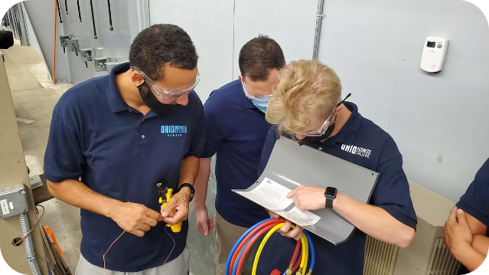


Introduction to Vocational Training
Vocational training prepares students for careers in specific skilled trades, technologies, or services. It focuses on practical, hands-on learning to develop expertise in a particular field, empowering students to thrive in in-demand professions.
by sushant sahu

Slide 2


Benefits of Vocational Training
1
Job-Ready Skills
2
Accelerated Careers
Vocational programs teach practical, industry-relevant skills that employers need, making graduates highly employable.
Vocational training is often faster and more affordable than a traditional four-year degree, allowing students to enter the workforce sooner.
3
Increased Earning Potential
Many vocational careers offer competitive salaries and opportunities for advancement, providing a strong return on investment.

Slide 3
In-Demand Vocational Careers
Healthcare
Skilled Trades
Information Technology
Medical assistants, dental hygienists, pharmacy technicians, and nursing aides are just a few of the high-growth careers in the healthcare field.
Electricians, plumbers, HVAC technicians, and construction workers are in high demand as infrastructure and housing needs continue to rise.
Computer support specialists, web developers, and network administrators are crucial to modern businesses and the digital economy.

Slide 4

Vocational Training Pathways
Associate's Degrees
Certificate Programs
Two-year degree programs that combine general education with advanced technical instruction in areas like nursing, computer programming, or automotive technology.
Short-term, focused programs that provide specific job-ready skills in fields like cosmetology, culinary arts, or truck driving.
1
2
3
Diplomas
One- or two-year programs that offer more comprehensive training for careers like medical billing, paralegal work, or HVAC installation.

Slide 5





Hands-On Learning Experiences
Internships
Apprenticeships
Simulations
Hands-On Labs
Gain real-world experience and make valuable industry connections.
Learn a skilled trade through a combination of classroom instruction and on-the-job training.
Practice job-specific skills in a controlled, safe environment.
Develop technical proficiency through practical, supervised exercises.

Slide 6

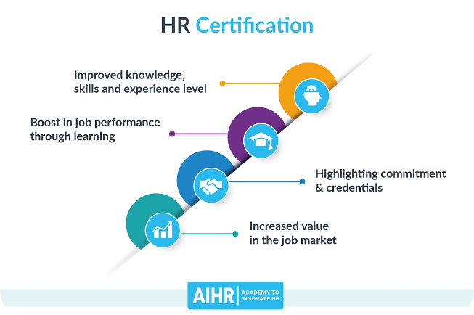
Certifications and Licensing
Industry Certifications
Licenses
Earn credentials that validate your skills and expertise, often required for certain vocational careers.
Many vocational fields, such as cosmetology, HVAC, and commercial driving, require state-issued licenses to practice legally.
Continuing Education
Transferable Credits
Vocational training often includes opportunities for ongoing professional development and skill upgrades.
Credits earned in some vocational programs may be transferable towards a related associate's or bachelor's degree.

Slide 7




Vocational Training Costs and Financing
Tuition and Fees
Financial Aid
Return on Investment
Vocational programs are generally more affordable than four-year universities, with costs ranging from a few thousand to tens of thousands of dollars.
Students may qualify for scholarships, grants, loans, and other forms of financial assistance to help cover the cost of vocational training.
The accelerated timeline and direct career path of vocational training often leads to a strong return on investment through higher earnings.

Slide 8


Transitioning from Vocational Training to the Workforce
Resume Building
Highlight your specialized skills and hands-on experience gained through vocational training.
Networking
Tap into industry connections made during internships, apprenticeships, and other vocational program activities.
Job Search
Utilize career placement services and job search resources provided by your vocational school.
Continuing Education
Consider further education, such as an associate's or bachelor's degree, to expand your career opportunities.

