Slide 1
Segmentation and Paging in Memory Management
Concepts ,Diagrams , and Address Translation
Presented by:
Gayatri Sahu

Slide 2
Introduction to Memory Management
Purpose: Efficient allocation of memory in multitasking environments
Techniques: Segmentation and PagingKey
goals: Isolation, protection, logical to physical mapping

Slide 3
What is Segmentation?
Memory divided into variable-sized segments (code, data, stack)Each segment has a base and limit
Logical address = (segment number, offset)
Segment table stores base and limit for each segment

Slide 4
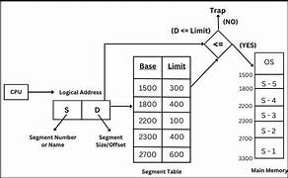
Segmentation Diagram

Slide 5
Segmentation Diagram(contd..)
Logical Address: (Segment: 2, Offset: 300)
Segment Table:
Segment 0: Base 1000, Limit 500
Segment 1: Base 1500, Limit 600
Segment 2: Base 3000, Limit 400
Translation: Physical Address = Base + Offset = 3000 + 300 = 3300

Slide 6
What is paging?
Memory divided into fixed-size pages and frames
Logical address = (Page number, Offset)
Page Table maps pages to frames
Eliminates external fragmentation

Slide 7
Paging Diagram
Page Table:
Page 0 → Frame 5
Page 1 → Frame 9
Page 2 → Frame 3
Logical Address: (Page 1, Offset 100)
Frame Size = 512 bytes
Physical Address = (Frame × Frame Size) + Offset = (9 × 512) + 100 = 4812

Slide 8
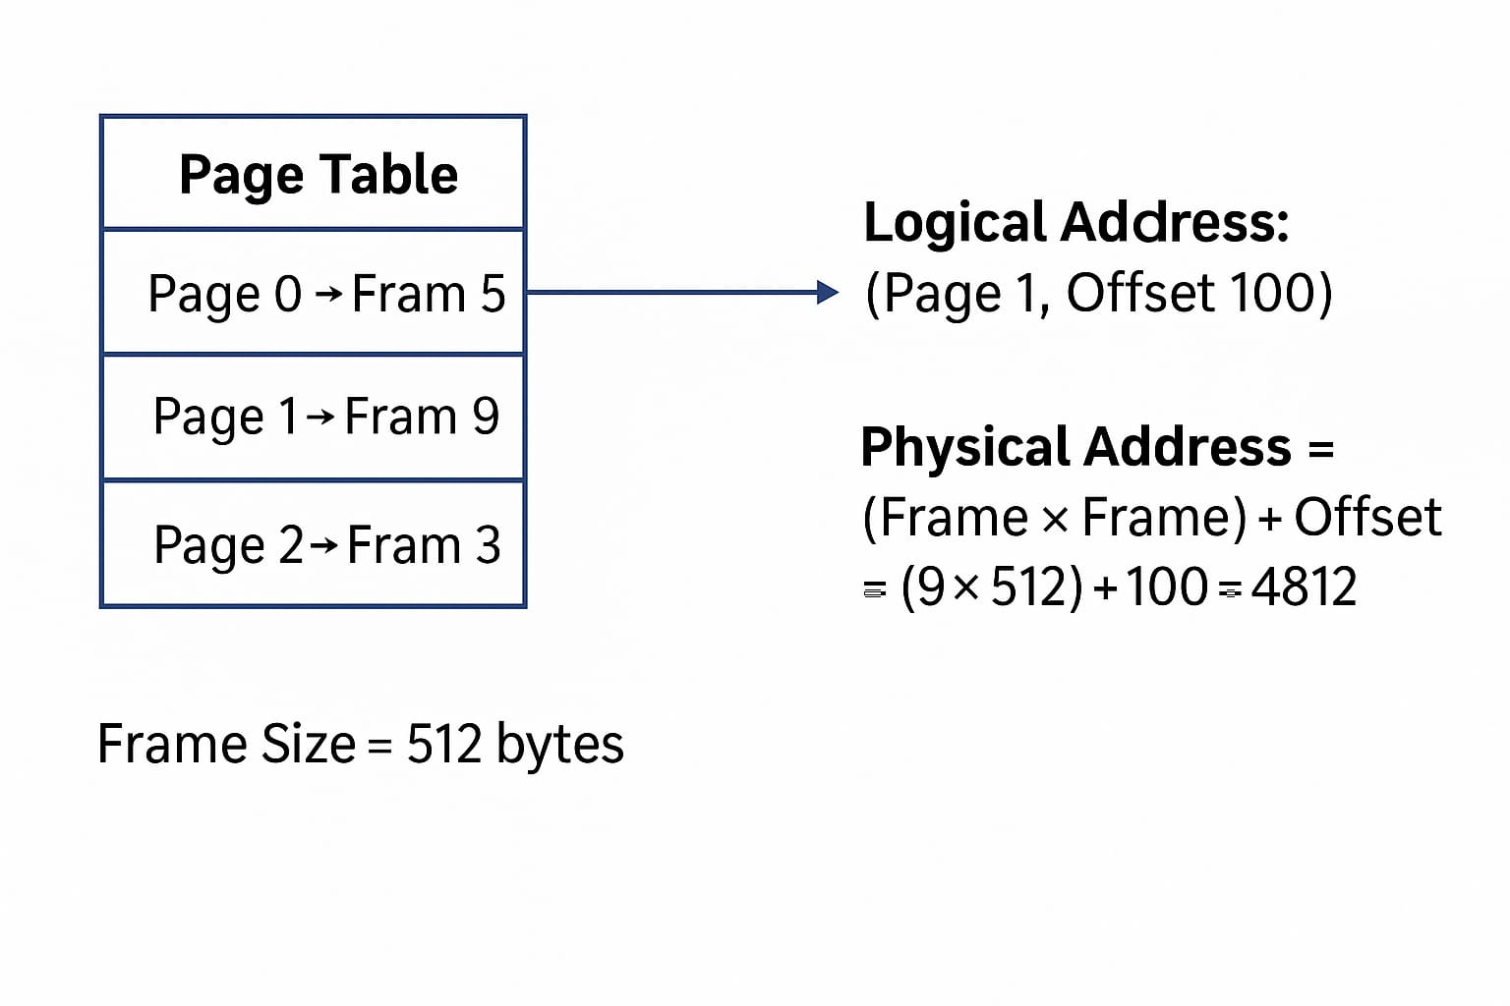
Paging Diagram(contd..)

Slide 9
Address Translation
Segmentation Example:
Segment 1: Base = 2000, Offset = 150 → Physical Address = 2150
Paging Example:
Page 2 → Frame 4, Offset = 100 → Physical Address = 4×512 + 100 = 2148

Slide 10
Conclusion
Both help manage memory efficiently and safely
Segmentation = logical view; Paging = physical efficiency
Some systems use segmented paging for hybrid benefits

