Slide 1

Seasonal Agriculture Performance Analysis
Sahu Krishna Chaitanya
Kakinada Institute of Technology Sciences
AICTE STU ID : STU6789e10bbe4db1737089291

Slide 2

PROBLEM STATEMENT
Agricultural activities are influenced by seasonal changes in environmental conditions, farming practices, resource availability, and market conditions. As a result, agricultural performance may differ from one season to another. However, raw agricultural data does not clearly explain how performance changes across seasons or what patterns can be seen under different seasonal conditions. The problem is to analyze the given agricultural dataset and study seasonal differences in agricultural performance by identifying meaningful patterns, trends, relationships, and variations in the available data.

Slide 3
PROJECT DESCRIPTION
Analyzed a dataset containing 4,000 agricultural records and 28 columns.
Dataset includes crop, season, weather, soil, fertilizer, irrigation, yield, production, cost, revenue, profit, water usage, and pest-risk information.
Performed data cleaning, statistical analysis, EDA, correlation analysis, and seasonal comparison.
Created additional metrics such as:
ROI %
Cost per Ton
Water-Cost Ratio
Used visualizations to identify important agricultural and financial patterns.

Slide 4

WHO ARE THE END USERS?
Farmers
Agricultural planners
Irrigation and water-management teams
Agricultural organizations
Farm/business managers
Sustainability and resource-management teams

Slide 5

Technology Used
Python – Data analysis and processing
Pandas – Data cleaning and manipulation
NumPy – Numerical analysis
Matplotlib – Data visualization
Seaborn – Statistical and advanced visualization
Google Colab – Development and execution environment

Slide 6
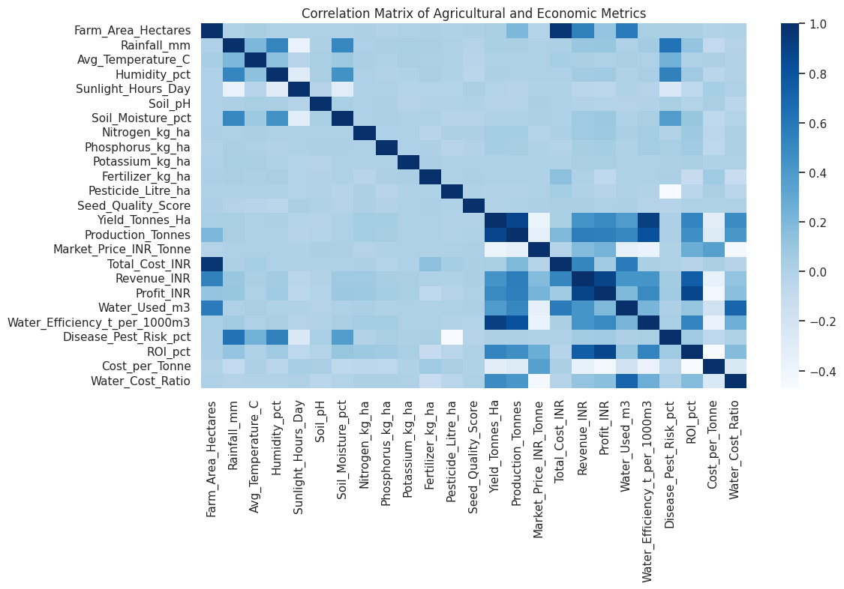
Correlation Matrix Of Agricultural & Economic Metrics
This heatmap shows how the 24 numeric variables are related to each other. Revenue, Cost, and Profit have a strong relationship because Profit is calculated from Revenue and Cost. Water Used and Water Efficiency are also strongly related to Yield and Production. Disease/Pest Risk has a weak relationship with most economic measures. This chart helps us identify which variables are useful for further analysis. It shows relationships, not cause and effect.

Slide 7
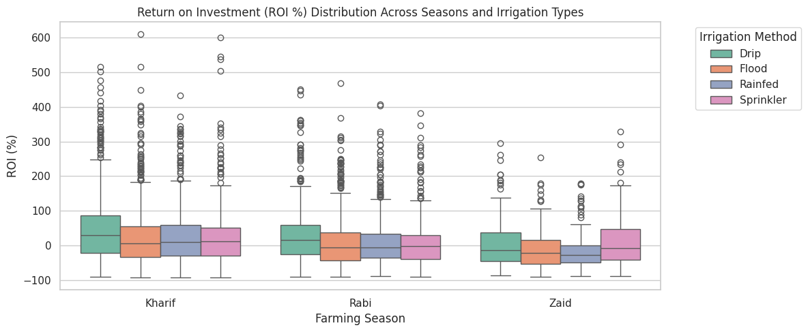
Univariate Distributions: Crop Yield & Disease/Pest Risk
This boxplot compares Return on Investment (ROI) across Kharif, Rabi, and Zaid seasons for different irrigation methods: Drip, Flood, Rainfed, and Sprinkler. Drip irrigation has the highest median ROI in all seasons. Zaid has the lowest overall ROI spread, while all methods show some high outliers. This suggests that drip irrigation may provide better ROI across seasons. However, results can vary from farm to farm, so it is not a guarantee.

Slide 8
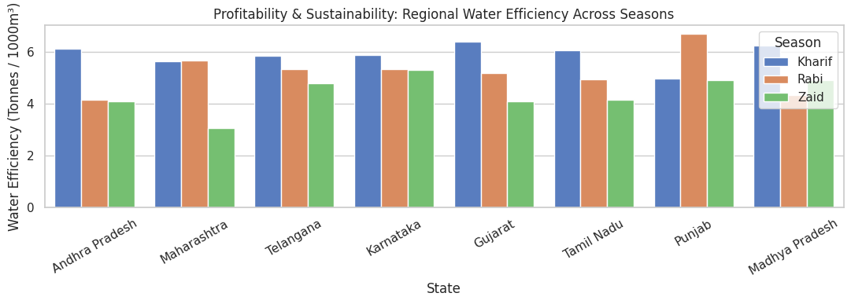
Regional Water Efficiency Across Seasons
This bar chart shows how many tons are produced using 1000m³ of water in different states and seasons. Some states, such as Punjab in Rabi and Gujarat in Kharif, have better water efficiency than others. The best season for water efficiency also differs from state to state. This shows that water efficiency can vary by region. However, the dataset does not explain the exact reasons, which could include soil, irrigation systems, or crop selection.

Slide 9
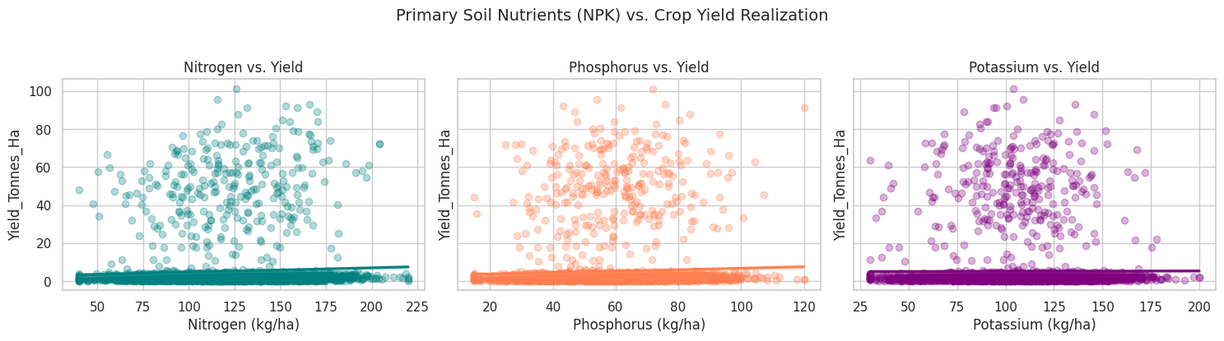
Primary Soil Nutrients (NPK) vs Crop Yield
These three scatterplots show the relationship between Nitrogen, Phosphorus, Potassium, and crop yield. All three
nutrients have a positive but weak relationship with yield. Yield increases only slightly as nutrient levels increase. Most of the yield differences happen at lower nutrient levels, while higher nutrient levels show smaller improvements. This suggests that using more fertilizer beyond a certain point may not increase yield much. Other factors such as weather, soil quality, and disease may have a bigger effect on yield.

Slide 10
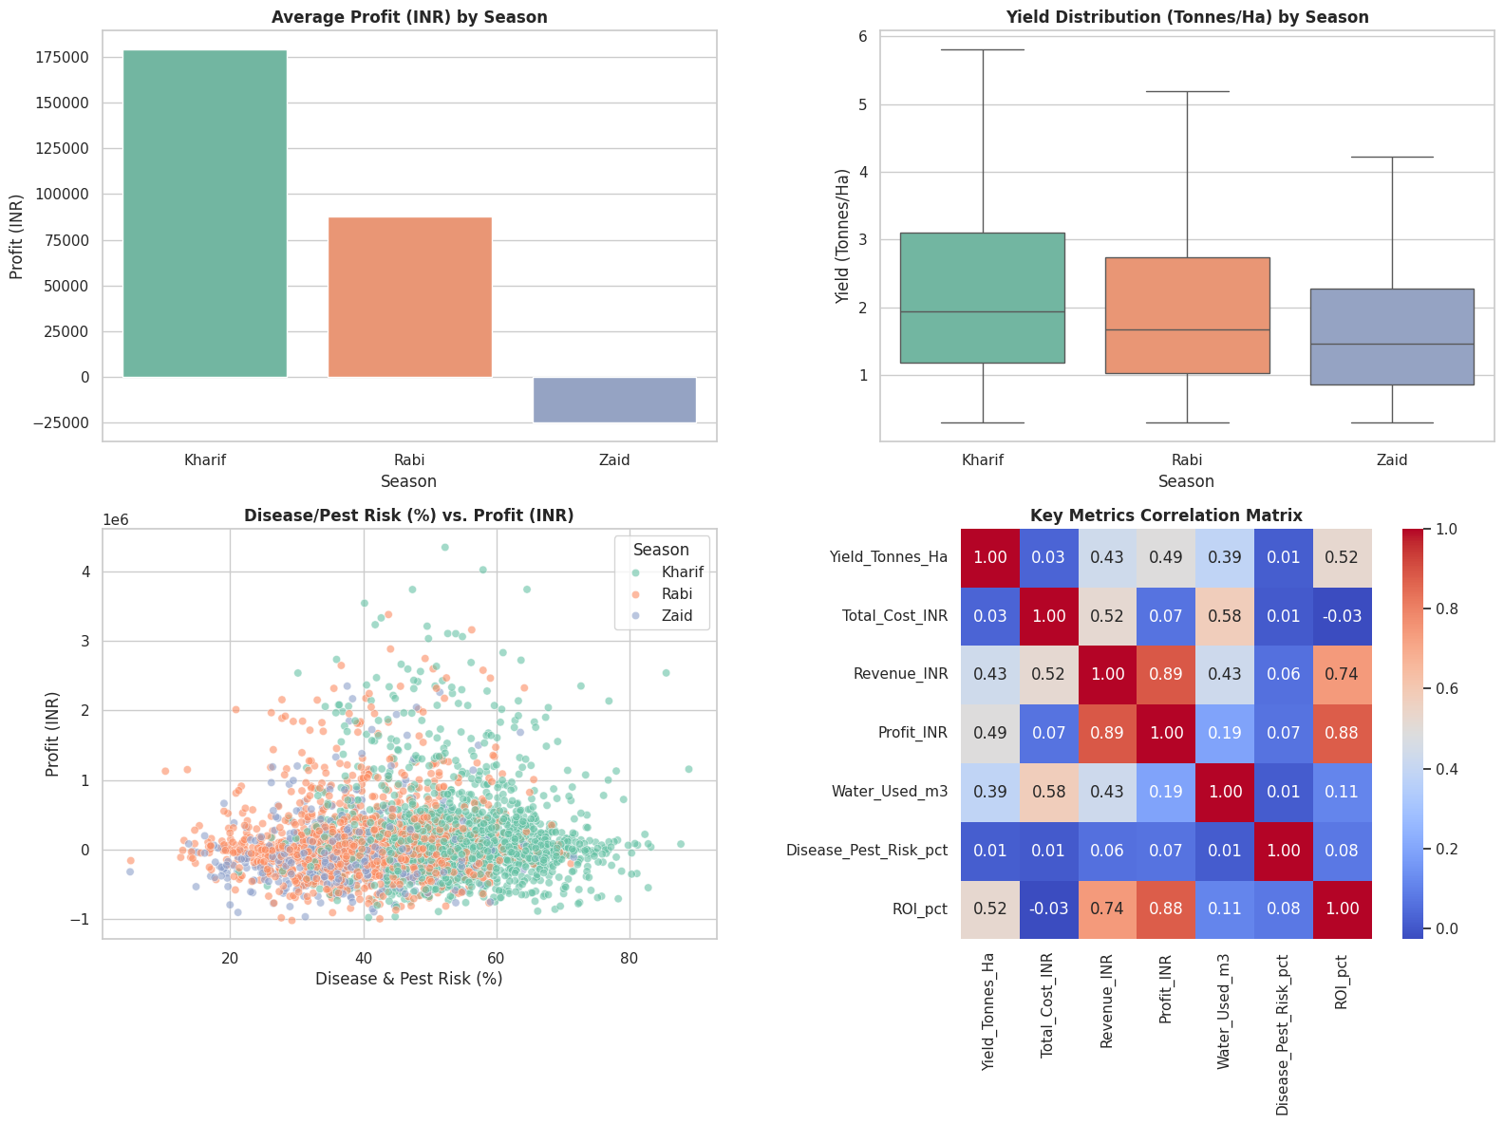
Seasonal Dashboard (Profit, Yield Distribution, Risk vs Profit, and Key Correlations)
This 4-panel dashboard gives a quick view of seasonal performance. Kharif has the highest average profit and the highest median yield, but it also has the widest yield variation and more outliers. Disease/Pest Risk and Profit do not show a clear relationship because the points are spread across different risk levels. The correlation panel shows that Profit is strongly related to Revenue and ROI, but less related to Water Use and Risk. Overall, this dashboard is useful for understanding which season performs best and the factors related to it. However, it shows relationships between variables and does not prove that the season itself causes these differences.

Slide 11
Future scope
Add real-time weather and market-price data.
Develop a seasonal crop recommendation system.
Build predictive models for yield and profit forecasting.
Use historical weather data for better seasonal prediction.
Develop an interactive dashboard using Power BI/Tableau.
Improve irrigation recommendations using water-efficiency analysis.
Develop early-warning models for disease and pest risk.

Slide 12
GitHub Link
Repository contains:
Colab notebook
Dataset
problem statement
Project documentation
https://github.com/sahukrishna-tech/Seasonal-Agriculture-Performance-Analysis

Slide 13

VOIS Course completion certificate Course name - Data Visualization

Slide 14
Thank you
Submitted by: Sahu Krishna Chaitanya

