Slide 1
SauceDemo Automation Capstone Project
Eclipse | Java | Maven | Selenium WebDriver | TestNG | Jenkins | Git | GitHub | JIRA
Name: Sahul Kumar Parida
Batch No: Java Selenium-3
Superset ID: 4644785

Slide 2
Contents
Project Overview
Key Features
Technology Stack
Project Structure
Key Test Scenarios
TestNG, Cucumber & HTML Reports
JIRA
Jenkins

Slide 3
Project Overview
This capstone project demonstrates a robust, scalable automated testing framework designed for the SauceDemo web application.
Objectives
Automate functional testing using Selenium WebDriver and TestNG
Implement BDD approach with Cucumber for better stakeholder collaboration
Ensure code quality through Git version control and collaborative development
Enable continuous testing with Jenkins CI/CD pipeline integration
Provide comprehensive reporting with ExtentReports and screenshot capture
Support cross-browser testing across Chrome and Firefox
Integrate with JIRA for requirement and defect management

Slide 4
Key Features
Feature | Description
Page Object Model | Maintainable and reusable page classes
Cucumber BDD | Gherkin-based feature files for better readability
Detailed Reporting | ExtentReports with graphical HTML output
Cross-Browser Support | Chrome and Firefox compatibility
Parallel Execution | TestNG parallel test execution
CI/CD Ready | Jenkins pipeline integration
JIRA Integration | Bug tracking and requirement management
Feature | Description
Page Object Model | Maintainable and reusable page classes

Slide 5
Technology Stack
Technology | Purpose
Java | Programming Language
Selenium WebDriver | Browser Automation
TestNG | Testing Framework
Cucumber | BDD Framework
Maven | Build & Dependency Management
ExtentReports | Test Reporting
GitHub | Version Control
Jenkins | CI/CD Pipeline

Slide 6
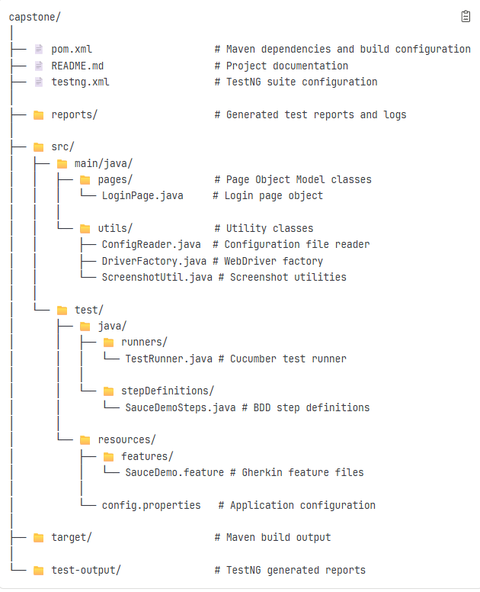
Project Structure

Slide 7
Key Test Scenarios
Scenario | Description
Valid Login | Authenticate with correct credentials (standard_user/secret_sauce) and verify successful dashboard access
Invalid Login | Test error handling with wrong username/password combinations and validate appropriate error messages
Add Item to Cart | Select products from inventory, add to cart, and verify cart counter updates and item persistence
Checkout Flow | Complete end-to-end purchase process from cart review → user info → payment → order confirmation
Logout Functionality | Verify session termination, redirect to login page, and cart data cleanup after logout
Page Verification | Validate page titles, key UI elements, navigation menus, and responsive design across pages
Product Sorting | Test sorting options: A–Z, Z–A, Price (Low to High), and Price (High to Low) on product listings

Slide 8
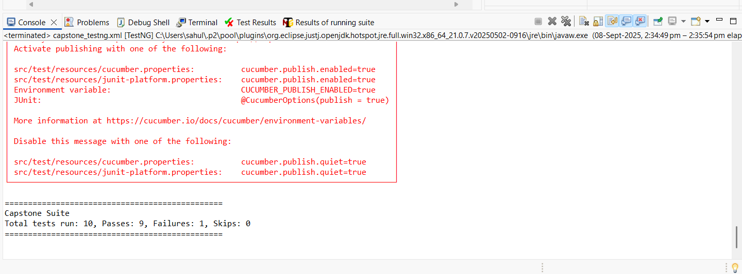
TestNG Output from Eclipse

Slide 9
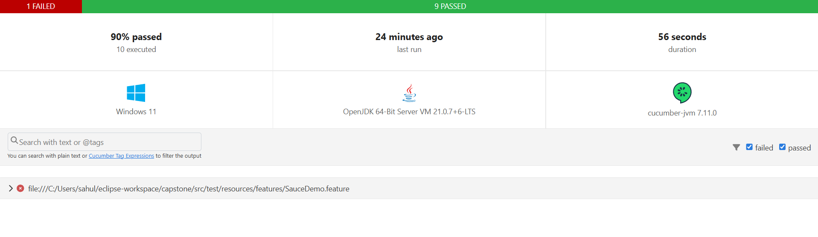
Cucumber HTML Report

Slide 10
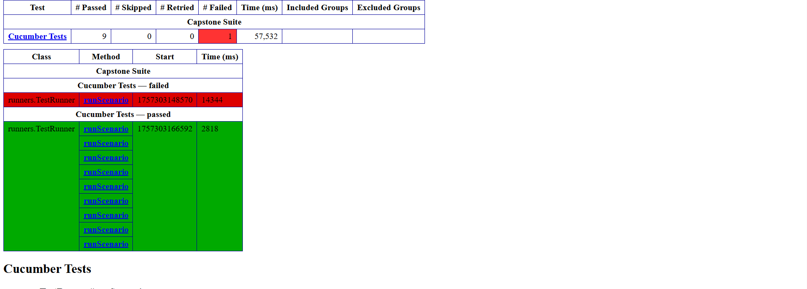
test-output/emailable-report.html Report

Slide 11
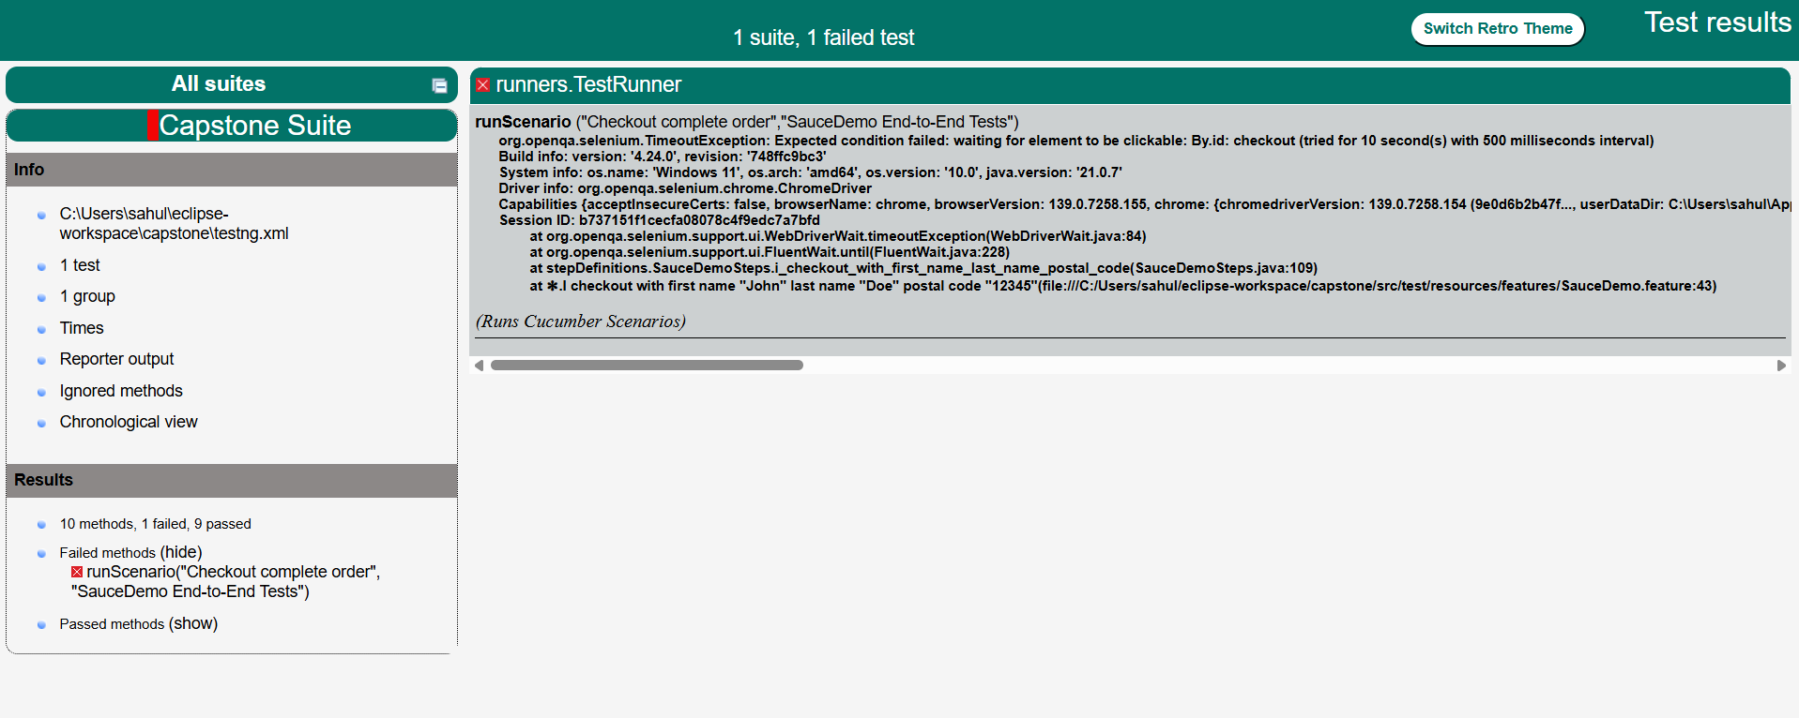
test-output/index.html Report

Slide 12
JIRA
Test Case Management
User Stories: Created for each module with acceptance criteria
Test Cases: Linked to JIRA tasks with traceability
Bug Reports: Automatic creation with screenshots and logs
Requirements: Tracked and managed throughout SDLC

Slide 13
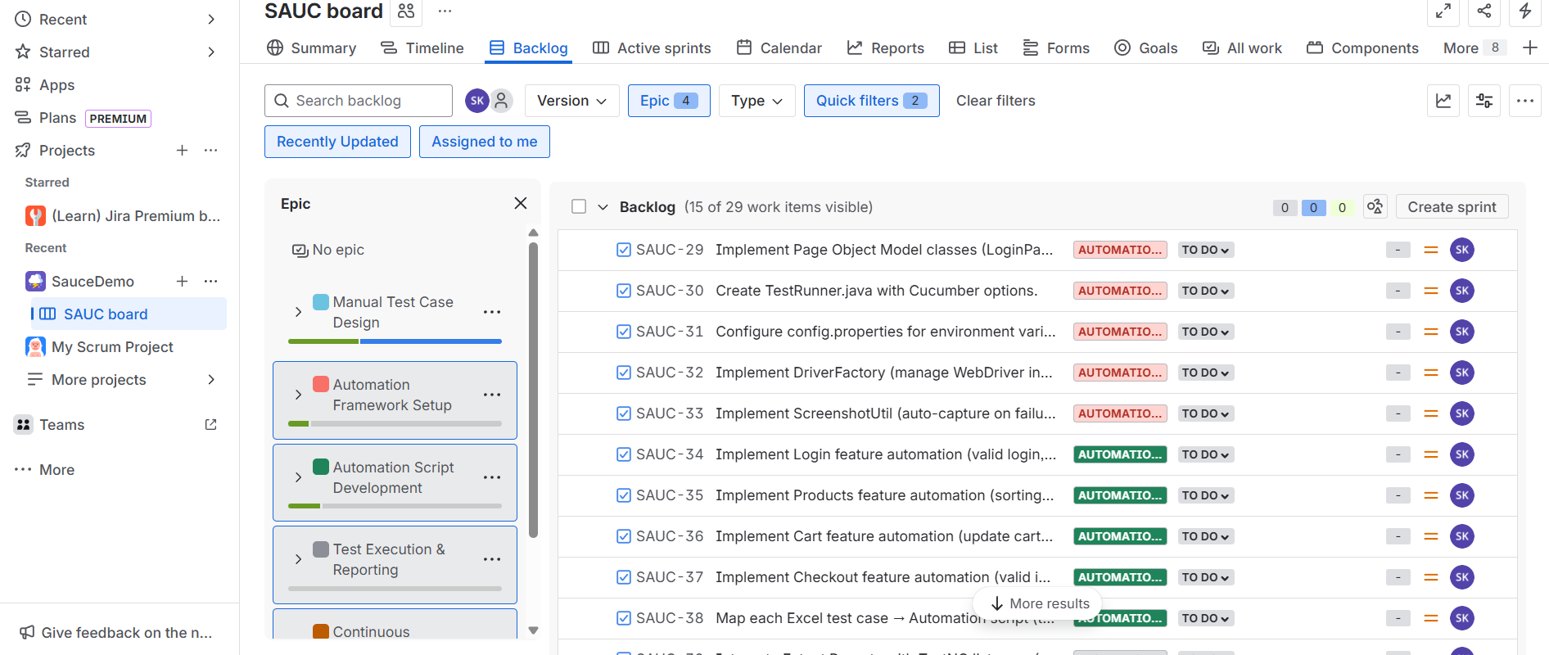
JIRA Backlog Dashboard

Slide 14
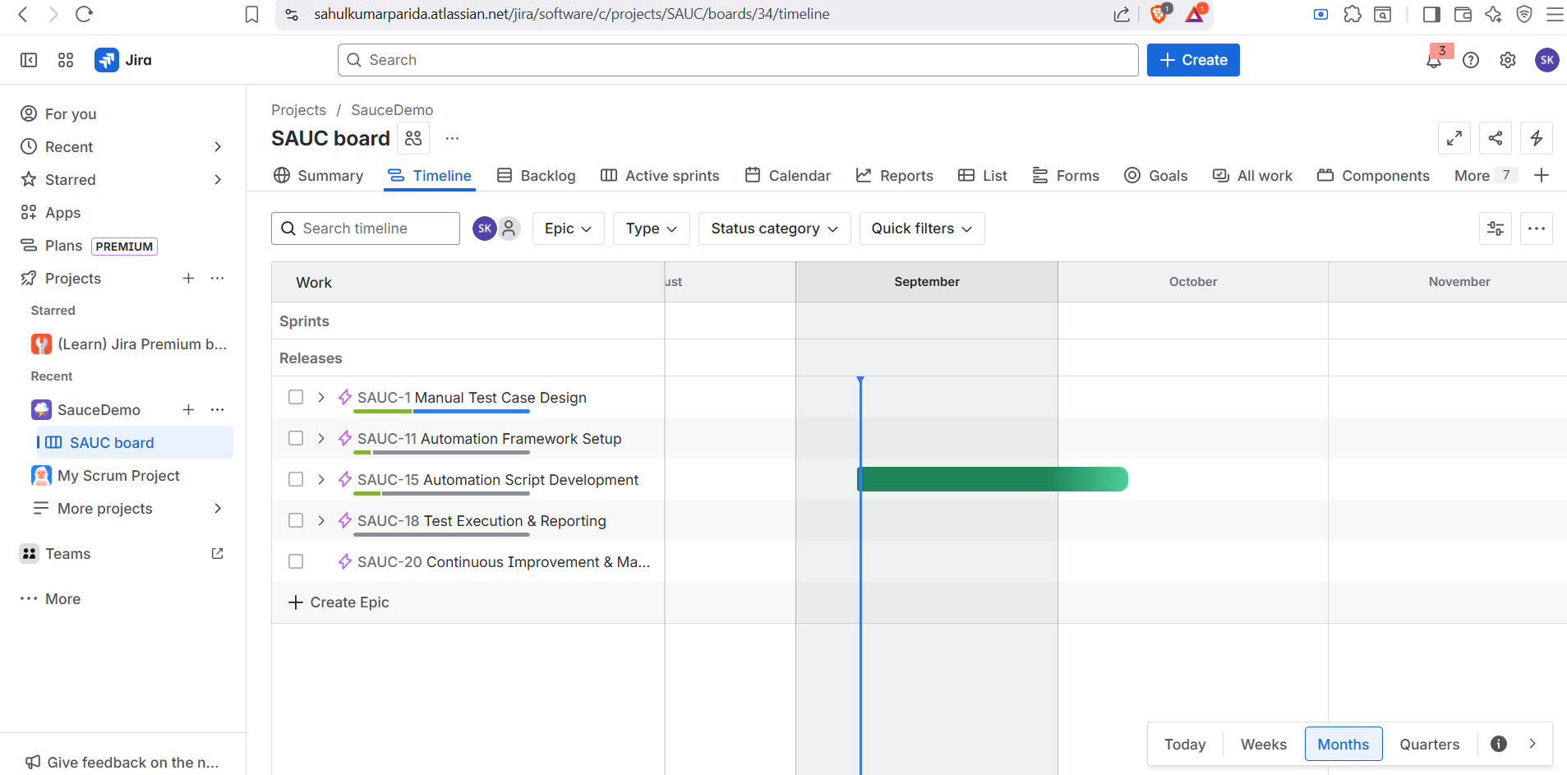
JIRA Timeline Dashboard

Slide 15
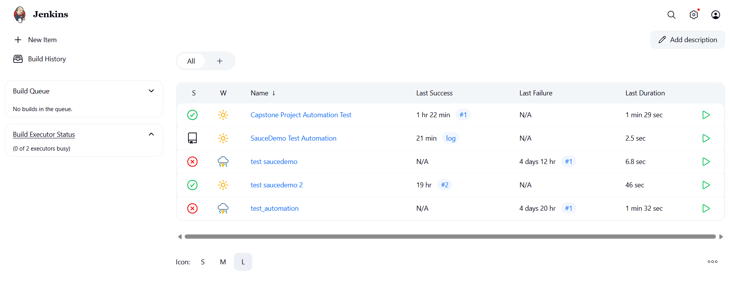
Jenkins Dashboard Output

Slide 16
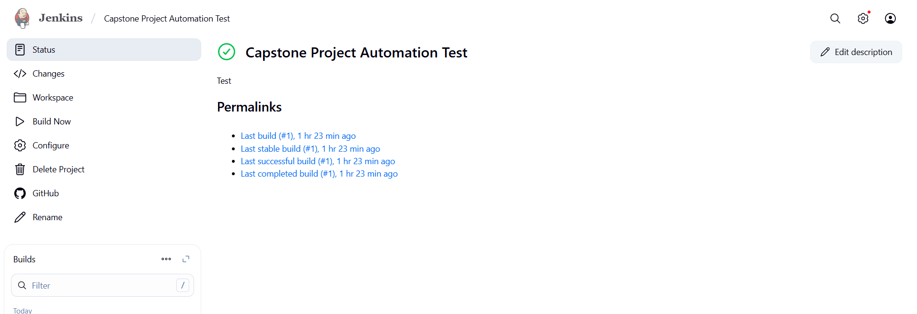
Jenkins Output

Slide 17
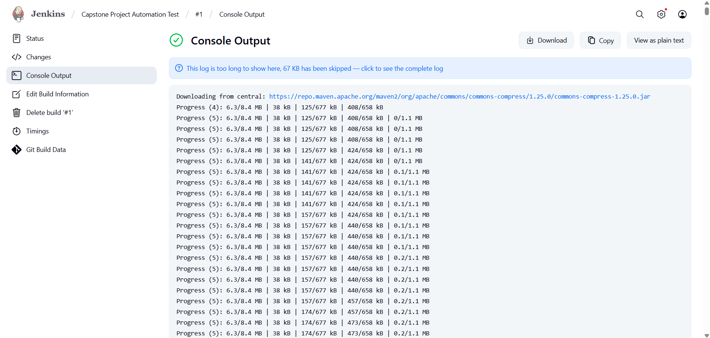
Jenkins Console Output

