Slide 1

KEYS
Keys in DBMS, is an attribute or set of an attribute which helps you to identify a row(tuple) in a relation(table). Keys allows you to find the relation between two tables. Keys help you uniquely identify a row in a table by a combination of one or more columns in that table.
WHY DO WE NEED KEYS?
Keys help you to identify any row of data in a table. In a real-world application, a table could contain thousands of records. Moreover, the records could be duplicated. Keys ensure that you can uniquely identify a table record despite these challenges.
Allows you to establish a relationship between and identify the relation between tables
Help you to enforce identity and integrity in the relationship.

Slide 2

TYPES OF KEYS

Slide 3
PRIMARY KEY
PRIMARY KEY is a column or group of columns in a table that uniquely identify every row in that table. The Primary Key can't be a duplicate meaning the same value can't appear more than once in the table. A table cannot have more than one primary key.
Rules for defining Primary key:
Two rows can't have the same primary key value
It must for every row to have a primary key value.
The primary key field cannot be null.
The value in a primary key column can never be modified or updated if any foreign key refers to that primary key.

Slide 4
Example:
In the following example, <code>StudID</code> is a Primary Key.
StudID | Roll No | First Name | LastName | Email
1 | 11 | Tom | Price | abc@gmail.com
2 | 12 | Nick | Wright | xyz@gmail.com
3 | 13 | Dana | Natan | mno@yahoo.com

Slide 5
FIND OUT SUPER KEY AND CANDIDATE KEYS
Algorithm
Check out for the FD given.
Now combine all elements present on the LHS of FD without repeating element.
This would be the set of super Key.
Now by applying the given FD ,reduce the set of the element.
Repeat step 4 till the set of all elements is not functionally determine by FD.
This would be the candidate key(irreducible set).

Slide 6
SUPER KEY
A superkey is a group of single or multiple keys which identifies rows in a table. A Super key may have additional attributes that are not needed for unique identification.
EmpSSN | EmpNum | Empname
9812345098 | AB05 | Shown
9876512345 | AB06 | Roslyn
199937890 | AB07 | James
In the above-given example, EmpSSN and EmpNum name are superkeys.

Slide 7
CANDIDATE KEY
CANDIDATE KEY is a set of attributes that uniquely identify tuples in a table. Candidate Key is a super key with no repeated attributes. The Primary key should be selected from the candidate keys. Every table must have at least a single candidate key. A table can have multiple candidate keys but only a single primary key.
Properties of Candidate key:
✔ It must contain unique values
✔ Candidate key may have multiple attributes
✔ Must not contain null values
✔ It should contain minimum fields to ensure uniqueness
✔ Uniquely identify each record in a table

Slide 8
Example:
In the given table Stud ID, Roll No, and email are candidate keys which help us to uniquely identify the student record in the table.
StudID | Roll No | First Name | LastName | Email
1 | 11 | Tom | Price | abc@gmail.com
2 | 12 | Nick | Wright | xyz@gmail.com
3 | 13 | Dana | Natan | mno@yahoo.com

Slide 9
Example-For the following
FD {A → BC, CD → E, B → D, E → A}
List the candidate keys for R.
Starting with A → BC, we can conclude: A → B and A → C. Since A → B and B → D, A → D (decomposition, transitive)
Since A → CD and CD → E, A → E (union, decomposition, transitive) Since A → A, we have (reflexive)
A → ABCDE from the above steps (union) Since E → A, E → ABCDE (transitive) Since CD → E, CD → ABCDE (transitive)
Since B → D and BC → CD, BC → ABCDE (augmentative, transitive) Also, C → C, D → D, BD → D, etc.
The candidate keys are therefore A, BC, CD, and E.

Slide 10
SOURCES
Data Base Management System by Navathe
Data Base Management System by C J date
Data Base Management System by Korth
https://www.studytonight.com/dbms/database-key.php
https://www.javatpoint.com/dbms-keys

Slide 11
Functional dependency
Data Base Management System

Slide 12
Functional dependency
Functional Dependency (FD) determines the relation of one attribute to another attribute in a database management system (DBMS) system. Functional dependency helps you to maintain the quality of data in the database. A functional dependency is denoted by an arrow →. The functional dependency of X on Y is represented by X → Y. Functional Dependency plays a vital role to find the difference between good and bad database design.

Slide 13
Example:
Employee number | Employee Name | Salary | City
1 | Dana | 50000 | San Francisco
2 | Francis | 38000 | London
3 | Andrew | 25000 | Tokyo
In this example, if we know the value of Employee number, we can obtain Employee Name, city, salary, etc. By this, we can say that the city, Employee Name, and salary are functionally depended on Employee number.

Slide 14
Key terms
Here, are some key terms for functional dependency:
Key Terms | Description
Axiom | Axioms is a set of inference rules used to infer all the functional dependencies on a relational database.
Decomposition | It is a rule that suggests if you have a table that appears to contain two entities which are determined by the same primary key then you should consider breaking them up into two different tables.
Dependent | It is displayed on the right side of the functional dependency diagram.
Determinant | It is displayed on the left side of the functional dependency Diagram.
Union | It suggests that if two tables are separate, and the PK is the same, you should consider putting them. together

Slide 15
Rules of Functional Dependencies
Below given are the Three most important rules for Functional Dependency:
Reflexive rule –. If X is a set of attributes and Y is_subset_of X, then X holds a value of Y.
Augmentation rule: When x -> y holds, and c is attribute set, then ac -> bc also holds. That is adding attributes which do not change the basic dependencies.
Transitivity rule: This rule is very much similar to the transitive rule in algebra if x -> y holds and y -> z holds, then x -> z also holds. X -> y is called as functionally that determines y.

Slide 16
Types of FD
Multivalued dependency:
Trivial functional dependency:
Non-trivial functional dependency:
Transitive dependency:

Slide 17
Multivalued dependency
Multivalued dependency occurs in the situation where there are multiple independent multivalued attributes in a single table. A multivalued dependency is a complete constraint between two sets of attributes in a relation. It requires that certain tuples be present in a relation.
Example:
In this example, maf_year and color are independent of each other but dependent on car_model. In this example, these two columns are said to be multivalue dependent on car_model.
This dependence can be represented like this:
car_model -> maf_year
car_model-> colour

Slide 18
Car_model | Maf_year | Color
H001 | 2017 | Metallic
H001 | 2017 | Green
H005 | 2018 | Metallic
H005 | 2018 | Blue
H010 | 2015 | Metallic
H033 | 2012 | Gray

Slide 19
Trivial Functional dependency:
The Trivial dependency is a set of attributes which are called a trivial if the set of attributes are included in that attribute.
So, X -> Y is a trivial functional dependency if Y is a subset of X.
For example:
Consider this table with two columns Emp_id and Emp_name.
{Emp_id, Emp_name} -> Emp_id is a trivial functional dependency as Emp_id is a subset of {Emp_id,Emp_name}.
Emp_id | Emp_name
AS555 | Harry
AS811 | George
AS999 | Kevin

Slide 20
NON-Trivial Functional dependency:
Functional dependency which also known as a nontrivial dependency occurs when A->B holds true where B is not a subset of A. In a relationship, if attribute B is not a subset of attribute A, then it is considered as a non-trivial dependency.
Example:
(Company} -> {CEO} (if we know the Company, we knows the CEO name)
But CEO is not a subset of Company, and hence it's non-trivial functional dependency.
Company | CEO | Age
Microsoft | Satya Nadella | 51
Google | Sundar Pichai | 46
Apple | Tim Cook | 57

Slide 21
Transitive dependency:
A transitive is a type of functional dependency which happens when t is indirectly formed by two functional dependencies.
Example:
Company | CEO | Age
Microsoft | Satya Nadella | 51
Google | Sundar Pichai | 46
Alibaba | Jack Ma | 54

Slide 22
{Company} -> {CEO} (if we know the compay, we know its CEO's name)
{CEO } -> {Age} If we know the CEO, we know the Age
Therefore according to the rule of rule of transitive dependency:
{ Company} -> {Age} should hold, that makes sense because if we know the company name, we can know his age.
Note: You need to remember that transitive dependency can only occur in a relation of three or more attributes.

Slide 23
Thank you
?

Slide 24
Normalization
Data Base Management System

Slide 25
Topics covered
Anomalies - Insert, Update and delete anomalies,
Normalization & De-normalization
Normal Form (1st NF and 2 NF)
Conversion from 1st NF to 2NF

Slide 26
Anomalies in DBMS
There are three types of anomalies that occur when the database is not normalized. These are
Insertion
Update and
Deletion anomaly.
Let’s Consider an example.
emp_id | emp_name | emp_address | emp_dept
101 | Rick | Delhi | D001
101 | Rick | Delhi | D002
123 | Maggie | Agra | D890
166 | Glenn | Chennai | D900
166 | Glenn | Chennai | D004

Slide 27
Update anomaly: In the above table we have two rows for employee Rick as he belongs to two departments of the company. If we want to update the address of Rick then we have to update the same in two rows or the data will become inconsistent. If somehow, the correct address gets updated in one department but not in other then as per the database, Rick would be having two different addresses, which is not correct and would lead to inconsistent data.
Insert anomaly: Suppose a new employee joins the company, who is under training and currently not assigned to any department then we would not be able to insert the data into the table if emp_dept field doesn’t allow nulls.
Delete anomaly: Suppose, if at a point of time the company closes the department D890 then deleting the rows that are having emp_dept as D890 would also delete the information of employee Maggie since she is assigned only to this department.

Slide 28
Example 2: Anomalies in DBMS
Idea: In the below table of Student Info, we have tried to store entire data about students.
Result: Entire branch data must be repeated for every student of branch.
S_id | Name | Age | Br_code | Br_name | Hod_Name
1 | A | 18 | 101 | CS | XYZ
2 | B | 19 | 101 | CS | XYZ
3 | C | 18 | 101 | CS | XYZ
4 | D | 21 | 102 | EC | PQR
5 | E | 20 | 102 | EC | PQR
6 | F | 19 | 103 | ME | KLM

Slide 29
Redundancy: When same data is stored multiple time unnecessarily in a database.
Disadvantage: 1. Insertion, deletion and modification anomalies.
2. Inconsistency (data) occurs.
3. Insertion in data base size and increase in time (slow in access).
Insertion Anomalies: When certain data (attributes) cannot be inserted into the database, without the presence of other data. For example: In above table, if no student enrolled for any branch then we can not add branch name.
Deletion Anomalies: If we delete some data (unwanted), it cause deletion of some other data (wanted) due to multiple entries.
Update Anomalies: When we want to update a single piece of data, but it must be done at all of its copies (due to multiple entries)

Slide 30
Normalization
Normalization is a process of organizing the data in database to avoid data redundancy, insertion anomaly, update anomaly & deletion anomaly.
Normalization Avoids
Duplication of Data
Insert Anomaly
Delete Anomaly
Update Anomaly
DE- NORMALIZATION: Denormalization is the process of adding redundant data to speed up complex queries involving multiple table JOINS. One might just go to a lower form of Normalization to achieve Denormalization and better performance. Data is included in one table from another in order to eliminate the second table which reduces the number of JOINS in a query and thus achieves performance.

Slide 31
Example
S_id | Name | Age | Br_code
1 | A | 18 | 101
2 | B | 19 | 101
3 | C | 18 | 101
4 | D | 21 | 102
5 | E | 20 | 102
6 | F | 19 | 103
Br_code | Br_name | Hod_Name
101 | CS | XYZ
102 | EC | PQR
103 | ME | KLM
As one paragraph contains a single idea similarly one table must contain direct and main data about an entity.
Normalization (Decomposition of Tables) of table is done on the basis of functional dependencies.

Slide 32
Normalization
Systematic process of reducing the redundancy and avoiding the existing anomalies in the relation.
Objectives of Normalization
Develop a good description of the data, its relationships and constraints
Produce a stable set of relations that
Is a faithful model of the enterprise
Is highly flexible
Reduces redundancy-saves space and reduces inconsistency in data
Is free of update, insertion and deletion anomalies

Slide 33
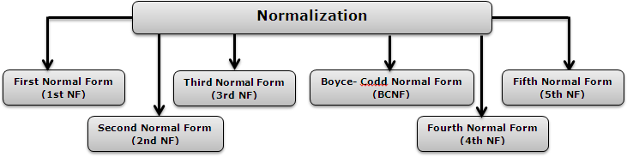
Types of Normalization

Slide 34
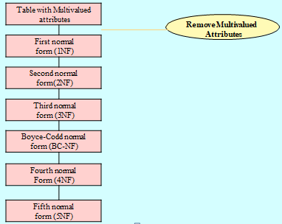
1 Normal Form
As per the rule of first normal form, an attribute (column) of a table cannot hold multiple values. It should hold only atomic values.

Slide 35
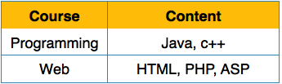
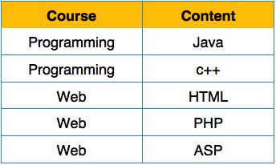
1 Normal Form
Disallows composite attributes, multivalued attributes i.e., attributes whose values for an individual tuple are non-atomic
Considered to be part of the definition of relation
1NF Example
We re-arrange the relation (table) as below, to convert it to First Normal Form

Slide 36
Check Normal form of Table
Not possible in 1st NF because it allow atomic Value. So it is not in INF.
Conversion in I NF
Roll | Name | Course
101 | CS | CN
 |  | OS
102 | EC | DBMS
 |  | CO
Br_code | Br_name | Hod_Name
101 | CS | CN
101 | CS | OS
102 | EC | DBMS
102 | EC | CO

Slide 37
Implication of INF
You must have single value in a single column, null value can be present.
Order of row and order of column is insignificant.
Every value must belong to same domain.
Every column should have unique name.

Slide 38
2 Normal Form
In 2nd NF:
Remove Partial Dependencies.
Functional Dependency: The value of one attribute in a table is determined entirely by the value of another.
Partial Dependency: A type of functional dependency where an attribute is functionally dependent on only part of the primary key (primary key must be a composite key).
Create separate table with the functionally dependent data and the part of the key on which it depends. Tables created at this step will usually contain descriptions of resources.
Definition: A relation is in 2NF if it is in 1NF and every non-key attribute is fully dependent on each candidate key of the relation.

Slide 39
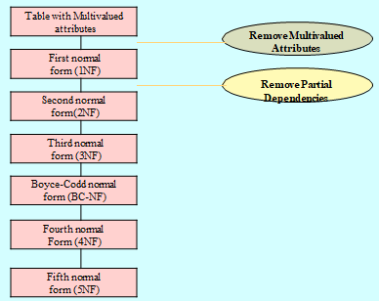

Slide 40
Example: 2nd Normal Form
Example: R ( ABCD)
Where, AB→ D and B→C
In this Candidate Key, (AB)+ = {ABCD}
Here, Prime attributes: AB
Non prime Attribute: CD
A relation schema R is in second normal form (2NF) if every non-prime attribute A in R is fully functionally dependent on the primary key
R can be decomposed into 2NF relations via the process of 2NF normalization
Dependent on both A and B
Depend only on B, called Partial Dependency

Slide 41
Example: 2nd Normal Form
A | B | C
a | 1 | X
b | 2 | Y
a | 3 | Z
c | 3 | Z
d | 3 | Z
e | 3 | Z
Relation: R (ABC)
Where, B→ C
Now, AB+ = {ABC}
So AB is candidate Key
Relation R
Not in 2nd NF, Because C has partial dependency
Relation R1
A | B
a | 1
b | 2
a | 3
c | 3
d | 3
e | 3
Relation R2
B | C
1 | X
2 | Y
3 | Z
R (ABC)
R1 (AB)
R2 (BC)
Now, it is in 2nd NF

Slide 42
Sources
Data Base Management System by Navathe
Data Base Management System by C J date
Data Base Management System by Korth
https://www.studytonight.com/dbms/database-normalization.php
https://beginnersbook.com/2015/05/normalization-in-dbms/
https://www.geeksforgeeks.org/normal-forms-in-dbms/
https://docs.microsoft.com/en-us/office/troubleshoot/access/database-normalization-description

Slide 43
Third Normal Form (3NF)
For any relation to be in 3NF:
It should be in 2NF.
It should NOT have any transitive dependency.
If X → Y and further Y→ Z, then it is a transitive dependency.
In other words, NPA → NPA is a transitive dependency.

Slide 44
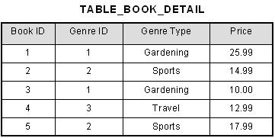
Third Normal Form (3NF)
In the given relation, BookID determines GenreID and further, GenreID determines GenreType.
This is a clear violation of 3NF.
Hence decomposition is required.

Slide 45
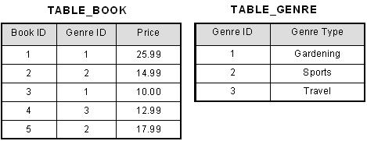
Decomposed Relations

Slide 46
BCNF (3.5NF)
For any relation to be in BCNF:
It must be in 3NF.
For any dependency X→Y, X must be a super key.

Slide 47

BCNF
In the given relation, (Student, Course) is a candidate key.
FDs are: (Student, Course) → Teacher
Teacher → Course
Teacher, being a non-prime (non-superkey) determines a prime attribute which is a problem here.

Slide 48
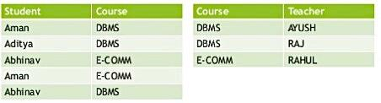
Decomposition of Relation

Slide 49
Fourth Normal Form (4NF)
For a relation to be in 4NF:
It must be in BCNF.
It must not have any non-trivial multi-valued dependency.

Slide 50

Fourth Normal Form
The dependencies in this relation are:
Student_Roll_No →Subject_Enrolled Student_Roll_No → Activity Enrolled
For value 45 of Student_Roll_No, multiple values of Subject_enrolled and Activity_Enrolled exist.
This leads to multi-valued dependency.
NOTE: For a multi-valued dependency to exist, there must be at least 3 attributes in a relation

Slide 51
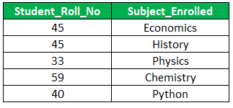

Decomposition of Relation

Slide 52
Functional dependency rules minimal cover and closure

Slide 53
Closure Property
The Closure Of Functional Dependency means the complete set of all possible attributes that can be functionally derived from given functional dependency using the inference rules known as Armstrong’s Rules.
If “F” is a functional dependency then closure of functional dependency can be denoted using “{F}⁺”.
There are three steps to calculate closure of functional dependency. These are:
Step-1 : Add the attributes which are present on Left Hand Side in the original functional dependency.
Step-2 : Now, add the attributes present on the Right Hand Side of the functional dependency.
Step-3 : With the help of attributes present on Right Hand Side, check the other attributes that can be derived from the other given functional dependencies. Repeat this process until all the possible attributes which can be derived are added in the closure.

Slide 54
Closure Of Functional Dependency : Example
Example-1 : Consider the table student_details having (Roll_No, Name,Marks, Location) as the attributes and having two functional dependencies.
FD1 : Roll_No Name, Marks
FD2 : Name Marks, Location
Solution: Now, We will calculate the closure of all the attributes present in the relation using the three steps mentioned below.
Step-1 : Add attributes present on the LHS of the first functional dependency to the closure.
{Roll_no}⁺ = {Roll_No}
Step-2 : Add attributes present on the RHS of the original functional dependency to the closure.
{Roll_no}⁺ = {Roll_No, Marks}

Slide 55
Step-3 : Add the other possible attributes which can be derived using attributes present on the RHS of the closure. So Roll_No attribute cannot functionally determine any attribute but Name attribute can determine other attributes such as Marks and Location using 2nd Functional Dependency(Name Marks, Location).
Therefore, complete closure of Roll_No will be :
{Roll_no}⁺ = {Roll_No, Marks, Name, Location}
Similarly, we can calculate closure for other attributes too i.e “Name”.
Step-1 : Add attributes present on the LHS of the functional dependency to the closure.
{Name}⁺ = {Name}
Step-2 : Add the attributes present on the RHS of the functional dependency to the closure.
{Name}⁺ = {Name, Marks, Location}

Slide 56
Step-3 : Since, we don’t have any functional dependency where “Marks or Location” attribute is functionally determining any other attribute , we cannot add more attributes to the closure. Hence complete closure of Name would be :
{ Name}⁺ = {Name, Marks, Location}
NOTE : We don’t have any Functional dependency where marks and location can functionally determine any attribute. Hence, for those attributes we can only add the attributes themselves in their closures. Therefore,
{Marks}⁺ = {Marks}
and
{Location}⁺ = { Location}

Slide 57
Inference rules for Functional Dependency
An FD X → Y is inferred from or implied by a set of dependencies F specified on R
if X → Y holds in every legal relation state r of R; that is, whenever R satisfies all the dependencies in F, X → Y also.
For example,
if each department has one manager, so that Dept_no uniquely determines Mgr_ssn (Dept_no → Mgr_ssn), and a manager has a unique phone number called Mgr_phone (Mgr_ssn → Mgr_phone), then these two dependencies together imply that Dept_no → Mgr_phone.holds in r.

Slide 58
Rules of Functional Dependencies
Three most important rules for Functional Dependency:
Reflexive rule: If X is a set of attributes and Y is_subset_of X, then X holds a value of Y.
The reflexive rule states that a set of attributes always determines itself or any of its subsets, which is obvious. Because this rule generates dependencies that are always true, such dependencies are called trivial. Formally, a functional dependency X → Y is trivial if X ⊇ Y; otherwise, it is nontrivial.
Augmentation rule: When x -> y holds, and c is attribute set, then ac -> bc also holds. That is adding attributes which do not change the basic dependencies.
The augmentation rule says that adding the same set of attributes to both the left- and right-hand sides of a dependency results in another valid dependency. According to IR3, functional dependencies are transitive.

Slide 59
Transitivity rule: This rule is very much similar to the transitive rule in algebra if x -> y holds and y -> z holds, then x -> z also holds. X -> y is called as functionally that determines y.
There are three other inference rules that follow from above rules as follows:
Decomposition or projective rule: {X → YZ} |=X → Y.
Union or additive rule: {X → Y, X → Z} |=X → YZ.
Pseudotransitive rule: {X → Y, WY → Z} |=WX → Z.

Slide 60
Attribute closure
The set “A*” is said to be the closure set of “A” if the set of attributes are functionally dependent on the attributes of “A”
Attribute closure algorithm: Determining X+, the Closure of X under F
Input: A set F of FDs on a relation schema R, and a set of attributes X, which is a subset of R.
X+ := X;
repeat
oldX+ := X+;
for each functional dependency Y → Z in F do
if X+ ⊇ Y then X+ := X+ ∪ Z;
until (X+ = oldX+);
Example: In the relation student an attribute closure is determined as
(ID)+ = {ID, Name, State,Country,Age}
(State)+ = {State, Country}

Slide 61
Use of attribute closure
There are several uses of attribute closure algorithm:
Finding candidate keys and super keys through attribute closure
If all attributes of the relation are present in attribute closure of an attribute set then such an attribute set will have a super key for that relation
If all attributes of the relation or determined by none of the attribute set then such a set will be a candidate key as well
(ID, Name)+ = {ID, Name, State, Country, Age}
(ID)+ = {ID, Name,State,Country, Age}
(ID, Name) will be super key but not as a candidate key because its subset (ID) + is equal to all attributes present in the relation. Hence, ID will be a candidate key.
Testing functional dependency
Computing closure of F

Slide 62
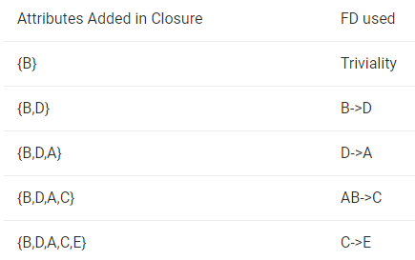
Example:
Find the attribute closures of given FDs R(ABCDE) = {AB->C, B->D, C->E,
D->A}
To find (B)+ ,we will add attribute in set using various FD which has been shown in table below.
We can find (C, D)+ by adding C and D into the set (triviality) and then E using(C->E) and then A using (D->A) and set becomes.
(C,D)+ = {C,D,E,A}
Similarly we can find (B,C)+ by adding B and C into the set (triviality) and then D using (B->D) and then E using (C->E) and then A using (D->A) and set becomes
(B,C)+ ={B,C,D,E,A}

Slide 63
Closure Of Functional Dependency : Calculating Candidate Key
A Candidate Key of a relation is an attribute or set of attributes that can determine the whole relation or contains all the attributes in its closure.“
Let’s try to understand how to calculate candidate keys.
Example-1 : Consider the relation R(A,B,C) with given functional dependencies :
FD1 : A ->B
FD2 : B -> C
Now, calculating the closure of the attributes as :
{A}+ = {A, B, C}
{B}+ = {B, C}
{C}+ = {C}
Clearly, “A” is the candidate key as, its closure contains all the attributes present in the relation “R”.

Slide 64
Closure Of Functional Dependency : Key Definitions
Prime Attributes : Attributes which are indispensable part of candidate keys. For example : “A, D, E” attributes are prime attributes in above example-2.
Non-Prime Attributes : Attributes other than prime attributes which does not take part in formation of candidate keys. For example.
Extraneous Attributes : Attributes which does not make any effect on removal from candidate key.

Slide 65
Example:
Consider the relation R(A, B, C, D) with functional dependencies :
FD1 : A ->BC
FD2 : B ->C
FD3 : D ->C
Here, Candidate key can be “AD” only. Hence,
Prime Attributes : A, D.
Non-Prime Attributes : B, C
Extraneous Attributes : B, C(As if we add any of the to the candidate key, it will remain unaffected). Those attributes, which if removed does not affect closure of that set.

Slide 66
Minimal Cover for a Set of FDs
Need for minimal Cover: Reduce the set F to its minimal form so that the minimal set is still equivalent to the original set F.
Minimal cover G for a set of FDs F:
Closure of F = closure of G.
Right hand side of each FD in G is a single attribute.
If we modify G by deleting an FD or by deleting attributes from an FD in G, the closure changes.
For minimal cover every FD in G is needed, and as small as possible in order to get the same closure as F.
e.g., A → B, ABCD → E, EF → GH, ACDF → EG has the following minimal cover:
A → B, ACD → E, EF → G and EF → H
Minimal Cover implies Lossless-Join, Dependency Preserving Decomposition.

Slide 67
Cont..
F = { AB -> C, C -> A, BC -> D, ACD -> B, D -> E, D - > G, BE -> C, CG -> B, CG -> D, CE -> A, CE -> G}
Notice that we have single attribute on the RHS in all FDs, we need to look for extraneous (redundant) attributes on the LHS and also look for FDs that are redundant.

Slide 68
Canonical cover
The ability of removing the redundant attributes without affecting the capabilities of the functional dependency is known as “canonical cover of functional dependency”.
Canonical cover of functional dependency is sometimes also referred to as “minimal cover”.
Canonical cover of functional dependency is denoted using "Mc".
A canonical cover of a set of functional dependencies F is a simplified set of functional dependencies that has the same closure as the original set F.

Slide 69
Steps to calculate the canonical cover.
Step-1: Decompose the functional dependencies using Decomposition rule(Armstrong’s Axiom) i.e. single attribute on right hand side.
Step-2 : Remove extraneous attributes from LHS of functional dependencies by calculating the closure of FD’s having two or more attributes on LHS.
Step-3 : Remove FD’s having transitivity.

Slide 70
Consider the following set F of functional dependencies:
F= { A -> BC B -> C A -> B AB -> C }
Steps to find canonical cover:
There are two functional dependencies with the same set of attributes on the left: A -> BC A -> B
These two can be combined to get: A -> BC.
Now, the revised set F becomes:
F= { A -> BC B -> C AB -> C }

Slide 71
Further readings
https://nptel.ac.in/content/storage2/nptel_data3/html/mhrd/ict/text/106105175/lec18.pdf
https://www.geeksforgeeks.org/canonical-cover-of-functional-dependencies-in-dbms/
https://www.minigranth.com/dbms-tutorial/canonical-cover-of-functional-dependency/

Slide 72
Normalization
Data Base Management System

Slide 73
Normalization
Normalization is a process of organizing the data in database to avoid data redundancy, insertion anomaly, update anomaly & deletion anomaly.
Normalization Avoids
Duplication of Data
Insert Anomaly
Delete Anomaly
Update Anomaly
DE- NORMALIZATION: Denormalization is the process of adding redundant data to speed up complex queries involving multiple table JOINS. One might just go to a lower form of Normalization to achieve Denormalization and better performance. Data is included in one table from another in order to eliminate the second table which reduces the number of JOINS in a query and thus achieves performance.

Slide 74
Types of Normalization

Slide 75
3 Normal Form
A table design is said to be in 3NF if both the following conditions hold:
Table must be in 2NF
Transitive functional dependency of non-prime attribute on any super key should be removed.
An attribute that is not part of any candidate key is known as non-prime attribute.
In other words 3NF can be explained like this: A table is in 3NF if it is in 2NF and for each functional dependency X-> Y at least one of the following conditions hold:
X is a super key of table
Y is a prime attribute of table
An attribute that is a part of one of the candidate keys is known as prime attribute.

Slide 76
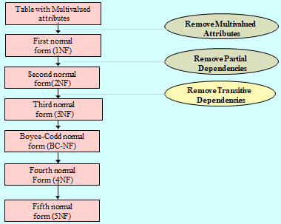

Slide 77

EXAMPLE
Consider this table:
FD set: {STUD_NO -> STUD_NAME, STUD_NO -> STUD_STATE, STUD_STATE -> STUD_COUNTRY, STUD_NO -> STUD_AGE}
Candidate Key: {STUD_NO}
For this relation in table , STUD_NO -> STUD_STATE and STUD_STATE -> STUD_COUNTRY are true. So STUD_COUNTRY is transitively dependent on STUD_NO. It violates the third normal form. To convert it in third normal form, we will decompose the relation STUDENT (STUD_NO, STUD_NAME, STUD_PHONE, STUD_STATE, STUD_COUNTRY_STUD_AGE) as:
STUDENT (STUD_NO, STUD_NAME, STUD_PHONE, STUD_STATE, STUD_AGE) STATE_COUNTRY (STATE, COUNTRY)

Slide 78
Boyce codd Normal Form
In BCNF:
When a relation has more than one candidate key, anomalies may result even though the relation is in 3NF.
3NF does not deal satisfactorily with the case of a relation with overlapping candidate keys
i.e. composite candidate keys with at least one attribute in common.
BCNF is based on the concept of a determinant.
A determinant is any attribute (simple or composite) on which some other attribute is fully functionally dependent.
A relation is in BCNF is, and only if, every determinant is a candidate key.
Definition: A relation is in Boyce-Codd Normal Form (BCNF) if every determinant is a candidate key. (See the links in the box at right for definitions of determinant and candidate key.)

Slide 79
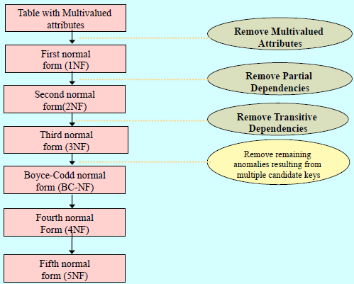
The difference between 3NF and BCNF is that for a functional dependency A → B, 3NF allows this dependency in a relation if B is a primary-key attribute and A is not a candidate key, Whereas BCNF insists that for this dependency to remain in a relation, A must be a candidate key.

Slide 80
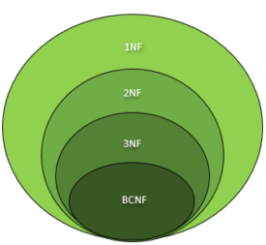
EXAMPLE
It (like, chomsky hierarchy) can be inferred that every relation in BCNF is also in 3NF.
To put it another way, a relation in 3NF need not to be in BCNF. Ponder over this statement for a while.
To determine the highest normal form of a given relation R with functional dependencies, the first step is to check whether the BCNF condition holds.
If R is found to be in BCNF, it can be safely deduced that the relation is also in 3NF, 2NF and 1NF as the hierarchy shows.
The 1NF has the least restrictive constraint – it only requires a relation R to have atomic values in each tuple.
The 2NF has a slightly more restrictive constraint.
The 3NF has more restrictive constraint than the first two normal forms but is less restrictive than the BCNF.
In this manner, the restriction increases as we traverse down the hierarchy.

Slide 81
Example:
1. For example consider relation R(A, B, C)
A -> BC, B -> A
A and B both are super keys so above relation is in BCNF.
Note –
BCNF decomposition may always not possible with dependency preserving, however, it always satisfies lossless join condition. For example, relation R (V, W, X, Y, Z), with functional dependencies:
V, W -> X Y, Z -> X W -> Y
It would not satisfy dependency preserving BCNF decomposition.
Note -:Redundancies are sometimes still present in a BCNF relation as it is not always possible to eliminate them completely.

Slide 82
4th Normal Form
Fourth Normal Form (4th NF)
In 4th NF:
An entity is in Fourth Normal Form (4NF) when it meets the requirement of being in Third Normal Form (3NF) and additionally: Has no multiple sets of multi-valued dependencies.
In other words, 4NF states that no entity can have more than a single one-to-many relationship within an entity if the one-to-many attributes are independent of each other.
Fourth Normal Form applies to situations involving many-to-many relationships.
In relational databases, many-to-many relationships are expressed through cross-reference tables.
Definition: A table is in fourth normal form (4NF) if and only if it is in BCNF and contains no more than one multi-valued dependency.

Slide 83
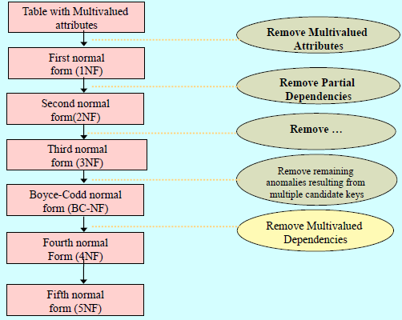

Slide 84
Example: 4th NF
Consider the database table of a class which has two relations R1 contains student ID(SID) and student name (SNAME) and R2 contains course id(CID) and course name (CNAME).
Table – R1(SID, SNAME)
Table – R2(CID, CNAME)
Table – R1 X R2
SID | SNAME
S1 | A
S2 | B
CID | CNAME
C1 | C
C2 | D
SID | SNAME | CID | CNAME
S1 | A | C1 | C
S1 | A | C2 | D
S2 | B | C1 | C
S2 | B | C2 | D
When there cross product is done it resulted in multivalued dependencies:
Multivalued dependencies (MVD) are:
SID->->CID; SID->->CNAME; SNAME->->CNAME

Slide 85
5th Normal Form
In 5th NF:
A relation that has a join dependency cannot be decomposed by a projection into other relations without spurious results
A relation is in 5NF when its information content cannot be reconstructed from several smaller relations i.e. from relations having fewer attributes than the original relation
Definition: A table is in fifth normal form (5NF) or Project-Join Normal Form (PJNF) if it is in 4NF and it cannot have a lossless decomposition into any number of smaller tables.
Fifth normal form, also known as join-projection normal form (JPNF), states that no non-trivial join dependencies exist.
5NF states that any fact should be able to be reconstructed without any anomalous results in any case, regardless of the number of tables being joined.
A 5NF table should have only candidate keys and it's primary key should consist of only a single column.

Slide 86
A relation R is in 5NF if and only if every join dependency in R is implied by the candidate keys of R.
A relation decomposed into two relations must have loss-less join Property, which ensures that no spurious or extra tuples are generated, when relations are reunited through a natural join.
Properties – A relation R is in 5NF if and only if it satisfies following conditions:
R should be already in 4NF.
It cannot be further non loss decomposed (join dependency)
Example – Consider the schema, with a case as “if a company makes a product and an agent is an agent for that company, then he always sells that product for the company”.
Under these circumstances, the ACP table is shown as:
AGENT | COMPANY | PRODUCT
A1 | PQR | Nut
A1 | PQR | Bolt
A1 | XYZ | Nut
A1 | XYZ | Bolt
A2 | PQR | Nut
Table – ACP

Slide 87
The relation ACP is again decompose into 3 relations. Now, the natural Join of all the three relations will be shown as:
Table – R1
Table – R2
Table – R3
AGENT | COMPANY
A1 | PQR
A1 | XYZ
A2 | PQR
AGENT | PRODUCT
A1 | Nut
A1 | Bolt
A2 | Nut
COMPANY | PRODUCT
PQR | Nut
PQR | Bolt
XYZ | Nut
XYZ | Bolt
Result of Natural Join of R1 and R3 over ‘Company’ and then Natural Join of R13 and R2 over ‘Agent’and ‘Product’ will be table ACP.
Hence, in this example, all the redundancies are eliminated, and the decomposition of ACP is a lossless join decomposition. Therefore, the relation is in 5NF as it does not violate the property of lossless join.

Slide 88
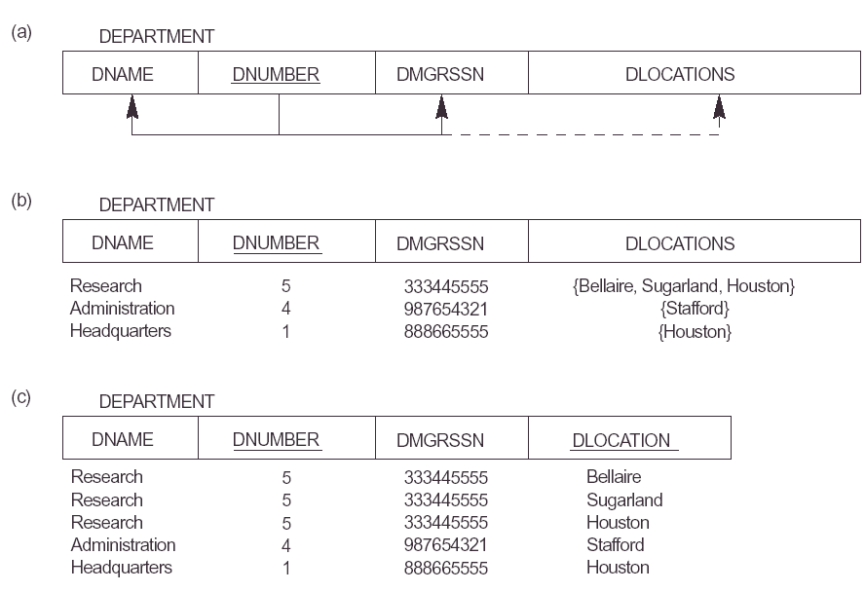

Slide 89
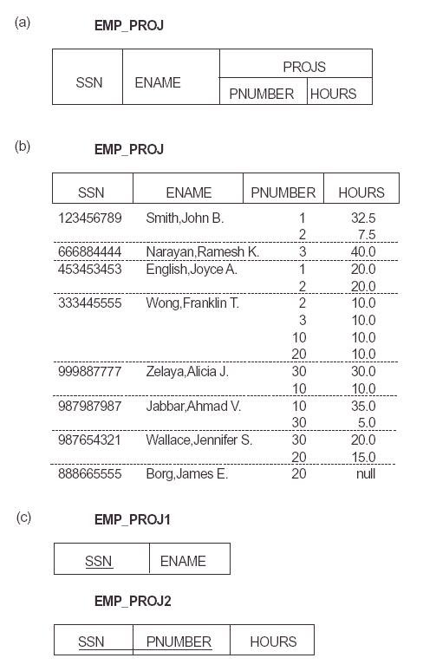

Slide 90
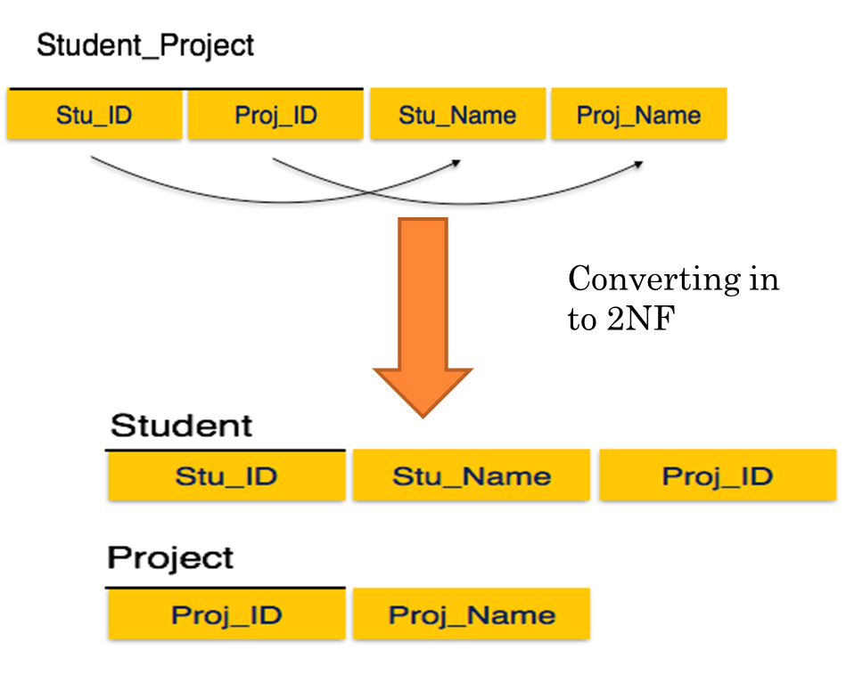

Slide 91
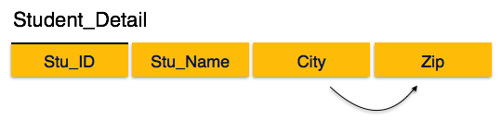
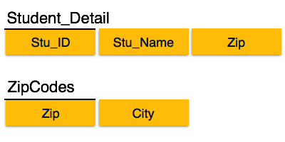
Converting into 3NF

Slide 92
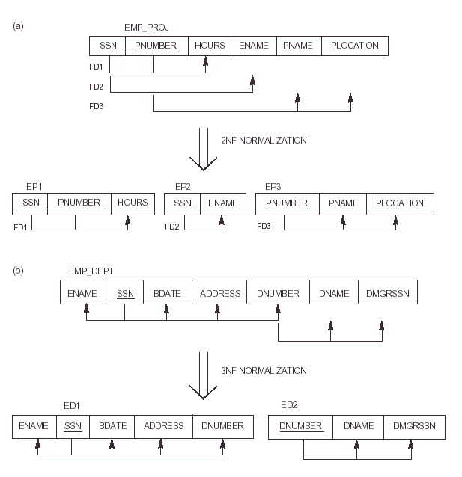

Slide 93

Two FDs exist in the relation TEACH:
fd1: { student, course} -> instructor
fd2: instructor -> course
Decomposing into 2 schemas
{Student,Instructor} {Student,Course}
{Course,Instructor} {Student,Course}
{Course,Instructor} {Instructor,Student}
All three decompositions will lose fd1.
We have to settle for sacrificing the
functional dependency preservation.
But we cannot sacrifice the
non-additivity property after decomposition.

Slide 94
sources
Data Base Management System by Korth
Data Base Management System by Navathe
Data Base Management System by C J Date
https://www.tutorialspoint.com/Fifth-Normal-Form-5NF
https://www.geeksforgeeks.org/introduction-of-4th-and-5th-normal-form-in-dbms/?ref=rp
https://www.studytonight.com/dbms/database-normalization.php

Slide 95
Decomposition & it’s types
Data Base Management System

Slide 96
What is decomposition?
Decomposition is the process of breaking down in parts or elements.
It replaces a relation with a collection of smaller relations.
It breaks the table into multiple tables in a database.
It should always be lossless, because it confirms that the information in the original relation can be accurately reconstructed based on the decomposed relations.
If there is no proper decomposition of the relation, then it may lead to problems like loss of information.
Properties of Decomposition

Slide 97
Properties of good decomposition
A decomposition of a relation R into sub-relations R1, R2,……., Rn should possess following properties:
The decomposition should be
Attribute Preserving ( All the attributes in the given relation must occur in any of the sub – relations)
Dependency Preserving ( All the FDs in the given relation must be preserved in the decomposed relations)
Lossless join ( The natural join of decomposed relations should produce the same original relation back, without any spurious tuples).
No redundancy ( The redundancy should be minimized in the decomposed relations).

Slide 98
Dependency Preserving
Dependency is an important constraint on the database.
Every dependency must be satisfied by at least one decomposed table.
If {A → B} holds, then two sets are functional dependent. And, it becomes more useful for checking the dependency easily if both sets in a same relation.
This decomposition property can only be done by maintaining the functional dependency.
In this property, it allows to check the updates without computing the natural join of the database structure.
Lack of Data Redundancy Lack of Data Redundancy is also known as a Repetition of Information.
The proper decomposition should not suffer from any data redundancy.
The careless decomposition may cause a problem with the data.
The lack of data redundancy property may be achieved by Normalization process.

Slide 99
Lossy Join Decomposition
"The decomposition of relation R into R1 and R2 is lossy when the join of R1 and R2 does not yield the same relation as in R." One of the disadvantages of decomposition into two or more relational schemes (or tables) is that some information is lost during retrieval of original relation or table.
Student
Example: Consider that we have table STUDENT with three attribute roll_no , sname and department.
Roll_no | Sname | Dept
111 | parimal | COMPUTER
222 | parimal | ELECTRICAL
This relation is decomposed into two relation no_name and name_dept :

Slide 100
No_name:
stu_joined :
Roll_no | Sname
111 | parimal
222 | parimal
Sname | Dept
parimal | COMPUTER
parimal | ELECTRICAL
In lossy decomposition, spurious tuples are generated when a natural join is applied to the relations in the decomposition.
stu_joined :
Roll_no | Sname | Dept
111 | parimal | COMPUTER
111 | parimal | ELECTRICAL
222 | parimal | COMPUTER
222 | parimal | ELECTRICAL
The above decomposition is a bad decomposition or Lossy decomposition.

Slide 101
Loss Less Join Decomposition
The relation schemas { R₁, R₂, …, R_{n} } is a lossless-join decomposition of R if:
for all possible relations r on schema R,
r = Π_{R1}( r ) Π _{R2}( r ) … Π _{Rn} ( r )
Example:
Student = ( sid, sname, major)
F = { sid → sname, sid → major}
{ sid, sname } + { sid, major } is a lossless join decomposition
the intersection = {sid} is a key in both schemas
{sid, major} + { sname, major } is not a lossless join decomposition
the intersection = {major} is not a key in either
{sid, major} or { sname, major }

Slide 102
Another Example
R = { A, B, C, D }
F = { A → B, C → D }.
Key is {AC}.
introduce
virtually
Decomposition: { (A, B), (C, D), (A, C) }
Consider it a two step decomposition:
Decompose R into R₁ = (A, B), R₂ = (A, C, D)
Decompose R₂ into R₃ = (C, D), R₄ = (A, C)
This is a lossless join decomposition.
If R is decomposed into (A, B), (C, D)
This is a lossy-join decomposition.

Slide 103
Checking Lossless Join Decomposition - α Test
Example 1: Let us consider a relation R(A,B,C,D,E)
With FDs
{A->BC, C->D, D->B, B->E, A->E}
Is decomposed into following 3 relations:
R1(A,B,C)
R2(C,D)
R3(B,D,E)
Then check the decompositions by test.
Initialize the table with α in the cell where an attribute exists for the corresponding relation as follows:
Now update the table while placing α and check whether any row contains α in all the columns. If so, then the decomposition is lossless.
In this example the second table contains all α’s in the first row. So the decomposition is lossless.
 | A | B | C | D | E
R1 | α | α | α
R2 |  |  | α | α
R3 |  | α |  | α | α
 | A | B | C | D | E
R1 | α | α | α | α | α
R2 |  | α | α | α | α
R3 |  | α |  | α | α

Slide 104
Functional dependency preserving
The dependency preservation decomposition is another property of decomposed relational database schema D in which each functional dependency X -> Y specified in F either appeared directly in one of the relation schemas R_{i} in the decomposed D or could be inferred from the dependencies that appear in some Ri. Decomposition D = { R₁ , R₂, R₃,,.., ,R_{m}} of R is said to be dependency-preserving with respect to F if the union of the projections of F on each R_{i} , in D is equivalent to F. In other words, R ⊂ join of R₁, R₁ over X. The dependencies are preserved because each dependency in F represents a constraint on the database. If decomposition is not dependency-preserving, some dependency is lost in the decomposition.

Slide 105
Example:
Let a relation R(A,B,C,D) and set a FDs F = { A -> B , A -> C , C -> D} are given. A relation R is decomposed into -
R₁ = (A, B, C) with FDs F₁ = {A -> B, A -> C},
and R₂ = (C, D) with FDs F₂ = {C -> D}.
F' = F₁ ∪ F₂ = {A -> B, A -> C, C -> D}
so, F' = F. And so, F'⁺ = F⁺.
Thus, the decomposition is dependency preserving decomposition.

Slide 106
sources
Data Base Management System by Korth
Data Base Management System by Navathe
Data Base Management System by C J Date
https://tutorialink.com/dbms/dependency-preserving-decomposition.dbms
https://tutorialink.com/dbms/decomposition.dbms

Slide 107
Thank you

