Slide 1
Image Processing in Python

Slide 2
CREATED BY:-
1.Sahul Kumar Parida (20BCS4919)
2.Aditya Raj (20BCS4955)
3.Kumar Shubham (20BCS4965)
4.Shaswat Rai (20BCS4905)

Slide 3
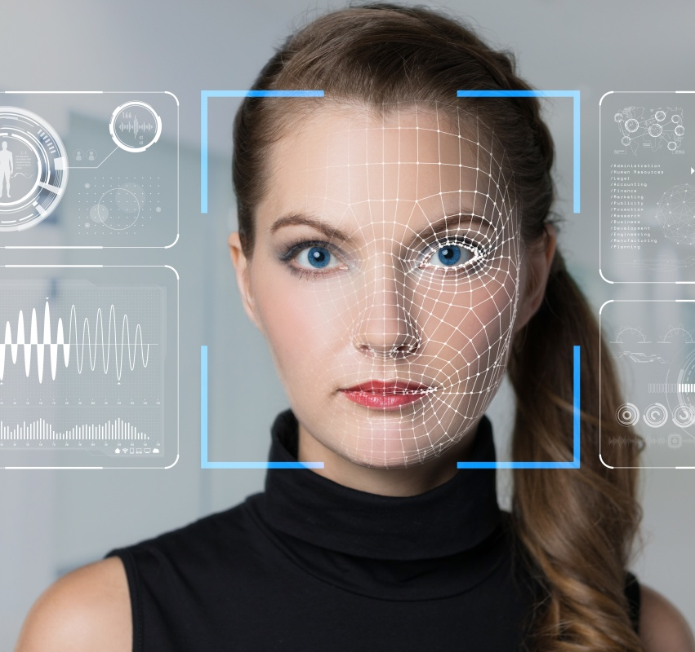
INDEX
Introduction
What is Image?
What is Image
Processing?
Why Image
Processing?
Problem!
Solution
How does it works?

Slide 4
INTRODUCTION
Image Processing Python Project is one form of signal processing for which the input is an image, such as photographs or frames of video; the output of image processing can be either an image or a set of characteristics or parameters related to the image. Image processing is a technique which involves different operation that can be performed on the image. Image processing plays a vital role in photography, computer science, and many other fields.

Slide 5
What is Image?
Before understanding image processing, we have to first understand what is an image in technical terms.
Image is a collection of pixels.
Pixel is a smallest unit in an image which contains color value.
Image is measured in PPI.
PPI stands for Pixels Per Inch. In one inch of image how many pixels are there.

Slide 6
What is Image Processing?
Lets understand Image Processing in Layman Terms.
When we edit a photo, sometimes we blur the image, sometimes we sharpen the color, sometimes we reduce the noise or sometimes we increase the brightness of the image. So these operations are called digital image processing.
Lets understand Image Processing in Technical Language.
When we perform the above operations with the help of algorithms on computers so the image gets manipulated, it is called digital image processing.

Slide 7
Why Image Processing?
Image processing has the lot of application in different fields like medical, computer science etc. In this project, we have implemented some of the image processing operations which will help the user to understand the concept of image processing. Therefore, the scope of this project is increasing.
The purpose of this project is to allow users to explore how digitized images can be processed using computer software.

Slide 8
Problem!
Data Scientists and Machine Learning engineers observe data and manipulate them. They also do predictions on the data. But the data is not always present in textual format. It is present in visual formats like videos and images as well.
If you want to observe videos and images you cannot apply normal techniques. You need to have a knowledge of image processing to study the data from video and image. And if you want to predict data from video and image you need to have a knowledge of Computer Vision. For handling these type of data we use image processing and for analyzation use Computer Vision.
Computer Vision is a sub domain of AI who trains images based on the algorithms and datasets.
If you want to become a successful data scientist you need to learn to handle all kinds of data.

Slide 9
Solution
The objective of our project is mainly concerned with basic operations on the image. So that user can get required a visual appearance. Image processing is the use of computer algorithm to perform, improve or change some quality of the image. Now a day, it is important in different fields.
The Python Image Processing Library adds image processing capabilities to the Python Interpreter. This library provides extensive file format, an efficient internal representation, and fairly powerful image processing tools. Actually, the Image Library designed for fast access.

Slide 10
Solution
The Python Image Library is ideal for image archival and batch processing application. Here our project is providing an image processing tool through which user can give desired effects to an image. It accepts input via mouse and keyboard and gives output on the screen.
So, just one click by mouse, you will get the image with the expected result. In this project, we are providing different image processing tool with GUI so it makes easy for the user to give desired effects to the image.

Slide 11
How does it works?
Digital image processing is concerned with processing of an image. Image processing is a method to perform operations on images like enhancing images, extracting text from image, detecting edge of image and many other operations. In digital image processing we take an image and convert that image in different forms. Like if we take color image we can convert it into grey image. In this both the input and output is an image. Usually Image Processing System includes treating images as two dimensional signals while applying already set signal processing methods to them.
Today, it is rapidly growing technology. It forms core research area within engineering and computer science disciplines too. Image processing has its wide applications in robotics, machine learning, neural networking, signal processing, medical field, graphics and animations and in many other fields.

Slide 12
THANKS!
Explore the world of Python.

